Slide 1
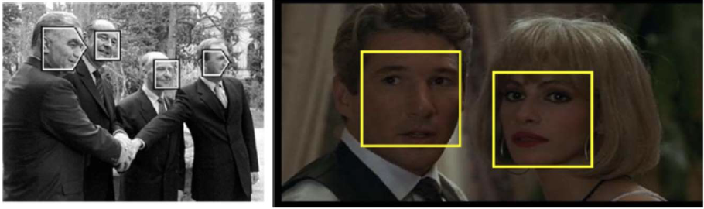

Slide 2
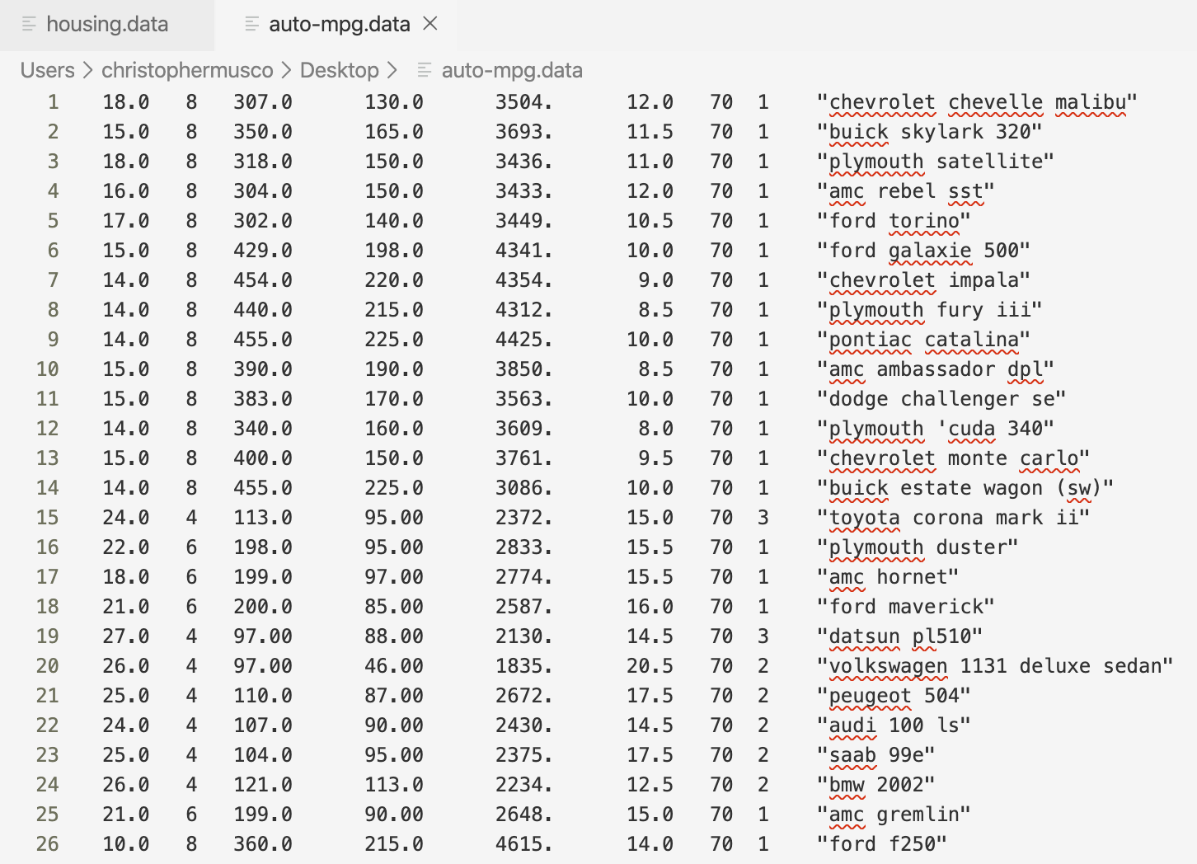
x₁
y₁
c
x₂
y₂
c
c
x₃
y₃

Slide 3
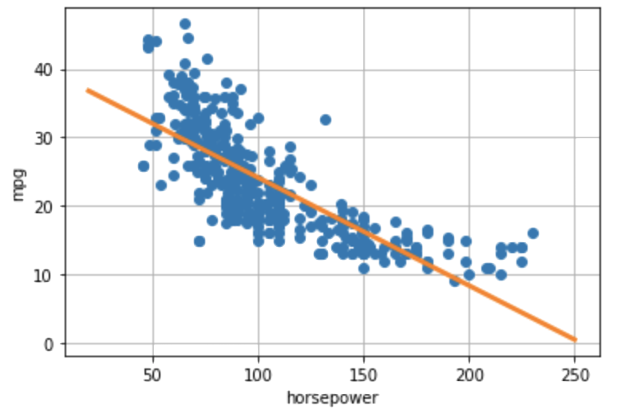
f_{β0, β1}(x)

Slide 4
y_{i} - f_{β0, β1}(x)
f_{β0, β1}(x)

Slide 5
Β₀* + Β₁*x

