Slide 1
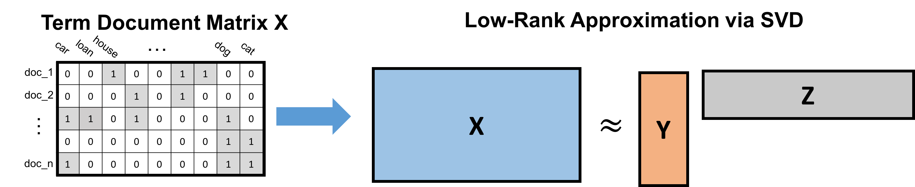
single docuement
term-document matrix
BOW features
LSA features
PCA
Y
x
≈
z
word vectors
document vectors
Y
M
≈
Y^{T}

Slide 2
≈
Y
z
z
word vectors
x
document vectors
term-document matrix
remove
“stop words”
Very small and handy for traveling or camping.
[ small, handy, traveling, camping ]

Slide 3
word
embedding
[ small, handy, traveling, camping ]
y₁ y₂ ... y_{q}
???
y₁ y₂ ... y_{q}
x
y₁ y₂ ... y_{q}
feature vector
SVD
y₁ y₂ ... y_{q}
v₁ v₂ v_{k}
x

Slide 4
small
average
handy
useless
average
heavy

Slide 5
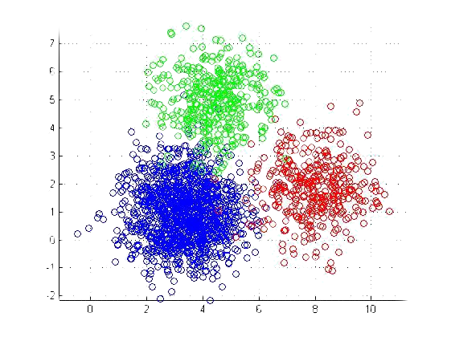
clustering

Slide 6
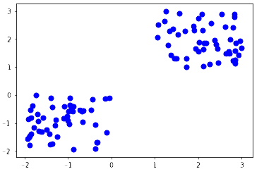

Slide 7
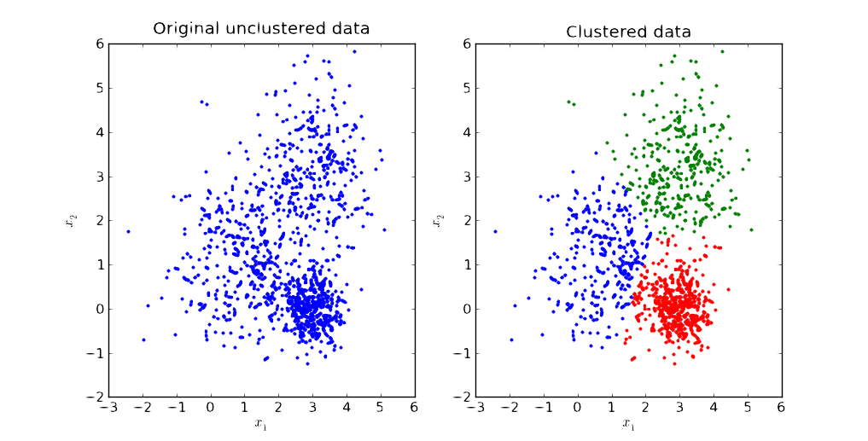
c₁
c₁
c₂
c₂
c₃
c₃

Slide 8



Slide 9
end
+1
end
-1
start
actions:
r
l
u
d

Slide 10
d
s
=
|𝒜 |
𝛳
z
Q(s,a,𝛳) = z[a]

