Slide 1
Eclipse based Requirement Tool Project
Goals, Relations, Concepts

Slide 2
Content
Kickoff: Meeting Agenda
Goals
Eclipse Open Source
Components
Related Tools / Technologies
Design Ideas

Slide 3
Kickoff: Meeting Agenda
Personal motivation
  For what is this all good?
  What to spend into the project?
Short overview about the project and technology
  Requirement Enginieering
  Eclipse
  RIF
"Business Model"
  How to publish project
  How to make money
Summarize goals
  What do we want technically
  Where do we want to be when, Timeline
Project organisation
  how to go on (regular meetings, communication structure?)
  Repositories etc.
  Distribution of Work Packages
Project name

Slide 4
Primary Goals / Key Features
Requirement Mgmt for Software Projects
Eclipse based integrated Requirement Management
File/SCM based management of Requirements
Tracing to Source, Tests, Documentation within IDE

Slide 5
Eclipse Open Source Project
Core Components of the Platform are released as Eclipse Open Source Project hosted by eclipse.org
Benefits:
  Better acceptance as anyone can use, change and enhance it (lower risks for users)
  Free promotion for our "product"
  Publicity for us
  New contacts and the Eclipse foundation is good connected with many companies
  Possibility to hold speeches at Eclipse Cons or to write Articles for Eclipse magazines

Slide 6
Components
Req. Function
Key Function
Custom Function
Optional Function
Open Source
Tool Exchange
(Word, Doors, ReqPro...)
Native Format Im/Exp
UseCase/Flows
Specifications
Import/Export FW
Java
Requirements
C
Authoring
Tracing FW
External Links/Navigation
Jira
Req. Types
Dependencies
...
Comments/Reviews
Traceability Matrix
Analysis FW
Requirement Document
Project
Lifecycle
Statistic
Version control
States
UI
Rights
Eclipse
Web
Variants
Model
Diff/Merge
Types, Req, Links
Behaviour Model

Slide 7
Utilized Technology
Java/Eclipse (IDE Platform)
RIF (HIS Requirement Interchange Format)
EMF (Eclipse Modeling Framework)
FCKEditor (JavaScript based XHMTL Editor)
Eclipse MyLyn (Task Oriented IDE)

Slide 8
Dependent Products
ALM Systems
  IBM Jazz (http://jazz.net)
  Polarion ALM (http://www.polarion.com/products/alm/index.php)
Requirement Tools
  Polarion Requoirements (http://www.polarion.com/products/requirements/index.php)
  IBM Doors
  IBM Requisit Pro
  Borland Caliber RM
  Eclipse ORMF (http://www.eclipse.org/ormf)
  Reqtify
SCM Systems
  CVS
  SVN
Ticket Systems
  Jira
  Bugzilla
  Trac

Slide 9
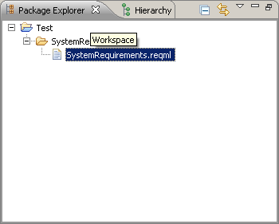
Design Idea: Requirement Storrage
Requirements, Types... are stored in XML-Document File in the Eclipse Workspace in user defined folders
Baselines and exchange of Requirements are managed via traditional SCM Systems
Basic Structure is defined by filesystem. XML-Files can be seen as Requirement Documents
Requiments in one Document can form a hirarchical tree
Flaw: System must keep track of inconsistencies of checked in artifacts
Different Filetypes for: Requirements, Types, internal Data/Links
Data to be saved:
  Requirements/Requirement Dependencies
  Specifications incl. requirements?
  Fulfillments+Links to requirements
  Internal types
Requirement File

Slide 10
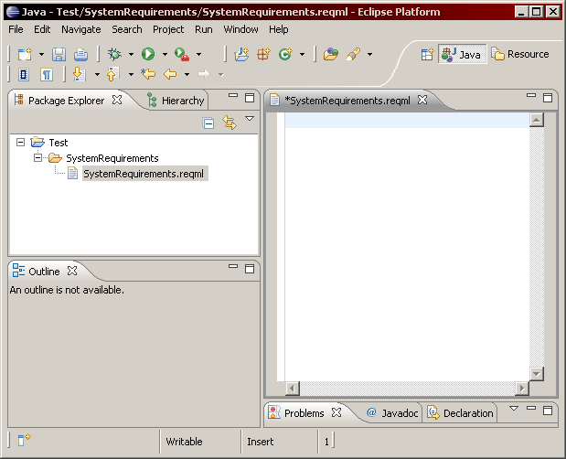
Design Idea: Type Authoring
Requirement types (definiting available attributes) are stored in user defined requirement type file
System keeps track of all defined types
Opening a requirement type file opens up a form based editor allowing to define new types
Semantic Constraints?
Requirement File
Editor
Outline

Slide 11
Design Idea: Requirement Authoring
Each requirement file forms an own tree of requirements
When creating a requirements file a requirement type (defining the available attributes) can be selected.
The requirement file opens up a multi tab editor. One tab shown single line attributes as table. For each attribute with complex content (description, rationale...) an own tab is created
Outline shows tree structure of the requirements
The FCKEditor can be used for editing requirements as it provides full XHTML functionality
Requirement File
Editor
Outline

Slide 12
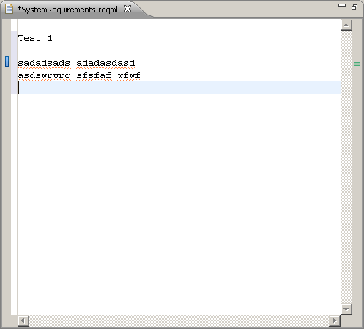
Design Idea: CI Tracing
Configuration Items like source, tests, documentation can be linked to requirements. A special fulfilment type requirement and a link is created for each such a trace and stored in the requirement document of the linked requirement
The system parses these links and creates Eclipse resource markers that can be used for navigation
Marked Location

Slide 13
Design Idea: Requirement Format
Requirements, Types, Links and other tracing information is stored in the RIF format
Multiple XML files can form a consistent requirement database
A datatype for SpecHirarchicalRoot of each requirement file is defined that defines the SpecType to be used for all requirements within a specific requirement document
Special internal attributes are added to each user defined SpecType for storing
  reviewer comments
  requirement state state (new, reviewed, approved, obsolete...)
  special requirement types (Workflow, Use Case, State machine...)
The requirement version is encoded into the internal unique ID of each requirement so changes to a requirement in fact create internally a new requirement. The last version of a requirement is marked obsolete. In that way traces from source/test code into a requirement point to the old version against which the code was developed. As this old requirement is marked obsolete broken links can easily be identified
A special URL type that references a link is introduces so that other requirements can be referenced from within the text of a requirement

