Slide 1
PrEsentation
Travel & Learn
English project by Frederic Georges and Constance Pineau
3rd of April 2017

Slide 2
INtroduction
Helpful website for travellers
Also, a cultural guide for English speaking countries
Quick learning exercises

Slide 3
Table of contents
Website presentation
Culture
Vocabulary
Grammar
Technical part
Conclusion
Demonstration

Slide 4

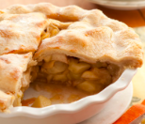
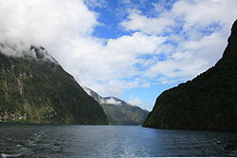
WebSite presentation - Culture
A real cultural guide
Practical informations
Guide to discover food specialties
Guide for your journey with things to do

Slide 5
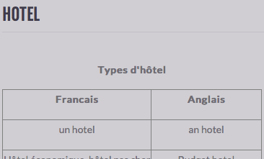
Website presentation - vocabulary
Vocabulary to help you in any situation
4 sections : Hotel, Food, Travel, Health
Each sections is divided, so it is very easy to use
Vocabulary helpful for your most common encounters

Slide 6
Website presentation - GRAMMAR
For having a basic knowledge of english
5 sections : Present, Past, Present perfect, Past perfect, Future
Each sections is divided in 4 parts : lessons, exercises
Quick learning exercises

Slide 7
Technical part – Improvements
We have used HTML, CSS, JavaScript : it is easy to use
To create a backend to improve the exercises, make them more flexible
After 3 tries the solution button appears
Statistics for progression
To create a « To Know » sections with pre-made sentences with several themes

Slide 8
Conclusion
The website is very useful for travelers
The website is easy to master
The website is easy to improve

Slide 9
PrEsentation
Thanks for your attention
Now, let’s try it !
English project by Frederic Georges and Constance Pineau
3rd of April 2017

