Slide 1

PrEsentation
Travel & Learn
English project by Frederic Georges and Constance Pineau
3rd of April 2017

Slide 2
INtroduction
More and more people are tempted to travel
English is the first world language
A website that helps people when they are travelling
Learning the basis of english
Specified vocabulary
Culture guide

Slide 3
Table of contents
Website presentation
Culture
Vocabulary
Grammar
Technical part
Demonstration
Conclusion

Slide 4

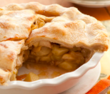
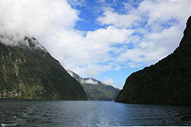
WebSite presentation - Culture
A real cultural guide
Practical informations
Guide to discover food specialties
Guide for your journey with things to do

Slide 5
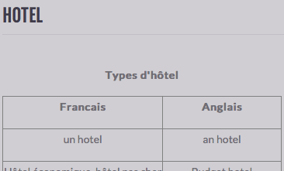
Website presentation - vocabulary
Vocabulary to help you in any situation
4 sections : Hotel, Food, Travel, Health
Each sections is divided, so it is very easy to use
Vocabulary helpful for your most common encounters

Slide 6
Website presentation - GRAMMAR
To have a basic knowledge of english
5 sections : Present, Past, Present perfect, Past perfect, Future
Each sections is divided in 4 parts : lessons, exercises
Quick learning exercises

Slide 7
Technical part – Improvements
We have used HTML, CSS, JavaScript : it is easy to use
To create a backend to improve the exercises, make them more flexible
Statistics for progression
After 3 tries the solution button appears
To create a « To Know » sections with pre-made sentences with several themes

Slide 8
Demonstration
Now, let’s try it !

Slide 9
Conclusion
The website is very useful for travelers
The website is easy to master
The website is easy to improve

Slide 10
PrEsentation
Thanks for your attention
English project by Frederic Georges and Constance Pineau
3rd of April 2017

