Slide 1
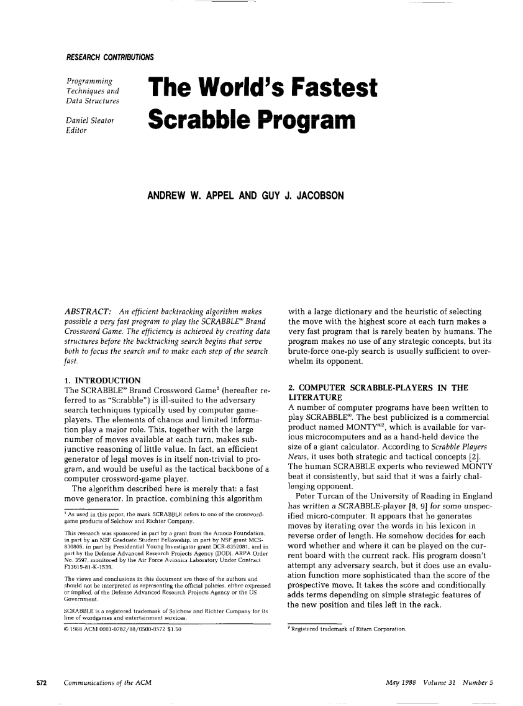
The World's Okayest
Scrabble Program
Casey Pore
CS540, Spring 2015

Slide 2
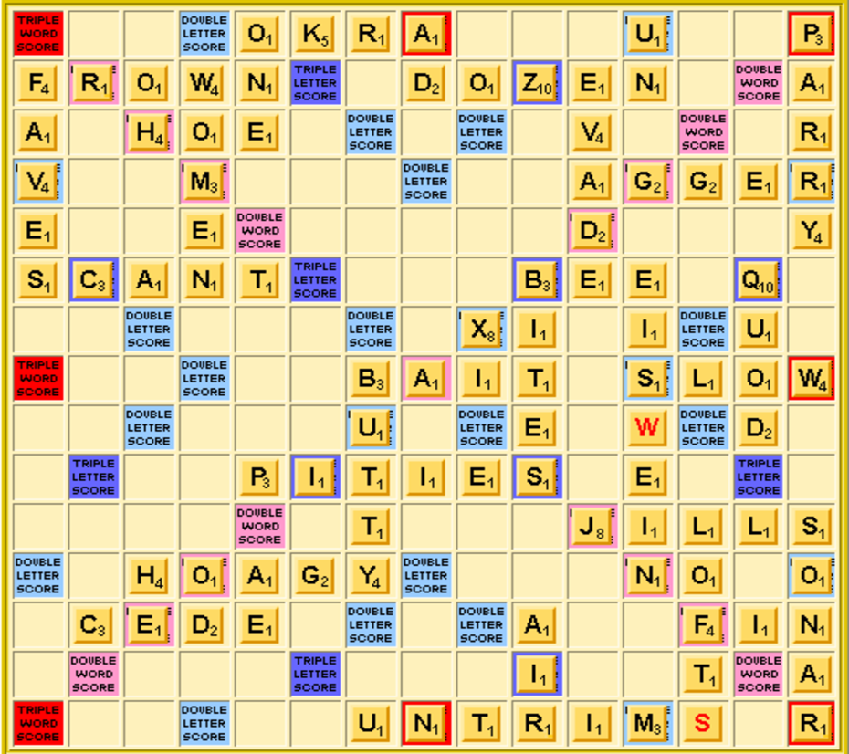
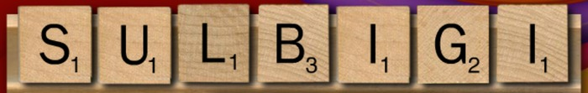
About Scrabble

Slide 3
Scrabble Properties and AI
Imperfect Information
  Until bag is empty
“Ill-suited to the adversary search techniques typically used by computer game-players.” (Appel & Jacobson)
“a good example of the “fundamental engineering” approach to constructing intelligent behavior.” (Sheppard)
Domain specific search
Heuristic-guided move selection
Endgame fully-observable

Slide 4
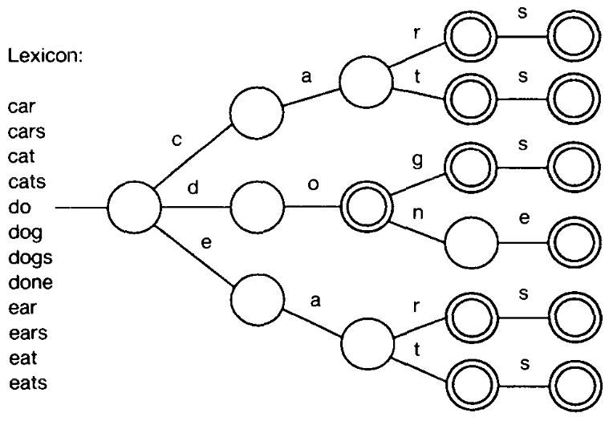
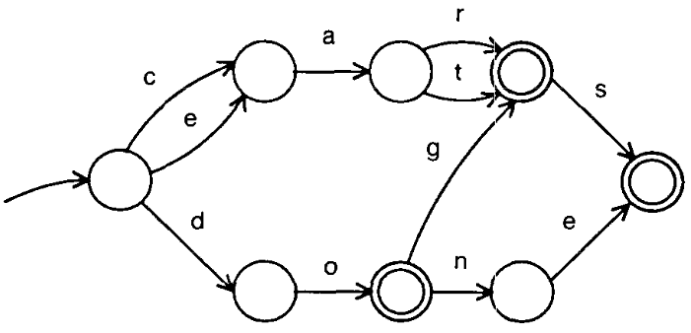
What's Up DAWG?
DAWG = Directed Acyclic Word Graph
Lexicon: Official Tournament and Club Word List
  178,691 words
  1.8MB → 687.5KB

Slide 5
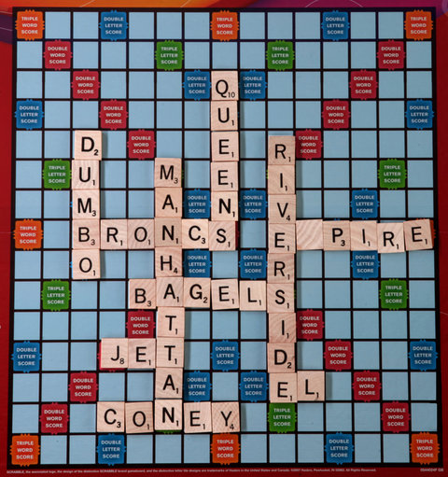
Search/Move Generation
5040 permutations (without repetition) for 7-tile rack.
  131,040 with 1 blank, 3,407,040 with 2-blanks (very rare)
Average 700 legal moves/position
  8000 with blanks

Slide 6
Implementation Comparison
 | A & J | Me | Sheppard
Search | Exhaustive | Exhaustive | Exhaustive
Heuristics | Max Score | Max Score Use Q Save Common S Moves Defend Bonus | Rack Evaluation -U With Q unseen -Vowel/Consonant Balance Tile Turnover First-turn openness
Pre-endgame | No | No | One-ply search w/ static evaluation function computed by an oracle
Endgame | No | No | B* search
Notes:
Rack Evaluation – Penalty for holding bad tiles

Slide 7
Preliminary Results
Program (heuristics) | Moves/Game | Average Move Time | Average Move Score | Average Game Score
Me (Max Move) | 15.59 | 4.5 secs | 24.015 | 379.1 (vs itself)
Me (Use Q) | 15.66 | 4.9 secs | 24.42 | 385.3 (vs Max Move)
A&J (Max Move) | 22.4 | 1.4 secs | 16.8 | 376.3 (vs itself)
Sheppard (Maven Multi-approach) | 10.5 | No Data | 35.0 | 367.5 (vs itself)
*To do: More heuristics and player competitions
Opportunities for speed improvement: Back-tracking, Cross-Check Pruning

