Slide 1
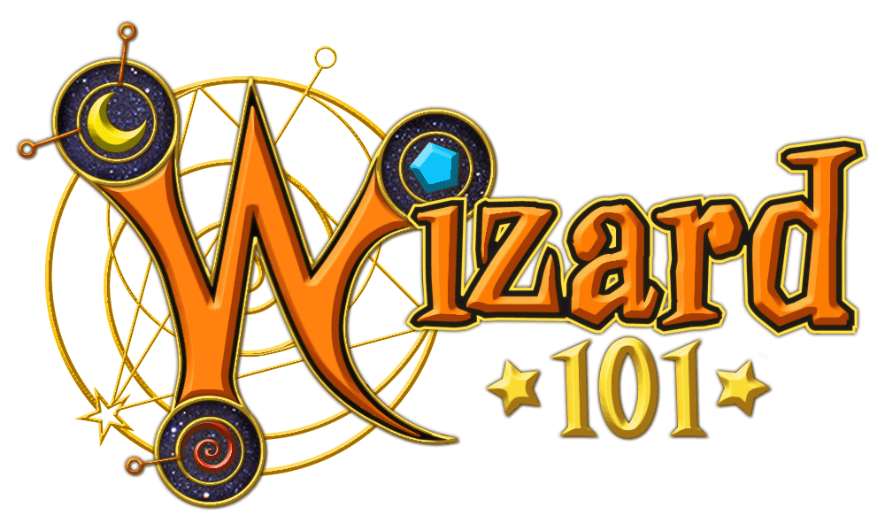
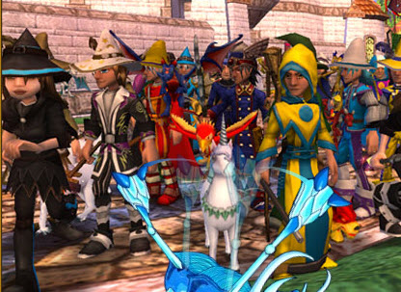


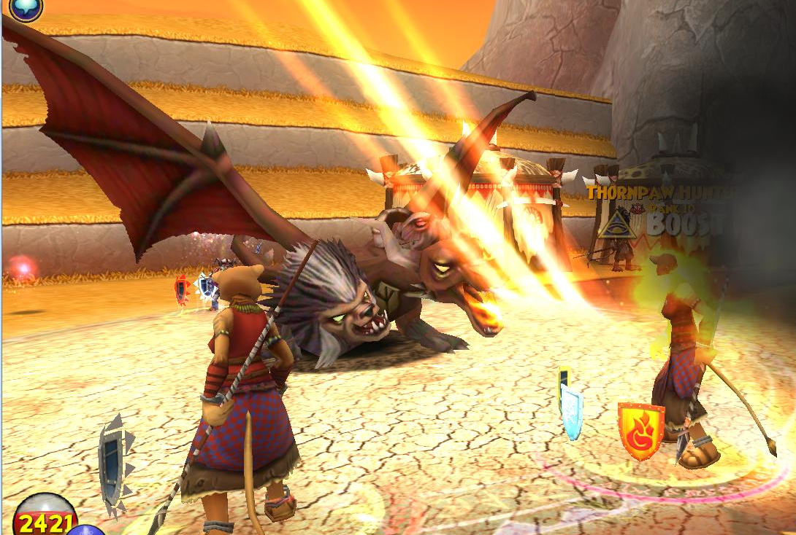
by Connor Porell
Launched in 2008
Family-friendly, team-oriented MMORPG
Developed by Kingsisle Entertainment
30 million players
Target audience 8- 15 yrs, but all ages play

Slide 2
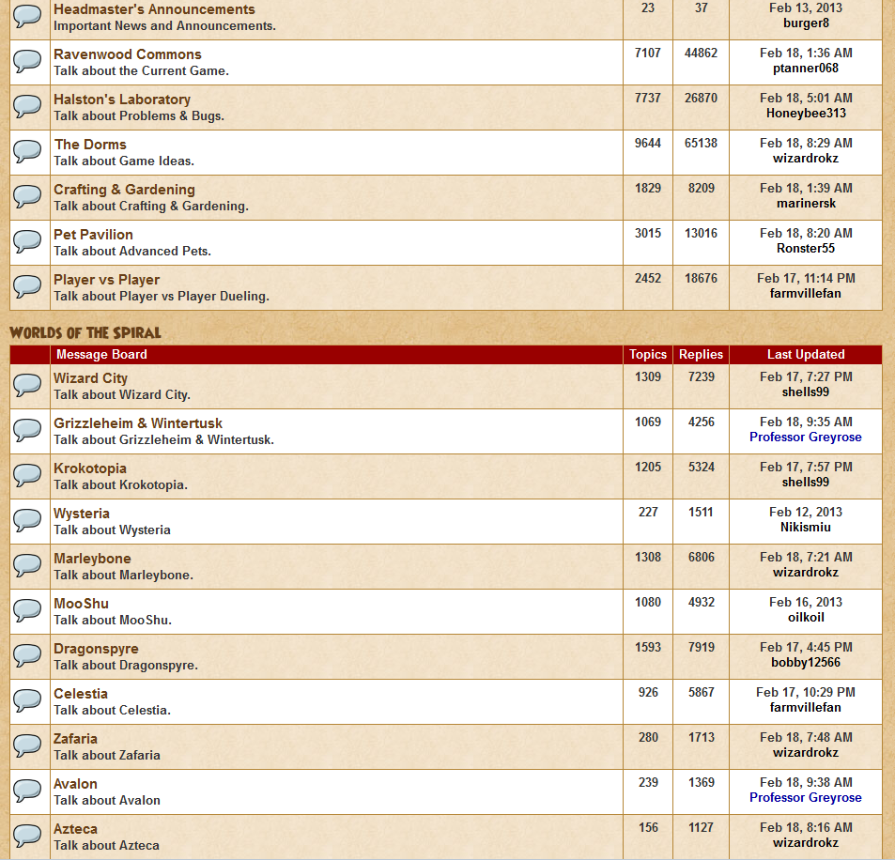

My Involvement – 1/11 – 2/20
Infiltrated the forums, mostly:
Problems and Bugs
Avalon/Azteca (newest worlds)
“The Commons” – current game discussion
PvP (where most of my attention was)

Slide 3
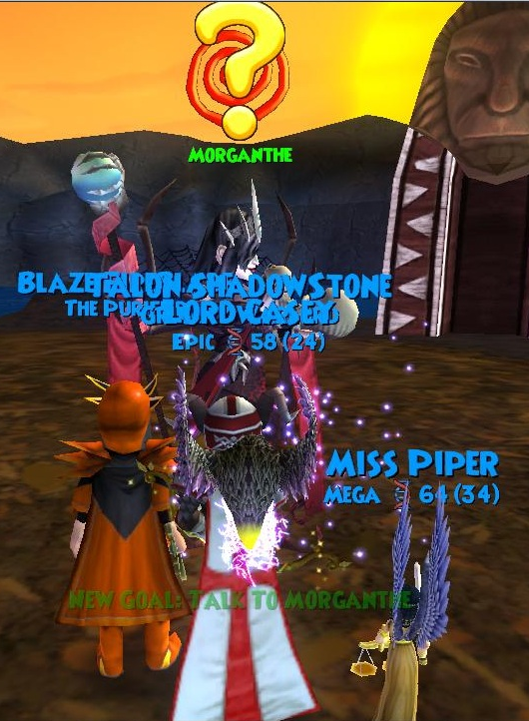
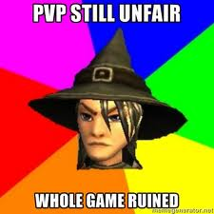
Issues in PvP
The vast majority of players’ issues with the game were in PvP.
Certain classes are overpowered
Certain spells should be nerfed/banned
Matchmaking issues
Ranking exploits
Unfortunately, this is an accurate representation of some players’ reactions towards these issues.

Slide 4
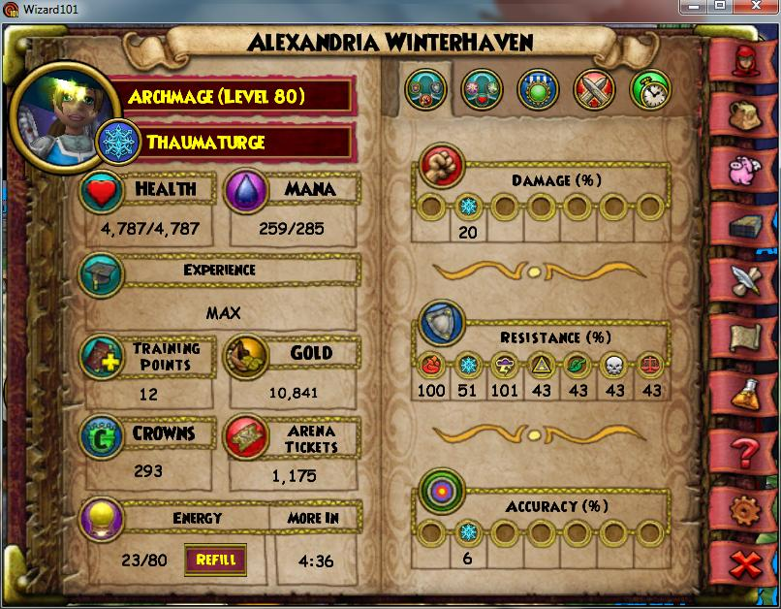
Player Complaints
Overpowered classes:
Storm (glass cannon)
Ice (wall)
Balance (jack-of-all-trades)
Complaints over these originate over their stat distribution and available spells and gear.
Cases like this (100% resist to 2 of the 7 types of damage)
All gear is legitimate – Wizard101 does not have cheats, hacks, or mods.

Slide 5
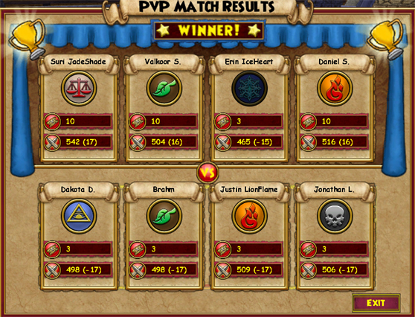
Leveling Exploits in PvP
Level/Rank-related Issues:
“Puppet matches” – low-leveled players join high-leveled players to gain easy PvP Ranks.
Matchmaking Formula:
Current formula needs changing.
Admins: Player Level and PvP Rank are taken into account, though level has more weight.
Players still report being place in unbalanced matches.

Slide 6

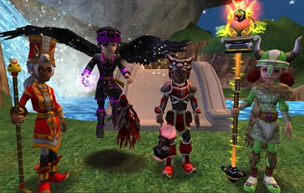
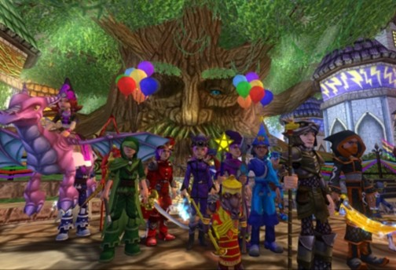
Susceptibility
Unfortunately, the community is extremely susceptible.
Huge fanbase – high chance of complaints.
Any competitive multiplayer is bound to have flaws.
Massive number of combinations of gear and spell builds.
Huge number of game elements to place blame on.

Slide 7
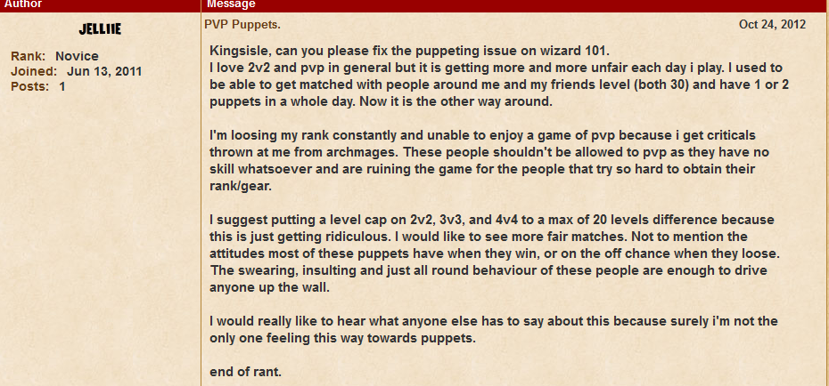

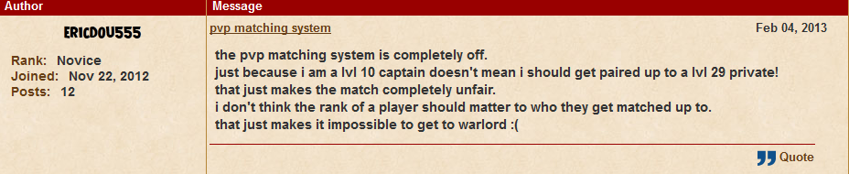
Evidence of the Problems

Slide 8
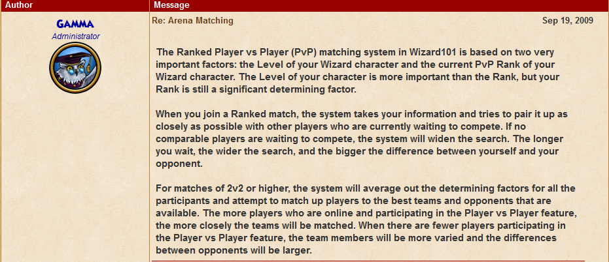
Current Solution
Current PvP matchmaking system – a mix of Rank and Level (mostly Level).
No banned gear/spells/character builds.
Install MINOR changes.
Usually on new features, shortly after they come out.
Little to no follow-up.

Slide 9
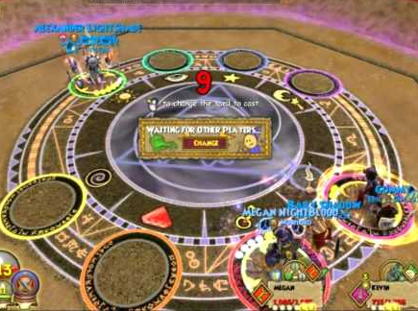
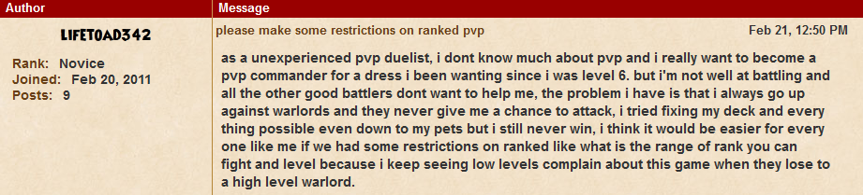
How would I fix it?
Matchmaking system overhaul:
Formula favors level much more over PvP rank.
Maximum range in team levels.
Avoids puppet matches.
Weekly PvP Feedback – Open discussion between devs and players.
Balance out gear- cut back on massive resists.
Make other gear more desirable.

Slide 10
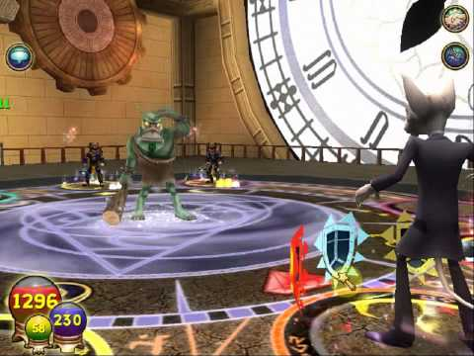
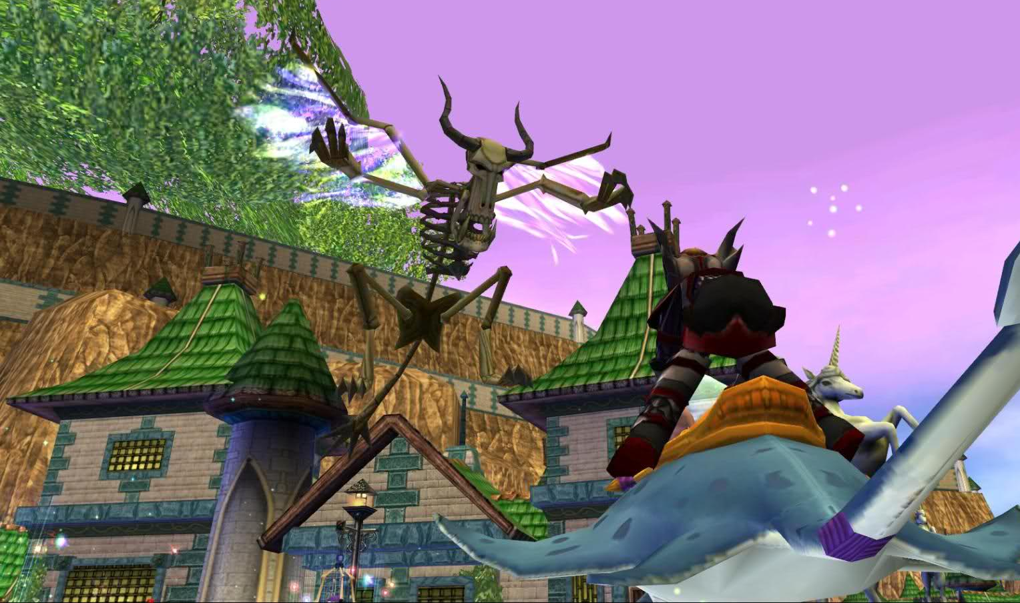
Conclusion
No competitive multiplayer is perfectly balanced.
See also: Pokemon, Halo, Civilization
The community has the right mindset.
PvP can be fixed- it just needs time.
Balance is difficult!
Just as important for developers as it is for players!
Thank you for watching!
Images were taken from Wizard101 or the Wizard101 forums.
All music was created by Nelson Everhart.

