Slide 1
PROGRESS REPORT
Spontaneous Adsorption of β-Lactoglobulin (1BEB)
at the Air–Water Interface
Molecular Dynamics Simulation Study
Force Field: CHARMM36m
Water: TIP3P
GROMACS 2020.4
April 2026
β-Lactoglobulin Adsorption at Air–Water Interface | CHARMM36m / GROMACS 2020.4

Slide 2
Objective
Why spontaneous? Why atomistic?
The Gap
This Work
Our previous MD studies place the protein directly at the interface
→ This creates a biased setup that cannot reveal:
• True adsorption pathway
• Real thermodynamic driving force
• Preferred orientation selection
• Pre-adsorption conformational changes
Fully unbiased spontaneous adsorption
→ Protein placed in bulk water center
→ No orientation bias, no pulling force
→ 1,000 ns production run
→ Atomistic CHARMM36m force field
First atomistic evidence of BLG spontaneous adsorption mechanism
β-Lactoglobulin Adsorption at Air–Water Interface | CHARMM36m / GROMACS 2020.4
2 / 10

Slide 3
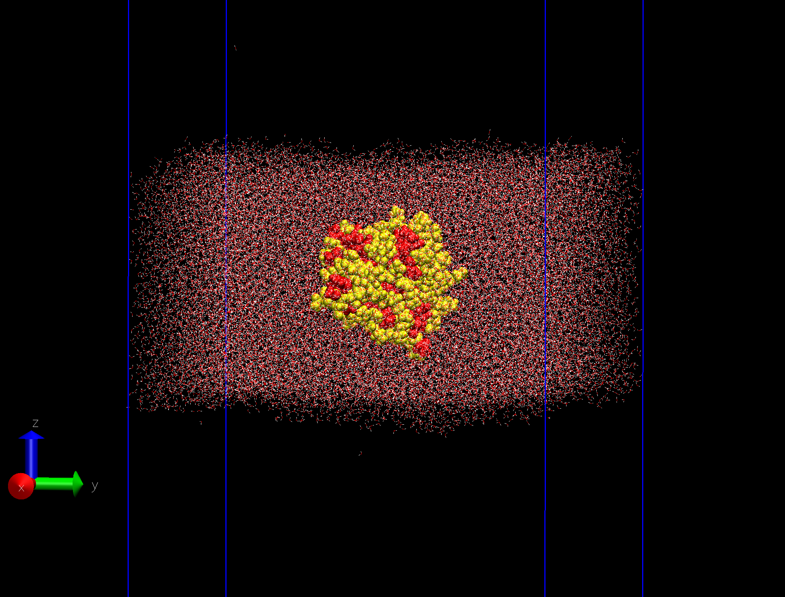
System Configuration
Slab geometry with vacuum runways
[Insert Figure: VMD visualization of slab system
showing vacuum / water slab / protein]
Parameter | Value
Protein | β-Lactoglobulin monomer (PDB: 1BEB)
Force Field | CHARMM36m
Water | TIP3P (~55,000 molecules)
Box (Slab) | 12 × 12 × 35 nm
Water Slab | ~7 nm thick (CoM at Z ~17.5 nm)
Vacuum | ~14 nm each side
Temperature | 298 K (V-rescale)
Timestep | 2 fs | VdW: force-switch 1.0–1.2 nm
pcoupl | OFF — required for slab geometry
DispCorr | OFF — CHARMM36 slab standard
β-Lactoglobulin Adsorption at Air–Water Interface | CHARMM36m / GROMACS 2020.4
3 / 10

Slide 4
Simulation Workflow
From bulk equilibration to 1 µs production
1
2
3
4
5
6
Energy Min.
NVT 100 ps
NPT 10 ns
Box Stretch
NVT Slab 10 ns
Production
1,000 ns
Steepest descent
cubic box ~7 nm
298 K equilibration
POSRES on
Density → ~1016 kg/m³
Parrinello-Rahman
Z: 7 → 35 nm
gmx editconf
Interface equilibration
POSRES on, gen_vel=yes
POSRES off
Fully unbiased MD
✓ Step 6 COMPLETE — 1,000 ns finished | Performance: 104.7 ns/day | Temperature stable: 297.99 K
β-Lactoglobulin Adsorption at Air–Water Interface | CHARMM36m / GROMACS 2020.4
4 / 10

Slide 5
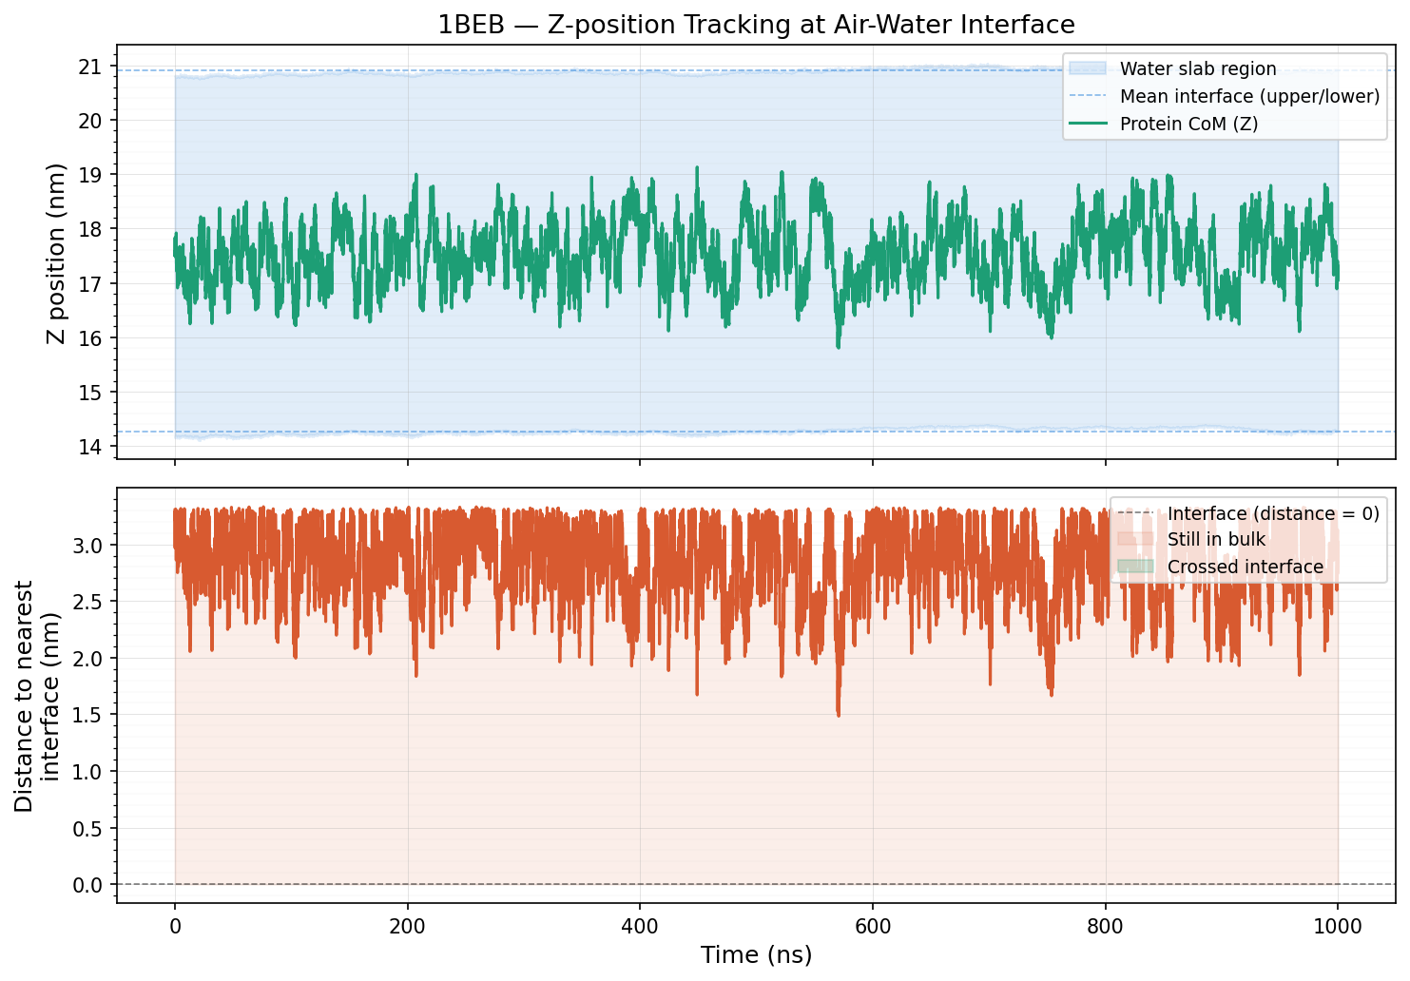
Diffusion Kinetics — Z-position Tracking
1,000 ns | Protein CoM vs. interface distance
[Insert Plot: z_position_track.png
(Z-position + distance to interface, 1,000 ns)]
3.303 nm
Distance to
interface (range)
>1 µs
Adsorption
timescale
NOT YET
Adsorption
status
Key Insight: BLG spontaneous adsorption from bulk center requires >1 µs — first atomistic quantification of this timescale.
β-Lactoglobulin Adsorption at Air–Water Interface | CHARMM36m / GROMACS 2020.4
5 / 10

Slide 6
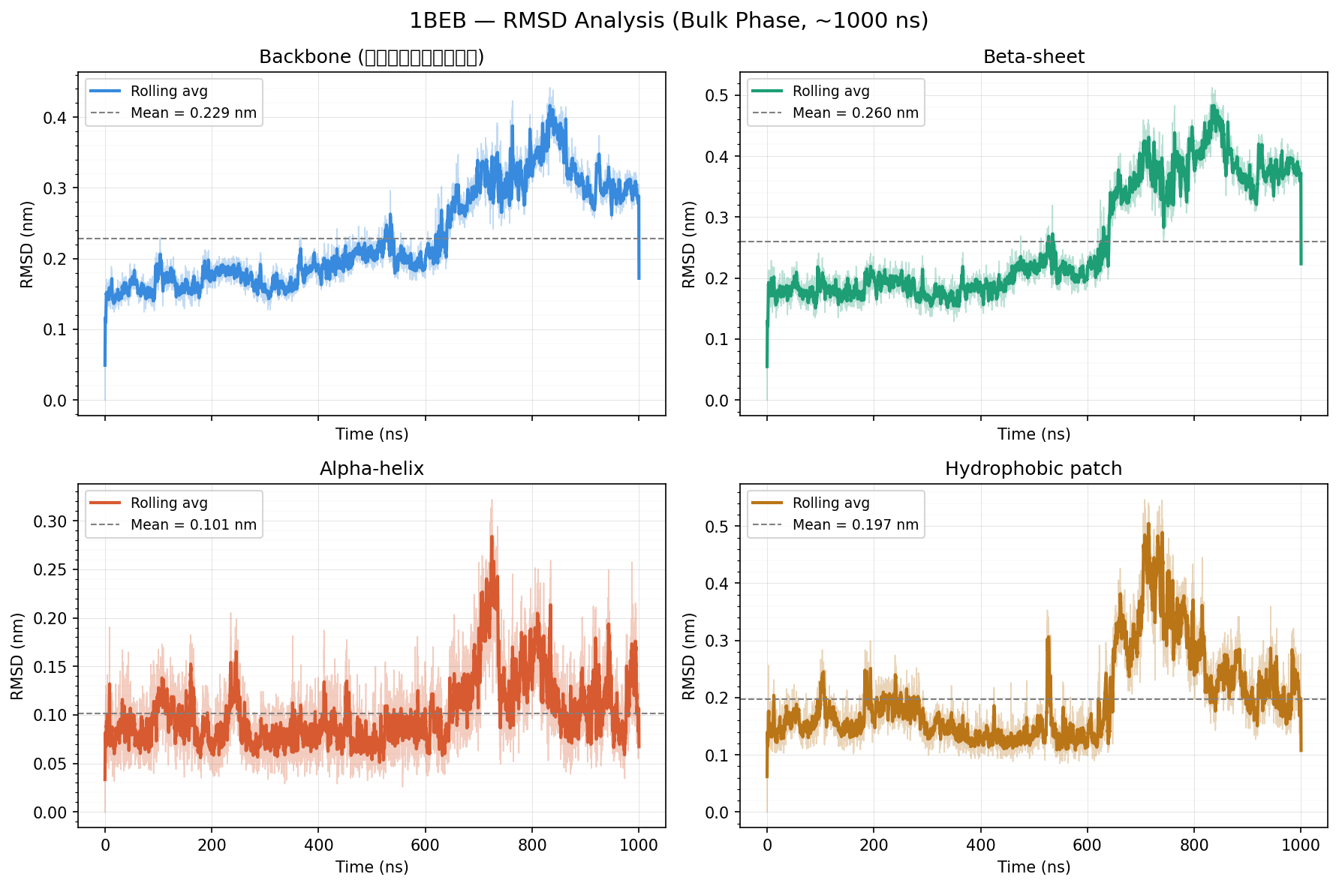
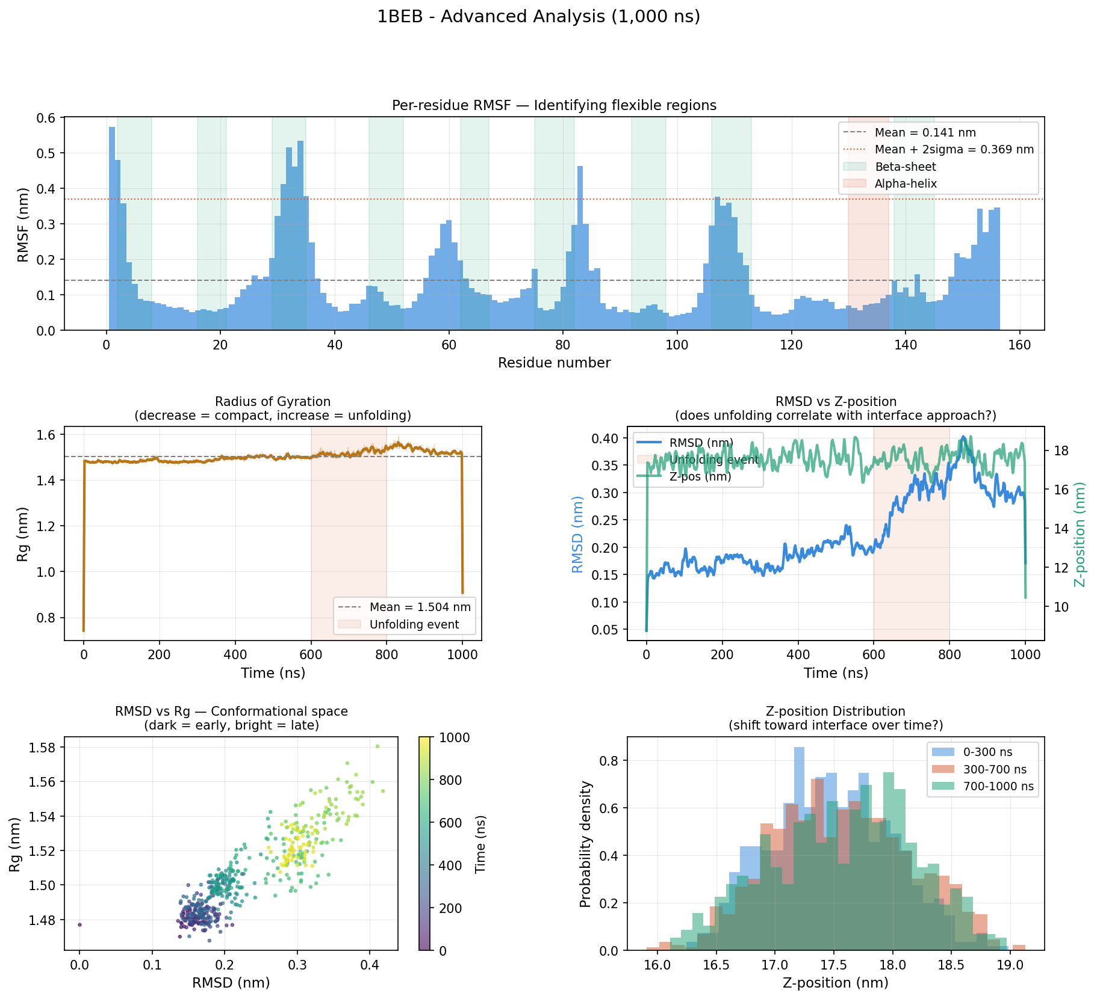
Structural Analysis — RMSD & Per-residue RMSF
Stability in bulk + identifying flexible regions
[Insert Plot: rmsd_analysis.png
(Backbone, Beta-sheet, Helix, Hydrophobic patch)]
[Insert Plot: advanced_analysis.png — Panel: Per-residue RMSF
(mean 0.141 nm, flexible loops highlighted)]
Region | Mean RMSD | RMSF note
Backbone | 0.229 nm | Stable early phase
Alpha-helix | 0.101 nm ✓ most stable | RMSF ~0.05–0.08 nm
Beta-sheet | 0.260 nm | Disrupted after 600 ns
Loop BC (res. 30–35) | — | RMSF ~0.53 nm — most flexible
β-Lactoglobulin Adsorption at Air–Water Interface | CHARMM36m / GROMACS 2020.4
6 / 10

Slide 7
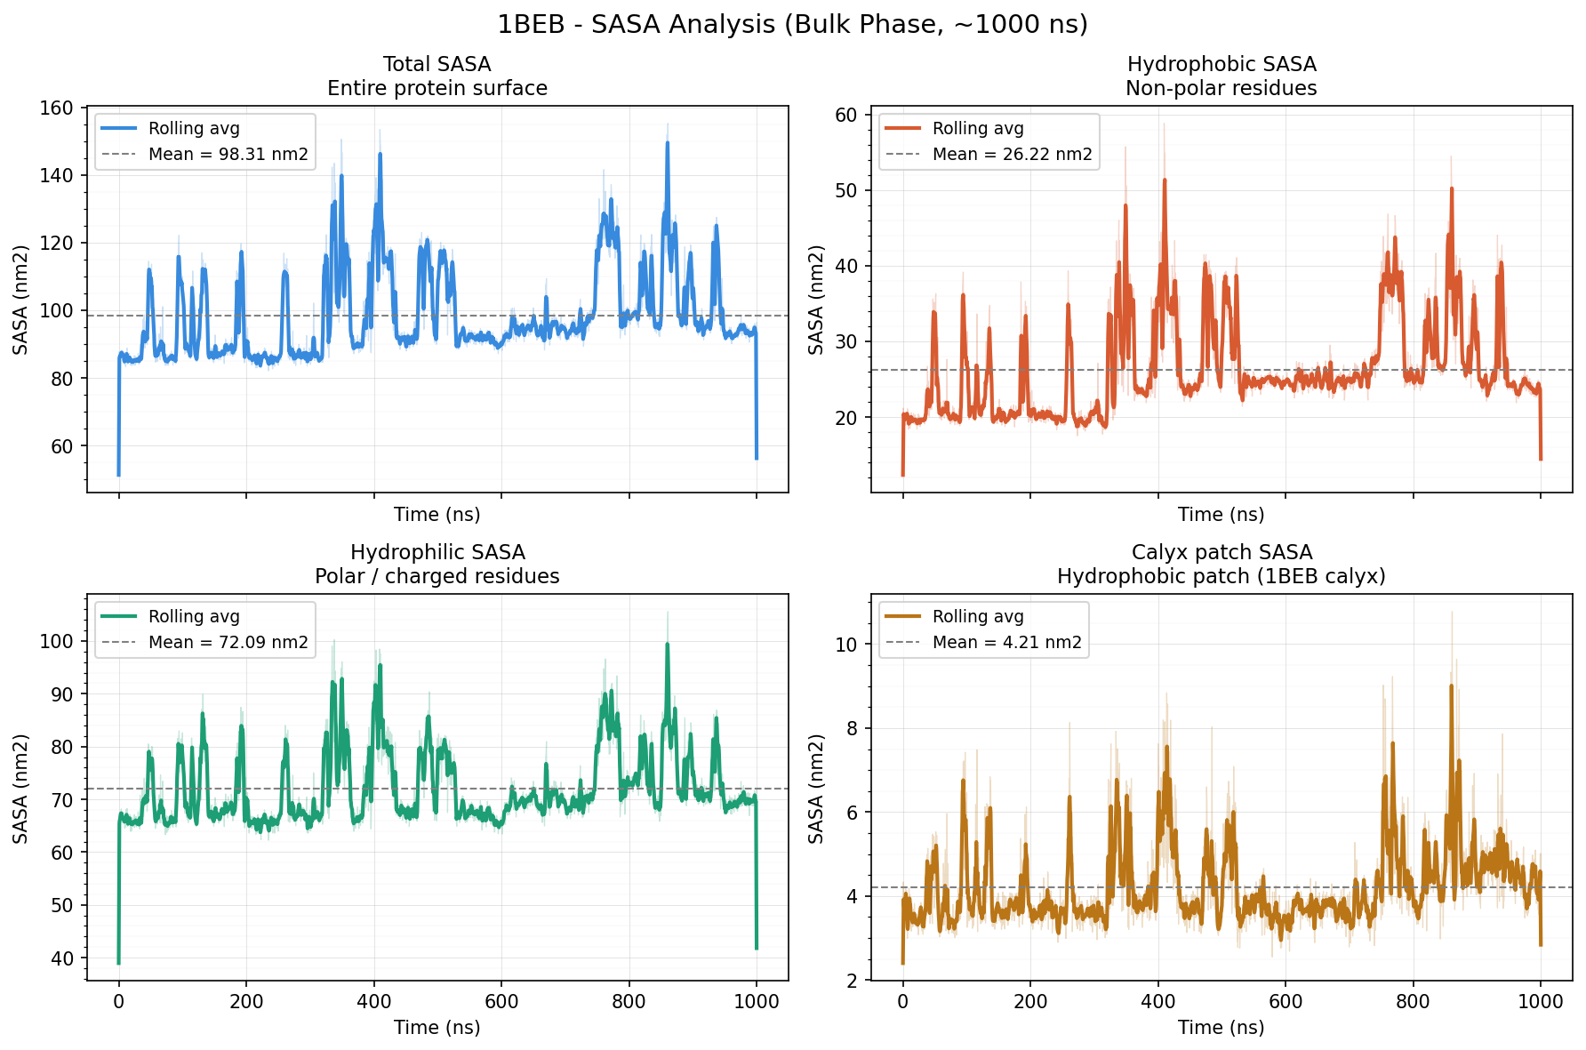
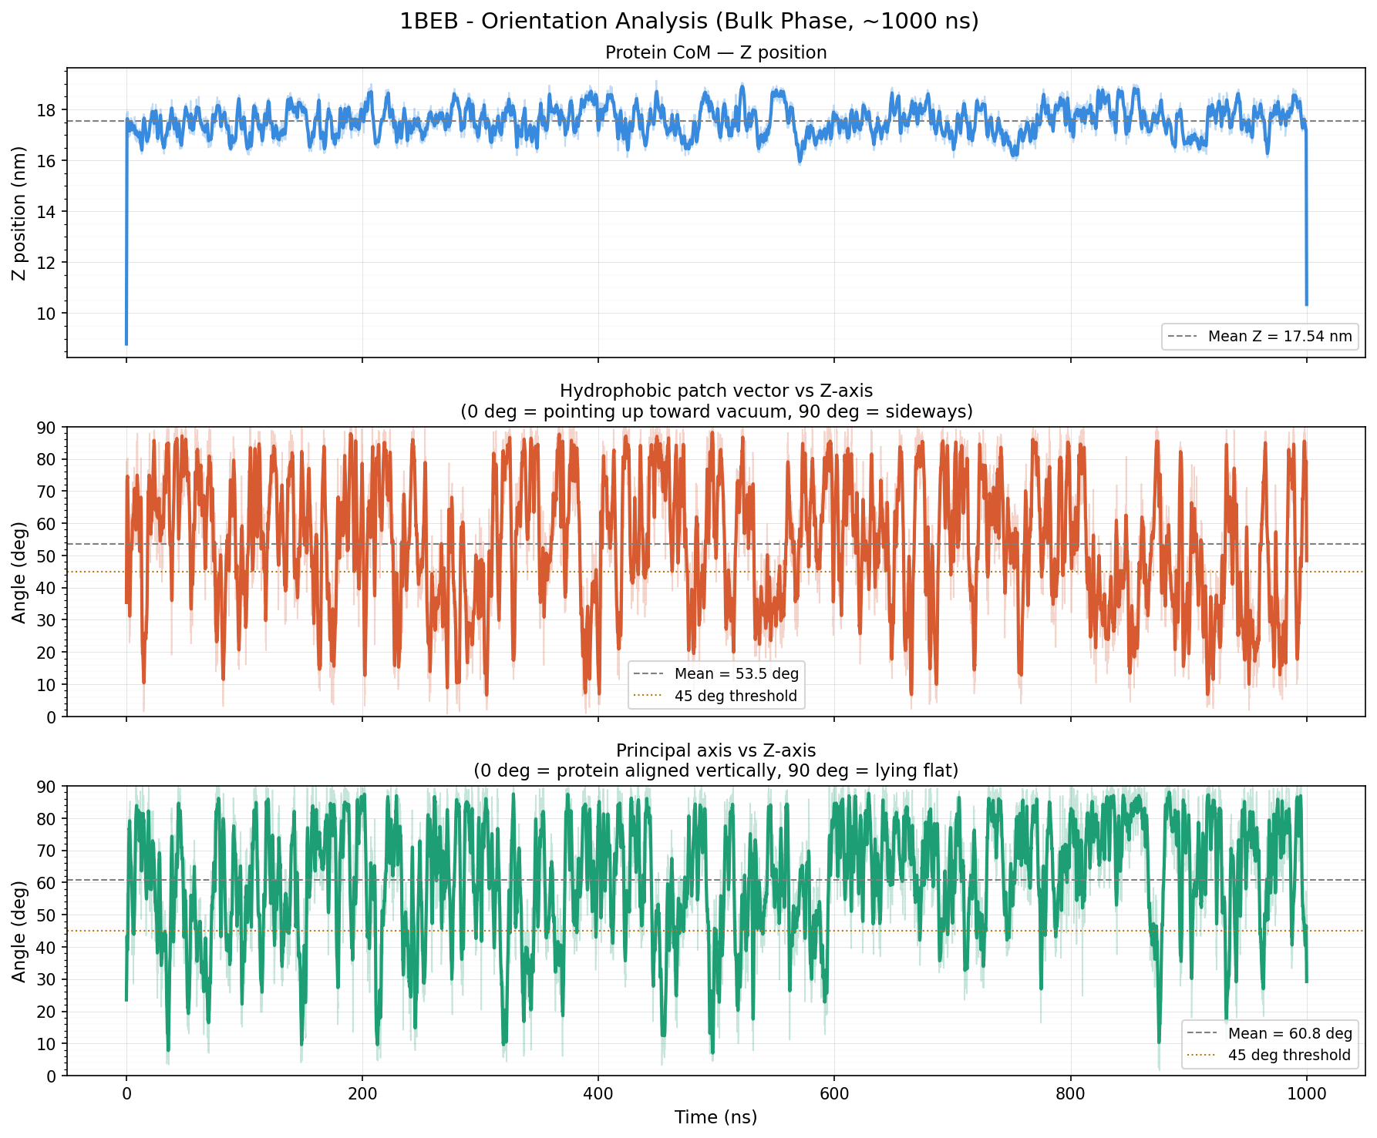
Hydrophobic Driving Force — SASA & Orientation
Increasing hydrophobic exposure over 1,000 ns
[Insert Plot: sasa_analysis.png
(Total / Hydrophobic / Hydrophilic / Calyx SASA vs time)]
[Insert Plot: orientation_analysis.png
(Hydrophobic patch angle vs Z-axis, 1,000 ns)]
+20%
50 nm²
53.5°
<20°
Hydrophobic SASA
0→1,000 ns
Peak hydrophobic
exposure (spike)
Mean patch angle
(random tumbling)
Transient favorable
orientation events
β-Lactoglobulin Adsorption at Air–Water Interface | CHARMM36m / GROMACS 2020.4
7 / 10

Slide 8
Key Event: Partial Unfolding at 600–800 ns
Pre-adsorption conformational activation
[Insert Plot: advanced_analysis.png — Panel: Radius of Gyration
(Rg increases 1.50 → 1.55 nm at 600–800 ns)]
[Insert Plot: advanced_analysis.png — Panel: RMSD vs Z-position
(RMSD & Z increase together at 600–800 ns)]
0–400 ns
400–600 ns
600–800 ns
800–1000 ns
Stable Bulk
Pre-Activation
Partial Unfolding
Near-Interface
Native folded state
RMSD ~0.15 nm
Rg ~1.50 nm
Conformational
fluctuations increase
SASA spikes more frequent
Rg → 1.55 nm
RMSD peaks 0.4 nm
Drift toward interface
Partially unfolded
state persists
Z-pos distribution shifts
β-Lactoglobulin Adsorption at Air–Water Interface | CHARMM36m / GROMACS 2020.4
8 / 10

Slide 9
Plan B — Near-Interface Simulation
Reducing diffusion barrier while maintaining spontaneous adsorption
VACUUM (~14 nm)
Parameter | Value
Starting file | slab_planb_v2.gro
Protein CoM Z | 18.700 nm
Distance to interface | 2.183 nm (measured)
Still spontaneous? | YES — no orientation bias
Replicas | 3 × 500 ns (seed: 1234 / 5678 / 9999)
Expected adsorption | 100–300 ns
WATER SLAB (~7 nm)
2.18 nm
Protein
VACUUM (~14 nm)
slab_planb_v2.gro
Energy Min.
NVT Slab
10 ns
Production
500 ns × 3
β-Lactoglobulin Adsorption at Air–Water Interface | CHARMM36m / GROMACS 2020.4
9 / 10

Slide 10
Summary & Research Roadmap
What we found — what comes next
Key Findings (1,000 ns)
Phase 1
IN PROGRESS
BLG Adsorption
1. Spontaneous adsorption from bulk requires >1 µs
→ first atomistic timescale quantification
2. Partial unfolding event at 600–800 ns
→ prerequisite for adsorption
3. Unfolding correlates with interface approach
→ unfolding drives adsorption tendency
4. Loop BC (res. 30–35) most flexible
→ predicted primary contact point
5. Hydrophobic SASA +20% over 1,000 ns
→ progressive pre-activation
1,000 ns ✓ + Plan B (3 replicas)
Phase 2
UPCOMING
Casein Adsorption
αs1-Casein (IDP) vs BLG comparison
Phase 3
PLANNED
Calcium Bridge
BLG + Casein + Ca²⁺ at interface
Phase 4
PLANNED
Fat Interaction
Triglyceride + protein film model
β-Lactoglobulin Adsorption at Air–Water Interface | CHARMM36m / GROMACS 2020.4
10 / 10

