Slide 1
Contact without Commitment
β-Lactoglobulin at the Air–Water Interface
First Unbiased Atomistic Molecular Dynamics Evidence
Chalakon Pornjariyawatch · Prapasiri Pongprayoon
Department of Chemistry, Kasetsart University | COMFHA Project | May 2026
Paper auto-review: 10/10 READY Target: JCIS (IF ~9)
1 / 15
Notes:
Wait for room to settle. Don't rush.
'Good morning/afternoon. Today I'll take you through our first paper on beta-lactoglobulin at the air-water interface. The title: Contact without Commitment. By the end, that phrase will be obvious.'

Slide 2
Today's Story
01
02
03
04
THE PROBLEM
OUR APPROACH
THE FINDINGS
IMPLICATIONS
An open question for 40 years
First unbiased atomistic MD at the AWI
613 contacts · 0 commitments · 5 insights
A pathfinder result for the field
Most time on Act 03 — that is where the science lives.
2 / 15
Notes:
Quick roadmap. Four acts.
Problem: question open for 40 years.
Approach: what makes this different.
Findings: five results — this is the heart.
Implications: pathfinder for the field.

Slide 3
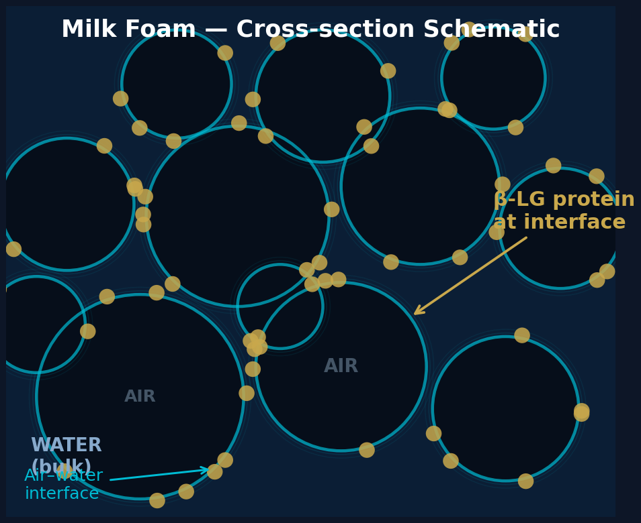
The Problem — What We Know and What Is Missing
β-Lactoglobulin (BLG)
• Dominant whey protein in bovine milk (~3 g/L)
• Forms a viscoelastic film at the air–water interface → stabilises foam
• Adsorbs slowly — seconds to minutes — a measured kinetic barrier
The gap
• All prior MD: oil–water only, pre-stressed protein, ≤ 200 ns
• CoM distance metric blind to surface contact for a 4 nm protein
No unbiased atomistic simulation of native BLG at the air–water interface existed before this work.
3 / 15
Notes:
BLG is ~3 g/L in bovine milk — the main whey protein.
It stabilises foam by forming a viscoelastic film at the AWI.
BLG adsorbs slowly. There is a measured kinetic barrier.
Classical explanation (Graham & Phillips 1979): surface tension drives unfolding.
But no one has seen this at atomic resolution. The gap — that is what we fill.

Slide 4
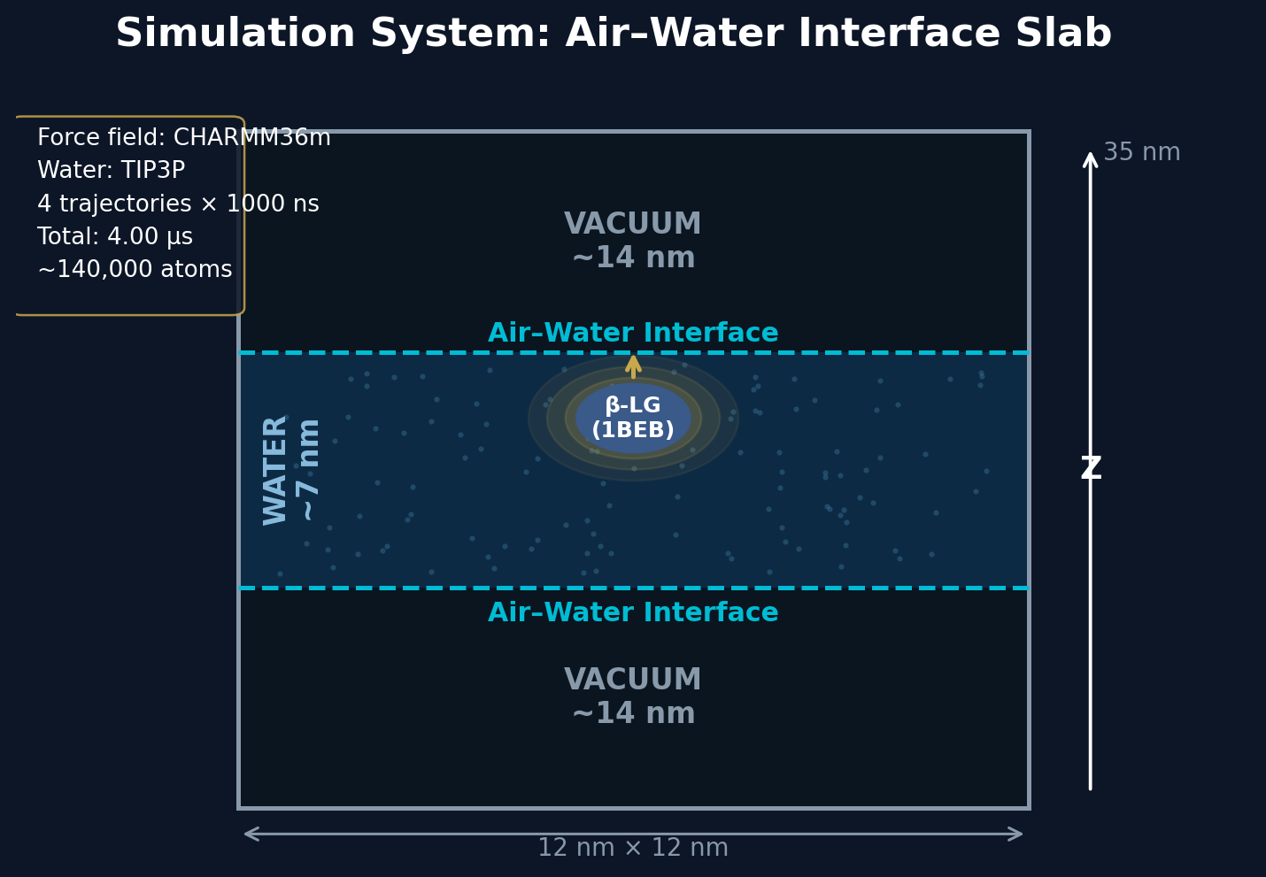
Our Approach — Slab Geometry + Atomic Contact Metric
Four independent trajectories
CENTER
Bulk start
1,000 ns
R1
Near AWI (2 nm)
1,000 ns
R2
Near AWI
1,000 ns
R3
Near AWI
1,000 ns
4.00 µs
cumulative
Contact metric: nearest-atom ≤ 0.30 nm (not CoM distance — recovers 613 events)
4 / 15
Notes:
12 × 12 × 35 nm slab. ~7 nm water, ~14 nm vacuum each side.
CHARMM36m + TIP3P. 298 K. No pressure coupling (slab geometry).
4 trajectories × 1000 ns = 4.00 µs total.
Key innovation: nearest-atom metric. CoM cannot detect contact for a 4 nm protein.

Slide 5
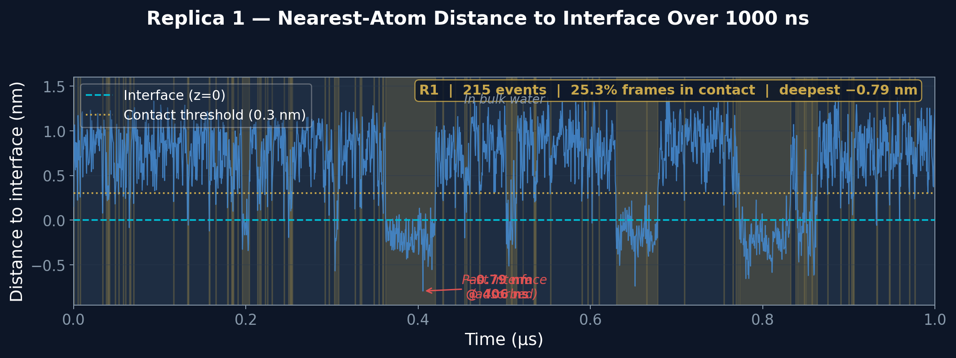
Finding 1 — Contact Is Frequent
613
7–23%
0.79 nm
< 1 ns
contact events across 4 replicas
of frames in contact per trajectory
deepest penetration past interface
typical duration (touch and retreat)
5 / 15
Notes:
613 contact events across 4 µs. 7-23% of frames per trajectory.
Blue trace: nearest-atom distance for R1. Gold shading: contact windows.
Atoms penetrate up to 0.79 nm past the interface plane.
But every event ends — the protein retreats.
BLG visits the interface constantly. It just does not stay.

Slide 6
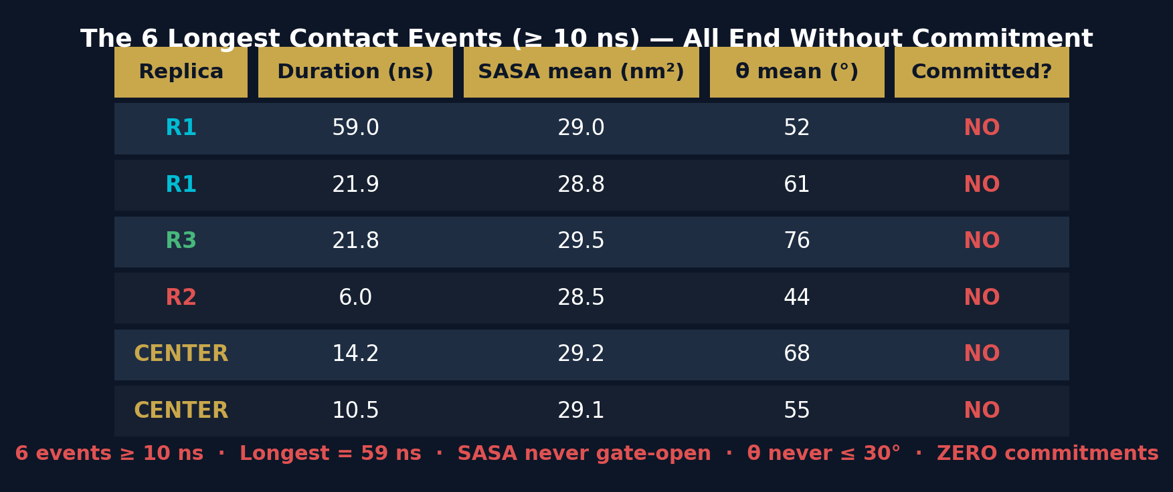
Finding 2 — Commitment Is Absent
0
stable adsorptions in 4.00 µs
(out of 613 contact events)
"59 nanoseconds of contact. The protein reaches the interface, probes it at atomic resolution — and retreats. Still no commitment."
6 / 15
Notes:
Zero stable adsorptions in 4 microseconds. That IS the result.
6 events last ≥ 10 ns. Longest is 59 ns.
All 6: SASA never above 32 nm², angle never ≤ 30°.
Contact is NOT the bottleneck — commitment is.
59 ns contact without commitment — a real kinetic bottleneck, not noise.

Slide 7
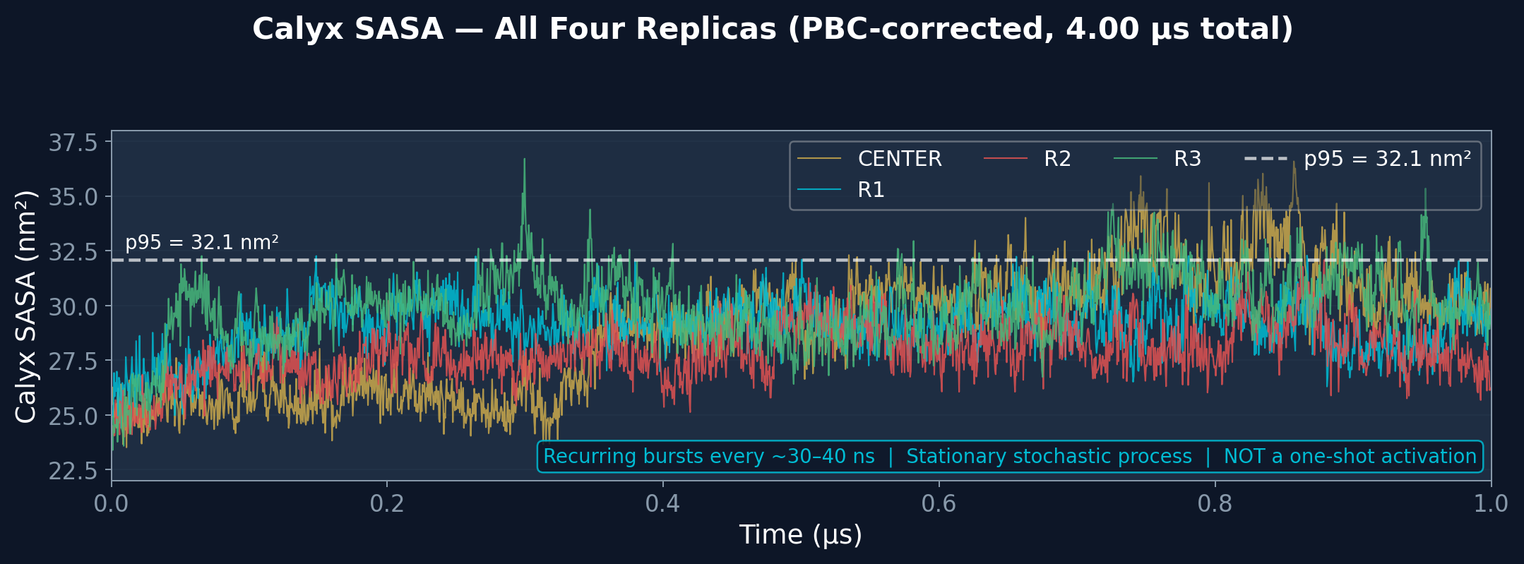
Finding 3 — Compact Globally, Breathing Locally
Rg = 1.496 ± 0.009 nm
Flat across 4 µs — globally compact throughout
α-helix RMSD ≤ 0.14 nm
Secondary structure intact — beta-barrel preserved
No global unfolding
Graham & Phillips (1979) model is NOT supported
Calyx SASA: 24–37 nm² · Recurring bursts every ~30–40 ns Stationary stochastic process — activation is local and perpetual
7 / 15
Notes:
Two findings on one slide — both about structure.
Rg flat at 1.496 ± 0.009 nm. No monotonic expansion. No global unfolding.
SASA fluctuates 24-37 nm², recurring every 30-40 ns across all replicas.
The calyx breathes constantly — this is a protein property.
Activation is local: calyx loop opening, not global unfolding.

Slide 8
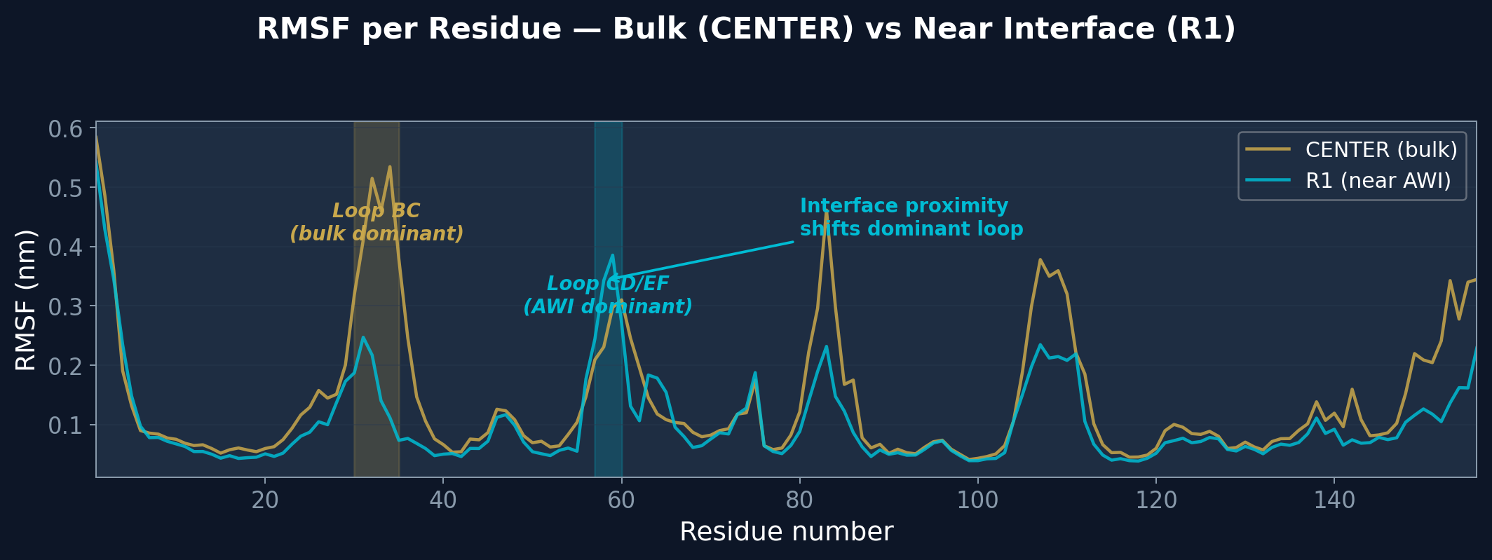
Finding 4 — Interface Shifts Which Loop Opens
Bulk (CENTER):
Loop BC (residues 30–35)
RMSF peak: 0.54 nm
Near AWI (R1):
Loop CD/EF (residues 57–60)
RMSF peak: 0.39 nm
The interface selects which loop is active. Loop CD/EF borders the calyx entrance → proximity drives calyx-opening motions. This identifies Loop CD/EF as the engineering target for mutant design.
8 / 15
Notes:
In bulk: Loop BC (residues 30-35) is most flexible — RMSF 0.54 nm.
Near AWI: Loop CD/EF (residues 57-60) becomes dominant.
The interface does not just attract the protein — it changes which loop is active.
Loop CD/EF borders the calyx entrance. Interface proximity selects calyx-opening motions.
Engineering target: stabilise Loop CD/EF in open conformation to accelerate adsorption.

Slide 9
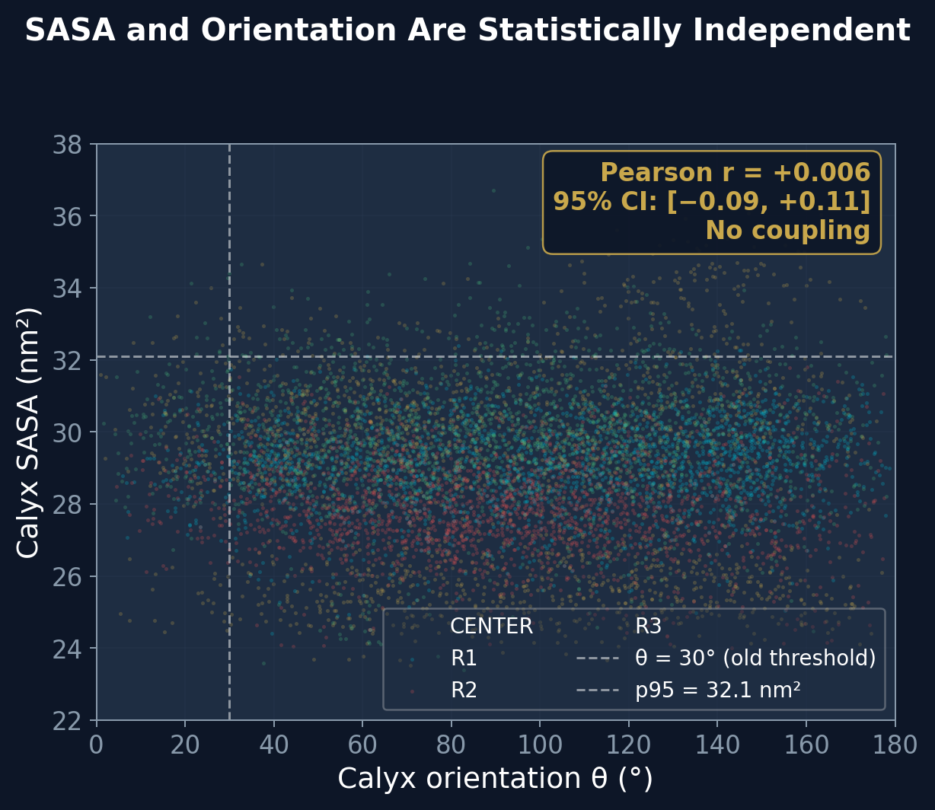
Finding 5 — Calyx Exposure and Orientation Are Independent
r = +0.006
Pearson correlation SASA vs. orientation θ
Block bootstrap 95% CI: [−0.09, +0.11] Rules out |r| > 0.11 at 95% confidence
What it means: Calyx opening and calyx alignment fluctuate independently. The two conditions needed for commitment never coincide reliably — that is why commitment is absent.
9 / 15
Notes:
r = +0.006. Essentially zero correlation.
95% CI [−0.09, +0.11] from block bootstrap (accounts for SASA autocorrelation 232 ns).
N_eff ≈ 17 independent observations in 4 µs — SASA is a slow variable.
The two things needed for commitment (SASA high AND orientation aligned) are independent.
Rare joint probability → why 59 ns contact still does not commit.

Slide 10
The Statistics Behind the Independence Claim
SASA autocorrelation
232 ns (range 81–394 ns across replicas)
SASA is a slow variable — consecutive frames are NOT independent
Effective N
N_eff ≈ 17 (from 4.00 µs / 2 × 232 ns)
Only ~17 truly independent SASA observations across the entire dataset
Block bootstrap
95% CI on r: [−0.09, +0.11]
Accounts for autocorrelation. Rules out |r| > 0.11 — no meaningful coupling
N_eff context
A common mistake: using n = 8,006 contact frames
With autocorrelation, raw n inflates significance by 400×. Block bootstrap corrects this
10 / 15
Notes:
This slide can be brief — 45 seconds.
The key point: we have 4 µs but only ~17 independent observations of SASA.
SASA autocorrelation is 232 ns — the variable is slow.
Block bootstrap corrects for this. CI [−0.09, +0.11] is the honest number.
Raw Pearson p-value is meaningless here — do not cite it.

Slide 11
Scientific Integrity — We Found Our Own Error and Fixed It
BEFORE — PBC Artifact
AFTER — PBC-corrected
• freeSASA without MDAnalysis unwrap
• Protein atoms split across periodic boundary
• Inflated SASA: 45–62 nm² (real value: 24–37 nm²)
• Apparent 3.3× gate suppression observed
• → Original paper narrative: "two-factor gate"
• MDAnalysis unwrap applied every frame
• All atoms in same periodic image
• Corrected SASA: 24–37 nm²
• r = +0.006 — no coupling, no gate
• → Current paper narrative: independence
→
We found our own error. We fixed it. We disclosed it fully in the Methods. The corrected physics — independence — is more interesting than the original artifact.
11 / 15
Notes:
This is the PBC artifact discovery from May 27, 2026.
freeSASA has no PBC awareness. Split atoms → SASA inflated 2× .
After applying MDAnalysis unwrap: SASA 45-62 → 24-37 nm², r becomes +0.006.
The two-factor gate suppression was entirely an artifact.
The independence result is actually more interesting and robust.
Good science = find your own errors, correct them, report them fully.
Disclose completely. Do not hide it. This is what makes the work trustworthy.

Slide 12
What This Work Establishes
First atomistic characterisation of the pre-commitment contact ensemble of native β-LG at the air–water interface
Contact frequent, commitment absent
Compact globally, loop-mediated locally
SASA ⊥ orientation on the µs timescale
613 events · deepest −0.79 nm 0 adsorptions in 4.00 µs Bottleneck is commitment, not contact
Rg flat at 1.496 ± 0.009 nm Loop CD/EF activated near AWI No global unfolding occurs
r = +0.006, CI [−0.09, +0.11] Commitment requires enhanced sampling This is where the barrier lives
This is the baseline the field needed before enhanced sampling can be designed and interpreted.
12 / 15
Notes:
Three things established for the first time:
1. Contact frequent, commitment absent — 613 events, 0 adsorptions.
2. Compact globally, loop-mediated locally — Rg flat, calyx loop opens.
3. SASA ⊥ orientation on µs scale — r=+0.006, independent.
The field needed this baseline. Now enhanced sampling has a well-defined target.

Slide 13
Implications for the Field
Loop CD/EF is the engineering target
Residues 57–60 become dominant near the AWI. Mutations that stabilise this loop in the open conformation should accelerate adsorption — a direct, testable prediction.
Enhanced sampling now has a well-defined collective variable
Commitment requires sampling along (SASA, θ). Metadynamics or REST2 can now compute the free energy barrier with a physically motivated CV. SET 1D data = baseline.
Contact/commitment dichotomy reframes the kinetic problem
Slow adsorption is not a diffusion problem — contact is frequent. The bottleneck is orientational and conformational coincidence. Prior kinetic models based on diffusion need revision.
13 / 15
Notes:
Three concrete implications:
1. Engineering: Loop CD/EF residues 57-60. Stabilise in open conformation.
2. Enhanced sampling: well-defined CV = (SASA, θ). Metadynamics next.
3. Conceptual: slow adsorption is not diffusion-limited, it is coincidence-limited.

Slide 14
What Comes Next
Phase 2 — β-Casein (Jul–Sep 2026)
Intrinsically disordered protein vs. folded BLG. Same slab geometry. Prediction: commits within 200 ns — no two-factor bottleneck for an IDP. AlphaFold2 structure ready.
Enhanced Sampling — Metadynamics along (SASA, θ)
Compute the PMF (free energy barrier) for commitment. SET 1D trajectories serve as the unbiased baseline. Will quantify the kinetic barrier for the first time.
Paper 1 — Submitting to JCIS
19 pages · 0 warnings · Auto-review Round 12: 10/10 READY Pending: Zenodo DOI + advisor sign-off → submit. github.com/cpornjar/blg-airwater-interface-md
14 / 15
Notes:
Three things next:
Phase 2: beta-casein. IDP vs. folded BLG. Start July 2026.
Enhanced sampling: metadynamics along (SASA, theta). Will quantify the barrier.
Paper 1: essentially done. Pending Zenodo upload and P.P. sign-off.

Slide 15
Summary
1
Contact is frequent, commitment is absent
613 events · deepest −0.79 nm · 0 adsorptions in 4.00 µs
2
Compact globally, loop-mediated locally
Rg flat 1.496 ± 0.009 nm · Loop CD/EF dominant near AWI · no unfolding
3
SASA and orientation are independent on the µs timescale
r = +0.006 · CI [−0.09, +0.11] · commitment requires enhanced sampling
COMFHA · Kasetsart University · May 2026 · Submitting to JCIS
15 / 15
Notes:
Three takeaways — say exactly these:
1. Contact frequent, commitment absent.
2. Compact globally, loop-mediated locally.
3. SASA independent of orientation on the µs scale.
Then: Thank you. Happy to take questions.

