Slide 1

Gun Confiscations in Louisville 2008-2017
Christina Porter

Slide 2
Special thanks to:
Eva Parke
Cassaria Edwards
Keturah Herron

Slide 3
Three Data Sets??
Firearms Intake
Firearms Data – Normalized Address
Firearms Data – Intersections
https://data.louisvilleky.gov/dataset/firearms-intake

Slide 4
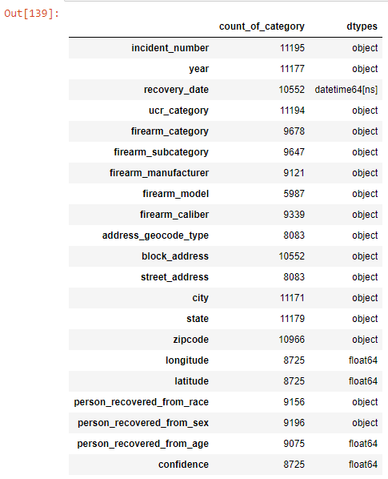
Viewing the Data

Slide 5
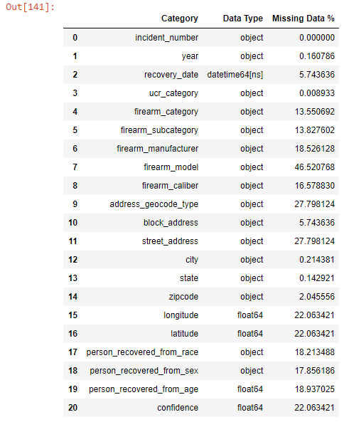
Viewing the Data

Slide 6
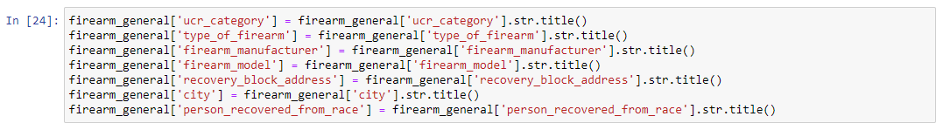
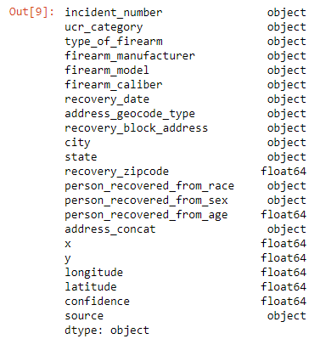
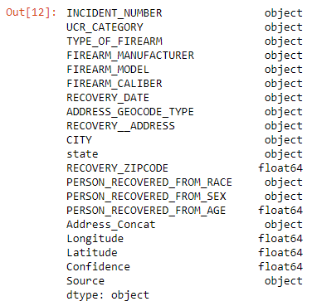
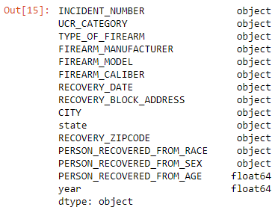
Cleaning the Data
Intersection
Address
General

Slide 7

Exploring the Data

Slide 8
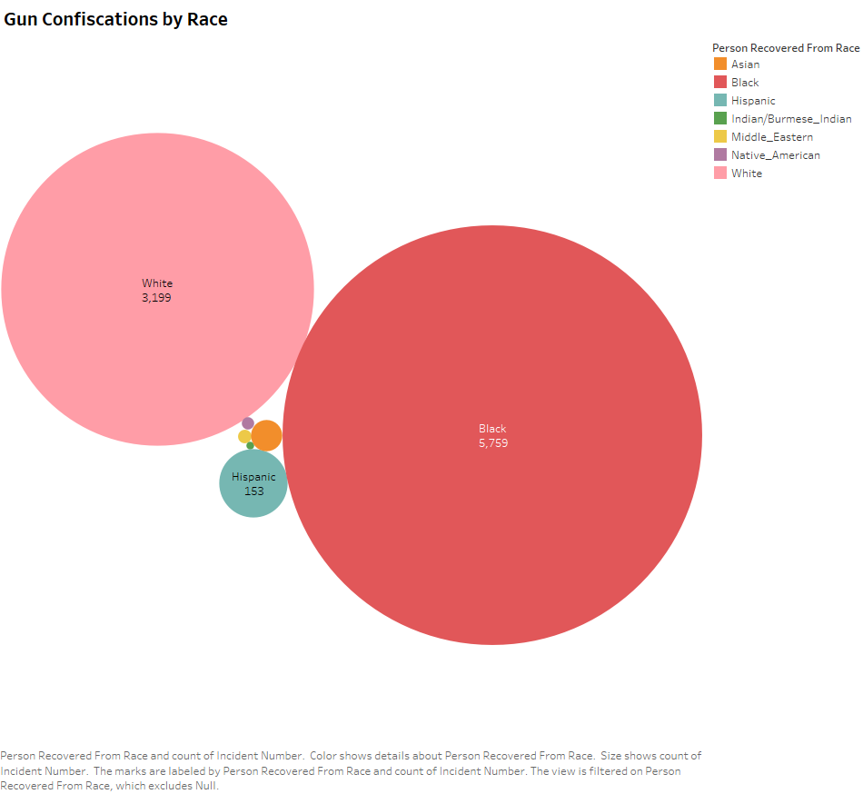

Slide 9
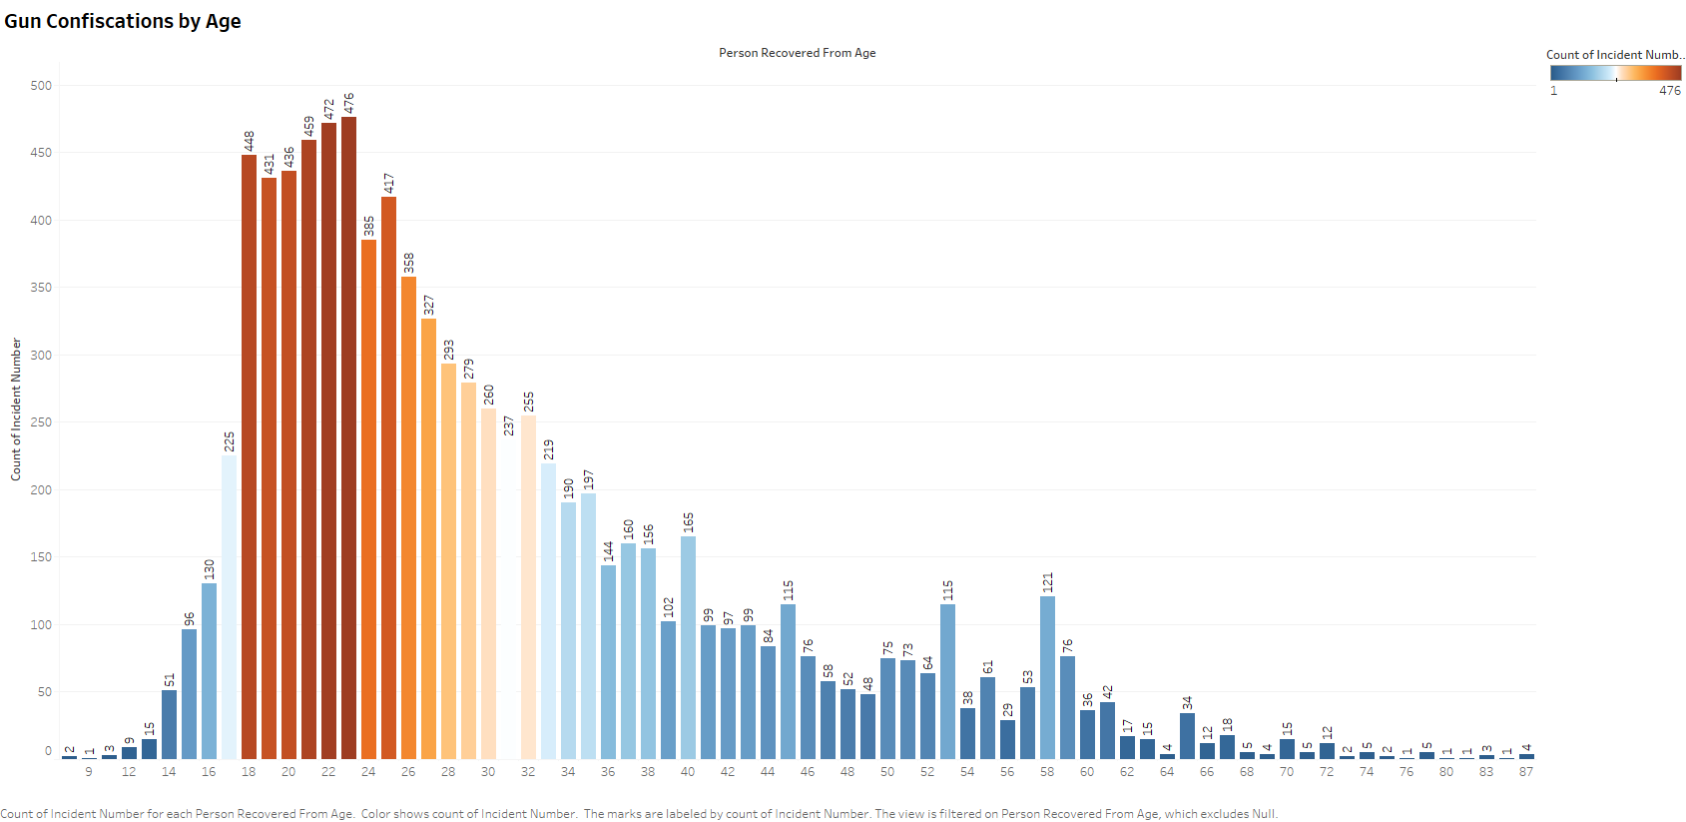

Slide 10
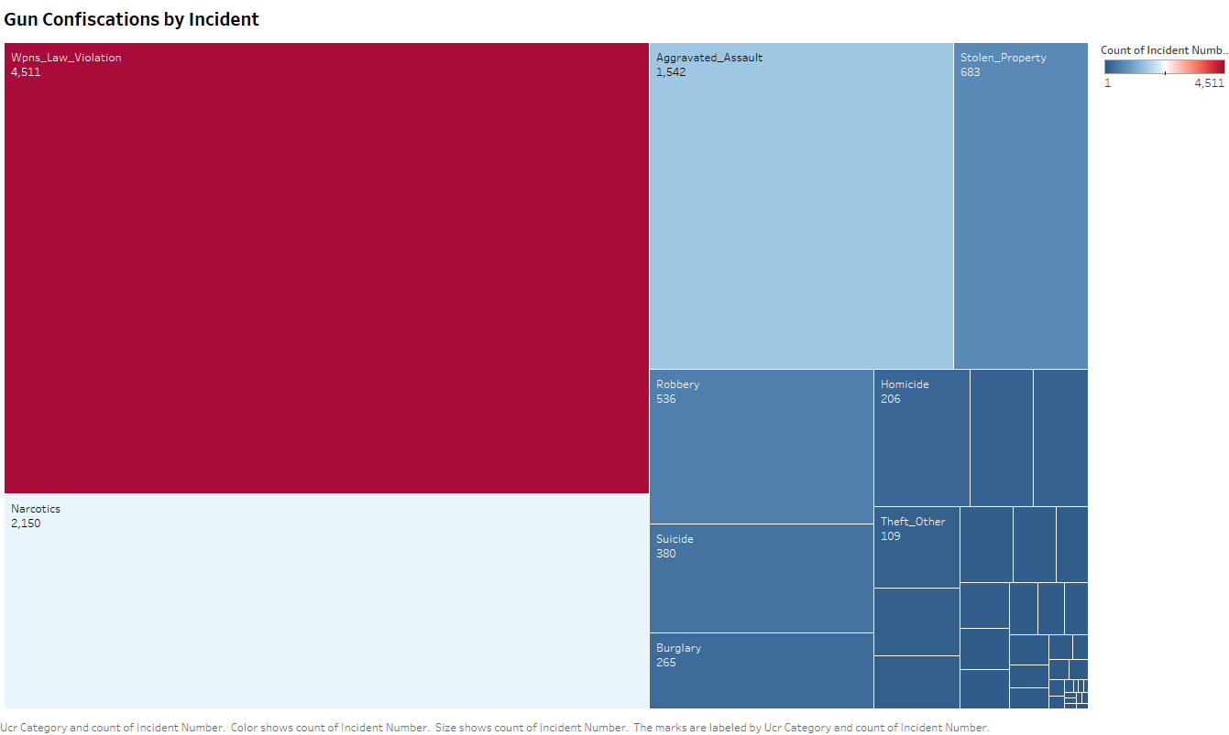

Slide 11
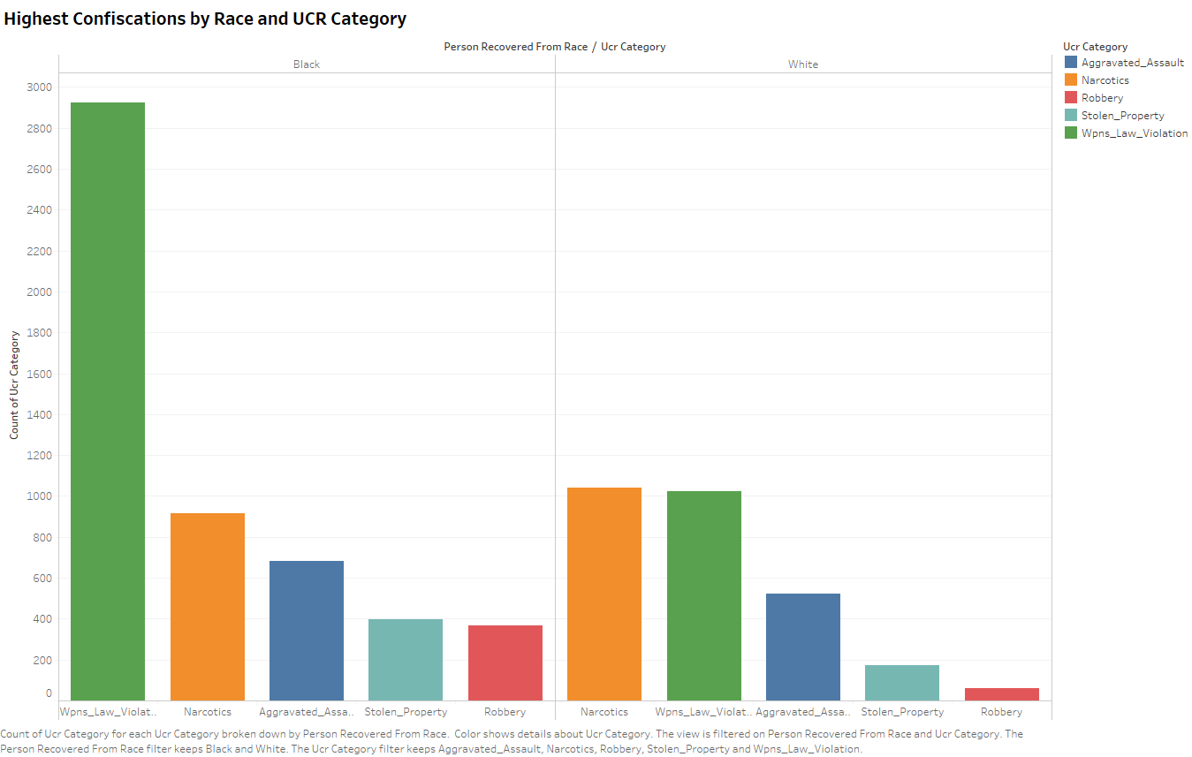

Slide 12
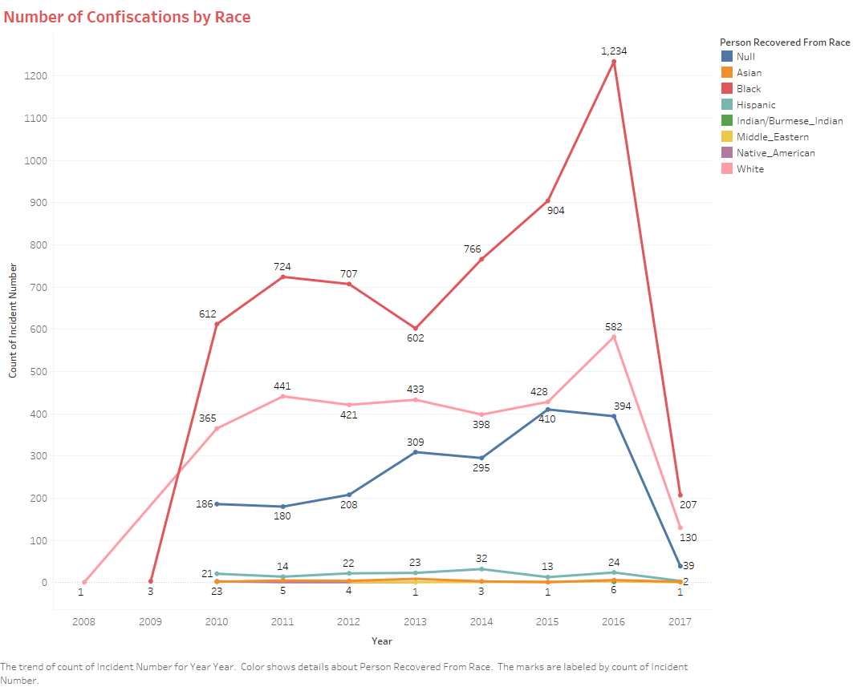

Slide 13
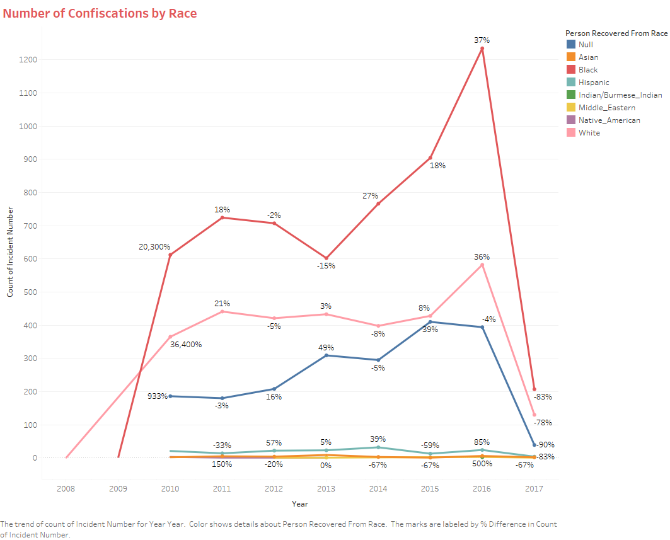

Slide 14
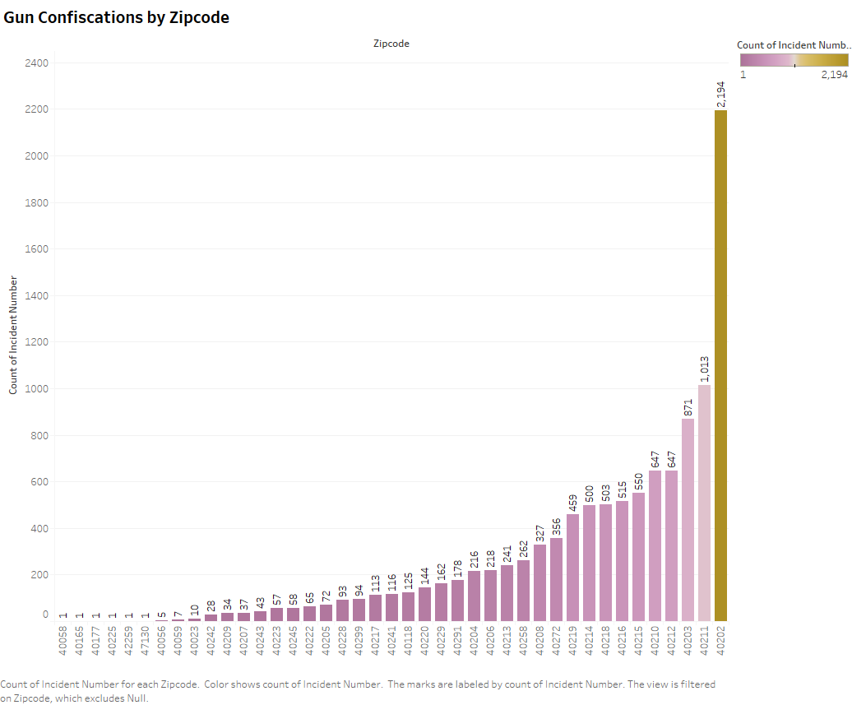

Slide 15
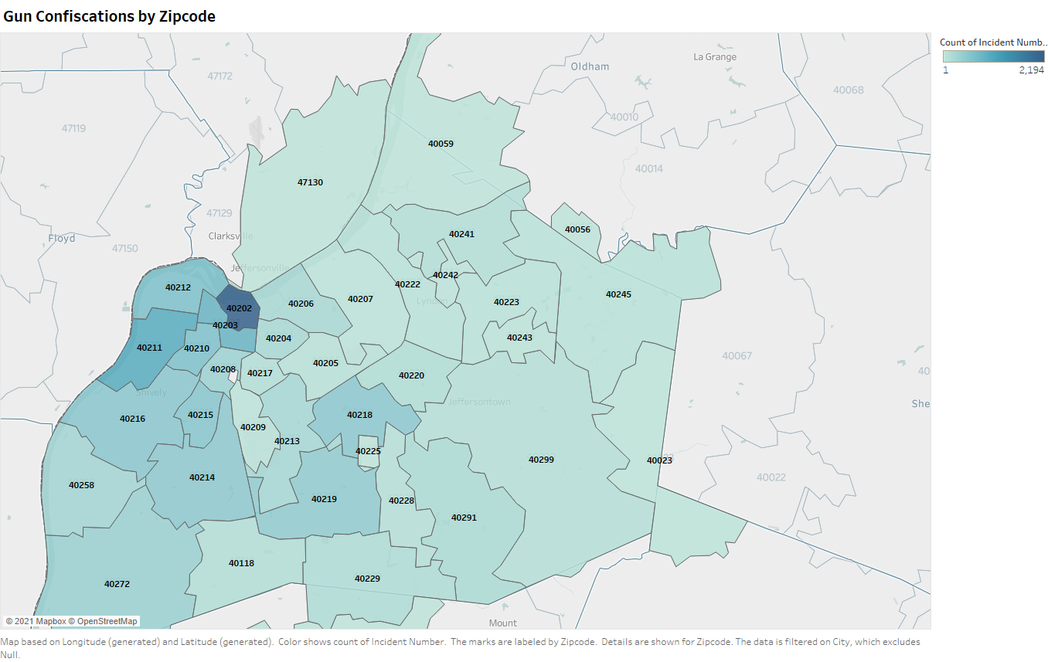

Slide 16
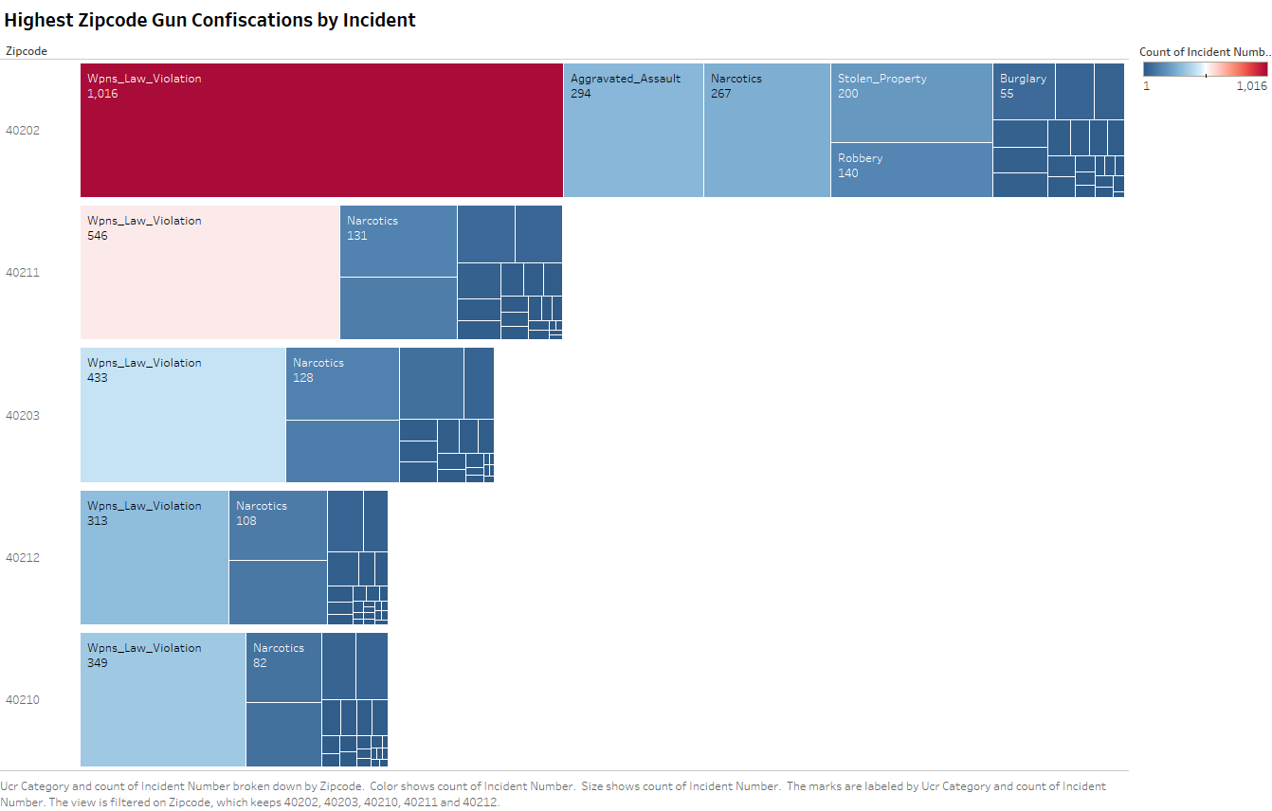

Slide 17
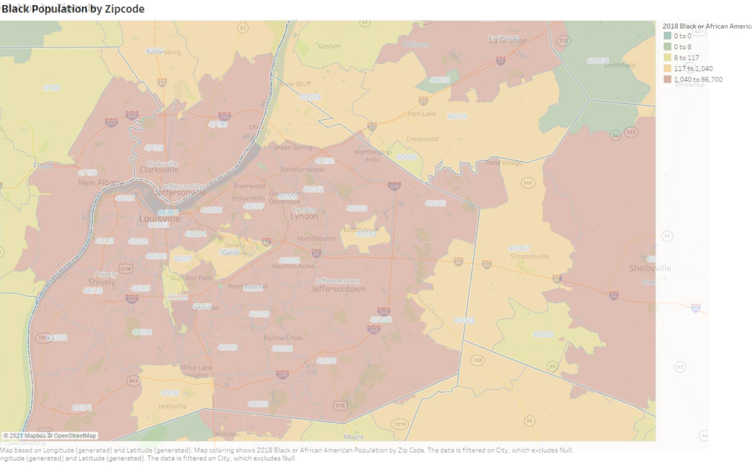

Slide 18
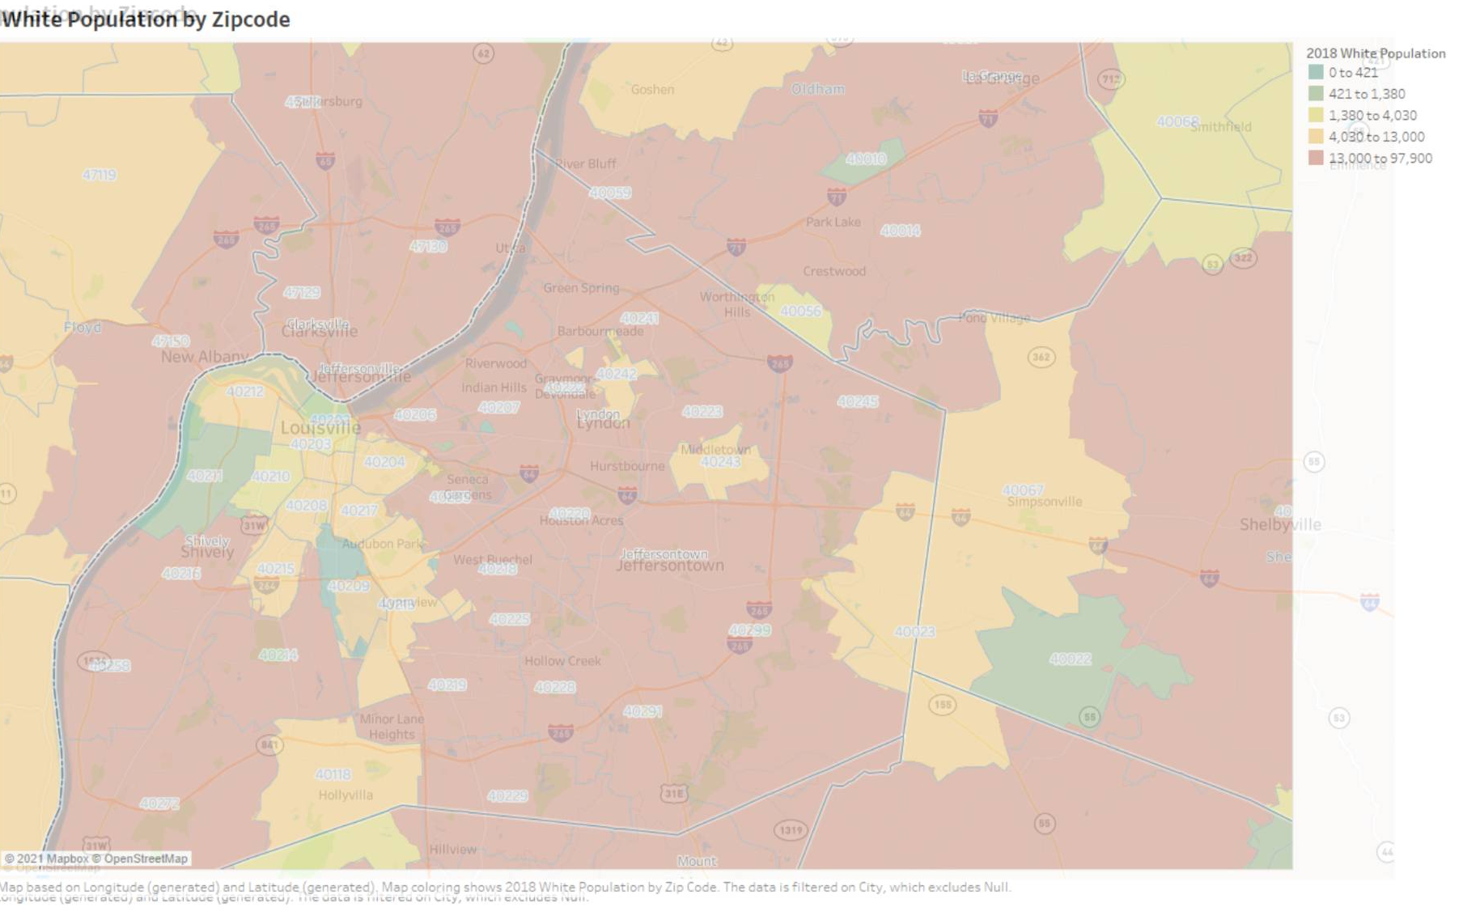

Slide 20
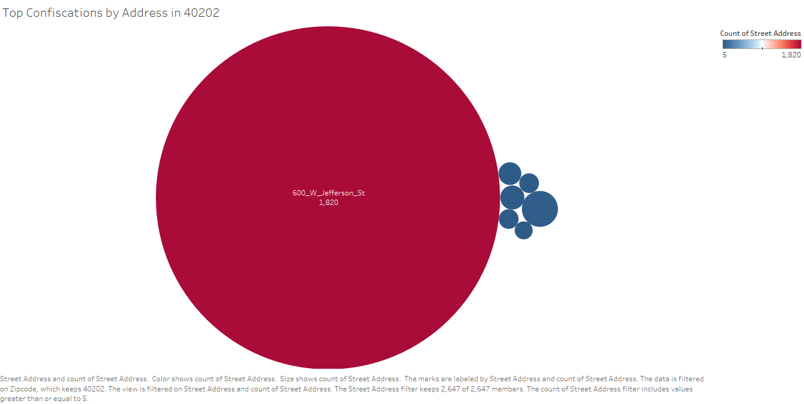

Slide 21
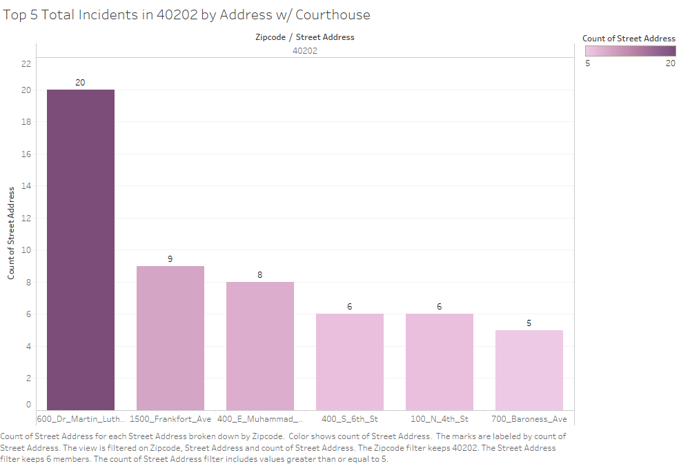

Slide 22
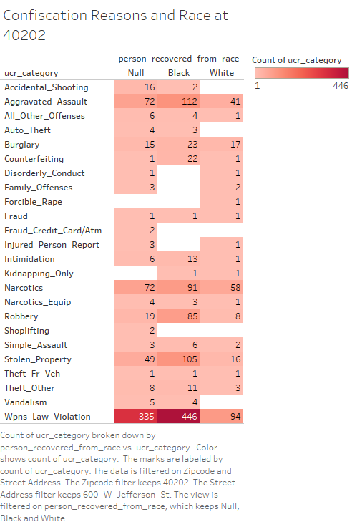

Slide 23
Now, what does this mean?

Slide 24
Now, what does this mean?

Slide 25
Now, what does this mean?
600_W_Jefferson_St accounts for 16.25% of our total data set!
That’s a LOT.
1820 / 11195 = .16257

Slide 26

What can we do with this information?
Is this data accurate?
Can we make any assumptions?
What CAN we use this dataset for?

Slide 27

Overall Recommendations
ACCOUNTABILITY

Slide 28
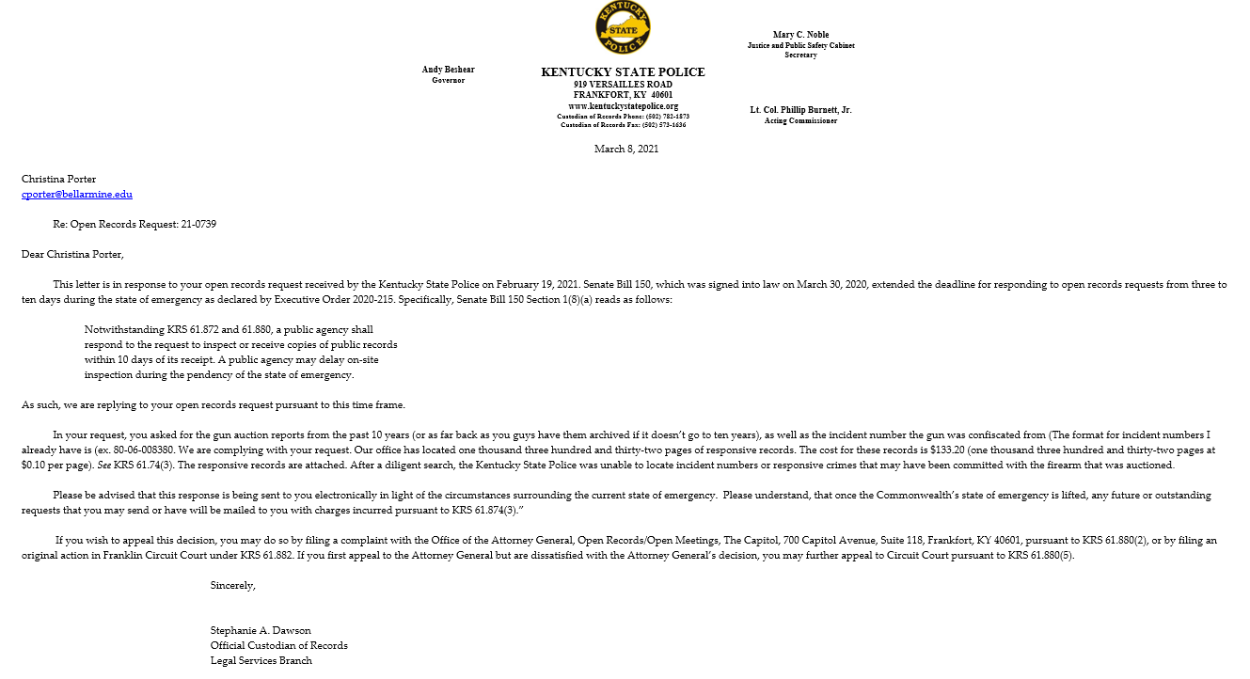
Future Work

Slide 29
More Information
https://github.com/cporterbellarmine/ButterflyProject

