Slide 1
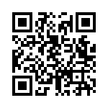
Astronomy in Your Pocket:
An Android Development Journey
Sean Dague
http://dague.net
@sdague

Slide 2
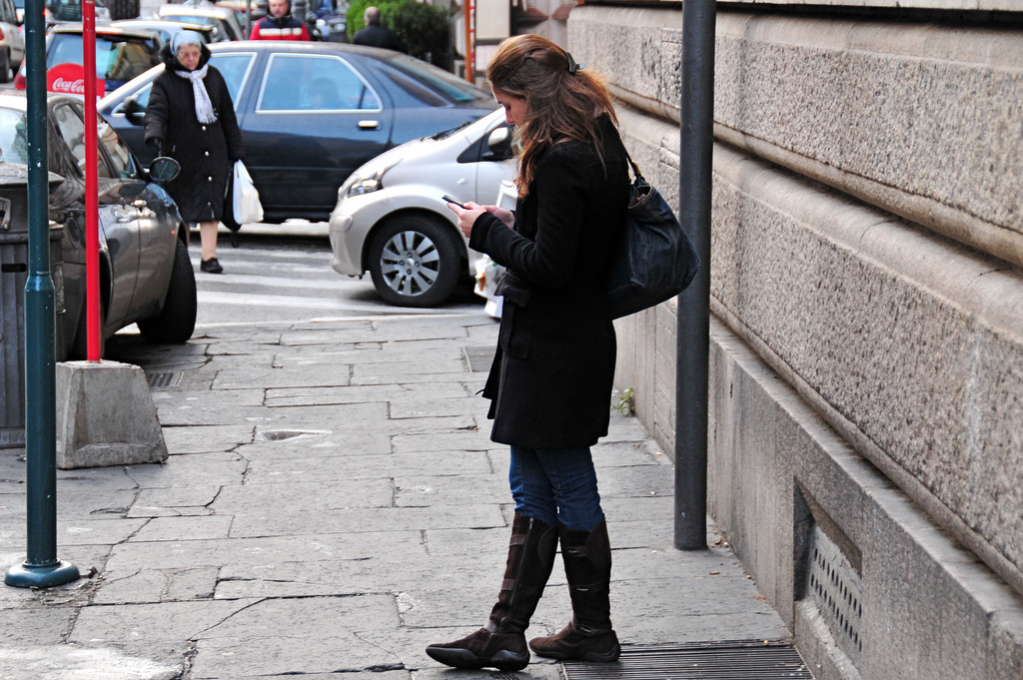
Mobile vs Small Computing
http://www.flickr.com/photos/yourdon/3077239642/sizes/l/in/photostream/

Slide 3
What Makes a Good Mobile Application?

Slide 4

My Itch
What am I looking at?

Slide 5
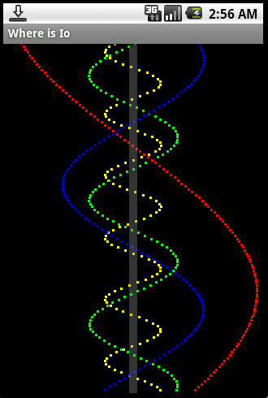
Where is Io - First Working Code

Slide 6
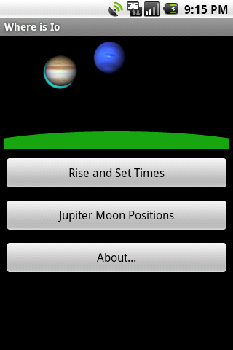
Where is Io

Slide 7
Main Layout
<?xml version="1.0" encoding="utf-8"?>
<LinearLayout android:id="@+id/LinearLayout01"
android:orientation="vertical"
android:layout_width="fill_parent" android:layout_height="fill_parent"
xmlns:android="http://schemas.android.com/apk/res/android">
<net.dague.astro.views.Diarama android:id="@+id/diarama"
android:layout_width="fill_parent" android:layout_height="150dp"
android:layout_margin="5dp"
android:src="@drawable/sun_icon"
/>
<Button android:id="@+id/time_button"
style="@style/AstroButton"
android:text="@string/time_text"
android:layout_width="fill_parent"
></Button>
<Button android:id="@+id/jupiter_button"
style="@style/AstroButton"
android:layout_width="fill_parent"
android:text="@string/jupiter_text"
></Button>
<Button android:id="@+id/about_button"
style="@style/AstroButton"
android:layout_width="fill_parent"
android:text="@string/about_label"
></Button>
</LinearLayout>

Slide 8
Main Layout
<?xml version="1.0" encoding="utf-8"?>
<LinearLayout android:id="@+id/LinearLayout01"
android:orientation="vertical"
android:layout_width="fill_parent" android:layout_height="fill_parent"
xmlns:android="http://schemas.android.com/apk/res/android">
<net.dague.astro.views.Diarama android:id="@+id/diarama"
android:layout_width="fill_parent" android:layout_height="150dp"
android:layout_margin="5dp"
android:src="@drawable/sun_icon"
/>
<Button android:id="@+id/time_button"
style="@style/AstroButton"
android:text="@string/time_text"
android:layout_width="fill_parent"
></Button>
<Button android:id="@+id/jupiter_button"
style="@style/AstroButton"
android:layout_width="fill_parent"
android:text="@string/jupiter_text"
></Button>
<Button android:id="@+id/about_button"
style="@style/AstroButton"
android:layout_width="fill_parent"
android:text="@string/about_label"
></Button>
</LinearLayout>
Layout Containers

Slide 9
Main Layout
<?xml version="1.0" encoding="utf-8"?>
<LinearLayout android:id="@+id/LinearLayout01"
android:orientation="vertical"
android:layout_width="fill_parent" android:layout_height="fill_parent"
xmlns:android="http://schemas.android.com/apk/res/android">
<net.dague.astro.views.Diarama android:id="@+id/diarama"
android:layout_width="fill_parent" android:layout_height="150dp"
android:layout_margin="5dp"
android:src="@drawable/sun_icon"
/>
<Button android:id="@+id/time_button"
style="@style/AstroButton"
android:text="@string/time_text"
android:layout_width="fill_parent"
></Button>
<Button android:id="@+id/jupiter_button"
style="@style/AstroButton"
android:layout_width="fill_parent"
android:text="@string/jupiter_text"
></Button>
<Button android:id="@+id/about_button"
style="@style/AstroButton"
android:layout_width="fill_parent"
android:text="@string/about_label"
></Button>
</LinearLayout>
Layout Containers
Resources

Slide 10
Main Layout
<?xml version="1.0" encoding="utf-8"?>
<LinearLayout android:id="@+id/LinearLayout01"
android:orientation="vertical"
android:layout_width="fill_parent" android:layout_height="fill_parent"
xmlns:android="http://schemas.android.com/apk/res/android">
<net.dague.astro.views.Diarama android:id="@+id/diarama"
android:layout_width="fill_parent" android:layout_height="150dp"
android:layout_margin="5dp"
android:src="@drawable/sun_icon"
/>
<Button android:id="@+id/time_button"
style="@style/AstroButton"
android:text="@string/time_text"
android:layout_width="fill_parent"
></Button>
<Button android:id="@+id/jupiter_button"
style="@style/AstroButton"
android:layout_width="fill_parent"
android:text="@string/jupiter_text"
></Button>
<Button android:id="@+id/about_button"
style="@style/AstroButton"
android:layout_width="fill_parent"
android:text="@string/about_label"
></Button>
</LinearLayout>
Layout Containers
Resources
Styles

Slide 11
Main Layout
<?xml version="1.0" encoding="utf-8"?>
<LinearLayout android:id="@+id/LinearLayout01"
android:orientation="vertical"
android:layout_width="fill_parent" android:layout_height="fill_parent"
xmlns:android="http://schemas.android.com/apk/res/android">
<net.dague.astro.views.Diarama android:id="@+id/diarama"
android:layout_width="fill_parent" android:layout_height="150dp"
android:layout_margin="5dp"
android:src="@drawable/sun_icon"
/>
<Button android:id="@+id/time_button"
style="@style/AstroButton"
android:text="@string/time_text"
android:layout_width="fill_parent"
></Button>
<Button android:id="@+id/jupiter_button"
style="@style/AstroButton"
android:layout_width="fill_parent"
android:text="@string/jupiter_text"
></Button>
<Button android:id="@+id/about_button"
style="@style/AstroButton"
android:layout_width="fill_parent"
android:text="@string/about_label"
></Button>
</LinearLayout>
Layout Containers
Resources
Styles
Display Independent Pixels

Slide 12
Main Layout
<?xml version="1.0" encoding="utf-8"?>
<LinearLayout android:id="@+id/LinearLayout01"
android:orientation="vertical"
android:layout_width="fill_parent" android:layout_height="fill_parent"
xmlns:android="http://schemas.android.com/apk/res/android">
<net.dague.astro.views.Diarama android:id="@+id/diarama"
android:layout_width="fill_parent" android:layout_height="150dp"
android:layout_margin="5dp"
android:src="@drawable/sun_icon"
/>
<Button android:id="@+id/time_button"
style="@style/AstroButton"
android:text="@string/time_text"
android:layout_width="fill_parent"
></Button>
<Button android:id="@+id/jupiter_button"
style="@style/AstroButton"
android:layout_width="fill_parent"
android:text="@string/jupiter_text"
></Button>
<Button android:id="@+id/about_button"
style="@style/AstroButton"
android:layout_width="fill_parent"
android:text="@string/about_label"
></Button>
</LinearLayout>
Layout Containers
Resources
Styles
Display Independent Pixels
Custom View

Slide 13
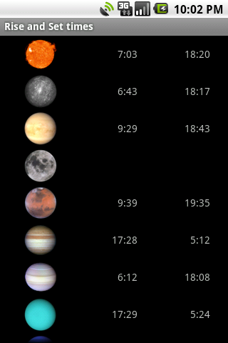
Second Activity

Slide 14

The Illusion Multitasking
User Visible
Screens
Activities
Process

Slide 15

The Illusion Multitasking
User Visible
Screens
onPause() - gives you a chance to save a state bundle

Slide 16

The Illusion Multitasking
User Visible
Screens
onCreate(bundle) - start up a new activity

Slide 17

The Illusion Multitasking
User Visible
Screens
onResume()
onPause()

Slide 18
The Illusion Multitasking
Under Memory Preasure
User Visible
Screens
onStop() ?
onDestroy() ?
no warning?

Slide 19
The Illusion Multitasking
User Visible
Screens
onCreate(bundle) - you did save state correctly, right?

Slide 20
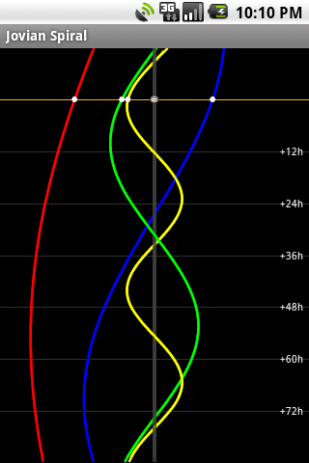
More Advanced Graphics

Slide 21
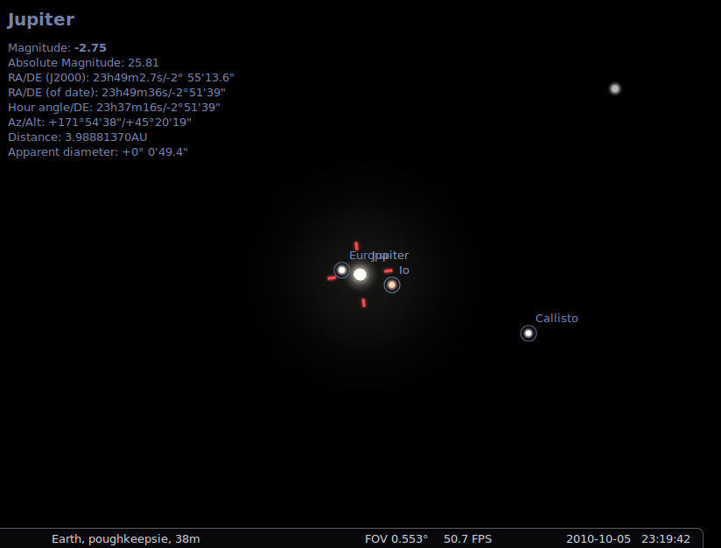
What Other Open Source Exists?

Slide 22
Words you never want to read
/************************************************************************
The L1 theory of the galilean satellites
by Valery Lainey can be found at
ftp://ftp.imcce.fr/pub/ephem/satel/galilean/L1
I (Johannes Gajdosik) have just taken the Fortran code and data
obtained from above and rearranged it into this piece of software.
I can neigther allow nor forbid the usage of the L1 theory.
The copyright notice below covers not the work of Valery Lainey
but just my work, that is the compilation of the L1 theory
into the software supplied in this file.
Copyright (c) 2005 Johannes Gajdosik
Permission is hereby granted, free of charge, to any person obtaining a
copy of this software and associated documentation files (the "Software"),
to deal in the Software without restriction, including without limitation
the rights to use, copy, modify, merge, publish, distribute, sublicense,
and/or sell copies of the Software, and to permit persons to whom the
Software is furnished to do so, subject to the following conditions:

Slide 23
Going Native
Rest of Application - Java
Java Class with native methods
JNI Export layer - C
C lib created from Stellarium

Slide 24


Slide 25
Computational Time
120 points per curve
Pure Computation
  HTC Hero - 17s
  Droid 1 - 12s
  Nexus One - 8s
5 Second Rule

Slide 26
Dance of the Threads
JovianSpiralView
Main UI
Draws to UI
Handles Animations
Uses Looper
JovianThread
JovianCalculator
Background
Data Cruncher
SQLite

Slide 27
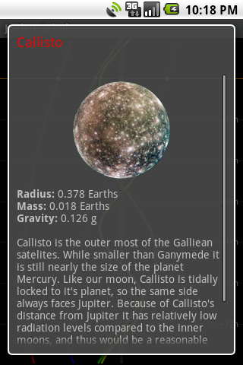
Detecting Touch

Slide 28
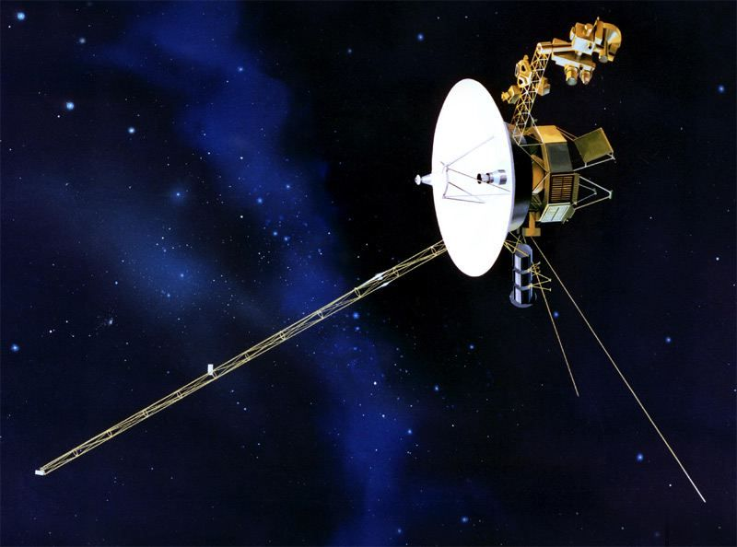
Thinking of the Possibilities

Slide 29
What Makes a Good Mobile Application?

Slide 30
Things to Remember With Android
No Save
No Quit
No foreground processing
You will be interupted, plan accordingly

Slide 31
Learning More
http://developer.android.com
http://android-developers.blogspot.com
http://github.com/sdague/where-is-io

