Slide 1
Objectives
In this session, you will learn to:
Vi Editor, Pico editor
Shell Scripting in linux
User Management – Unix/Linux
Notes:
Introduce the students to the course by asking them what they know about forensics. Next, ask the students what they know about system forensics and why is it required in organizations dependent on IT. This could be a brief discussion of about 5 minutes.
Lead the discussion to the objectives of this chapter.

Slide 2
How to Add a New User in Linux
What Is Linux passwd/groups?
It’s important to introduce two files that we will be using as examples of adding users to a group in Linux.
In the /etc directory, the passwd and the group files hold all of the users and group information. These files are essential when logging on to the system. Anytime you add a user to a group in Linux, that user is added to the passwd file.
Here’s a look at /etc/passwd:
1. Issue command: less /etc/passwd
2. Use the arrow keys to go up and down, and q to exit.

Slide 3
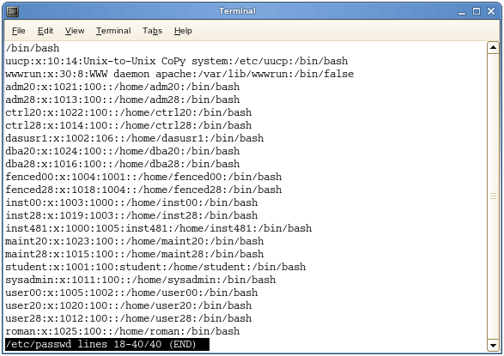
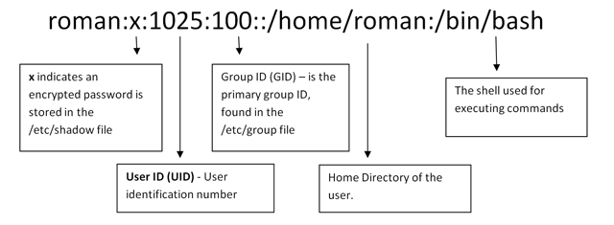

Slide 4
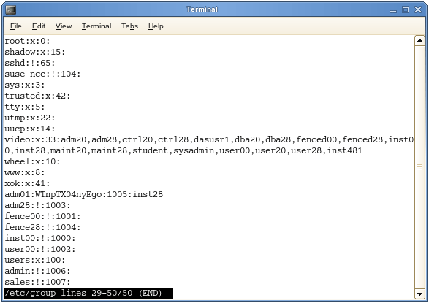
How to Add a New User in Linux
Edit the file directly or use the commands below. It’s recommended to use the commands, especially if you’re a beginner, because you don’t want to accidentally corrupt the passwd file.
Here's the group file:

Slide 5
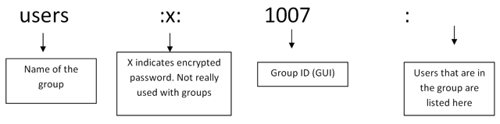
How to Add a New User in Linux
The /etc/group file holds all of the group information, as well as the users belonging to each group. The structure is very similar to that of /etc/password.

Slide 6
How to Add a New User in Linux
Again, these files are vital to the.
How to Add a User to Linux
Follow these steps to add an existing user to a group in Linux:
1. ( sudo adduser )
2. Use the command useradd "name of the user" (for example, useradd roman)
3. Use su plus the name of the user you just added to log on.

Slide 7
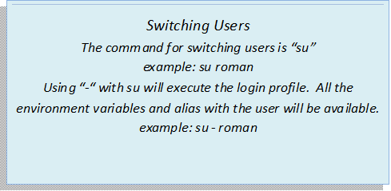
How to Add a New User in Linux

Slide 8
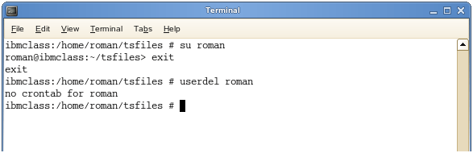
How to Delete a User From Linux
sudo userdel neha
Use the command userdel “name of the user” (for example, userdel roman).
The command -d sets home directory for the user (if it’s different than the default which is /home/”user’s name”). Using -d on its own will only set the home directory for the user, but does not create it. You can see this is confirmed by “echo $HOME” which tells me my home directory.
** Make sure to exit the neha user by typing exit

Slide 9
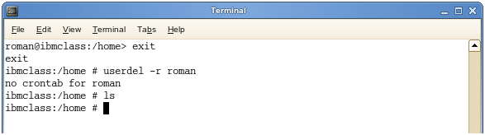
How to Delete a User From Linux
Use the -r command along with userdel to delete the user as well as the home directory.

Slide 10
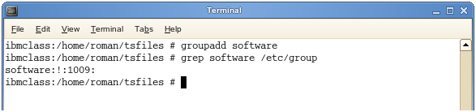
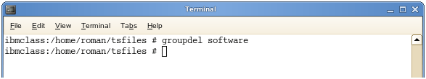
How to Add a Group in Linux
To create a new group in Linux, follow these steps:
1. Use the groupadd command.
2. Replace new_group with the name of the group you want to create.
3. Confirm by checking the /group/etc file (for example, grep software /etc/group or cat /etc/group).
4. Use the groupdel command to remove the group entirely.

Slide 11
How to Add a Group in Linux
1)while creating the user user- you can add them to an existing group
sudo useradd -g software kalpana
2)user is already there, you can later add then to an existing group
sudo usermod -Gsoftware richard
sudo usermod -Gsoftware david

Slide 12
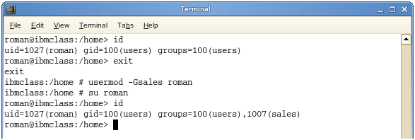
How to Add a User to a Group in Linux
2. Use the command id roman to confirm
You can also use -G on its own to add a user to another group.
***** To add an existing user to a group.
sudo usermod –Gabcd ahm
This will add ahm user to abcd group
*** To verify the users group ( id ahm)

Slide 13
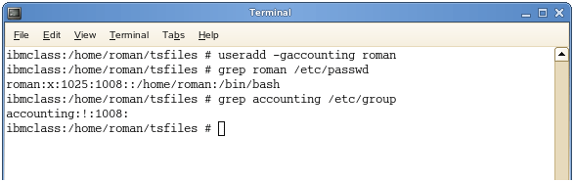
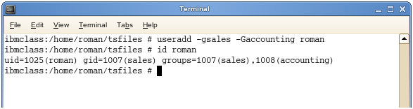
How to Add a User to a Group in Linux
To add the user roman to the group “accounting,” do the following:
1. Use the command useradd –g accounting roman (-g changes the user’s primary group).
** This will create new user
and add that to group.
2. Run the grep command to confirm.
If you want to add the user roman to the group “accounting” and make his primary group “sales,” do this:
1. Use the command -G for other groups (-G adds the user to a new group but also keeps them in the old one (append).

Slide 14
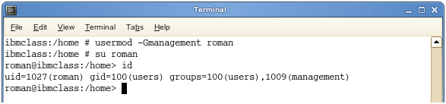
How to Change a User’s Group in Linux
If a user is already created and you just want to add that user to a group:
Use the command usermod -Gmanagement “name of user”.

Slide 15
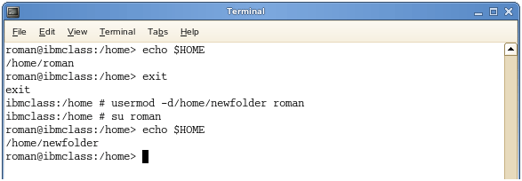
How to Change a User’s Group in Linux
If you want to change the primary group a user is assigned to:
Use the command usermod.
Replace the examplegroup with the name of the group you want to be the primary.
Replace the exampleusername with the name of the user account.
If you want to change a user’s home directory:
Use the command usermod -d/home/newfolder “name of user”.

Slide 16
To Change password
How to Change Passwords in Linux
To change passwords in Linux:
1. Login as root.
2. use the command passwd "username" (for example, passwd roman).
Sudo gpasswd –d neha sudo
** remove neha from sudo group
List all the sudo users details
Grep ‘^sudo:.*$’ /etc/group | cut –d: -f4

Slide 17
Shell Scripting
Usually shells are interactive that mean, they accept command as input from users and execute them. However some time we want to execute a bunch of commands routinely, so we have type in all commands each time in terminal.
As shell can also take commands as input from file we can write these commands in a file and can execute them in shell to avoid this repetitive work. These files are called Shell Scripts or Shell Programs. Shell scripts are similar to the batch file in MS-DOS. Each shell script is saved with .sh file extension eg. myscript.sh
A shell script have syntax just like any other programming language. If you have any prior experience with any programming language like Python, C/C++ etc. it would be very easy to get started with it.
Notes:
Introduce the students to the course by asking them what they know about forensics. Next, ask the students what they know about system forensics and why is it required in organizations dependent on IT. This could be a brief discussion of about 5 minutes.
Lead the discussion to the objectives of this chapter.

Slide 18
Shell Scripting
A shell script comprises following elements –
Shell Keywords – if, else, break etc.
Shell commands – cd, ls, echo, pwd, touch etc.
Functions
Control flow – if..then..else, case and shell loops etc.
Notes:
Introduce the students to the course by asking them what they know about forensics. Next, ask the students what they know about system forensics and why is it required in organizations dependent on IT. This could be a brief discussion of about 5 minutes.
Lead the discussion to the objectives of this chapter.

Slide 19
Shell Scripting
Why do we need shell scripts
There are many reasons to write shell scripts –
To avoid repetitive work and automation
System admins use shell scripting for routine backups
System monitoring
Adding new functionality to the shell etc.
Notes:
Introduce the students to the course by asking them what they know about forensics. Next, ask the students what they know about system forensics and why is it required in organizations dependent on IT. This could be a brief discussion of about 5 minutes.
Lead the discussion to the objectives of this chapter.

Slide 20
Shell Scripting
pico first.sh
echo “Enter your name :”
read name
echo “Welcome $name”
Save and run
sh.first.sh
Notes:
Introduce the students to the course by asking them what they know about forensics. Next, ask the students what they know about system forensics and why is it required in organizations dependent on IT. This could be a brief discussion of about 5 minutes.
Lead the discussion to the objectives of this chapter.

Slide 21
Shell Scripting
pico first.sh
echo “Enter your name :”
read name
echo “Welcome $name”
Save and run
sh.first.sh
Notes:
Introduce the students to the course by asking them what they know about forensics. Next, ask the students what they know about system forensics and why is it required in organizations dependent on IT. This could be a brief discussion of about 5 minutes.
Lead the discussion to the objectives of this chapter.

Slide 22
Shell Scripting
pico first.sh
echo “Enter your name :”
read name
echo “Welcome $name”
Save and run
sh.first.sh
Notes:
Introduce the students to the course by asking them what they know about forensics. Next, ask the students what they know about system forensics and why is it required in organizations dependent on IT. This could be a brief discussion of about 5 minutes.
Lead the discussion to the objectives of this chapter.

Slide 23
Shell Scripting
pico addnumbers.sh
echo “Enter first number:”
read num1
echo “Enter second number:”
read num2
echo “The sum of $num1 and $num2 is :” + `expr $num1 + $num2`
Save and run
sh addnumbers.sh
Notes:
Introduce the students to the course by asking them what they know about forensics. Next, ask the students what they know about system forensics and why is it required in organizations dependent on IT. This could be a brief discussion of about 5 minutes.
Lead the discussion to the objectives of this chapter.

Slide 24
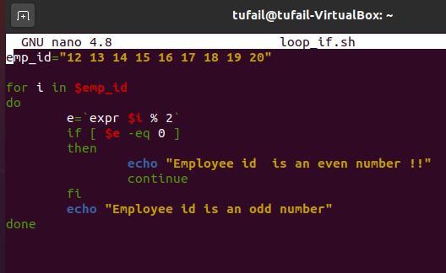
Shell Scripting
Arrays , Loops and if in shell scrpting
Notes:
Introduce the students to the course by asking them what they know about forensics. Next, ask the students what they know about system forensics and why is it required in organizations dependent on IT. This could be a brief discussion of about 5 minutes.
Lead the discussion to the objectives of this chapter.

