Slide 1
The Standard
C++ Library
Version 1: Dr. Ofir Pele
Version 2: Dr. Erel Segal-Halevi

Slide 2
Concepts
A concept is a list of requirements on a type.
STL defines a hierarchy of concepts for containers,
iterators, and element types.
Concepts for element types include:
Currently, concepts appear in documentation only.
Maybe in C++20 they will be part of the code.
Equality Comparable -
types with operator== ,...
LessThan Comparable -
types with operator< ,...
Assignable -
types with operator=
and copy Ctor

Slide 3
Concepts - Example
Consider:
The user must provide a type that has a less-than operator (<) to compare two values of type T, the result of which must be convertible to a Boolean value.
– In short: T must be LessThan Comparable
template<typename T> const T& min(const T& x,
const T& y)
{
return x < y? x : y;
}

Slide 4
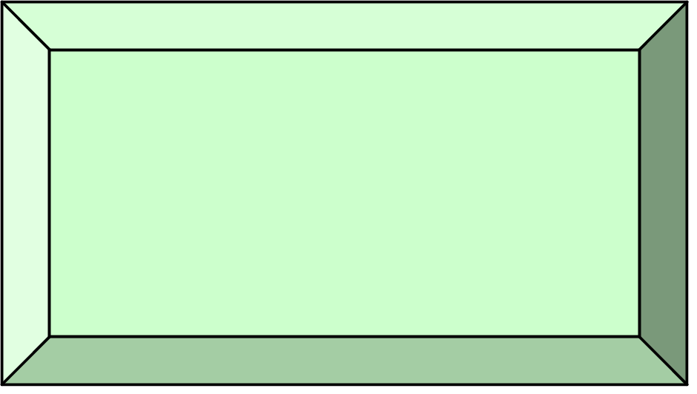
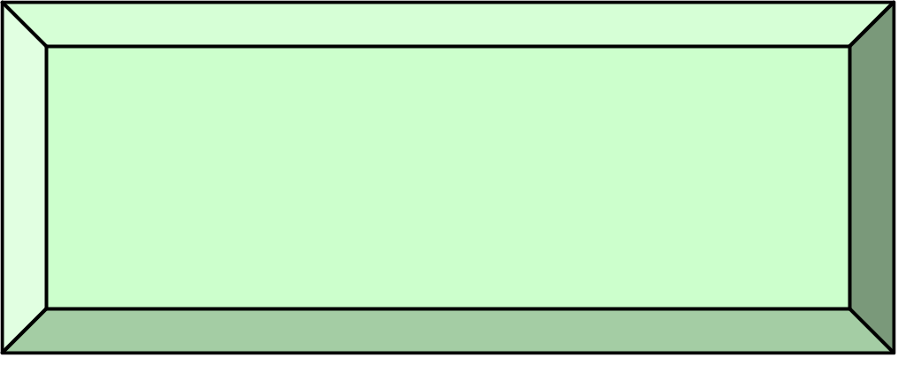
Main Components
Function
Objects
Iterators
Adaptors
Containers
Algorithms
Streams
Strings

Slide 5
Containers
Holds copies of elements.
Assumes elements have:
Copy Ctor & operator =
The standard defines the interface.
Two main classes
  Sequential containers:
  list, vector,....
  Associative containers:
  map, set ...
Assignable -
types with operator=
and copy Ctor

Slide 6
Containers documentation
see http://www.cplusplus.com/reference/stl/

Slide 7
STL: Sequential Containers

Slide 8
Sequential Containers
Maintain a linear sequence of objects.
forward_list - a singly-linked list.
list - a doubly-linked list.
  Efficient insertion/deletion in front/end/middle
vector - an extendable sequence of objects
  Efficient insertion at end, and random access
deque – double-ended queue
  Efficient insertion/deletion at front/end
  Random access
array – fixed size, on the stack.

Slide 9
vector<T>
  Contiguous array of elements of type T
  Random access
  Can grow on as needed basis
std::vector<int> v(2);
v[0]= 45;
v[1]= 32;
v.emplace_back(60); //C++11

Slide 10
Vectors of ints
Creating an empty vector and filling it:
std::vector<int> vec;
vec.push_back(42);
vec.emplace_back(42); // equivalent
Creating a vector with 10 ints with value 42:
std::vector<int> vec(10,42);
std::vector<int> vec(10); // default is 0
Initializing a vector like an array:
std::vector<int> vec { 42, 52, 62 };
Initializing a vector from iterators:
std::vector<int> v2(vec.begin(),vec.end());

Slide 11
Vectors of objects (folder 1)
Creating an empty vector and filling it:
std::vector<MyClass> vec;
vec.push_back(MyClass{42});
vec.emplace_back(42); // more efficient
Creating a vector with 10 objs:
std::vector<MyClass> vec(10,MyClass{42});
std::vector<MyClass> vec(10); // default ctor
Initializing a vector like an array (calls ctor):
std::vector<MyClass> vec { {42}, {52}, {62} };
Initializing a vector from iterators:
std::vector<MyClass> v2(vec.begin(),vec.end());

Slide 12
Adding elements
Inserts a new element at the end:
void push_back(const T&)
    a.push_back(t)
}
amortized constant time

Slide 13
Adding elements-C++11
Construct and insert a new element at the end:
template<typename… Args>
void emplace_back(Args&&… args)
    a.emplace_back(t)
}
amortized constant time

Slide 14
size and capacity
size
capacity
  The first “size” elements are constructed (initialized)
  The last “capacity - size” elements are uninitialized
  push_back / emplace_back use the uninitialized elements until they are full; then, they multiply the vector size by 2.

Slide 15
emplace_back / push_back
Average Time Complexity
If we inserted n elements we paid:
1+2+1+4+1+1+1+8+…+n =
O(n) + 1+2+4+…+n =
O(n)
On average an each insertion cost O(1)

Slide 16
size and capacity methods
uint size() const;
uint capacity() const;
void reserve(uint new_capacity);
// ensure that the capacity is
// at least "new_capacity".
size
capacity

Slide 17
vector<T> v
v.shrink_to_fit() // c++11

Slide 18
Accessing elements
Without boundary checking:
reference operator[](size_type n)
const_reference operator[](size_type n) const
With boundary checking:
reference at(size_type n)
const_reference at(size_type n) const

Slide 19
Associated types in vector
vector<typename T>::
  value_type - The type of object, T, stored
  reference - Reference to T
  const_reference - const Reference to T
  iterator - Iterator used to iterate through a vector (how would you write it?)
  …

Slide 20
vectors: C++ vs. Java
Look at cplusplus documentation of vector.
Look at Java documentation of Vector.
Differences:
  Simple class vs. interface and vtable.
  Simple elements vs. class elements.
  Two accessors (with and without range check) vs. a single accessor

Slide 21
STL: Associative Containers

Slide 22
Associative Containers
Supports efficient retrieval of elements
(values) based on keys.
(Typical) Implementation:
red-black binary trees
hash-table

Slide 23
Sorted Associative Containers
set
A set of unique keys ordered by <
map
Associate a value to key (associative array)
Unique value of each key, ordered by <
multiset, multimap
Same, but allow multiple values
unordered_set, unordered_map
Same, but without order (faster).

Slide 24
Sorted Associative Containers & Order
Sorted associative containers assume that their elements are LessThanComparable.
They use operator< as default order.
We can control order using our own
comparison function.
We need to use a functor.

Slide 25
Functor
A functor in C++ is an object with an operator(). Examples:
Pointer to function (like in C);
A class that implements operator();
Lambda expressions.

Slide 26
Example (see also folder 2)
class c_str_less {
public:
bool operator()(const char* s1,
const char* s2) {
return (strcmp(s1,s2) < 0);
}
};
c_str_less cmp; // declare an object
if(cmp(“aa”,”ab”))
…
if( c_str_less()(“a”,”b”) )
Creates temporary objects, and
then call operator()

Slide 27
Template comparator example
template<typename T>
class less {
public:
bool operator()(const T& lhs, const T& rhs)
{ return lhs < rhs; }
};
less<int> cmp; // declare an object
if( cmp(1,2) )
…
if( less<int>()(1,2) )
…
Creates temporary objects,
and then call operator()

Slide 28
Using Comparators
// ascending order
// uses operator < for comparison
set<int> s1;
set<int,less<int>> s1; // same
// descending order
// uses operator > for comparison
set<int,greater<int>> s2;

Slide 29
Using Comparators
Creates a default constructed
MyComp object.
set<int,MyComp> s3;
MyComp cmp(42);
set<int,MyComp> s4(cmp);
Use given MyComp object.

Slide 30
Why should we use classes as functors?
So we get the “power” of classes.
Examples:
  Inheritance.
  To parameterize our functions in run time or in compile time.
  To accumulate information.

Slide 31
Functor example: dice code example

