Slide 1
The Standard
C++ Library –
Iterators
and
Algorithms
Version 1: Dr. Ofir Pele
Version 2: Dr. Erel Segal-Halevi

Slide 2
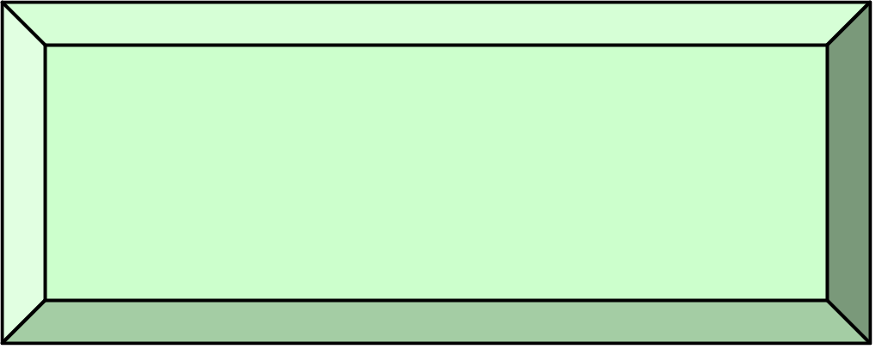
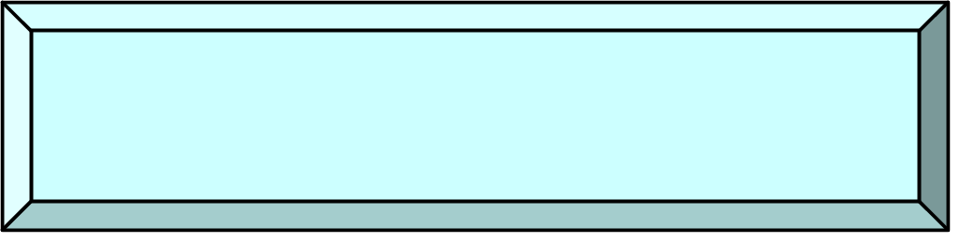
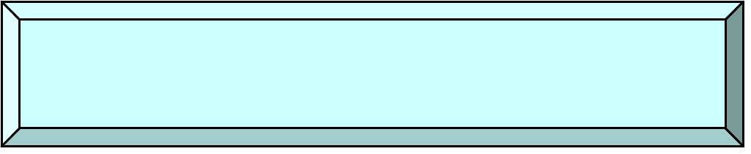
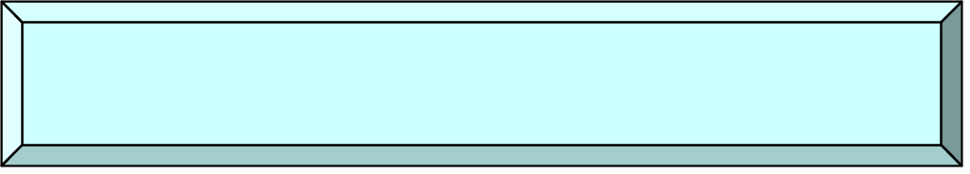

Iterators
++, input
++, output
Input Iterator
Output Iterator
++, I/O
Forward Iterator
++, --, I/O
Bi-directional Iterator
Pointer
arithmetic
Random-Access Iterator

Slide 3

Iterator Types
Output: write only and can write only once
Input: read many times each item
Forward supports both read and write
Bi-directional support also decrement
Random supports random access
(just like C pointer)

Slide 4
Iterators & Containers
Input/output/forward iterators:
iostreams (folder 3)
Bidirectional iterators:
list, map, set
Random access iterators:
vector

Slide 5
Iterators & Containers
class NameOfContainer {
…
typedef … iterator; // iterator type
iterator begin(); // first element
iterator end(); // element after last
NameOfContainer<...> c
…
NameOfContainer<...>::iterator it;
for( it= c.begin(); it!=c.end(); ++it)
// do something that changes *it

Slide 6
Iterators & Containers: c++11
class NameOfContainer {
…
typedef … iterator; // iterator type
iterator begin(); // first element
iterator end(); // element after last
NameOfContainer<...> c
…
for(auto it= c.begin(); it!=c.end(); ++it)
// do something that changes *it

Slide 7
Iterators & Containers: c++11
class NameOfContainer {
…
typedef … iterator; // iterator type
iterator begin(); // first element
iterator end(); // element after last
NameOfContainer<...> c
…
for(auto& val : c)
// do something that changes val

Slide 8
const_iterators & Containers
class NameOfContainer {
…
typedef … const_iterator; // iterator type
const_iterator begin() const; // first element
const_iterator end() const; // element after last
NameOfContainer<...> c
…
NameOfContainer<...>::const_iterator it;
for( it= c.begin(); it!=c.end(); ++it)
// do something that does not change *it

Slide 9
const_iterators & Containers: c++11
class NameOfContainer {
…
typedef … const_iterator; // iterator type
const_iterator cbegin() const; // first element
const_iterator cend() const; // element after last
NameOfContainer<...> c
…
for(auto it= c.cbegin(); it!=c.cend(); ++it)
// do something that does not change *it

Slide 10
const_iterators & Containers: c++11
class NameOfContainer {
…
typedef … const_iterator; // iterator type
const_iterator cbegin() const; // first element
const_iterator cend() const; // element after last
NameOfContainer<...> c
…
for(const auto& val : c)
// do something that does not change val

Slide 11
const_iterators & Containers
…
const_iterator cbegin() const;
const_iterator cend() const;
const_iterator begin() const;
const_iterator end() const;
…
iterator begin();
iterator end();
Note that the begin() and end() methods that
return regular iterator are not const methods.
i.e: if we get a container by const (const ref, ...)
we can't use these methods. We have to use
the methods that return const_iterator
[end of first week]

Slide 12
IntBufferSwap example revisited
See folder 4.
Focus on iterator and const_iterator.

Slide 13
Iterators & Sequence Containers
SeqContainerName<...> c;
SeqContainerName<...>::iterator i,j;
c.insert(i,x) – inserts x before i
c.insert(i,first,last)
– inserts elements in [first,last) before i
c.erase(i) – erases the element that i points to
c.erase(i,j)
– erase elements in range [i,j)

Slide 14
Iterators & Sequence Containers c++11
SeqContainerName<...> c;
SeqContainerName<...>::iterator i,j;
c.emplace(i,p1,...,pn):
Constructs and inserts before i an object
with a constructor that gets p1,...,pn
parameters

Slide 15
Iterators & other Containers
insert and erase has the same ideas,
except they keep the invariants of the specific
container.
For example, a Sorted Associative Container
will remain sorted after insertions and erases.

Slide 16
Iterators & other Containers
So what does c.insert(pos,x) does, when c
is a Unique Sorted Associative Container ?
Inserts x into the set, using pos as a hint to
where it will be inserted.

Slide 17
Iterators & other Containers: c++11
So what does c.emplace_hint(pos,x) does,
when c is a Unique Sorted Associative
Container?
Constructs and Inserts x into the set,
using pos as a hint to where it will be inserted.

Slide 18
Iterator validity
When working with iterators, we have to
remember that their validity can change
What is wrong with this code?
Container<...> c;
...
for(auto i= c.begin(); i!=c.end(); ++i )
if( f( *i ) ) { // some test
c.erase(i);
}

Slide 19
Iterator validity
Two cases:
list, set, map
  i is not a legal iterator

Slide 20
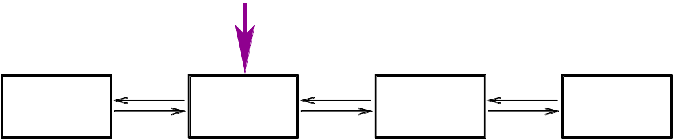
Iterator validity
Two cases:
list, set, map
  i is not a legal iterator

Slide 21
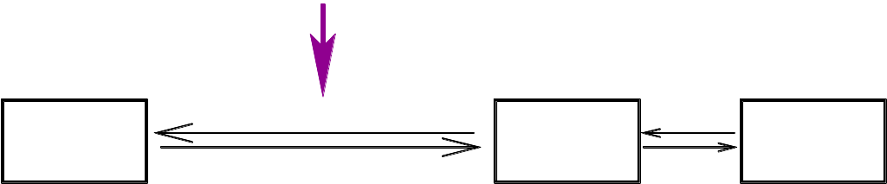
Iterator validity
Two cases:
list, set, map
  i is not a legal iterator

Slide 22
Iterator validity
Two cases:
list, set, map
  i is not a legal iterator
vector
  i points to the element after
0
1
2
3
4
5
6
7

Slide 23
Iterator validity
Two cases:
list, set, map
  i is not a legal iterator
vector
  i points to the element after
0
1
3
4
5
6
7

Slide 24
Iterator validity
Two cases:
list, set, map
  i is not a legal iterator
vector
  i points to the element after
In either case,
this is not what we want…

Slide 25
Iterator validity – second try...
Container<...> c;
auto i= c.begin();
while( i!=c.end() ) {
auto j= i;
++i;
if( f( *j ) ) { // some test
c.erase(j);
...
}Works for set, map, list, not vector or deque

Slide 26
Erasing during iteration (folder 5)
Container<...> c;
...
for(auto i= c.begin(); i!=c.end();/*no ++i*/ )
if( f( *i ) ) { // some test
i = c.erase(i);
} else {
++i;
}

Slide 27
Iterators & Map
Suppose we work with:
map<string,int> dictionary;
map<string,int>::iterator it;
…
it = dictionary.begin();
What is the type of *it ?

Slide 28
Iterators & Map
Every STL container type Container defines
Container::value_type
Type of elements stored in container
This is the type returned by an iterator
Container::value_type operator*();

Slide 29
Iterators & Map
Ok, so what type of elements does a
map return?
map<KeyType,ValueType> keeps pairs
  KeyType key – “key” of entry
  ValueType value – “value” of entry

Slide 30
Pairs
template< typename T1, typename T2>
struct pair {
typedef T1 first_type;
typedef T2 second_type;
T1 first;
T2 second;
pair( const T1& x, const T2& y )
: first(x), second(y)
{}
};

Slide 31
Map value_type
template< typename Key, typename T,
typename Cmp = less<Key> >
class map {
public:
typedef pair<const Key, T> value_type;
typedef Key key_type;
typedef T mapped_type;
typedef Cmp key_compare;
};

Slide 32
Using map iterator
map<string,int> dict;
…
for( auto i = dict.cbegin();
i != dict.cend();
++i )
{
cout << i->first << “ “
<< i->second << “\n”;
}

Slide 33
Using map iterator
map<string,int> dict;
…
for( const auto& val : dict) {
cout << val.first << “ “
<< val.second << “\n”;
}

Slide 34
Iterators and Assoc. Containers (folder 6)
Additional set of operations:
iterator C::find(key_type const& key)
Return iterator to first element with key.
Return end() if not found
iterator C::lower_bound(key_type const& key)
Return iterator to first element greater or equal to key
iterator C::upper_bound(key_type const& key)
Return iterator to first element greater than key

Slide 35
Adaptors
Good functionality, wrong interface
For example, adaptors of basic containers
with limited interface:
stack<T,SequentialContainer>
queue<T,SequentialContainer>

Slide 36
stack<T,SequentialContainer>
provides emplace, push, pop, top, size, empty,...
Notice that unlike java, pop , is not returning a value. i.e: it's a void function.
The reason (historic with c++-11?):
to make pop return a value it would be either inefficient or wrong: http://www.sgi.com/tech/stl/stack.html#3

Slide 37
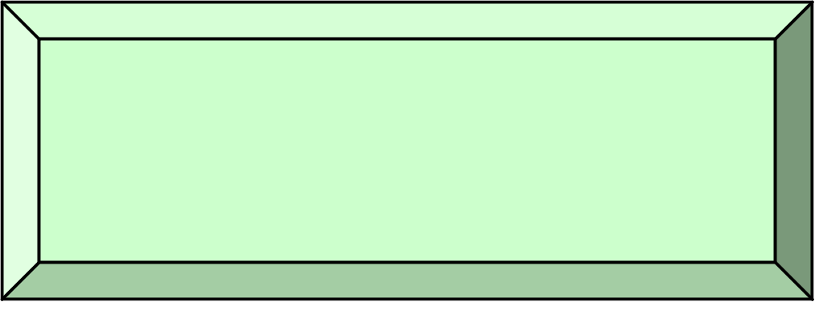
Algorithms
Most STL algorithms works on sequences
Sequences are passed as two iterators:
  beginning element
  element one after last
Algorithms depend on iterator type
not on container type
p
q
sequence [p,q)

Slide 38
Example – merge documentation

Slide 39
copy
template< typename In, typename Out>
Out copy(In first, In last, Out res)
{
while (first != last)
*res++ = *first++;
return res;
}

Slide 40
copy
template< typename In, typename Out>
Out copy(In first, In last, Out res)
{
while (first != last)
*res++ = *first++;
return res;
}
What's wrong with this ?
void foo(const vector<char>& v) {
vector<char> v2;
...
copy(v.begin(),v.end(), v2.begin());

Slide 41
copy
template< typename In, typename Out>
Out copy(In first, In last, Out res)
{
while (first != last)
*res++ = *first++;
return res;
}
What's wrong with this ?
OUT OF BOUND !
void foo(const vector<char>& v) {
vector<char> v2;
...
copy(v.begin(),v.end(), v2.begin());

Slide 42
So how can we copy and insert ?
Solution #1: Use insert explicitly
void foo(const vector<char>& v) {
vector<char> v2;
...
v2.insert(v2.end(),v.begin(),v.end());

Slide 43
So how can we copy and insert ?
Solution #2: Use back_inserter, which returns an iterator that knows to “push_back”. See folder 6.
void foo(const vector<char>& v) {
vector<char> v2;
...
copy(v.begin(),v.end(), back_inserter(v2));

Slide 44
sort – using operator <
template <class RandomAccessIterator>
void sort(RandomAccessIterator first,
RandomAccessIterator last);
Example usage(the hard way):
sort< vector<int>::iterator >
(vec.begin(), vec.end());

Slide 45
sort – using operator <
template <class RandomAccessIterator>
void sort(RandomAccessIterator first,
RandomAccessIterator last);
Example usage:
sort(vec.begin(), vec.end());

Slide 46
sort – using operator <
template <class RandomAccessIterator>
void sort(RandomAccessIterator first,
RandomAccessIterator last);
Example usage with primitive arrays:
int arr[5];
...
sort(arr, arr+5);

Slide 47
sort – using operator <
template <class RandomAccessIterator>
void sort(RandomAccessIterator first,
RandomAccessIterator last);
Example usage with primitive arrays (C++11):
int arr[5];
...
sort(begin(arr), end(arr));

Slide 48
sort – using comparator
template <class RandomAccessIterator,
class StrictWeakOrdering>
void sort(RandomAccessIterator first,
RandomAccessIterator last,
StrictWeakOrdering comp);
Example usage:
sort(vec.begin(), vec.end(), greater<int>());

Slide 49
sort – compile error
list<int> l(nums, nums+SIZE);
sort(l.begin(), l.end());

Slide 50
sort – compile error
list<int> l(nums, nums+SIZE);
sort(l.begin(), l.end());
list iterators are bidirectional and not random access !

Slide 51
g++
/usr/lib/gcc/i486-linux-gnu/4.1.2/../../../../include/c++/4.1.2/bits/stl_algo.h: In function ‘void std::sort(_RandomAccessIterator, _RandomAccessIterator) [with _RandomAccessIterator = std::_List_iterator<int>]’:
Main.cpp:17: instantiated from here
/usr/lib/gcc/i486-linux-gnu/4.1.2/../../../../include/c++/4.1.2/bits/stl_algo.h:2713: error: no match for ‘operator-’ in ‘__last - __first’
/usr/lib/gcc/i486-linux-gnu/4.1.2/../../../../include/c++/4.1.2/bits/stl_bvector.h:182: note: candidates are: ptrdiff_t std::operator-(const std::_Bit_iterator_base&, const std::_Bit_iterator_base&)
/usr/lib/gcc/i486-linux-gnu/4.1.2/../../../../include/c++/4.1.2/bits/stl_algo.h: In function ‘void std::__final_insertion_sort(_RandomAccessIterator, _RandomAccessIterator) [with _RandomAccessIterator = std::_List_iterator<int>]’:
/usr/lib/gcc/i486-linux-gnu/4.1.2/../../../../include/c++/4.1.2/bits/stl_algo.h:2714: instantiated from ‘void std::sort(_RandomAccessIterator, _RandomAccessIterator) [with _RandomAccessIterator = std::_List_iterator<int>]’
Main.cpp:17: instantiated from here
/usr/lib/gcc/i486-linux-gnu/4.1.2/../../../../include/c++/4.1.2/bits/stl_algo.h:2357: error: no match for ‘operator-’ in ‘__last - __first’
...

Slide 52
g++
/usr/lib/gcc/i486-linux-gnu/4.1.2/../../../../include/c++/4.1.2/bits/stl_algo.h: In function ‘void std::sort(_RandomAccessIterator, _RandomAccessIterator) [with _RandomAccessIterator = std::_List_iterator<int>]’:
Main.cpp:17: instantiated from here
/usr/lib/gcc/i486-linux-gnu/4.1.2/../../../../include/c++/4.1.2/bits/stl_algo.h:2713: error: no match for ‘operator-’ in ‘__last - __first’
/usr/lib/gcc/i486-linux-gnu/4.1.2/../../../../include/c++/4.1.2/bits/stl_bvector.h:182: note: candidates are: ptrdiff_t std::operator-(const std::_Bit_iterator_base&, const std::_Bit_iterator_base&)
/usr/lib/gcc/i486-linux-gnu/4.1.2/../../../../include/c++/4.1.2/bits/stl_algo.h: In function ‘void std::__final_insertion_sort(_RandomAccessIterator, _RandomAccessIterator) [with _RandomAccessIterator = std::_List_iterator<int>]’:
/usr/lib/gcc/i486-linux-gnu/4.1.2/../../../../include/c++/4.1.2/bits/stl_algo.h:2714: instantiated from ‘void std::sort(_RandomAccessIterator, _RandomAccessIterator) [with _RandomAccessIterator = std::_List_iterator<int>]’
Main.cpp:17: instantiated from here
/usr/lib/gcc/i486-linux-gnu/4.1.2/../../../../include/c++/4.1.2/bits/stl_algo.h:2357: error: no match for ‘operator-’ in ‘__last - __first’
...
???

Slide 53
g++
/usr/lib/gcc/i486-linux-gnu/4.1.2/../../../../include/c++/4.1.2/bits/stl_algo.h: In function ‘void std::sort(_RandomAccessIterator, _RandomAccessIterator) [with _RandomAccessIterator = std::_List_iterator<int>]’:
Main.cpp:17: instantiated from here
/usr/lib/gcc/i486-linux-gnu/4.1.2/../../../../include/c++/4.1.2/bits/stl_algo.h:2713: error: no match for ‘operator-’ in ‘__last - __first’
...

Slide 54
g++ -D_GLIBCXX_CONCEPT_CHECKS and STLFilt
BD Software STL Message Decryptor v2.47a for gcc
stl_algo.h: In function ‘void sort(_List_iterator<int>, _List_iterator<
int>)’:
Main.cpp:17: instantiated from here
stl_algo.h:2713: error: no match for ‘operator-’ in ‘__last - __first’
stl_algo.h: In function ‘void __final_insertion_sort(
_List_iterator<int>, _List_iterator<int>)’:
stl_algo.h:2714: instantiated from ‘void sort(
_List_iterator<int>, _List_iterator<int>)’
Main.cpp:17: instantiated from here
...

Slide 55
g++ -D_GLIBCXX_CONCEPT_CHECKS and STLFilt
...
Main.cpp:17: instantiated from here
boost_concept_check.h:223: error: conversion from ‘
bidirectional_iterator_tag’ to non-scalar type ‘
random_access_iterator_tag’ requested

Slide 56
Cryptic error messages
STLFilt:
An STL Error Message Decryptor for C++:
http://www.bdsoft.com/tools/stlfilt.html

Slide 57
Cryptic error messages
Different compilers:
clang++ (free)
intel c++ (not free)

Slide 58
Strings

Slide 59
What is a string ?
a typedef for basic_string<char>
The basic_string class represents a Sequence of characters.
It contains:
  all the usual operations of a Sequence.
  standard string operations such as search and concatenation.

Slide 60
How to convert something to a string?
c++11: to_string for primitives
Using std::ostringstream
We can encapsulate the string conversion and format into stringify functions – stringify example

Slide 61
More?
Lots of other features, especially in c++11 (threads,…)
Other libraries:
  Boost
  opencv, dlib, armadillo, zlib, …

