Slide 1
The Standard
C++ Library –
Iterators
Version 1: Dr. Ofir Pele
Version 2: Dr. Erel Segal-Halevi

Slide 2
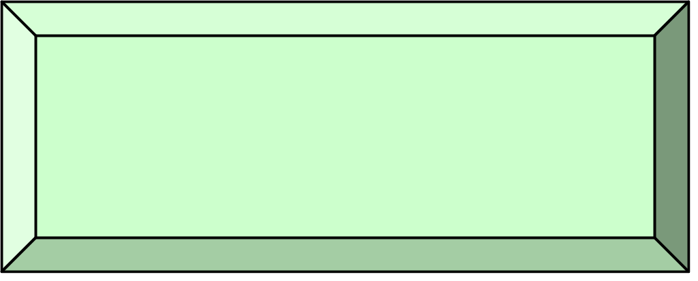
Why Iterators?
Instead of writing e.g. "find" for vector, "find" for unordered_set, "find" for array, etc. -
- we write only one find that accepts two iterators (begin and end):
http://www.cplusplus.com/reference/algorithm/find/
The same "find" would work for any container that defines the iterators correctly, and even for non-containers such as "range", "chain".

Slide 3
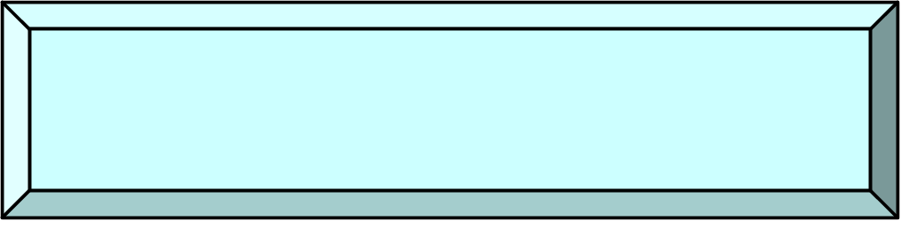
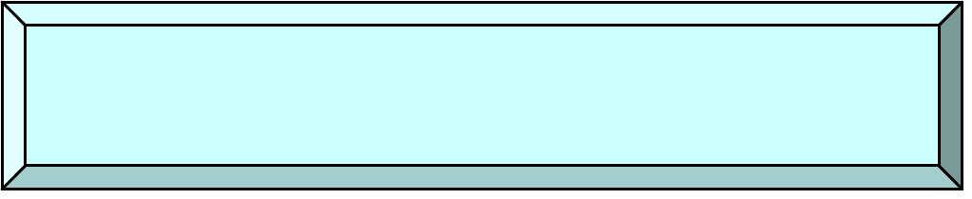
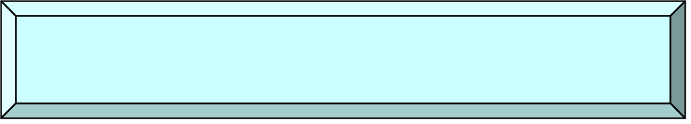

Iterator types
++, input
++, output
Input Iterator
Output Iterator
++, I/O
Forward Iterator
++, --, I/O
Bi-directional Iterator
Pointer
arithmetic
Random-Access Iterator

Slide 4

Iterator Types
Output: write only and can write only once
Input: read many times each item
Forward supports both read and write
Bi-directional support also decrement
Random supports random access
(just like C pointer)

Slide 5
Iterators & Containers
Input/output/forward iterators:
iostreams (folder 3)
Bidirectional iterators:
list, map, set
Random access iterators:
vector

Slide 6
Iterators & Containers
class NameOfContainer {
…
typedef … iterator; // iterator type
iterator begin(); // first element
iterator end(); // element after last
NameOfContainer<...> c
…
NameOfContainer<...>::iterator it;
for( it= c.begin(); it!=c.end(); ++it)
// do something that changes *it

Slide 7
Iterators & Containers: c++11
class NameOfContainer {
…
typedef … iterator; // iterator type
iterator begin(); // first element
iterator end(); // element after last
NameOfContainer<...> c
…
for(auto it= c.begin(); it!=c.end(); ++it)
// do something that changes *it

Slide 8
Iterators & Containers: c++11
class NameOfContainer {
…
typedef … iterator; // iterator type
iterator begin(); // first element
iterator end(); // element after last
NameOfContainer<...> c
…
for(auto& val : c)
// do something that changes val

Slide 9
const_iterators & Containers
class NameOfContainer {
…
typedef … const_iterator; // iterator type
const_iterator begin() const; // first element
const_iterator end() const; // element after last
NameOfContainer<...> c
…
NameOfContainer<...>::const_iterator it;
for( it= c.begin(); it!=c.end(); ++it)
// do something that does not change *it

Slide 10
const_iterators & Containers: c++11
class NameOfContainer {
…
typedef … const_iterator; // iterator type
const_iterator cbegin() const; // first element
const_iterator cend() const; // element after last
NameOfContainer<...> c
…
for(auto it= c.cbegin(); it!=c.cend(); ++it)
// do something that does not change *it

Slide 11
const_iterators & Containers: c++11
class NameOfContainer {
…
typedef … const_iterator; // iterator type
const_iterator cbegin() const; // first element
const_iterator cend() const; // element after last
NameOfContainer<...> c
…
for(const auto& val : c)
// do something that does not change val

Slide 12
const_iterators & Containers
…
const_iterator cbegin() const;
const_iterator cend() const;
const_iterator begin() const;
const_iterator end() const;
…
iterator begin();
iterator end();
Note that the begin() and end() methods that
return regular iterator are not const methods.
i.e: if we get a container by const (const ref, ...)
we can't use these methods. We have to use
the methods that return const_iterator
[end of first week]

Slide 13
IntBufferSwap example revisited
See folder 4.
Focus on iterator and const_iterator.

Slide 14
Iterators & Sequence Containers
SeqContainerName<...> c;
SeqContainerName<...>::iterator i,j;
c.insert(i,x) – inserts x before i
c.insert(i,first,last)
– inserts elements in [first,last) before i
c.erase(i) – erases the element that i points to
c.erase(i,j)
– erase elements in range [i,j)

Slide 15
Iterators & Sequence Containers c++11
SeqContainerName<...> c;
SeqContainerName<...>::iterator i,j;
c.emplace(i,p1,...,pn):
Constructs and inserts before i an object
with a constructor that gets p1,...,pn
parameters

Slide 16
Iterators & other Containers
insert and erase has the same ideas,
except they keep the invariants of the specific
container.
For example, a Sorted Associative Container
will remain sorted after insertions and erases.

Slide 17
Iterators & other Containers
So what does c.insert(pos,x) does, when c
is a Unique Sorted Associative Container ?
Inserts x into the set, using pos as a hint to
where it will be inserted.

Slide 18
Iterators & other Containers: c++11
So what does c.emplace_hint(pos,x) does,
when c is a Unique Sorted Associative
Container?
Constructs and Inserts x into the set,
using pos as a hint to where it will be inserted.

Slide 19
Iterator validity
When working with iterators, we have to
remember that their validity can change
What is wrong with this code?
Container<...> c;
...
for(auto i= c.begin(); i!=c.end(); ++i )
if( f( *i ) ) { // some test
c.erase(i);
}

Slide 20
Iterator validity
Two cases:
list, set, map
  i is not a legal iterator

Slide 21
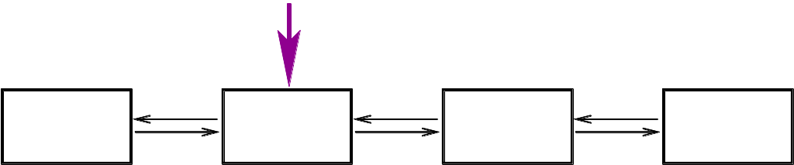
Iterator validity
Two cases:
list, set, map
  i is not a legal iterator

Slide 22
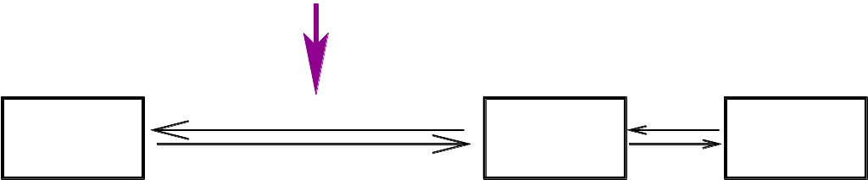
Iterator validity
Two cases:
list, set, map
  i is not a legal iterator

Slide 23
Iterator validity
Two cases:
list, set, map
  i is not a legal iterator
vector
  i points to the element after
0
1
2
3
4
5
6
7

Slide 24
Iterator validity
Two cases:
list, set, map
  i is not a legal iterator
vector
  i points to the element after
0
1
3
4
5
6
7

Slide 25
Iterator validity
Two cases:
list, set, map
  i is not a legal iterator
vector
  i points to the element after
In either case,
this is not what we want…

Slide 26
Iterator validity – second try...
Container<...> c;
auto i= c.begin();
while( i!=c.end() ) {
auto j= i;
++i;
if( f( *j ) ) { // some test
c.erase(j);
...
}Works for set, map, list, not vector or deque

Slide 27
Erasing during iteration (folder 5)
Container<...> c;
...
for(auto i= c.begin(); i!=c.end();/*no ++i*/ )
if( f( *i ) ) { // some test
i = c.erase(i);
} else {
++i;
}

Slide 28
Iterators & Map
Suppose we work with:
map<string,int> dictionary;
map<string,int>::iterator it;
…
it = dictionary.begin();
What is the type of *it ?

Slide 29
Iterators & Map
Every STL container type Container defines
Container::value_type
Type of elements stored in container
This is the type returned by an iterator
Container::value_type operator*();

Slide 30
Iterators & Map
Ok, so what type of elements does a
map return?
map<KeyType,ValueType> keeps pairs
  KeyType key – “key” of entry
  ValueType value – “value” of entry

Slide 31
Pairs
template< typename T1, typename T2>
struct pair {
typedef T1 first_type;
typedef T2 second_type;
T1 first;
T2 second;
pair( const T1& x, const T2& y )
: first(x), second(y)
{}
};

Slide 32
Map value_type
template< typename Key, typename T,
typename Cmp = less<Key> >
class map {
public:
typedef pair<const Key, T> value_type;
typedef Key key_type;
typedef T mapped_type;
typedef Cmp key_compare;
};

Slide 33
Using map iterator
map<string,int> dict;
…
for( auto i = dict.cbegin();
i != dict.cend();
++i )
{
cout << i->first << “ “
<< i->second << “\n”;
}

Slide 34
Using map iterator
map<string,int> dict;
…
for( const auto& val : dict) {
cout << val.first << “ “
<< val.second << “\n”;
}

Slide 35
Iterators and Assoc. Containers (folder 6)
Additional set of operations:
iterator C::find(key_type const& key)
Return iterator to first element with key.
Return end() if not found
iterator C::lower_bound(key_type const& key)
Return iterator to first element greater or equal to key
iterator C::upper_bound(key_type const& key)
Return iterator to first element greater than key

