Slide 1
The Standard
C++ Library –
Algorithms
Based on: Jonathan Boccara, "105 algorithms in less than an hour", CPPCON 2018, https://youtu.be/2olsGf6JIkU
Summarized by: Erel Segal-Halevi

Slide 2

Algorithms
In C++17, there are 105 algorithms that perform common programming tasks.
We need to know them all.
Why? - otherwise, we will try to implement them ourselves as part of larger projects, and:
  Make bugs (no time to test..),
  Produce inefficient code (no time to optimize..)
How can we remember them? - use a map →

Slide 3
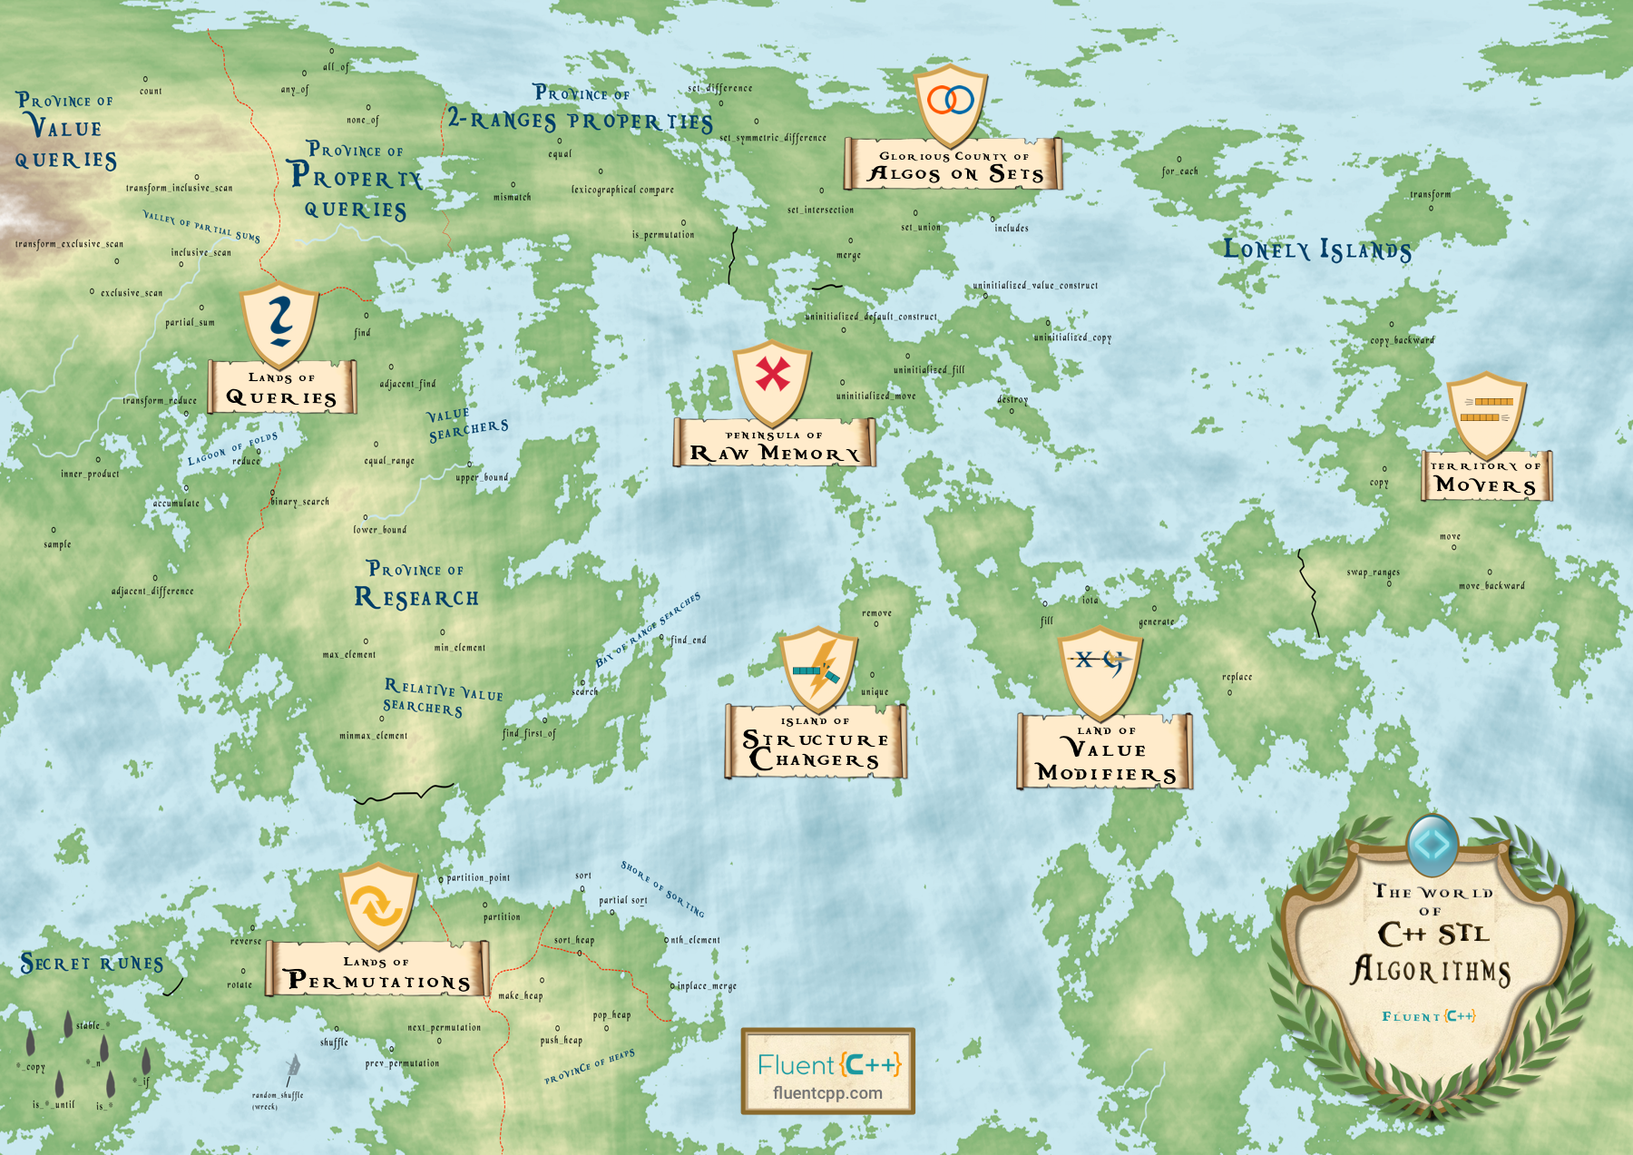
https://youtu.be/2olsGf6JIkU?t=475

Slide 4
Queries (10)
Algorithms that calculate a value related to the collection, without modifying it.

Slide 5
Set Algorithms (11)
Operations on any sorted collection (including std::set but also sorted vectors)

Slide 6
Permutations (12)
Algorithms that move elements around the collection, without changing their values:

Slide 7
Movers (13)
Algorithms that move things between collections.

Slide 8
Value modifiers (14)
Modify values in a collection.

Slide 9
Runes (15)
Words you can add to an algorithm to get a new algorithm:

Slide 10
Structure changers (16)
STL algorithms work on iterators, so they cannot change the size!
Solution: move the remaining elements to the beginning of the collection, and return an iterator to the new end.

Slide 11
(17)

Slide 12
p
q
sequence [p,q)

