Slide 1
The Standard
C++ Library
Version 1: Dr. Ofir Pele
Version 2: Dr. Erel Segal-Halevi

Slide 2
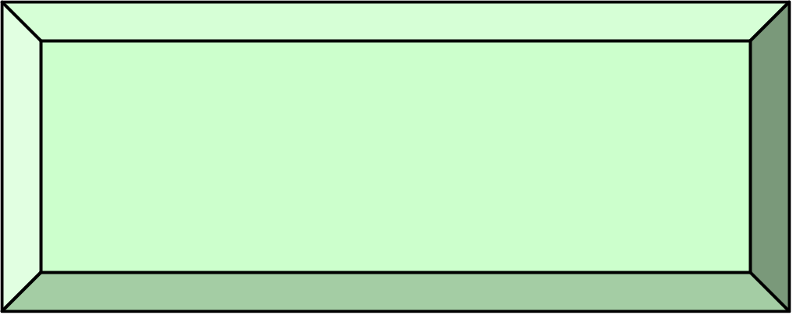
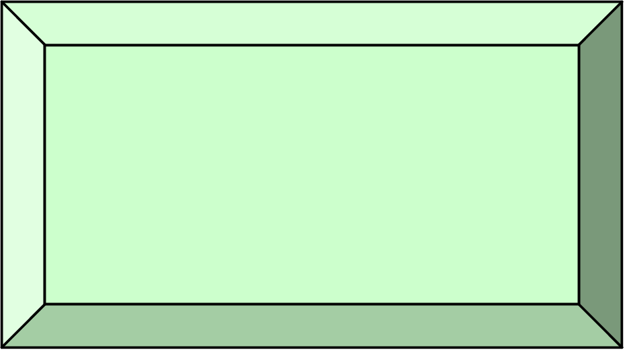
Main Components
Iterators
Containers
Algorithms
Functors

Slide 3
Containers
Holds copies of elements.
Assumes elements have:
Copy Ctor & operator =
The standard defines the interface.
Two main classes
  Sequential containers:
  list, vector,....
  Associative containers:
  map, set ...
Assignable -
types with operator=
and copy Ctor

Slide 4
Containers documentation
see http://www.cplusplus.com/reference/stl/

Slide 5
STL: Sequential Containers

Slide 6
Sequential Containers
Maintain a linear sequence of objects.
forward_list - a singly-linked list.
list - a doubly-linked list.
  Efficient insertion/deletion in front/end/middle
vector - an extendable sequence of objects
  Efficient insertion at end, and random access
deque – double-ended queue
  Efficient insertion/deletion at front/end
  Random access
array – fixed size, on the stack.

Slide 7
vector<T>
  Contiguous array of elements of type T
  Random access
  Can grow on as needed basis
std::vector<int> v(200);
v[0]= 45;
v[100]= 32;
v.emplace_back(60); //C++11

Slide 8
Vectors of ints
Creating an empty vector and filling it:
std::vector<int> vec;
vec.push_back(42);
vec.emplace_back(42); // equivalent
Creating a vector with 10 ints with value 42:
std::vector<int> vec(10,42);
std::vector<int> vec(10); // default is 0
Initializing a vector like an array:
std::vector<int> vec { 42, 52, 62 };
Initializing a vector from iterators:
std::vector<int> v2(vec.begin(),vec.end());

Slide 9
Vectors of objects (folder 1)
Creating an empty vector and filling it:
std::vector<MyClass> vec;
vec.push_back(MyClass{42});
vec.emplace_back(42); // more efficient
Creating a vector with 10 objs:
std::vector<MyClass> vec(10,MyClass{42});
std::vector<MyClass> vec(10); // default ctor
Initializing a vector like an array (calls ctor):
std::vector<MyClass> vec { {42}, {52}, {62} };
Initializing a vector from iterators:
std::vector<MyClass> v2(vec.begin(),vec.end());

Slide 10
Adding elements
Inserts a new element at the end:
void push_back(const T&)
    a.push_back(t)
}
amortized constant time

Slide 11
Adding elements-C++11
Construct and insert a new element at the end:
template<typename… Args>
void emplace_back(Args&&… args)
    a.emplace_back(t)
}
amortized constant time

Slide 12
size and capacity
size
capacity
  The first “size” elements are constructed (initialized)
  The last “capacity - size” elements are uninitialized
  push_back / emplace_back use the uninitialized elements until they are full; then, they multiply the vector size by 2.

Slide 13
emplace_back / push_back
Average Time Complexity
If we inserted n elements we paid:
1+2+1+4+1+1+1+8+…+n =
O(n) + 1+2+4+…+n =
O(n)
On average an each insertion cost O(1)

Slide 14
size and capacity methods
uint size() const;
uint capacity() const;
void reserve(uint new_capacity);
// ensure that the capacity is
// at least "new_capacity".
size
capacity

Slide 15
vector<T> v
v.shrink_to_fit() // c++11

Slide 16
Accessing elements
Without boundary checking:
reference operator[](size_type n)
const_reference operator[](size_type n) const
With boundary checking:
reference at(size_type n)
const_reference at(size_type n) const

Slide 17
Associated types in vector
vector<typename T>::
  value_type - The type of object, T, stored
  reference - Reference to T
  const_reference - const Reference to T
  iterator - Iterator used to iterate through a vector (how would you write it?)
  …

Slide 18
vectors: C++ vs. Java
Look at cplusplus documentation of vector.
Look at Java documentation of Vector.
Differences:
  Simple class vs. interface and vtable.
  Simple elements vs. class elements.
  Two accessors (with and without range check) vs. a single accessor

Slide 19
deque
More efficient insertion at start and middle;
Less efficient deallocation.
How do we know? - performance tests:
https://www.codeproject.com/Articles/5425/An-In-Depth-Study-of-the-STL-Deque-Container
Implementation – non contiguous blocks:
https://stackoverflow.com/a/6292437/827927

Slide 20
STL: Associative Containers

Slide 21
Associative Containers
Supports efficient retrieval of elements
(values) based on keys.
(Typical) Implementation:
red-black binary trees
hash-table

Slide 22
Sorted Associative Containers
set
A set of unique keys ordered by <
map
Associate a value to key (associative array)
Unique value of each key, ordered by <
multiset, multimap
Same, but allow multiple values
unordered_set, unordered_map
Same, but without order (faster).

Slide 23
Sorted Associative Containers & Order
Sorted associative containers assume that their elements are LessThanComparable.
They use operator< as default order.
We can control order using our own
comparison function.
We need to use a functor.

Slide 24
Functor
A functor in C++ is an object with an operator(). Examples:
Pointer to function (like in C);
A class that implements operator();
Lambda expressions.

Slide 25
Example (see also folder 2)
class c_str_less {
public:
bool operator()(const char* s1,
const char* s2) {
return (strcmp(s1,s2) < 0);
}
};
c_str_less cmp; // declare an object
if(cmp(“aa”,”ab”))
…
if( c_str_less()(“a”,”b”) )
Creates temporary objects, and
then call operator()

Slide 26
Template comparator example
template<typename T>
class less {
public:
bool operator()(const T& lhs, const T& rhs)
{ return lhs < rhs; }
};
less<int> cmp; // declare an object
if( cmp(1,2) )
…
if( less<int>()(1,2) )
…
Creates temporary objects,
and then call operator()

Slide 27
Using Comparators
// ascending order
// uses operator < for comparison
set<int> s1;
set<int,less<int>> s1; // same
// descending order
// uses operator > for comparison
set<int,greater<int>> s2;

Slide 28
Using Comparators
Creates a default constructed
MyComp object.
set<int,MyComp> s3;
MyComp cmp(42);
set<int,MyComp> s4(cmp);
Use given MyComp object.

Slide 29
Why should we use classes as functors?
So that we get the “power” of classes:
  Inheritance.
  Parameterize our functions in run time.
  (folder 2).
  Accumulate information.

Slide 30
Tuples
(folder 0)
Can hold a fixed number of elements of various types.
Particularly useful in a return statement, to let your function return several values.
Shortest (most automated) version:
auto f () {
return std::make_tuple(5,'a',"hello");
}
// in main:
auto [ii,cc,ss] = f();
Longer versions in folder 0.

Slide 31
Adaptors
Good functionality, wrong interface
For example, adaptors of basic containers
with limited interface:
stack<T,SequentialContainer>
queue<T,SequentialContainer>

Slide 32
stack<T,SequentialContainer>
provides emplace, push, pop, top, size, empty,...
Notice that unlike java, pop , is not returning a value. i.e: it's a void function.
The reason (historic with c++-11?):
to make pop return a value it would be either inefficient or wrong: http://www.sgi.com/tech/stl/stack.html#3

Slide 33
Strings
A string is just a typedef for basic_string<char>
The basic_string class represents a Sequence of characters.
It contains:
  all the usual operations of a sequential container.
  useful string operations such as search and concatenation.

Slide 34
How to convert something to a string?
c++11: to_string for primitives
Using std::ostringstream
We can encapsulate the string conversion and format into stringify functions – stringify example

