Slide 1
The Standard
C++ Library –
Iterators
Version 1: Dr. Ofir Pele
Version 2: Dr. Erel Segal-Halevi

Slide 2


Main Components
Iterators
Containers
Algorithms
Functors

Slide 3
Why Iterators?
Instead of writing e.g. "find" for vector, "find" for unordered_set, "find" for array, etc. -
- we write only one find that accepts two iterators (begin and end):
http://www.cplusplus.com/reference/algorithm/find/
The same "find" would work for any container that defines the iterators correctly, and even for non-containers such as "range", "accumulate".

Slide 4
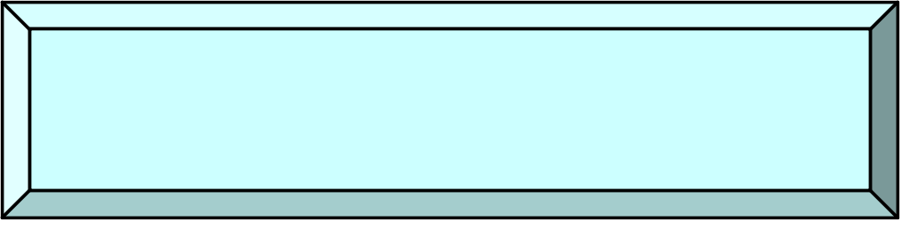
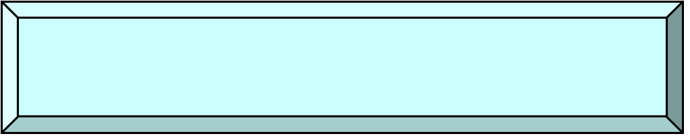
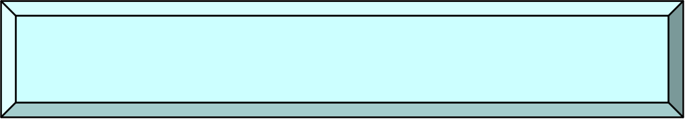
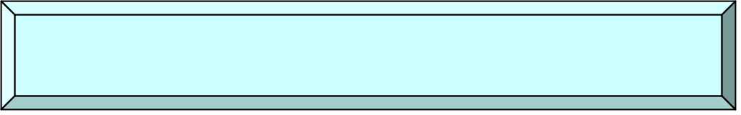
Iterator types
++, input
++, output
Input Iterator
Output Iterator
++, I/O
Forward Iterator
++, --, I/O
Bidirectional Iterator
Pointer
arithmetic
Random-Access Iterator

Slide 5

Iterator Types
Output: write only and can write only once
Input: read many times each item
Forward supports both read and write
Bi-directional support also decrement
Random supports random access
(just like C pointer)

Slide 6
Iterator types of containers
Input/output/forward iterators:
iostreams (folder 1)
Bidirectional iterators:
list, map, set
Random access iterators:
vector

Slide 7
IntBufferSwap example revisited
See folder 2.
Focus on iterator and const_iterator.

