Slide 1
The Standard
C++ Library
Modifying containers
Version 1: Dr. Ofir Pele
Version 2: Dr. Erel Segal-Halevi

Slide 2
Iterators & Sequence Containers
SeqContainerName<...> c;
SeqContainerName<...>::iterator i,j;
c.insert(i,x) – inserts x before i
c.insert(i,first,last)
– inserts elements in [first,last) before i
c.erase(i) – erases the element that i points to
c.erase(i,j)
– erase elements in range [i,j)

Slide 3
Iterators & Sequence Containers c++11
SeqContainerName<...> c;
SeqContainerName<...>::iterator i,j;
c.emplace(i,p1,...,pn):
Constructs and inserts before i an object
with a constructor that gets p1,...,pn
parameters

Slide 4
Iterator validity
When working with iterators, we have to
remember that their validity can change
What is wrong with this code?
Container<...> c;
...
for(auto i= c.begin(); i!=c.end(); ++i )
if( f( *i ) ) { // some test
c.erase(i);
}

Slide 5
Iterator validity
Two cases:
list, set, map
  i is not a legal iterator

Slide 6
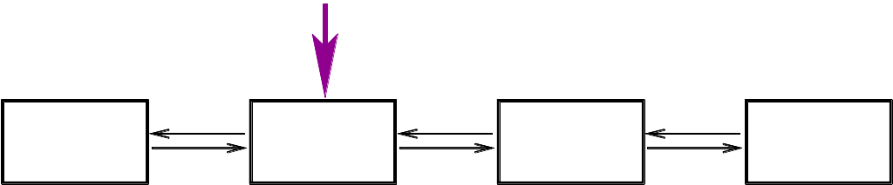
Iterator validity
Two cases:
list, set, map
  i is not a legal iterator

Slide 7
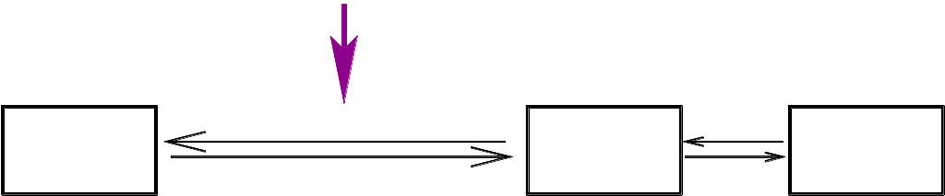
Iterator validity
Two cases:
list, set, map
  i is not a legal iterator

Slide 8
Iterator validity
Two cases:
list, set, map
  i is not a legal iterator
vector
  i points to the element after
0
1
2
3
4
5
6
7

Slide 9
Iterator validity
Two cases:
list, set, map
  i is not a legal iterator
vector
  i points to the element after
0
1
3
4
5
6
7

Slide 10
Iterator validity
Two cases:
list, set, map
  i is not a legal iterator
vector
  i points to the element after
In either case,
this is not what we want…

Slide 11
Erasing during iteration (folder 3)
Container<...> c;
...
for(auto i= c.begin(); i!=c.end();/*no ++i*/ )
if( f( *i ) ) { // some test
i = c.erase(i);
} else {
++i;
}

