Slide 1
The Standard
C++ Library –
Algorithms
Based on: Jonathan Boccara,
"105 algorithms in less than an hour", CPPCON 2018, https://youtu.be/2olsGf6JIkU
Summarized by: Erel Segal-Halevi

Slide 2


Main Components of STL
Iterators
Containers
Algorithms
Functors

Slide 3
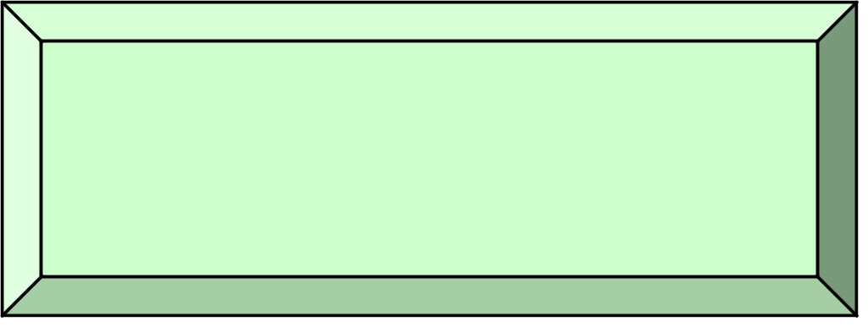
Algorithms
In C++17, there are 105 algorithms that perform common programming tasks.
We need to know them all.
Why? - otherwise, we will try to implement them ourselves as part of larger projects, and:
  Make bugs (no time to test..),
  Produce inefficient code (no time to optimize..)
How can we remember them? - use a map →

Slide 4
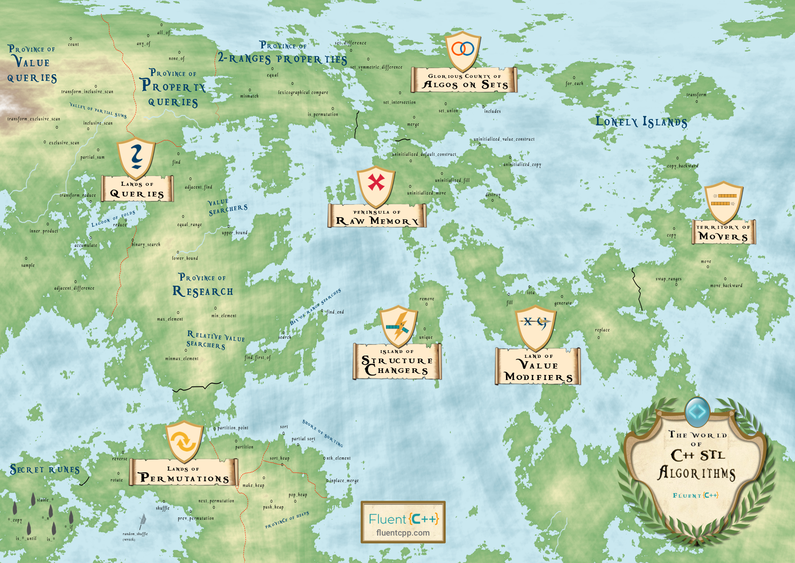
https://youtu.be/2olsGf6JIkU?t=475

Slide 5
Queries (10)
Algorithms that calculate a value related to the collection, without modifying it.

Slide 6
Set Algorithms (11)
Operations on any sorted collection (including std::set but also sorted vectors)

Slide 7
Permutations (12)
Algorithms that move elements around the collection, without changing their values:

Slide 8
Movers (13)
Algorithms that copy/move things between collections.

Slide 9
Value modifiers (14)
Modify values in a collection.

Slide 10
Runes (15)
Words you can add to an algorithm to get a new algorithm:

Slide 11
Structure changers (16)
STL algorithms work on iterators, so they cannot change the size!
Solution: move the remaining elements to the beginning of the collection, and return an iterator to the new end.

Slide 12
Others (17)

Slide 13
What now?
Use algorithms instead of loops.
Read the documentation: preconditions, postconditions, complexity
Invent your own algorithms!

Slide 14
p
q
sequence [p,q)

