Slide 1
The Standard
C++ Library
Version 1: Dr. Ofir Pele
Version 2: Dr. Erel Segal-Halevi

Slide 2


Main Components
Iterators
Containers
Algorithms
Functors

Slide 3
Containers
Fixed size:
pair, tuple, array
Sequence containers:
forward_list, list, vector, deque, [basic_string]
Associative containers:
set, multiset, map, multimap
unordered_set, multiset, map, multimap
Container adaptors:
stack, queue, priority_queue

Slide 4
Containers – General Rules
Holds copies of elements.
Assumes elements have:
Copy Ctor & operator =
Assignable -
types with operator=
and copy Ctor

Slide 5
Pairs, Tuples
(folder 0)
Can hold a fixed number of elements of various types.
Particularly useful in a return statement, to let your function return several values.
Best style:
tuple<int,char,string> f () {
return {5,'a',"hello"};
}
// in main:
auto [ii,cc,ss] = f();
Other styles in folder 0.

Slide 6
Tuple – when NOT to use

Slide 7
STL: Sequential Containers

Slide 8
Sequential Containers
Objects are ordered by the user
 | insert first | insert middle | insert last | random access | iterate forward | iterate back | find | storage
forward_ list | fast | fast | fast | slow | fast | slow | slow | heap
list | fast | fast | fast | slow | fast | fast | slow | heap
deque | fast | ~slow | fast | ~fast | fast | fast | slow | heap
vector | slow | slow | ~fast | fast | fast | fast | slow | heap
basic_ string | slow | slow | ~fast | fast | fast | fast | slow | heap
array | - | - | - | fast | fast | fast | slow | stack

Slide 9
vector<T>
  Contiguous array of elements of type T
  Random access
  Can grow on as needed basis
  Most useful in practice
std::vector<int> v(200);
v[0]= 45;
v[100]= 32;
v.emplace_back(60);

Slide 10
Vectors of ints
Creating an empty vector and filling it:
std::vector<int> vec;
vec.push_back(42);
vec.emplace_back(42); // equivalent
Creating a vector with 10 ints with value 42:
std::vector<int> vec(10,42);
std::vector<int> vec(10); // default is 0
Initializing a vector like an array:
std::vector<int> vec { 42, 52, 62 };
Initializing a vector from iterators:
std::vector<int> v2(vec.begin(),vec.end());

Slide 11
Vectors of objects
Creating an empty vector and filling it:
std::vector<MyClass> vec;
vec.push_back(MyClass{42,43});
vec.emplace_back(42,43); // more efficient
Creating a vector with 10 objs:
std::vector<MyClass> vec(10,MyClass{42,43});
std::vector<MyClass> vec(10); // default ctor
Initializing a vector like an array (calls ctor):
std::vector<MyClass> vec { {42,43}, {52}, {62,72} };
Initializing a vector from iterators:
std::vector<MyClass> v2(vec.begin(),vec.end());

Slide 12
push vs. emplace
Inserts a new element at the end:
void push_back(const T&)
    a.push_back(t)
Construct and insert a new element at end:
template<typename… Args>
void emplace_back(Args&&… args)
    a.emplace_back(t)

Slide 13
size and capacity
size
capacity
The first “size” elements are constructed (initialized)
The last “capacity - size” elements are uninitialized
push_back / emplace_back use the uninitialized elements until they are full; then, they multiply the vector capacity by 2.

Slide 14
emplace_back / push_back
Average Time Complexity
If we inserted n elements we paid:
1+2+1+4+1+1+1+8+…+n =
O(n) + 1+2+4+8+16+…+n =
O(n)
On average an each insertion cost O(1)

Slide 15
size and capacity methods
(see folder 1)
uint size() const;
uint capacity() const;
void reserve(uint new_capacity);
// ensure that the capacity is
// at least "new_capacity".
size
capacity

Slide 16
vector<T> v
v.shrink_to_fit() // c++11

Slide 17
Accessing elements
Without boundary checking:
reference operator[](size_type n)
const_reference operator[](size_type n) const
With boundary checking:
reference at(size_type n)
const_reference at(size_type n) const

Slide 18
Associated types in vector (folder 8)
vector<typename T>::
value_type - The type of object, T, stored
reference - Reference to T
const_reference - const Reference to T
iterator - Iterator used to iterate through a vector (how would you write it?)

Slide 19
vectors: C++ vs. Java
Look at cplusplus documentation of vector.
Look at Java documentation of Vector.
Differences:
  Simple class vs. interface and vtable.
  Simple elements vs. class elements.
  Two accessors (with and without range check) vs. a single accessor

Slide 20
deque
More efficient insertion at start and middle;
Less efficient deallocation.
How do we know? - performance tests:
https://www.codeproject.com/Articles/5425/An-In-Depth-Study-of-the-STL-Deque-Container
Implementation – non contiguous blocks:
https://stackoverflow.com/a/6292437/827927

Slide 21
basic_strings
The well-known string is just a typedef for basic_string<char>.
basic_string can be used with any char-like type (folder 1).
 | String operations (e.g. substr, replace, stol) | Non-trivial classes (e.g. with vptr, heap usage)
vector | No | Yes
basic_ string | Yes | No

Slide 22
STL: Associative Containers

Slide 23
Associative Containers
Supports efficient retrieval of elements
(values) based on keys.
(Typical) Implementation:
red-black binary trees
hash-table

Slide 24
Associative Containers
Ordered: Objects are ordered by "<".
Insertion, deletion, find: O(log n).
set: Unique keys.
map: Associate unique keys to values.
multiset: Allows multiple keys.
multimap: Associate keys to multiple values.
Unordered: Insertion, deletion, find: O(1).
unordered_set: Unique keys.
unordered_map: Associate keys to values.
unordered_multiset: Allows multiple keys.
unordered_multimap: Associate keys to multiple values.

Slide 25
Sorted Associative Containers & Order
Sorted associative containers assume that their elements are LessThanComparable.
They use operator< as default order.
We can control order using our own
comparison function.
We need to use a functor.

Slide 26
Functor
A functor in C++ is an object with an operator(). Examples:
Pointer to function (like in C);
A class that implements operator();
Lambda [] expressions.

Slide 27
Functor in the STL
template<typename T>
class less {
public:
bool operator()(const T& lhs, const T& rhs)
{ return lhs < rhs; }
};
less<int> cmp; // declare an object
if( cmp(1,2) )
…
if( less<int>()(1,2) )
…
Creates temporary objects,
and then call operator()

Slide 28
Using Comparators
// ascending order
// uses operator < for comparison
set<int> s1;
set<int,less<int>> s1; // same
// descending order
// uses operator > for comparison
set<int,greater<int>> s2;

Slide 29
Using Comparators
Creates a default constructed
MyComp object.
set<int,MyComp> s3;
MyComp cmp(42);
set<int,MyComp> s4(cmp);
Use given MyComp object.

Slide 30
Why should we use classes as functors?
So that we get the “power” of classes:
Inheritance.
Parameterize our functions in run time.
(folder 2).
Accumulate information.

Slide 31
Container Adaptors
Take any sequential container;
return a container with a given interface:
stack: last in – first out;
queue: first in – first out;
priority_queue: best in – first out.

Slide 32
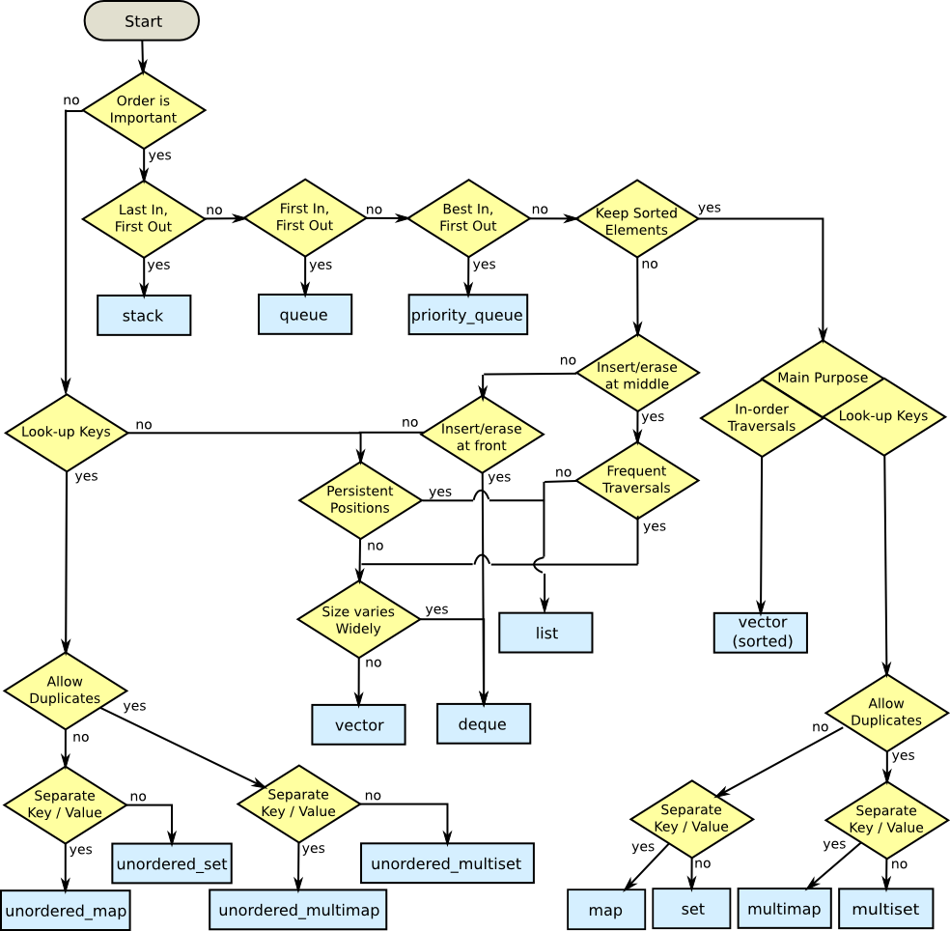
How to choose a container?
Mikael Persson https://stackoverflow.com/a/22671607/827927

