Slide 1
The for loop
repetitive C/C++ instructions

Slide 2
The for loop
The for loop is designed to iterate a number of times. Its syntax is: for (initialization; condition; increase/decrease)
statement;
This loop repeats statement while condition is true.

Slide 3
It works in the following way:
for (initialization; condition; increase/decrease)
statement;
1) initialization is executed. Generally, this declares a counter variable, and sets it to some initial value. This is executed a single time, at the beginning of the loop.
2) condition is checked. If it is true, the loop continues; otherwise, the loop ends, and statement is skipped, going directly to step 5.
3) statement is executed. As usual, it can be either a single statement or a block enclosed in curly braces { }.
4) increase/decrease is executed, and the loop gets back to step 2.
5) the loop ends: execution continues by the next statement after it.

Slide 4
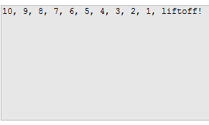
// countdown using a for loop
#include <iostream>
using namespace std;
int n;
int main ()
{
for (n=10; n>0; n--)
cout << n << ", ";
cout << "liftoff!\n";
}

Slide 5
for ( var = intial_value; how long to execute; var++/var--)
{
//statement to be repeatedly executed
}

Slide 6
for ( var = intial_value; how long to execute; var++/var--)
{
//statement to be repeatedly executed
}
for ( i = 20; i<=50; i++ )
{
cout<<i<<“ “;
}

Slide 7
for ( var = intial_value; how long to execute; var++/var--)
{
//statement to be repeatedly executed
}
Sample 1
for ( i = 20; i<=50; i++ )
{
cout<<i<<“ “;
}
Sample 2
for ( i = 20; i<=50; i++ )
{
cout<<i<<“\n“;
}

