Slide 1
Writing Linux FS
4 FUN
Notes:
Lets get started: My name is Maciej and my today presentation is called “Writing Linux File System for Fun”

Slide 2
Outline
Why
Main Concepts and bit of history
Earlier design decisions
On disk layout
Implementing own FS
On disk layout
Code Fragments:
Kernel Implementation
Other tools mkfs, fsdb
Notes:
Outline of this talk:
- First of all I would like to speak about motivation of this talk and some goals of presentation
Next we will touch a bit of history to see evolution of Filesystems
Some design decisions as well as on disk layouts
Next part of this presentation will walk through implementation of own Filesystem
On disk layout
Core structures
Fragments of the code

Slide 3
Why this talk?!
Cons
Writing FS is quite time consuming (approx. 10 years…)
Just few production ready FS, many abandoned or not truly maintained
Pros
Learning: Address specific gap
Solving other complicated problems
Storage stack is complicated and usually became a bottleneck
Data is foundation of most todays application
Notes:
First of all I just want to touch why people may not be interested in FS:
It take a long time to develop enterprise ready FS from scratch, according to some sources is about 10 years in m/h (according to some Sun managers)
There is only few truly reliable and production ready File systems, most of them are open sourced,
So even if someone will write own filesystem it will take a lot of time and will be hard to do money on that software
But there are also some reasons why people might be interested in presentation about FS:
- Address a specific gap in learning:
FS Concepts aren't difficult, they can be cover during presentation or short book, and I will cover some of them during this presentation
From the other side once understanding the easiest modern and functional Linux filesystem ext2 is not big deal to move forward and read ext4 and then xfs, zfs, btrfs
The problem that I had in my learning curve was to move from the point where you have good understanding of the FS concept to the point where you will be able to read and understand simplest modern FS like ext2.
I cannot promise that after this talk you will be able to achieve this, but definitely this material address the mentioned gap in the learning process, and I believe is really good starting point for the people that want to fill it.
Solving other complicated problems:
Because data and access to it is most often critical part of many applications is really beneficial to engineers to have good understanding of storage stack and the primary stack is Filesystem.
Storage usually became a bottleneck in many applications, to be able to solve multilayer complex problems engineers need good understanding of all components.

Slide 4
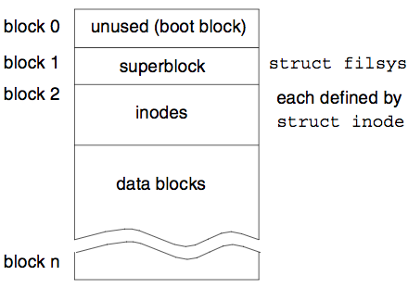
Early days: 6th ed. of UNIX
File system: one internal component of the kernel
Not possible to use other FS
Block size as fixed 512 bytes
Possible indirect block (up to 3 level depth)
Max size of file: 32*32*32 data blocks
Notes:
Lets start with early implementation of FS from 6th edition of UNIX.
Thanks to Lions’ book form 76 “commentary on 6th Edition UNIX“ and source code that was attached to the book we can take a look on initial implementation.
Back in the 70th, 6th version of UNIX had less than 9000 LOC, which make it easy to read.
Funny fact: quote from the book:
“It has been suggested that 1000 lines of the code represents the practical limit in size for a program which is to be understood and maintained by a single individual”
On Disk structure:
First block used for boot block
Superblock in second block
Then inode table
And data blocks
Other important design consequences:
Filesystem was fixed part of the kernel, not possible to add/remove or mount filesystem
Size of block was fixed 512 bytes which probably was sufficient at the beginning but during the time this value reduced a FS performance
FS supported hard links and indirect blocks
Max size of the file = 32*32*32 = 32,768 blocks (of 512 bytes)

Slide 5
Early days: 6th ed. of UNIX
struct inode {
i_mode // file type*
i_nlink // nr of hard links
i_uid
i_gid
i_size
i_addr[7] // 7 pointers to blocks
i_mtime // modify time
i_atime // access time
}
Note: Mode define specified file: directory IFDIR, block device IFBLK or char dev IFCHR
Notes:
Here is how inode structure looked in 6th V
Interesting fact is that it didn’t dramatically changed since then
We have inside :
- First field is interesting: because it describe file type: directory/regular file/block device or char device. For files on disks only dir/regular file make sense. But this hack was due to the required change in architecture,
- Number of hard links
User id
Group id
size
Array with 7 pointers to the blocks
Modify/access time
Architectural change required:
As V6 had one 'hardcoded' Filesystem, but during the period between SVR3-4 number of commercial filesystems types such as VxFS or SGI xfs increased dramatically, and the FS architecture required some change.

Slide 6
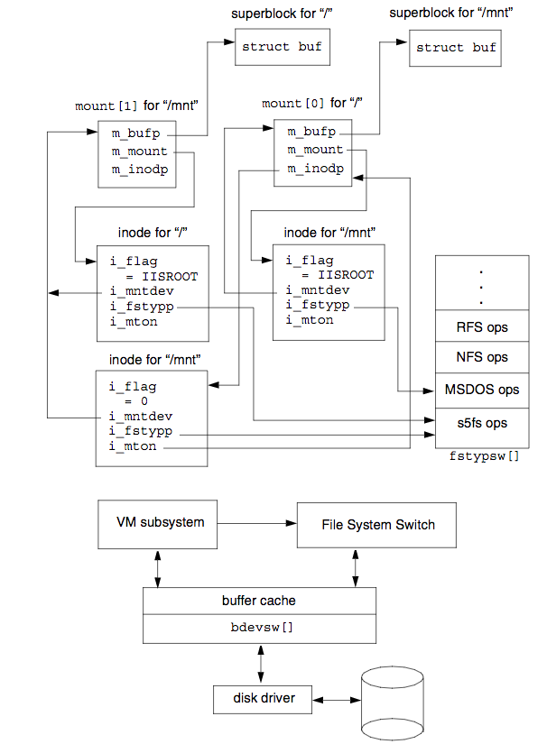
File System Switch
Main goal: provide framework under which multiple filesystems could exist in parallel
Divide FS to independent layer and in-core (FS dependent)
FS representation for file called “inode”
Short lived, being replaced by Sun VFS.
Notes:
FSS
---
Introduced in SVR3 File System Switch architecture introduced a framework under which multiple filesystems types could coexist in parallel.
Not well documented
Funny Fact:
FSS required traditional SysV FS to have some name to be able to mount using mount tool, it became known as the s5 filesystem.
FSS made a boundary between the filesystem-independent layer of the kernel and the FS dependent layer
(called then in-core inodes: on disk layout structure) but allow also diskless FS such as NFS and RFS had non-disk based structures
FSS was short lived, being replaced by the better Sun VFS/vnode interface introduced in SVR4.

Slide 7
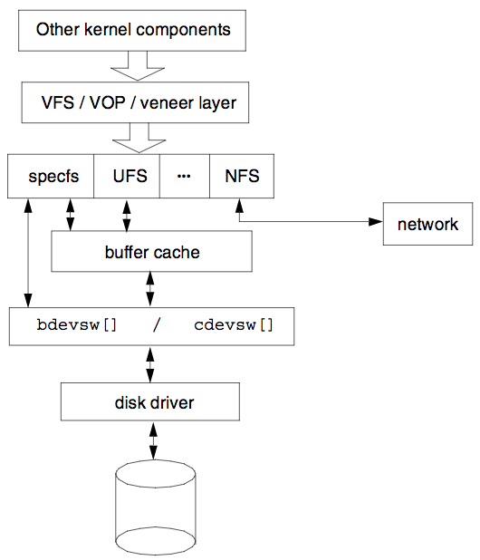
SunOS VFS/vnode
VFS unified UNIX filesystems by split into independent and in-core layers
vnodes are part of VFS and inodes part of the in-core layer
Common layer for kernel components to r/w to the files
vnode contain private data field which was used to store in-core inode
inode->i_private = dm_inode
Notes:
VFS
---
Kleiman, S. (1986). “Vnodes: An Architecture for Multiple File System Types in Sun UNIX” [KLEI86].
Design decisions:
■ The filesystem implementation should be clearly split into a filesystem independent and filesystem-dependent layer. The interface between the two should be well defined.
■ It should support local disk filesystems such as the 4.2BSD Fast File System (FSS), non-UNIX like filesystems such as MS-DOS, stateless filesystems such as NFS, and stateful filesystems such as RFS (Remote file sharing)
■ Filesystem operations across the interface should be atomic such that several operations do not need to be encompassed by locks.
vnode structure contained all that was needed by the filesystem-independent layer while allowing individual filesystems to hold a reference to a private data structure;
in the case of the disk-based filesystems this may be an inode, for NFS, an rnode, and so on.
inode->private = dm_inode
Linux not use vnodes but instead keep them as inodes (inodes are part of VFS layer but names similar to FSS) and in-core inodes have names defined by the filesystem layer.

Slide 8
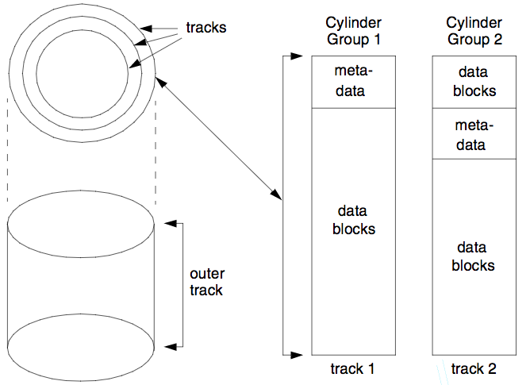
On Disk Layout: UFS
Initial UNIX FS has poor performance
UFS new design concerned the layout of data on disks i.e:
Track contains same amount of data
The old UNIX FS was only able to use 3 to 5 percent of the disk bandwidth while the FFS up to 47 percent of the disk bandwidth*
Notes:
UFS
formerly known as the Berkley Fast File System (FFS)
UFS has been one of the most studied of UNIX filesystems, and has been ported to nearly every flavor of UNIX
Decisions taken for the design of UFS also found their way into other fs including ext2
---
Changes due to poor performance of UNIX FS
Some early work between 3BSD and BSD4.0, which doubled the block size of the old filesystem to 1024 bytes, showed that the performance could be increased by a factor of two.
The increase in block size also reduced the need for indirect data blocks for many files.
One crucial aspect of the new design concerned the layout of data on disks, as shown in Figure.
The new filesystem was divided into a number of cylinder groups that mapped directly to the cylindrical layout of data on disk drives at that time
—note that on early disk drives, each cylinder had the same amount of data whether toward the outside of the platter or the inside.
Each cylinder group contained a copy of the superblock, a fixed number of inodes, bitmaps describing free inodes and data blocks,
a summary table describing data block usage, and the data blocks themselves.
The number of inodes per cylinder group was calculated such that there was one inode created for every 2048 bytes of data.
It was deemed that this should provide far more files than would actually be needed.
Results are not always truly representative of real world situations, and the
FFS can perform badly when fragmentation starts to occur over time. This is
particularly true after the filesystem reaches about 90 percent of the available
space. This is, however, generally true of all different filesystem types.
Finally features that were introduced to the FS with FFS:
Symbolic links.
Prior to their introduction, only hard links were supported in the original UNIX filesystem.
Long file names.
The old filesystem restricted file names to 15 characters. The FFS provided file names of arbitrary length. In the first FFS
implementation, file names were initially restricted to 255 characters.
File locking.
To avoid the problems of using a separate lock file to synchronize
updates to another file, the BSD team implemented an advisory locking scheme. Locks could be shared or exclusive.
File rename.
A single rename() system call was implemented. Previously,
three separate system calls were required which resulted in problems
following a system crash.
Quotas.
The final feature added was that of support for user quotas.
All of these features are taken for granted today an
d are expected to be available on most filesystems on all versions of UNIX.
Later UFS was ported to Solaris and enhanced in additional features
What’s Changed Since the Early UFS Implementation?
For quite some time, disk drives have no longer adhered to fixed-size cylinders, on the basis that more data can be stored on those tracks closer to the edge of the platter than on the inner tracks.
This now makes the concept of a cylinder group somewhat of a misnomer, since the cylinder groups no longer map directly to the cylinders on the disk itself.
Thus, some of the early optimizations that were present in the earlier UFS implementations no longer find use with today’s disk drives and may, in certain circumstances, actually do more harm than good.
However, the locality of reference model employed by UFS still results in inodes and data being placed in close proximity and therefore is still an aid to performance.

Slide 9
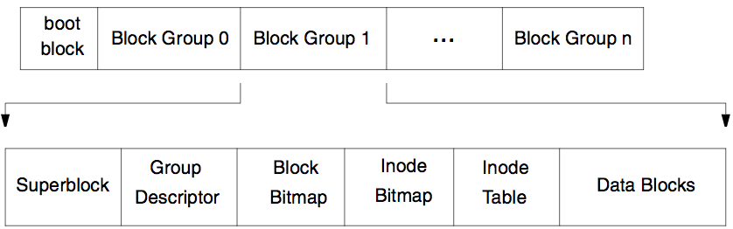
On Disk layout: EXT2
EXT2 divide filesystem to number of block groups
inode allocation done during mkfs
Fixed offset for first Block Group, space for bootloader
Notes:
ext2
----
The layout of structures on disk is shown in Figure <>.
Aside from the boot block, the filesystem is divided into a number of fixed size block groups.
Each block group manages a fixed set of inodes and data blocks and contains a copy of the superblock that is shown as follows.
Note that the first block group starts at an offset of 1024 bytes from the start of the disk slice or volume.
During mkfs ext2 allocate all inodes, which can be costly process for large disks
When writing sequentially to a file, ext2 tries to pre-allocate space in units of 8 contiguous blocks.
Unused pre-allocation is released when the file is closed, so no space is wasted.

Slide 10
Sample implementation dummyfs
Implemented as in kernel module (possible to implement in user space using FuseFS)
Provide basic functionality necessary to mount read write files to the disk
Pseudo modern on disk layout
Good starting point to learn internal/implementing more advanced features
Not using kernel caching mechanisms

Slide 11
Inode structures:
inode has addr_table which describe 3 possible extends
Extends are contiguous space of block described by range Begin-End
Default size of range during allocation

Slide 12
On Disk layout
Simple but not trivial
Inode table and Inode bitmap are ‘files’ which allow them to scale
Blocks addresses are 32 bit integers which define limits

Slide 13
Basic components:
Main implementation of specific components in
dir.c
file.c
inode.c
super.c
Structures inside dummy_fs.h shared by kernel and user space components
Module implementation in dummyfs.c: registration of FS, allocate memory for inodes

Slide 14
In-Core structures
struct dm_inode {
u8 i_version;
u8 i_flags;
u32 i_mode;
u32 i_ino;
u16 i_uid;
u32 i_ctime;
u32 i_mtime;
u32 i_size;
u32 i_addrb[DM_EXT_SIZE];
u32 i_addre[DM_EXT_SIZE];
};
struct dm_superblock {
u32 s_magic;
u32 s_version;
u32 s_blocksize;
u32 inode_table;
u32 inode_cnt;
u32 inode_bitmap;
};
struct dm_dir_entry {
u32 inode_nr;
u8 name_len;
char name[256];
};
Notes:
Support for 255 characters in the directory entries, but waste of time can be mitigated by not using 256 but pseudo entry plus record size

Slide 15
Fragments: Mount
// mount process:
struct file_system_type dummyfs_type = {
.name = "dummyfs",
.mount = dummyfs_mount,
.kill_sb = dummyfs_kill_sb,
.fs_flags = FS_REQUIRES_DEV
};
register_filesystem(&dummyfs_type)
struct dentry *dummyfs_mount(…)
*fs_type, flags, *dev_name, *data
{
mount_bdev(fs_type, flags, dev_name, data, dummyfs_fill_super);
...
static int dummyfs_fill_super(...)
*sb, *data, silent
{
struct dm_superblock *d_sb;
struct buffer_head *bh;
struct inode *root_inode;
struct dm_inode *root_dminode;
bh = sb_bread(sb, DM_SUPER_OFFSET);
d_sb = (struct dm_superblock *)bh->b_data;
bh = sb_bread(sb, DM_ROOT_INODE_OFFSET);
root_dminode = (struct dm_inode *)bh->b_data;
root_inode = new_inode(sb);
...
Notes:
Mount process:
Define and register FS
interesting fields: fs_flags we require device, some in memory FS doesn’t require that
mount, kill_sb for mounting/umounting FS

Slide 16
Fragments: lookup “implement ls”
int dummy_readdir(struct file *filp, struct dir_context *ctx)
... // get from filp underlaying inode
/* For each extends from file */
for (i = 0; i < DM_INODE_TSIZE; ++i) {
u32 blk = di->i_addrb[i], e = di->i_addre[i];
while (blk < e) {
bh = sb_bread(sb, blk);
BUG_ON(!bh);
dir_rec = (struct dm_dir_entry *)(bh->b_data);
for (j = 0; j < sb->s_blocksize; j+=size(*dir_rec)) {
/* skip empty/free inodes */
if (dir_rec->inode_nr == 0xdeeddeed)
skip;
dir_emit(ctx, dir_rec->name,
dir_rec->name_len,
dir_rec->inode_nr,
DT_UNKNOWN);
filp->f_pos += sizeof(*dir_rec);
ctx->pos += sizeof(*dir_rec);
dir_rec++;
}
/* Move to another block */
blk++;
bforget(bh);
}
}
// file ops
const struct file_operations dummy_dir_ops = {
.iterate_shared = dummy_readdir,
};
const struct file_operations dummy_file_ops = {
.read_iter = dummy_read,
.write_iter = dummy_write,
}
// Ops filled during the iget(inode_nr)
// ls from user space will call readdir
// for inode

Slide 17
Fragment read/write
ssize_t dummy_write(struct kiocb *iocb, struct iov_iter *from)
...
//Get VFS and in-core structures from io
inode = iocb->ki_filp->f_path.dentry->d_inode;
sb = inode->i_sb;
dinode = inode->i_private;
dsb = sb->s_fs_info;
// Find the block and offset to write
blk = dm_alloc_ifn(dsb, dinode, off, count);
boff = dm_get_loffset(dinode, off);
bh = sb_bread(sb, blk);
buffer = (char *)bh->b_data + boff;
copy_from_user(buffer, buf, count);
iocb->ki_pos += count;
mark_buffer_dirty(bh);
sync_dirty_buffer(bh);
brelse(bh);
store_dmfs_inode(sb, dinode);
return count;
}
// file ops
const struct file_operations dummy_file_ops = {
.read_iter = dummy_read,
.write_iter = dummy_write,
}
// Ops filled during the iget()
// ls from user space will call readdir
// for inode

Slide 18
User Space tools
mkfs
Initialize the device to be used by FS.
Write initial FS state
fsdb
Development tool reading structures from raw device
Understand on disk structure
fsck
Try to recover inconsistent state of FS (due to crash/corruption).

Slide 19
Fragment mkfs
int write_root_inode (int fd) {
// construct root inode
struct dm_inode root_inode = {
.i_version = 1,
.i_flags = 0,
.i_mode = S_IFDIR | S_IRWXU | S_IROTH | S_IXOTH,
.i_uid = 0,
.i_ctime = dm_ctime,
.i_mtime = dm_ctime,
.i_size = 0,
.i_ino = DM_ROOT_INO,
.i_addrb = {DM_ROOT_INODE_OFFSET + 1, 0, 0},
.i_addre = {DM_ROOT_INODE_OFFSET + DM_EXALLOC+1, 0, 0},
};
lseek(fd, DM_ROOT_OFFSET * DM_BSIZE, SEEK_SET);
write(fd, &root_inode, sizeof(root_inode)));
// write root to the inode table as a first entry
lseek(fd, (DM_ITABLE_OFFSET + 1) * DM_BSIZE, SEEK_SET);
write(fd, &blk, sizeof(uint32_t))
// Write initial FS state to the device
// arg is targ device: /dev/sdb or lv /dev/sdb1
fd = open(argv[1], O_RDWR);
if (fd == -1) {
perror("Error: cannot open the device!\n");
return -1;
}
// wipe out device before writing wipe_out_device(fd, 1));
// Write actual on disk structure
write_superblock(fd));
write_metadata(fd);
write_inode_table(fd);
write_root_inode(fd);
write_lostfound_inode(fd);
//write entries to inode table
write_root2itable(fd);
write_laf2itable(fd);

Slide 20
Other resources:
J.Lions: "A commentary on the sixth edition UNIX Operating System”
V6 sources: https://minnie.tuhs.org/cgi-bin/utree.pl
S.R. Kleiman (86): “Vnodes: An Architecture for Multiple File System Types in Sun UNIX”
McKusick (84): “A Fast File System for UNIX.”
Steve D. Pate: "UNIX Filesystems: Evolution, Design and Implementation”
github.com/gotoco/dummyfs

Slide 21
Q&A

