Slide 1
A Lecture
Dave Luk, Yours Truly.

Slide 2
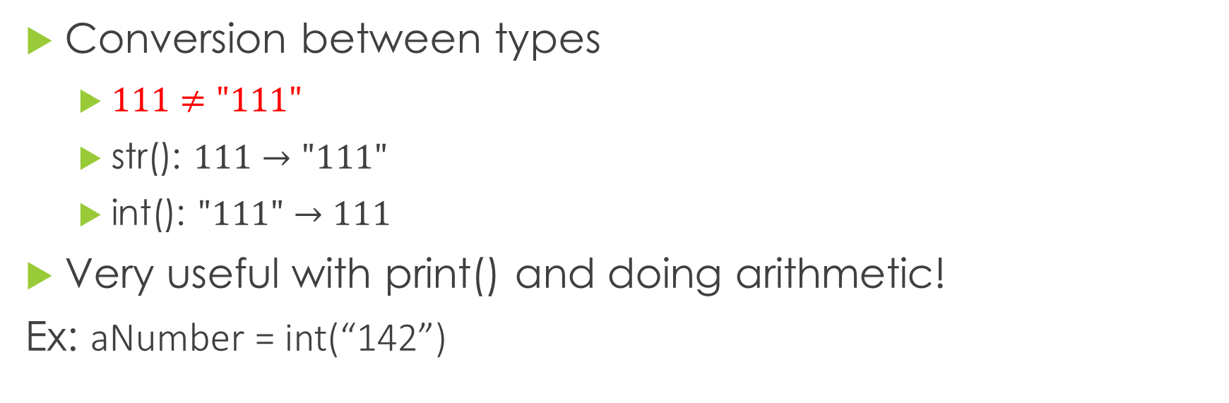
Type Casting – Syntax
Conversion between types
$111≠\text{"111}"$
str(): $111→"111"$
int(): $"\text{111"}→111$
Very useful with print() and doing arithmetic!
Ex: aNumber = int(“142”)
Notes:
Mention further references can be found on handout

Slide 3
List – Creation
A List is a structure to store an ordered arrangement of things
Ex: groceries-List = [“Milk”, “Eggs”, “Cat food”]
Empty Lists can also be created
Ex: thingsDaveGiveADamnAbout = []
Notes:
Remember to mention the importance of a initialized sizes.

Slide 4
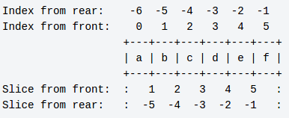
List – Access
To get to a specific element in the list, we will need an index
Indices starts from 0 as the first element and count onwards
Ex: yoloFirst = youtubeComments[0]

Slide 5
List – Assignment & Modification
Assign or modify elements are just like variables!
Ex: list[0] = “first element”
list[0] = “changed element”
Method to add extra space and value to end of list:
Ex: list.append(“a new element”)

Slide 6
String – Creation
A String is an arrangement of symbols/characters.
Ex: ‘this is a string’
“This also works”
’’’This also works…’’’
“”” I just like MOooooOOOoOooooooOoOAR
space”””

Slide 7
String – Operators
2 Strings can be joined together using +
Ex: aMotivationalSpeech = “You meme” + “ a lot to me”
Strings can be repeated using *
Ex: catDaveChant = “cats!” * 3

Slide 8
String – Formatting
format() method is a powerful tool to create complex strings with variables.
Ex: adele = “Hello {}”
print(adele.format(“from the Otter slide”))
print(adele.format(“, it’s meme”))

Slide 9
For Loop – Syntax
A control structure that iterates over a sequence of numbers
Ex: for x in range(1,5):
print(“Rule {} of fight club: don’t talk about fight club”.format(x) + “again” * (x-1))

