Slide 1
@odinthenerd – not the god

Slide 2
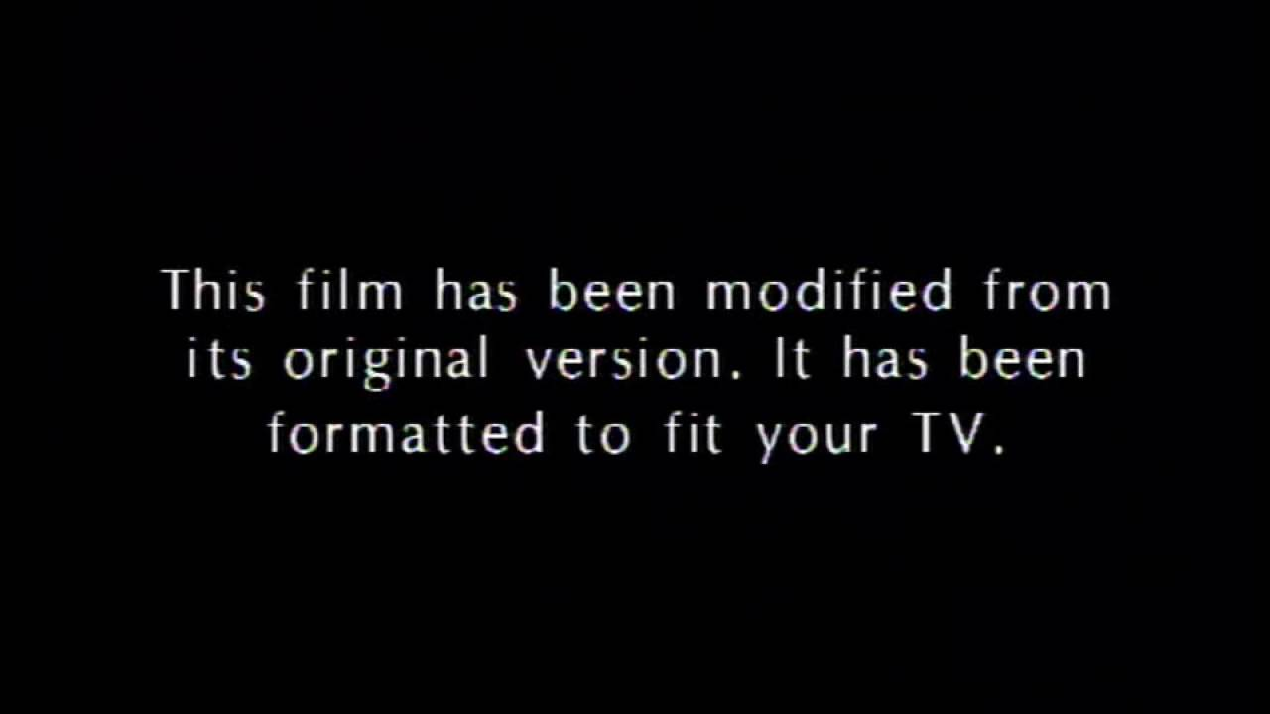

Slide 3
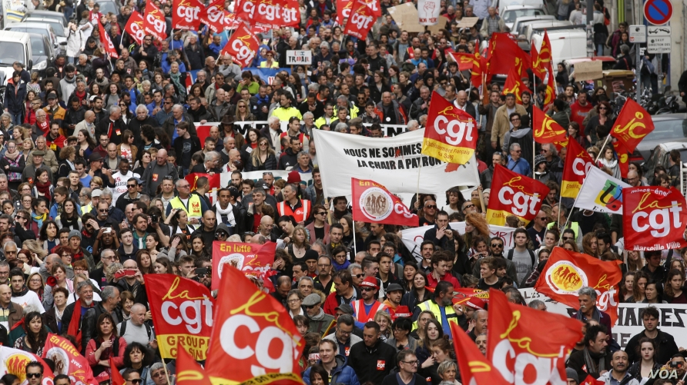

Slide 4

Tacit DSL all the things

Slide 5
狗 貓 all the things

Slide 6
DSL
Domain
Specific
Language

Slide 7
DSL
Domain
Specific
Language
printf

Slide 8
DSL
Domain
Specific
Language
printf
iostreams

Slide 9
DSL
Domain
Specific
Language
printf
iostreams
regex

Slide 10
DSL
Domain
Specific
Language
printf
iostreams
regex
ranges TS

Slide 11
Ranges
std::vector<thing> v; for (const auto& e : v | rv::reverse
| rv::transform(awesomeify) | rv::filter(is_awesome)) { //do something with e };

Slide 12
Is this good?

Slide 13
„Conventional programming languages are growing ever more enormous, but not stronger.
Is this good?

Slide 14
„Conventional programming languages are growing ever more enormous, but not stronger.
Inherent defects at the most basic level cause them to be both fat and weak:
Is this good?

Slide 15
„Conventional programming languages are growing ever more enormous, but not stronger.
Inherent defects at the most basic level cause them to be both fat and weak:
their primitive word-at-a-time style of programming inherited from their common ancestor --the von Neumann computer, […] and their lack of useful mathematical properties for reasoning about programs.“
Is this good?

Slide 16
„Conventional programming languages are growing ever more enormous, but not stronger.
Inherent defects at the most basic level cause them to be both fat and weak:
their primitive word-at-a-time style of programming inherited from their common ancestor --the von Neumann computer, […] and their lack of useful mathematical properties for reasoning about programs.“
Is this good?
Can Programming Be
Liberated from the
von Neumann Style?
A Functional Style and
Its Algebra of Programs
-- John Backus 1978
Notes:
Steppanov

Slide 17
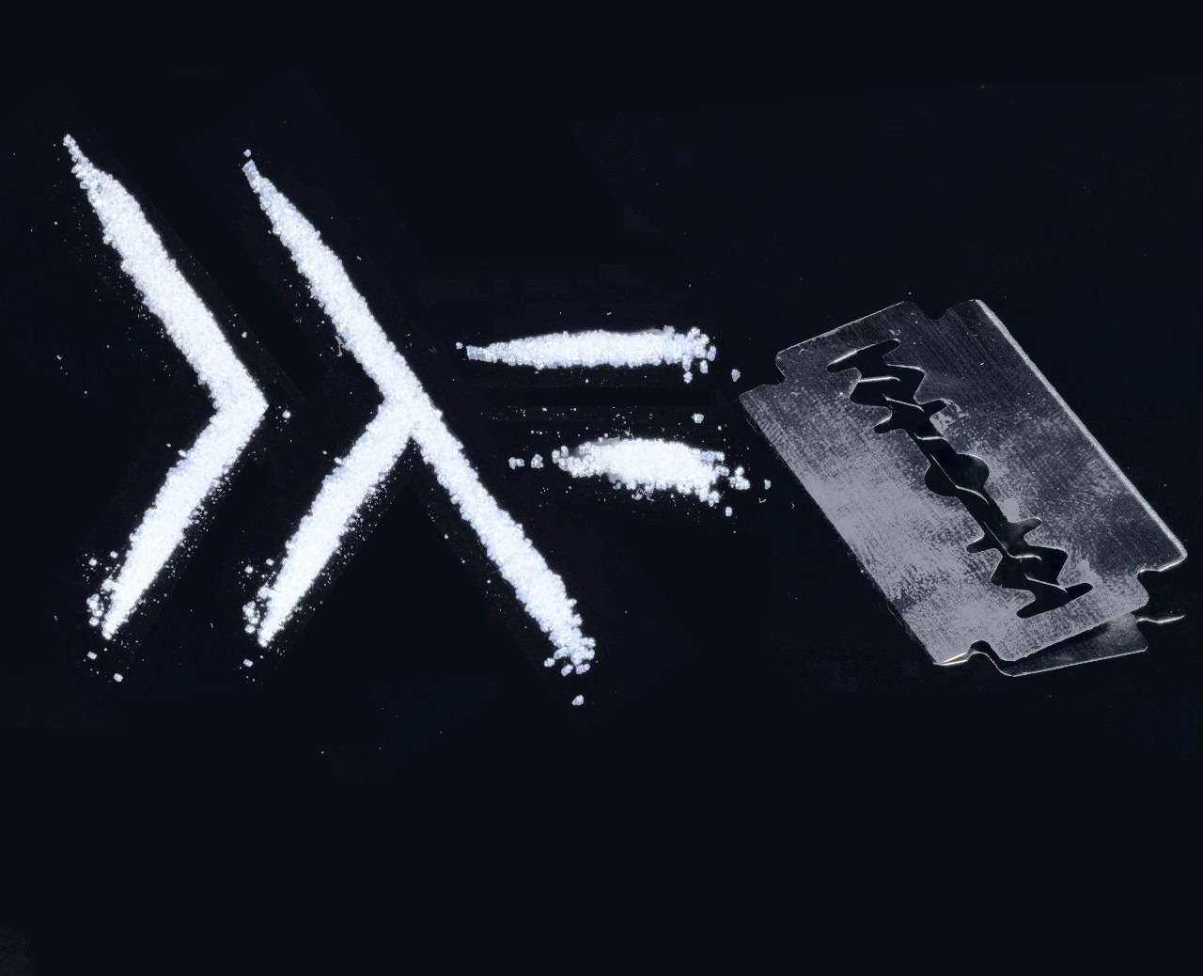

Slide 18
BASH
ls | head -3

Slide 19
BASH
ls | head -3
ls | head -3 | tail -1

Slide 20
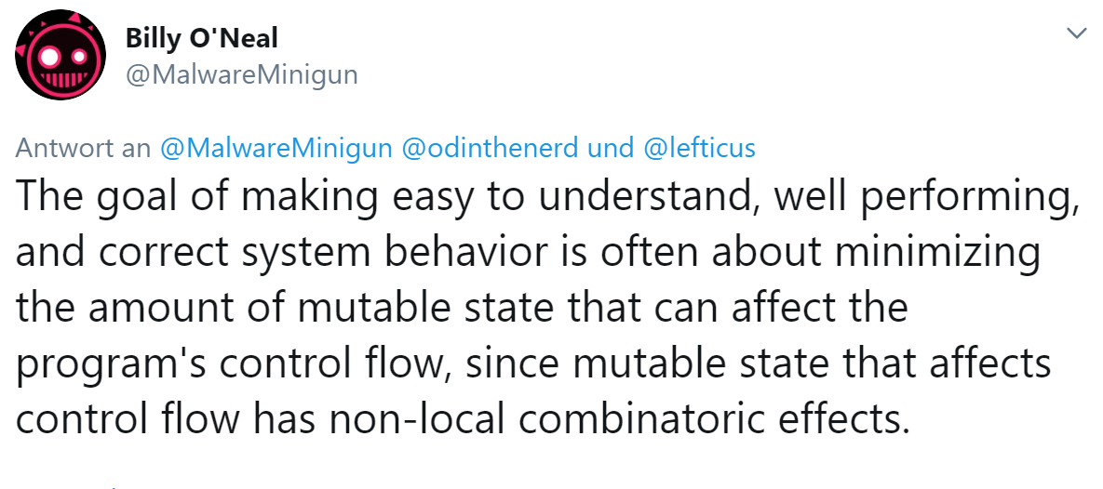

Slide 21
“what to do” parameters
void foo(bar& a, baz& b, bool c){
//calculate the world
if(c){
//do things
}
else{
//do other things
}
}

Slide 22
void foo(bar& a, baz* b){
//calculate the world
if(b){
//do things
}
else{
//do other things
}
}

Slide 23
void foo1(bar& a, baz& b){
//calculate the world
//do things
}
void foo2(bar& a){
//calculate the world
//do other things
}

Slide 24
?? calculate_the_world(bar& a){
//calculate the world
}
void foo1(bar& a, baz& b){
calculate_the_world(a);
//do things
}
void foo2(bar& a){
calculate_the_world(a);
//do other things
}

Slide 25
?? calculate_the_world(bar& a){
//calculate the world
}
void foo1(bar& a, baz& b){
calculate_the_world(a);
//do things
}
void foo2(bar& a){
calculate_the_world(a);
//do other things
}

Slide 26
?? calculate_the_world(bar& a){
//calculate the world
}
void foo1(bar& a, baz& b){
auto [??] = calculate_the_world(a);
//do things
}
void foo2(bar& a){
auto [??] = calculate_the_world(a);
//do other things
}

Slide 27
Problem of local variables
void foo(bar& a, baz& b, bool c){
//calculate the world
if(c){
//do things
}
else{
//do other things
}
}

Slide 28
Functional solution
void calculate_the_world(std::function<??> f, bar& a){
//calculate the world
f(??);
}

Slide 29
void calculate_the_world(std::function<??> f, bar& a){
//calculate the world
f(??);
}
struct do_things{
baz& b;
void operator(??, bar& a){
//do things
}
}
void do_other_things(??, bar& a){
//do other things
}

Slide 30
Single parameter solution
void do_things(int i, baz& b){
//do things
}
void do_other_things(int i){
//do other things
}
do_things(calculate_the_world(a),b);
do_other_things(calculate_the_world(a));

Slide 31
Can ranges help?

Slide 32
Can ranges help?
No

Slide 33
Can ranges help?
No
But the DSL can

Slide 34
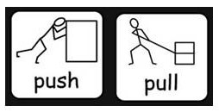
Pull vs. push model

Slide 35
Incidental Push Model
void a(thing b){ //logic b -> c,d f(c,d); }

Slide 36
Incedental Push Model
void a(thing b){ //logic b -> c,d if(c){ f(d); } else { g(d); } }

Slide 37
Incedental Push Model
State Machine Here
void a(thing b){ //logic b -> c,d if(c){ f(d); } else { g(d); } }

Slide 38
Composing functions
input | fun | gun | hun
{1, 2} -> fun

Slide 39
Composing functions
input | fun | gun | hun
{1, 2} -> fun -> 3 -> gun

Slide 40
Composing functions
input | fun | gun | hun
{1, 2} -> fun -> 3 -> gun -> 6 -> hun -> void

Slide 41
Composing functions
input | fun | gun | hun
{1, 2} -> fun -> 3 -> gun -> 6 -> hun -> void
1 -> fun -> {1, 2, 5}

Slide 42
Composing functions
input | fun | gun | hun
{1, 2} -> fun -> 3 -> gun -> 6 -> hun -> void
1 -> fun -> {1, 2, 5} -> gun -> 9 -> hun -> void

Slide 43
Heterogeneous algorithms
auto animals = hana::make_tuple(
Fish{"Nemo"},
Cat{"Garfield"},
Dog{"Snoopy"});

Slide 44
Heterogeneous algorithms
auto animals = hana::make_tuple(
Fish{"Nemo"},
Cat{"Garfield"},
Dog{"Snoopy"}); auto get_name = [](auto& a) { return a.name; };

Slide 45
Heterogeneous algorithms
auto animals = hana::make_tuple(
Fish{"Nemo"},
Cat{"Garfield"},
Dog{"Snoopy"}); auto get_name = [](auto& a) { return a.name; }; auto names =
hana::transform(animals, get_name) ;

Slide 46
Heterogeneous algorithms
auto animals = hana::make_tuple(
Fish{"Nemo"},
Cat{"Garfield"},
Dog{"Snoopy"}); auto get_name = [](auto& a) { return a.name; }; auto rnames = hana::reverse(
hana::transform(animals, get_name));

Slide 47
Heterogeneous algorithms
auto rnames = animals |
tmp::transform(get_name) |
tmp::reverse;
auto rnames = hana::reverse(
hana::transform(animals, get_name));

Slide 48
pack
- product type
- “language level tuple”-ish
- means of passing heterogeneous containers

Slide 49
Tacit solution
calculate_the_world(a) | do_other_things;

Slide 50
Tacit solution
calculate_the_world(a) | push_front(b) | do_things;
calculate_the_world(a) | do_other_things;

Slide 51
unwrapping
std::tuple<int,bool> t;

Slide 52
unwrapping
std::tuple<int,bool> t; t | foo;

Slide 53
unwrapping
std::tuple<int,bool> t; t >>= foo;

Slide 54
unwrapping
std::tuple<int,bool> t; t >>= foo; std::apply(foo,t);

Slide 55
unwrapping
std::tuple<int,bool> t;
t foo(A,B,C); pack(a...) >>= foo | bar;

Slide 56
unwrapping
std::tuple<int,bool> t;
t foo(A,B,C); pack(a...) >>= foo >>= bar;

Slide 57
Heterogeneous algorithms
auto rnames = animals >>=
tmp::transform(get_name) |
tmp::reverse;
//dsl reduces compile time
auto rnames = hana::reverse(
hana::transform(animals, get_name));

Slide 58
optional
auto u = [](std::optional<horse> o){ return o >>= add_magic; }

Slide 59
optional
auto u = [](std::optional<horse> o){ return o >>= add_magic | add_horn; }

Slide 60
optional
auto u = [](std::optional<horse> o){ return o >>= add_magic >>= add_horn; }

Slide 61
noise
auto u = [](std::optional<horse> o){ return o >>= add_magic >>= add_horn; }

Slide 62
signal
auto u = [](std::optional<horse> o){ return o >>= add_magic >>= add_horn; }

Slide 63
noise
auto u = [](std::optional<horse> o){ return o >>= add_magic >>= add_horn; } auto u = identity >>= add_magic >>= add_horn;

Slide 64
Terser lambda syntax
auto u = [](std::optional<horse> o){ return o >>= add_magic >>= add_horn; } auto u = ~add_magic >>= add_horn;

Slide 65
optional
auto u = [](std::optional<horse> o){ return o >>= add_magic >>= add_horn; } auto u = ~add_magic >>= add_horn;
u(foo);

Slide 66
boost.parameter2
constexpr auto scale_image = tee(get_image,get_width,get_height) | [](Image img, Width w, Height h)->Image { // do the things }

Slide 67
boost.parameter2
constexpr auto scale_image = tee(get_image,get_width,get_height) | [](Image img, Width w, Height h)->Image { // do the things }

Slide 68
boost.parameter2
auto scale_image
(Image img, Width w, Height h)->Image { // do the things }

Slide 69
Simons cat
std::optional<image_view> get_cute_cat (image_view img) { auto cropped = find_cat(img); if (!cropped) { return std::nullopt; } auto with_tie = add_bow_tie(*cropped); if (!with_tie) { return std::nullopt; } auto with_sparkles = make_eyes_sparkle(*with_tie); if (!with_sparkles) { return std::nullopt; } return add_rainbow(make_smaller(*with_sparkles)); }

Slide 70
Simons cat
tl::optional<image_view> get_cute_cat (image_view img) { return crop_to_cat(img) .and_then(add_bow_tie) .and_then(make_eyes_sparkle) .map(make_smaller) .map(add_rainbow); }

Slide 71
Simons cat
auto cuteify_cat = crop_to_cat >>= add_bow_tie >>= make_eyes_sparkle >>= make_smaller | add_rainbow;

Slide 72
Unwrap a variant?
my_variant >>= foo;

Slide 73
visit
my_variant >>= foo; std::visit(foo,my_variant);

Slide 74
Visit a pointer?
void f(int* bar){
bar >>= baz; }

Slide 75
sum_type
- lightweight variant
- has an explicit nothing state

Slide 76
Composable visitors
v >>= partition(pred, foo, bar);

Slide 77
Composable visitors
v >>= partition(pred, foo, bar);
v >>= subset<T,U> | bar;

Slide 78
visit
queue.pop() >>= first_match( case_(int) => foo, case_(char) => use_(a,_1,s) | bar );

Slide 79
visit
queue.pop() >>= first_match(
thing1.dispatch,
thing2.dispatch,
thing3.dispatch)

Slide 80
state machine
variant<S1,S2,S3> sm;

Slide 81
state machine
variant<S1,S2,S3> sm;
auto transition(S1&,E1&&)->S2;

Slide 82
state machine
variant<S1,S2,S3> sm;
auto transition(S1&,E1&&)->S2; auto transition(S1&,E2&&)->S3;
constexpr auto process_ev = use(~_2, _1) |
transition >>= assign_to(sm);
process_ev(e,sm);

Slide 83
state machine
variant<S1,S2,S3> sm;
auto transition(S1&,E1&&)->S2; auto transition(S1&,E2&&)->S3; auto transition(S2&,E1&&)->nothing;
constexpr auto process_ev = use(~_2, _1) |
transition >>= assign_to(sm);
process_ev(e,sm);

Slide 84
state machine
variant<S1,S2,S3> sm;
auto transition(S1&,E1&&)->S2; auto transition(S1&,E2&&)->S3; auto transition(S2&,E1&&)->nothing; auto transition(S2&,E2&&)->fragment<S1,nothing>;
constexpr auto process_ev = use(~_2, _1) |
transition >>= assign_to(sm);
process_ev(e,sm);

Slide 85
state machine
variant<S1,S2,S3> sm;
auto transition(S1&,E1&&)->S2; auto transition(S1&,E2&&)->S3; auto transition(S2&,E1&&)->nothing; auto transition(S2&,E2&&)->fragment<S1,nothing>;
auto transition(S3&,E1&&)->nothing; auto transition(S3&,E2&&)->fragment<S3,S1,nothing>; constexpr auto process_ev = use(~_2, _1) |
transition >>= assign_to(sm);
process_ev(e,sm);

Slide 86
state machine
variant<S1,S2,S3> sm;
auto transition(S1&,E1&&)->S2; auto transition(S1&,E2&&)->S3; auto transition(S2&,E1&&)->nothing; auto transition(S2&,E2&&)->fragment<S1,nothing>;
auto transition(S3&,E1&&)->nothing; auto transition(S3&,E2&&)->fragment<S3,S1,nothing>; constexpr auto process_ev = use(~_2, _1) |
transition >>= assign_to(sm);
process_ev(e,sm);

Slide 87
a more powerful state machine
//call with event, sm, visitor constexpr auto process_ev =
use(~_2, _1,
_2 | tap<"sm">,
_3 | tap<"visiter">) | tap<"visiter"> >>=
assign_to(tap<"sm">);

Slide 88
a more powerful state machine
//call with event, sm, visitor constexpr auto process_ev =
use(~_2, _1,
_2 | tap<"sm">,
_3 | tap<"visiter">) | tap<"visiter"> >>=
assign_to(tap<"sm">);

Slide 89
a more powerful state machine
//call with event, sm, visitor constexpr auto process_ev =
use(~_2, _1,
_2 | tap<"sm">,
_3 | tap<"visiter">) | tap<"visiter"> >>=
assign_to(tap<"sm">);

Slide 90
Sub machine
auto transition(S2&s,E2 e)->one_of<S1,nothing>{ return process_ev(e,s,v); }

Slide 91
a more powerful state machine
//call with event, sm, visitor constexpr auto process_ev =
use(~_2, _1,
_2 | tap<"sm">,
_3 | tap<"visiter">) | tap<"visiter"> >>= partition(
tap<"sm">.is_alternative,
assign_to(tap<"sm">),identity);

Slide 92
Encapsulated sub-machine
template<typename T, typename U>
class reader_sm : sm_stuff<reader_sm>{ variant<A,B,C> _sm; auto operator(A&s,E1&&e)->B; auto operator(A&s,E2&&e)->fragment<A,T,U>; friend class sm_stuff<reader_sm>;
}

Slide 93
auto my_uart = mixin( /...*/, mqtt(my_json) | my_queue ); auto handle_event = first_match(
pwm.dispatch,
switches.dispatch); run(handle_event,my_uart,pwm,switches)

Slide 94
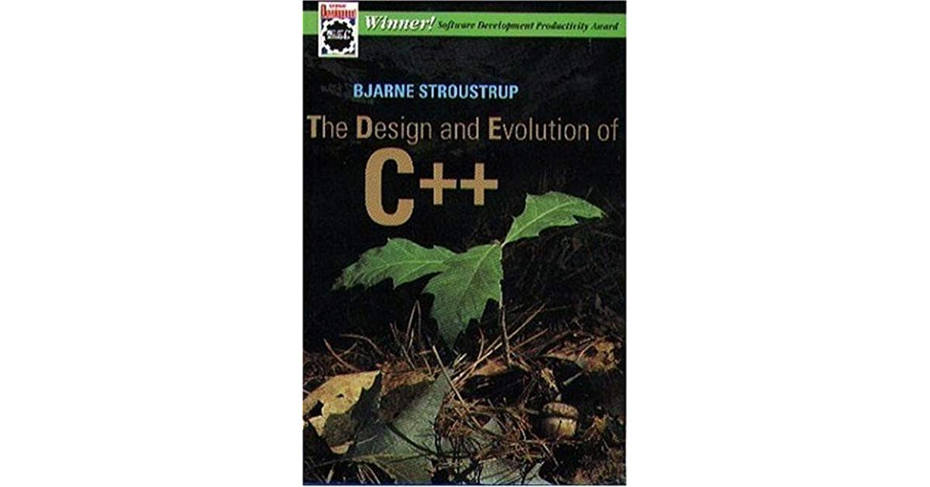

Slide 95
@odinthenerd
Github.com
Twitter.com
Gmail.com
Blogspot.com
LinkedIn.com
Embo.io

