Slide 1
IMAGEBIND: One Embedding Space To Bind Them All
June 25th, 2023
발표자: 김병현
이미지처리팀: 류채은, 안종식, 조경진, 최승준

Slide 2
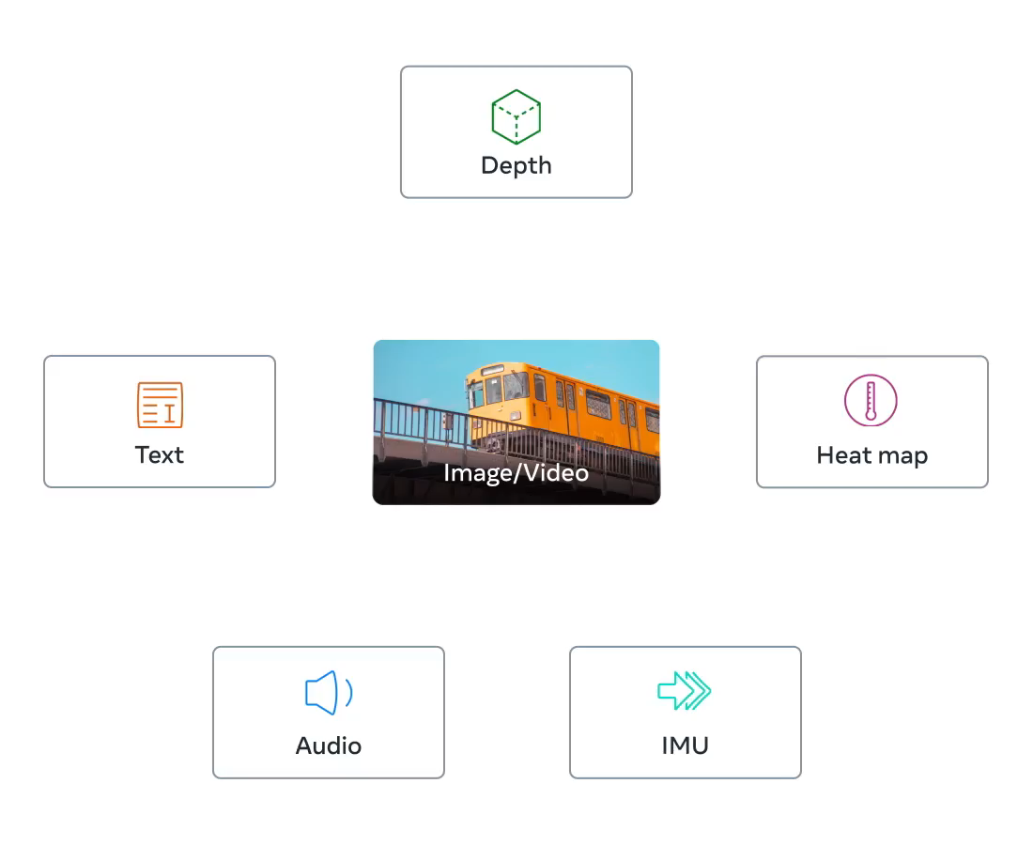
ImageBind
The first AI model capable of binding data from six modalities at once, without the need for explicit supervision.

Slide 3
Power of Image
A single image can bind together many experiences – an image of a beach can remind us of the sound of waves, the texture of the sand, a breeze, or even inspire a poem. This ‘binding’ property of images offers many sources of supervision to learn visual features, by aligning them with any of the sensory experiences associated with images. Ideally, for a single joint embedding space, visual features should be learned by aligning to all of these sensors. However, this requires acquiring all types and combinations of paired data with the same set of images, which is infeasible.

Slide 4
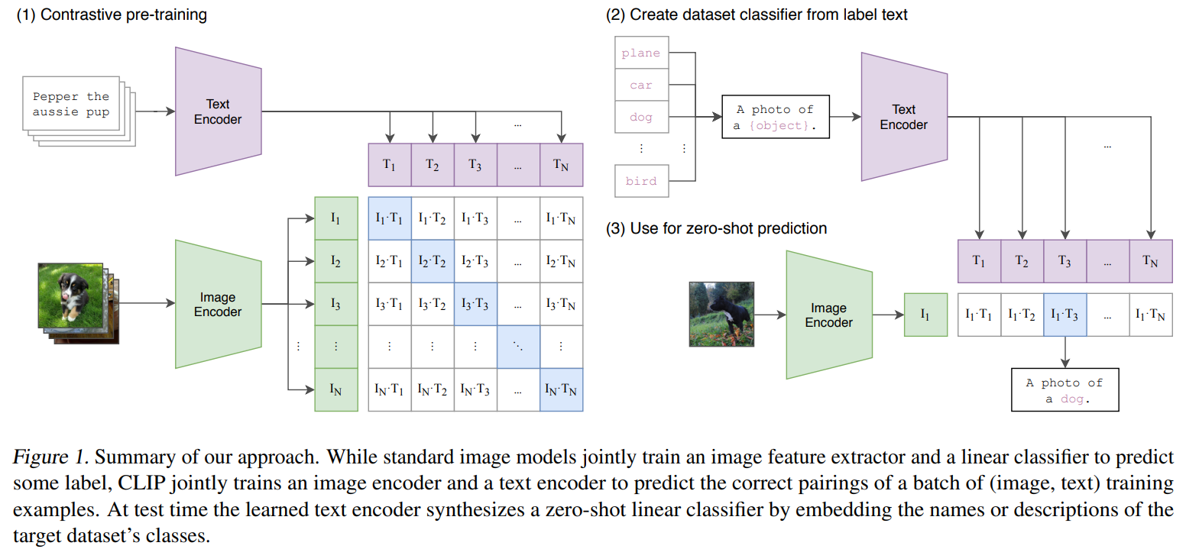
Related Works
Language Image Pre-training
Learning Transferable Visual Models From Natural Language Supervision (CLIP)
Radford, A., Kim, J. W., Hallacy, C., Ramesh, A., Goh, G., Agarwal, S., ... & Sutskever, I. (2021, July). Learning transferable visual models from natural language supervision. In International conference on machine learning (pp. 8748-8763). PMLR.

Slide 5
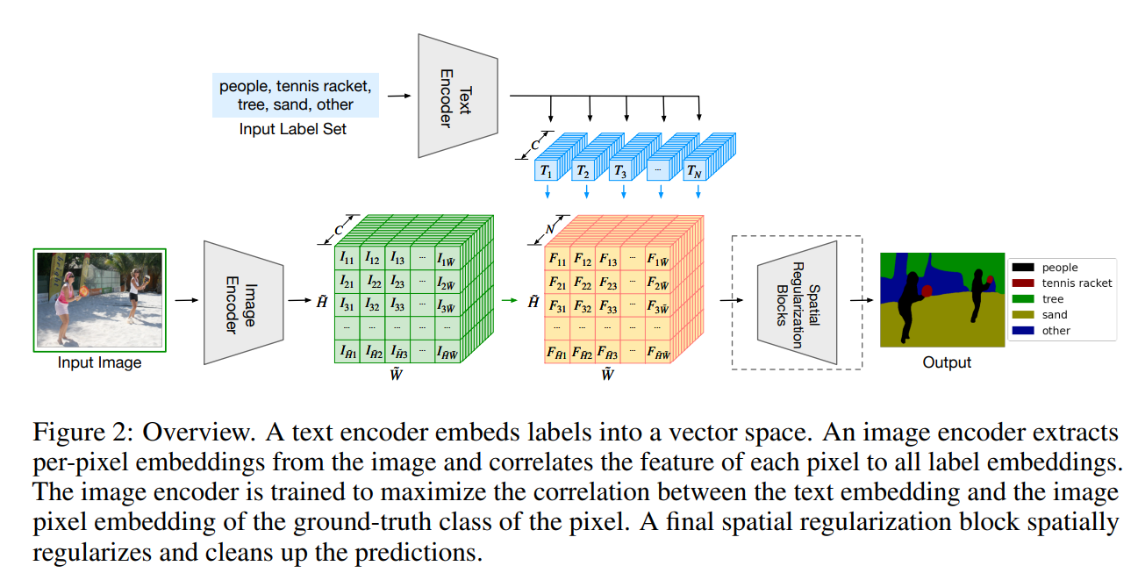
Related Works
Feature Alignment
Language-driven Semantic Segmentation
Li, B., Weinberger, K. Q., Belongie, S., Koltun, V., & Ranftl, R. (2022). Language-driven Semantic Segmentation. arXiv e-prints, arXiv-2201.

Slide 6
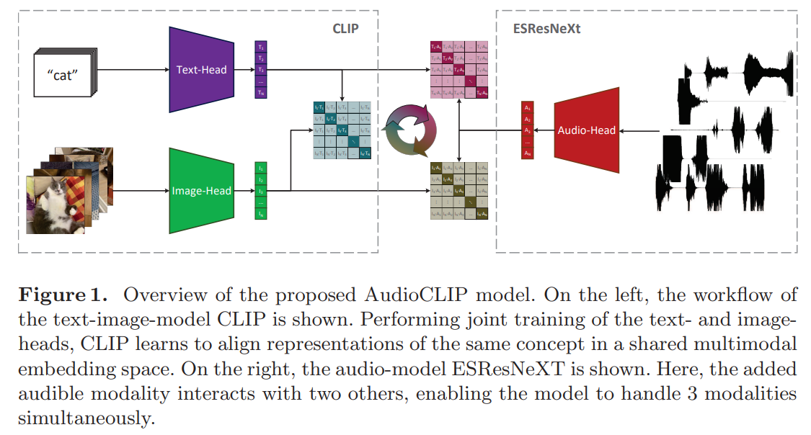
Related Works
Multi-Modal Learning
AudioCLIP
Guzhov, A., Raue, F., Hees, J., & Dengel, A. (2022, May). Audioclip: Extending clip to image, text and audio. In ICASSP 2022-2022 IEEE International Conference on Acoustics, Speech and Signal Processing (ICASSP) (pp. 976-980). IEEE.

Slide 7
Limitations of Previous Works
Recently, many methods learn image features aligned with text, audio etc. These methods use a single pair of modalities or, at best, a few visual modalities. However, the final embeddings are limited to the pairs of modalities used for training. Thus, video-audio embeddings cannot directly be used for image-text tasks and vice versa. A major obstacle in learning a true joint embedding is the absence of large quantities of multimodal data where all modalities are present together.

Slide 8
Contribution of this paper
We use large-scale image-text paired data along with naturally paired ‘self-supervised’ data across four new modalities - audio, depth, thermal, and Inertial Measurement Unit (IMU) readings – and show strong emergent zero-shot classification and retrieval performance on tasks for each of these modalities. These emergent properties improve as the underlying image representation is made stronger. On audio classification and retrieval benchmarks, IMAGEBIND’s emergent zero-shot classification matches or outperforms specialist models trained with direct audio-text supervision on benchmarks like ESC, Clotho, AudioCaps. IMAGEBIND representations also outperform specialist supervised models on few-shot evaluation benchmarks. Finally, we show that IMAGEBIND’s joint embeddings can be used for a wide variety of compositional tasks as illustrated in Figure 1, including cross-modal retrieval, combining embeddings via arithmetic, detecting audio sources in images, and generating images given audio input.

Slide 9
Q&A
Q & A

Slide 10
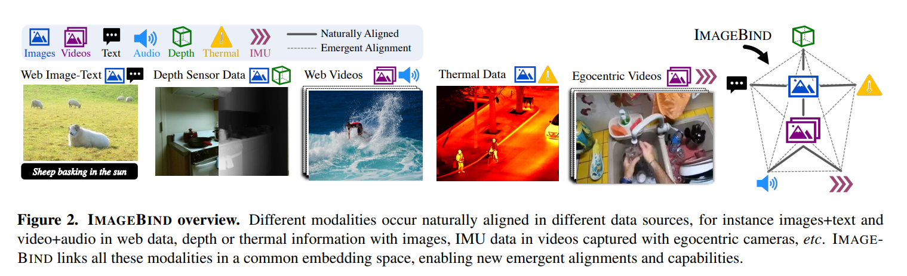
Method

Slide 11
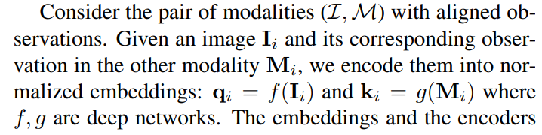
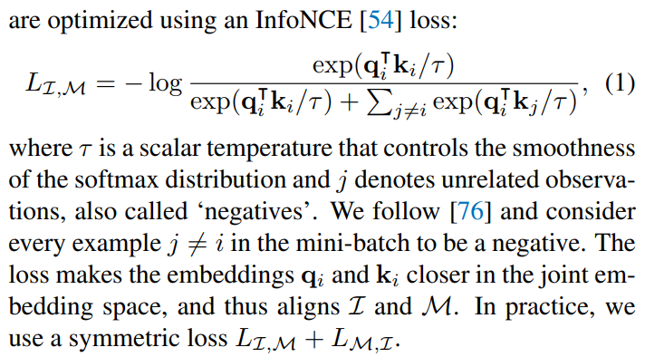
Binding Modalities with Images

Slide 12
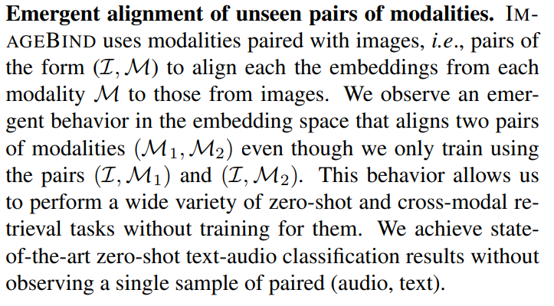
Binding Modalities with Images

Slide 13
Implementation Details
We use a Transformer architecture for all the modality encoders. We use 1) the Vision Transformer (ViT) for images. Following, we use the 2) same encoder for images and videos. We temporally inflate the patch projection layer of the ViT and use 2 frame video clips sampled from 2 seconds. We follow for 3) encoding audio and convert a 2 second audio sampled at 16kHz into spectrograms using 128 mel-spectrogram bins. As the spectrogram is also a 2D signal like an image, we use a ViT with a patch size of 16 and stride 10. We treat 4) thermal images and 5) depth images as one-channel images and also use a ViT to encode them. We follow to convert depth into disparity maps for scale invariance. We extract the 6) IMU signal consisting of accelerometer and gyroscope measurements across the X, Y , and Z axes. We use 5 second clips resulting in 2K time step IMU readings which are projected using a 1D convolution with a kernel size of 8. The resulting sequence is encoded using a Transformer. Finally, we follow the 7) text encoder design from CLIP.

Slide 14
Q&A
Q & A

Slide 15
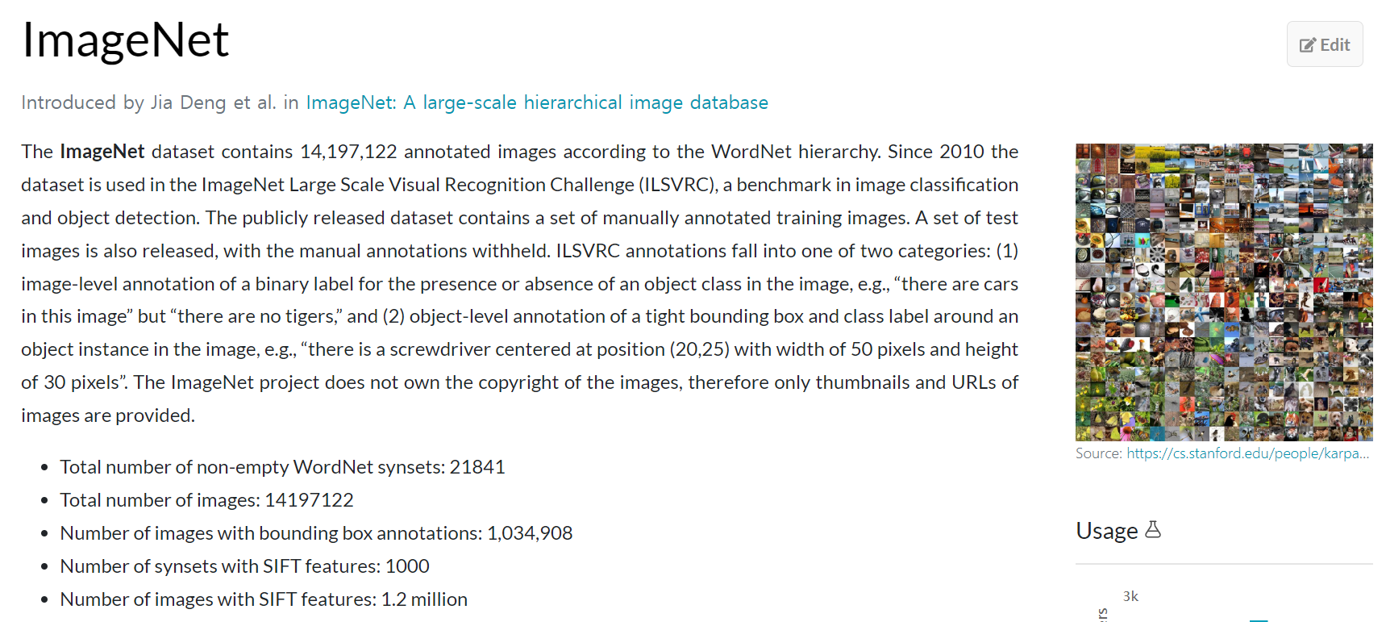
Image Classification Datasets
ImageNet (IN1K)

Slide 16
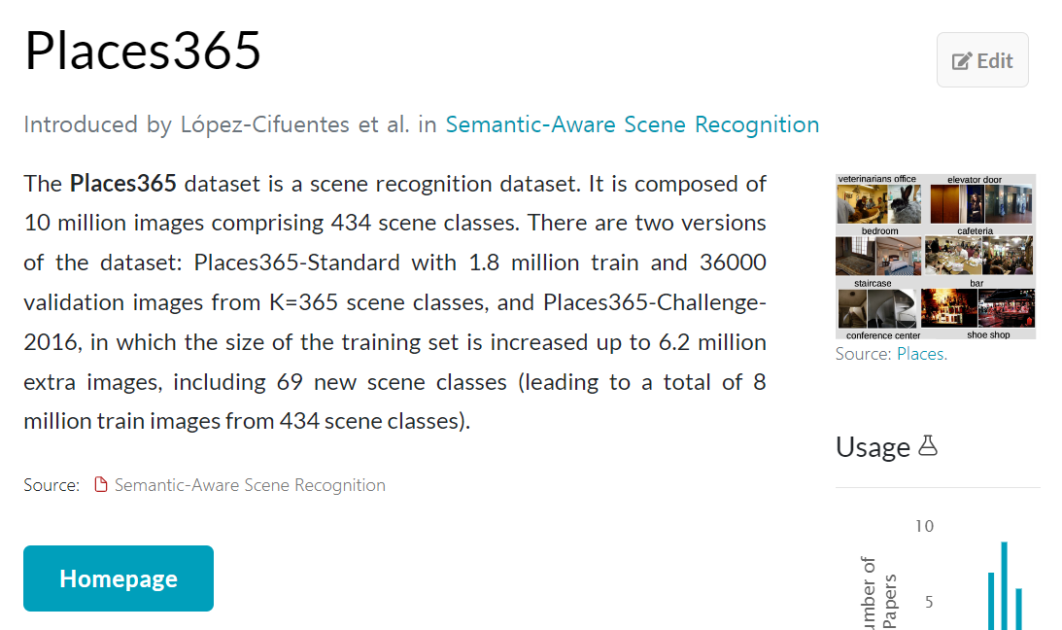
Image Classification Datasets
Places365 (P365)

Slide 17
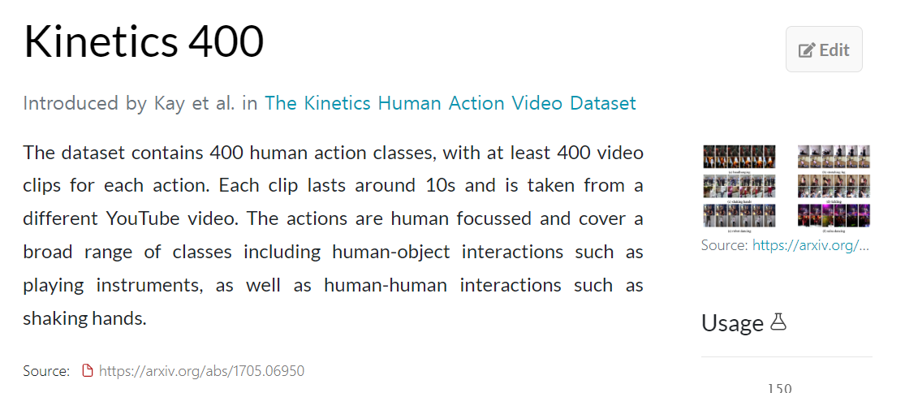
Video Datasets
Kinetics 400 (K400)

Slide 18
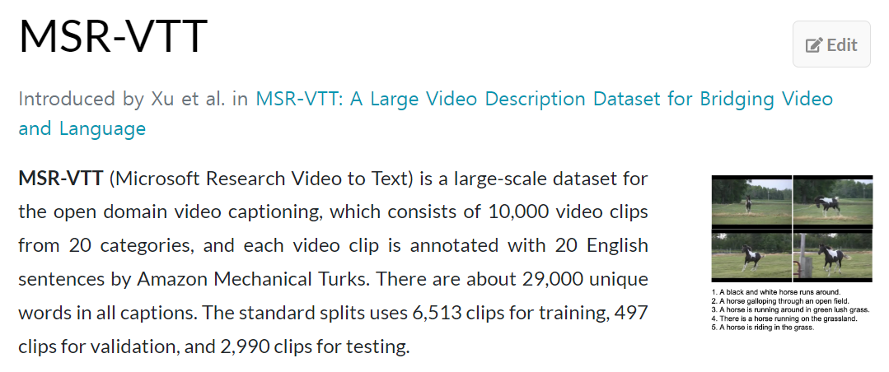
Video Datasets
MSR-VTT

Slide 19
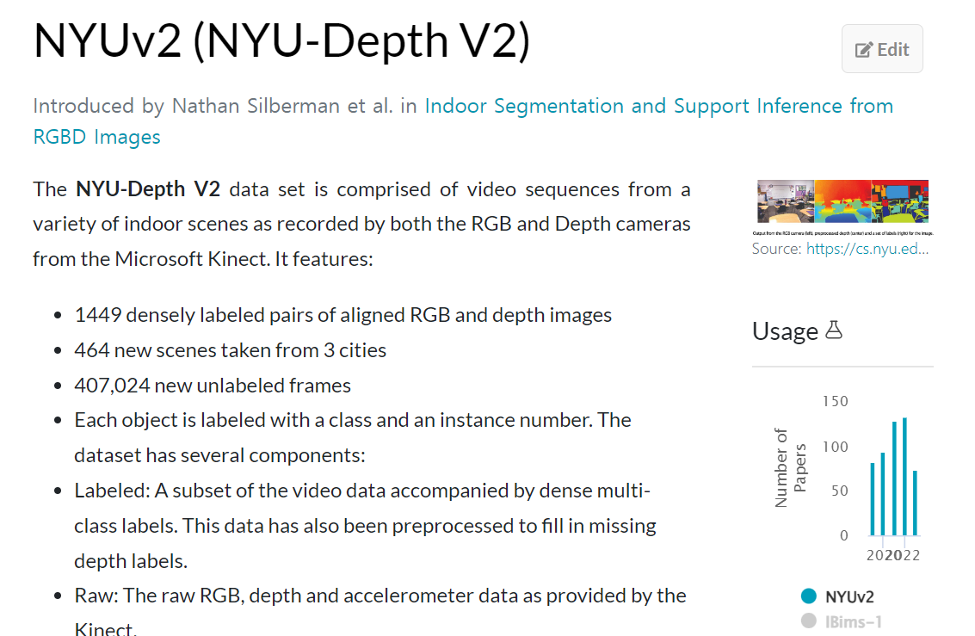
Depth Datasets
NYUv2-Depth Only (NYU-D)

Slide 20
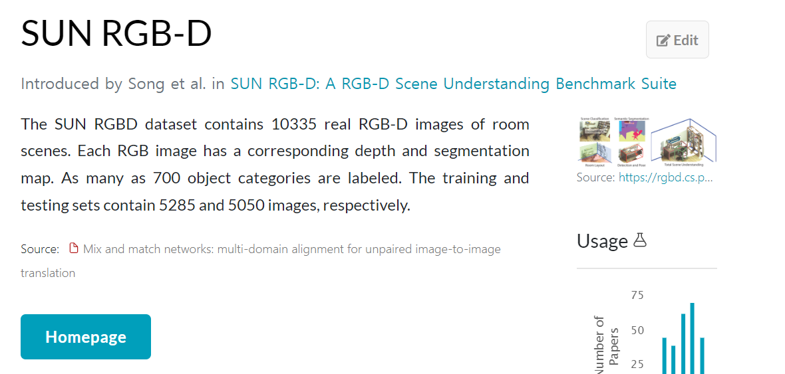
Depth Datasets
SUN-Only Depth (SUN-D)

Slide 21
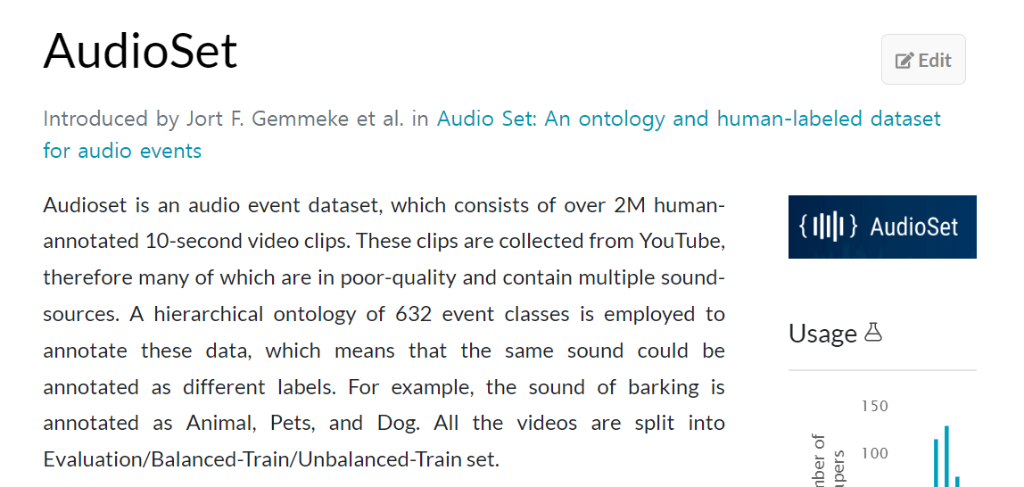
Audio Datasets
AudioSet

Slide 22
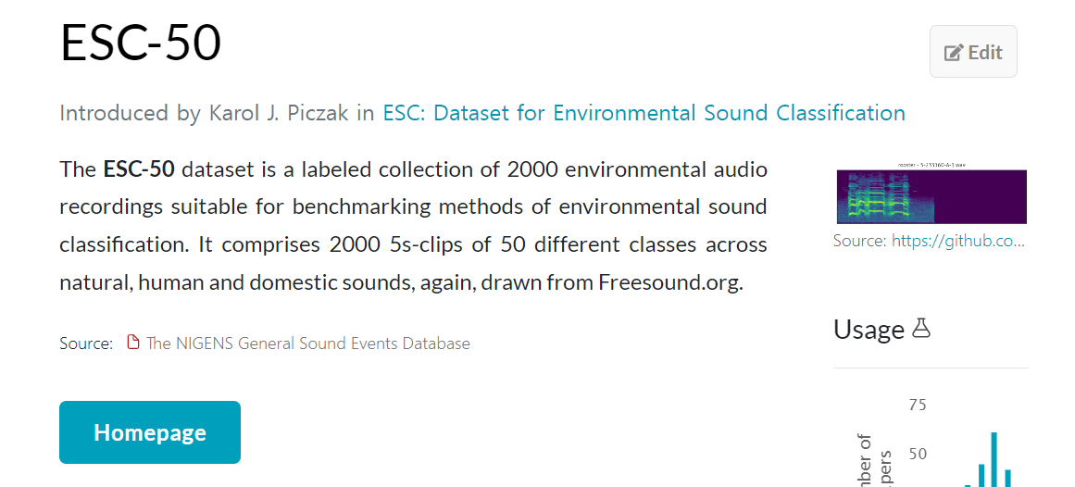
Audio Datasets
ESC-50

Slide 23
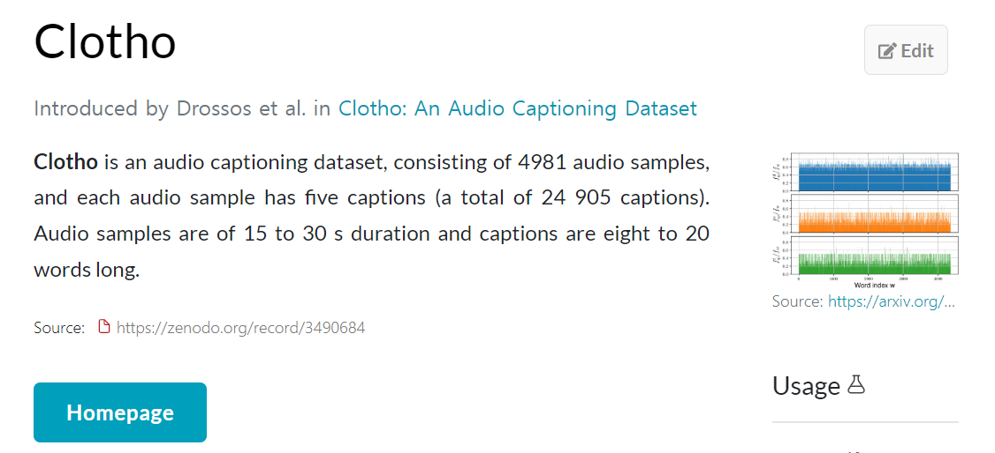
Audio Datasets
Clotho

Slide 24
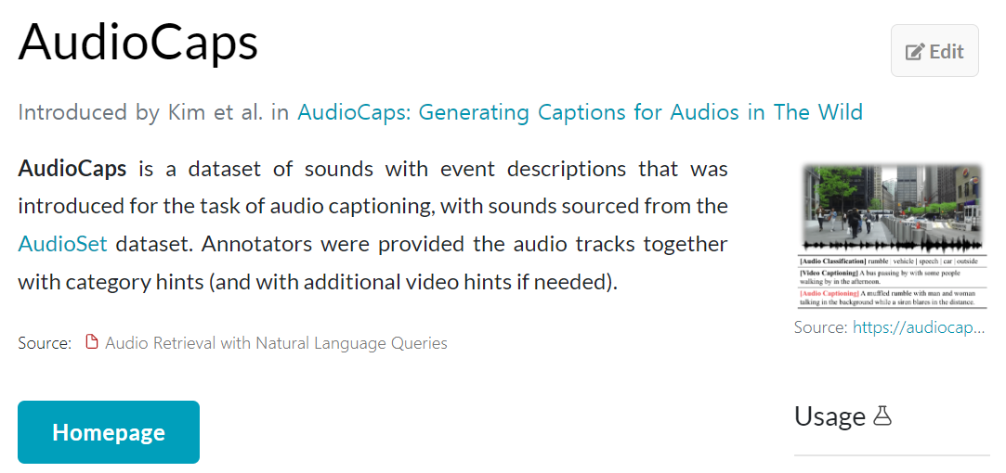
Audio Datasets
AudioCaps

Slide 25
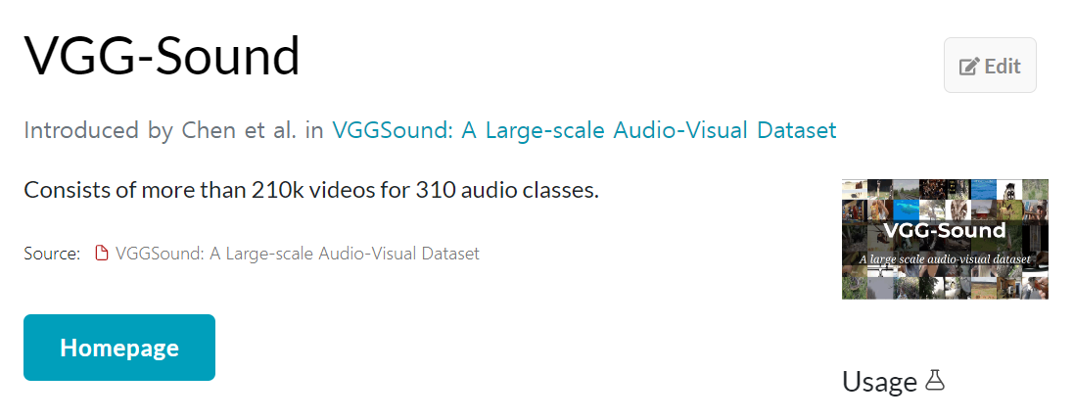
Audio Datasets
VGG-Sound

Slide 26
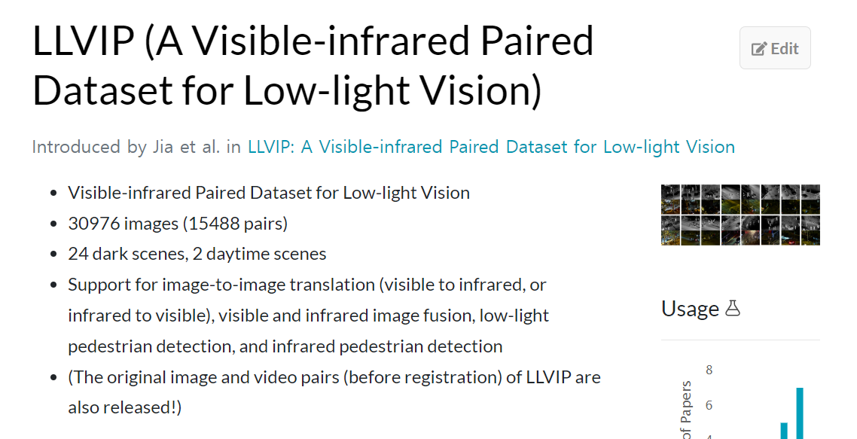
Infrared Dataset
LLVIP

Slide 27
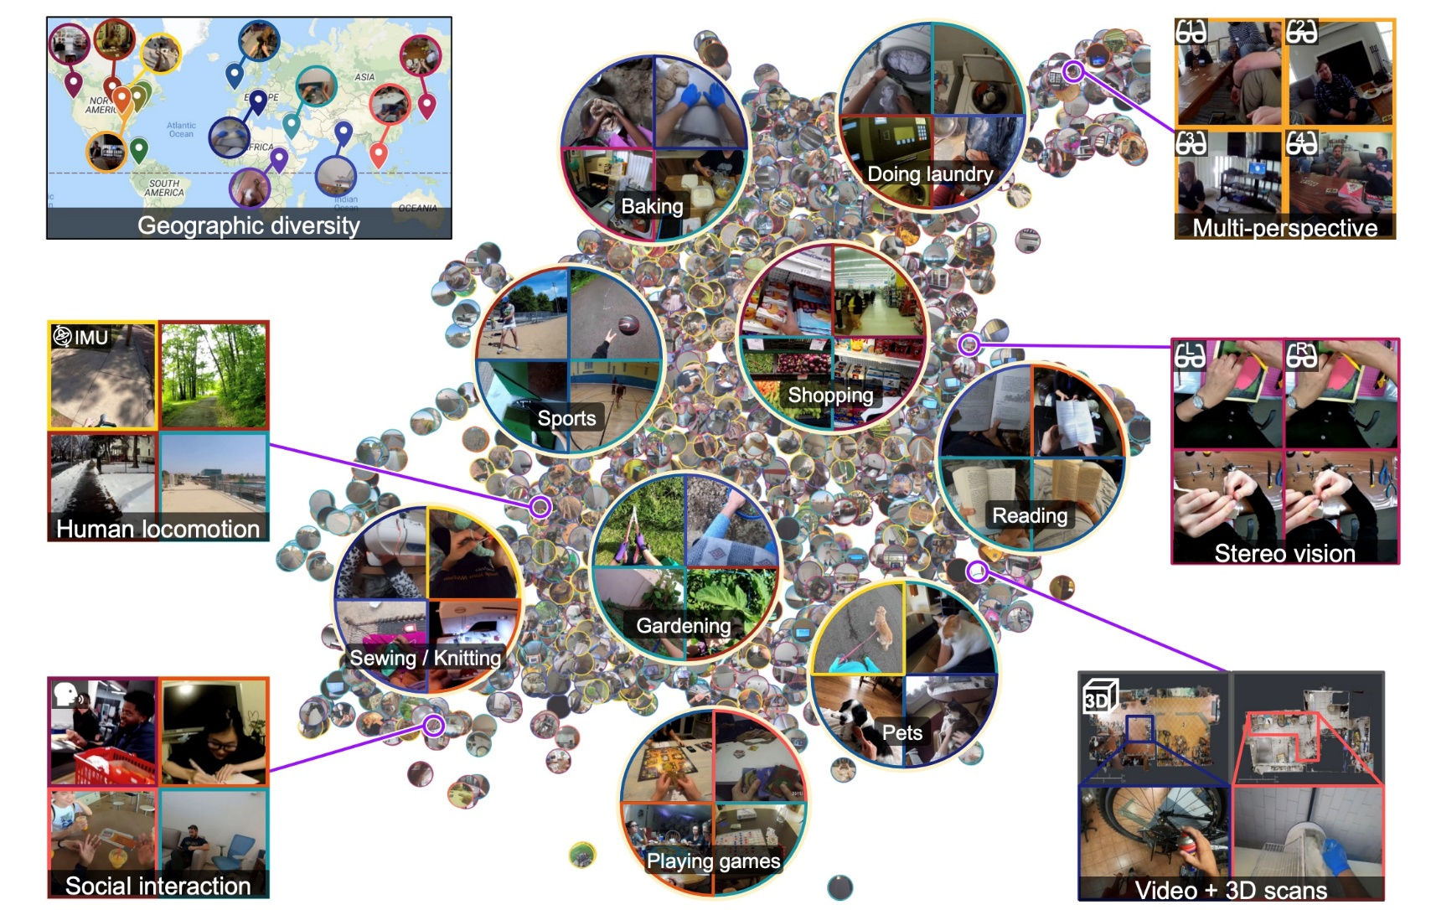
IMU Dataset
Ego4D

Slide 28
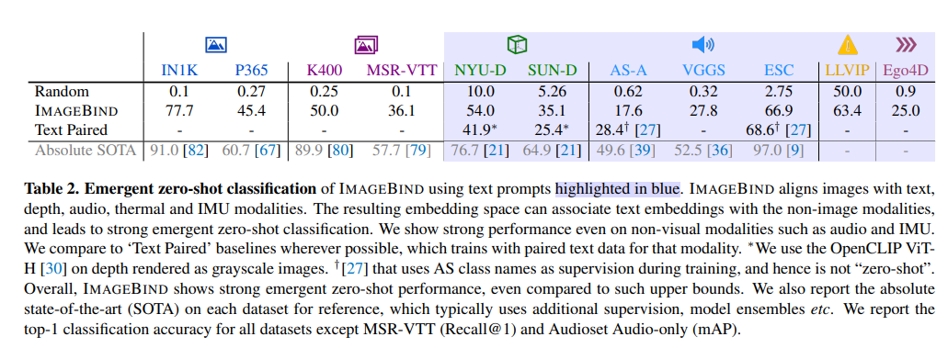
Experiments
Emergent zero-shot classification

Slide 29
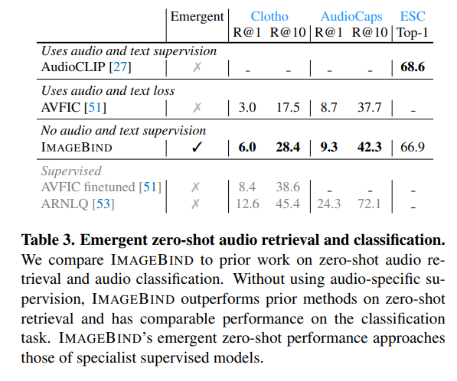
Experiments
Emergent zero-shot audio retrieval and classification

Slide 30
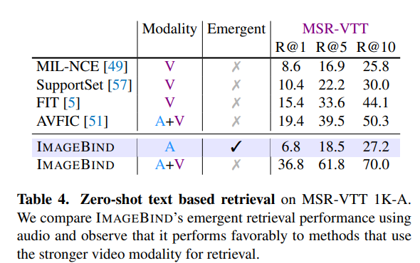
Experiments

Slide 31
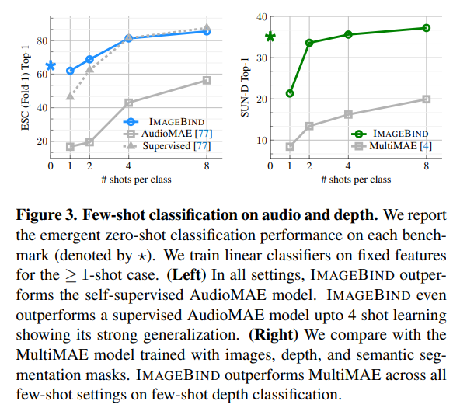
Experiments
Few-shot classification

Slide 32
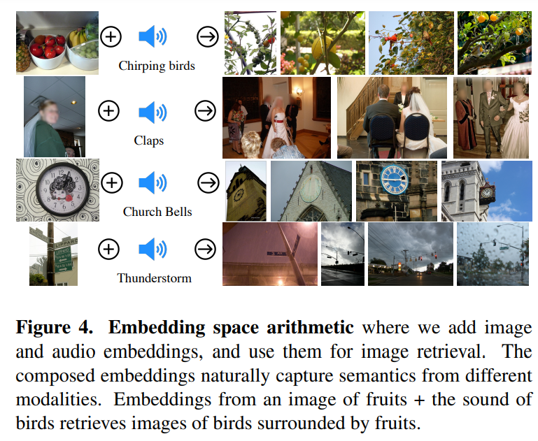
Experiments

Slide 33
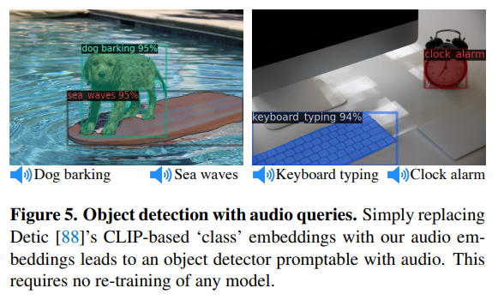
Experiments
Object detection with audio queries

Slide 34
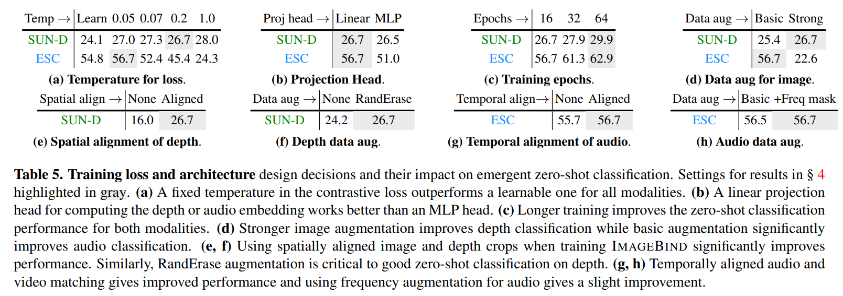
Ablation Study

Slide 35
Q&A
Q & A

Slide 36
Thank you for your attention!!
Thank you for your attention!!

