Slide 1
InternImage: Exploring Large-Scale Vision Foundation Models with Deformable Convolutions
발표자: 김병현
이미지처리팀:
강인하, 김현진, 안종식, 이주영, 이희재, 현청천

Slide 2
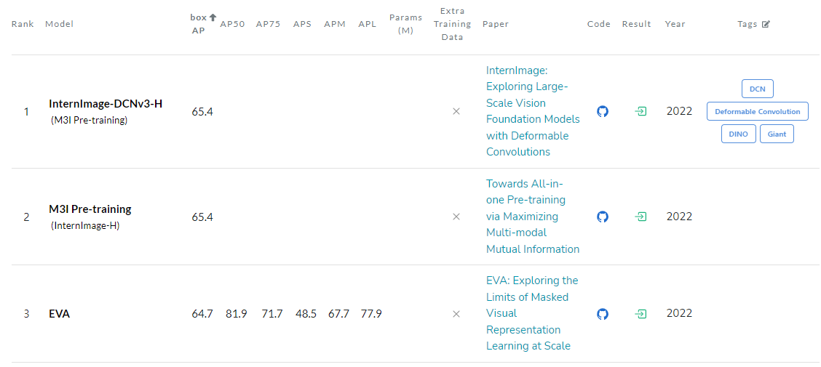
InterImage
State-of-the-Art (COCO test-dev) Backbone Network
Released by OpenGVLab

Slide 3
Introduction
Success of Transformers in Computer Vision Tasks
CNN-based foundation models can also achieve comparable or even better performance than ViTs when equipped with similar operator-/architecture-level designs, scaling-up parameters, and massive data.

Slide 4
Introduction
Gap between CNNs and ViTs
Operator Level
Long-range dependency
Adaptive spatial aggregation
Architecture View
Advanced components
Layer Normalization
Feed Forward Networks
GELU
Recent Long-Range CNNs
Very large kernels (31x31)
Gap with SOTA ViTs

Slide 5
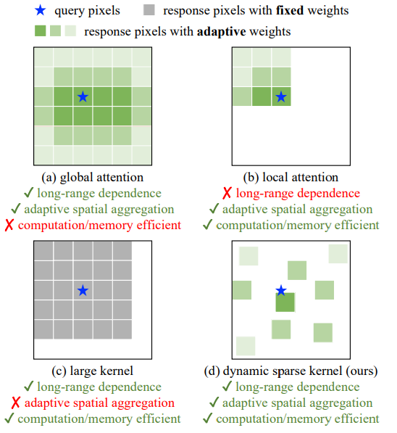
Introduction
Comparison of different core operators

Slide 6
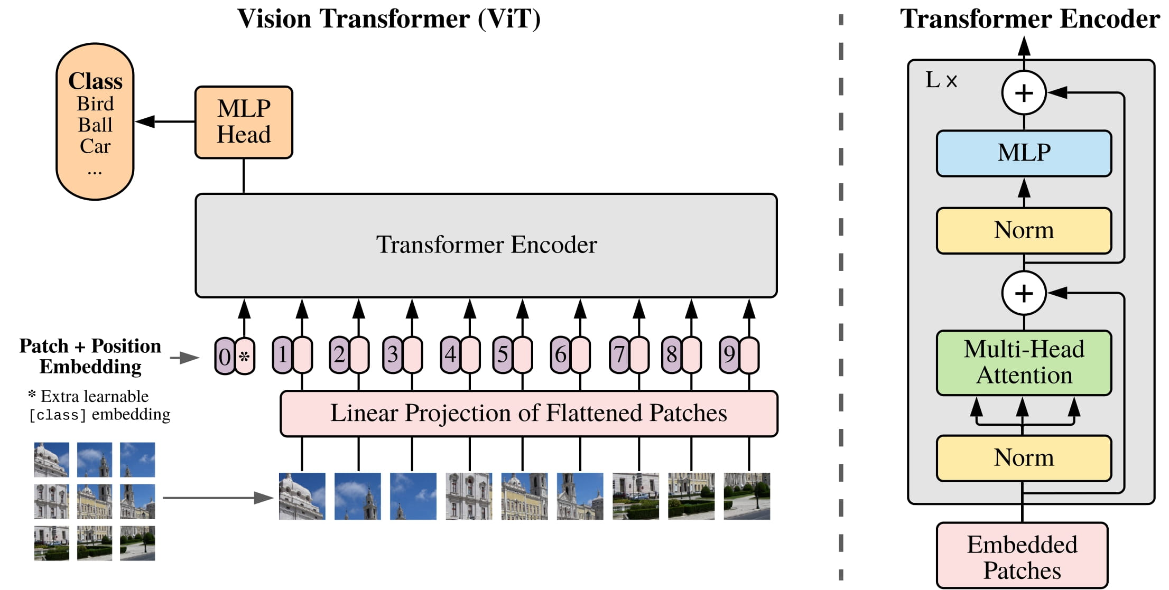
Introduction
Global Attention: Vision Transformer
Architecture of ViT
Dosovitskiy, Alexey, et al. "An image is worth 16x16 words: Transformers for image recognition at scale." arXiv preprint arXiv:2010.11929 (2020).

Slide 7
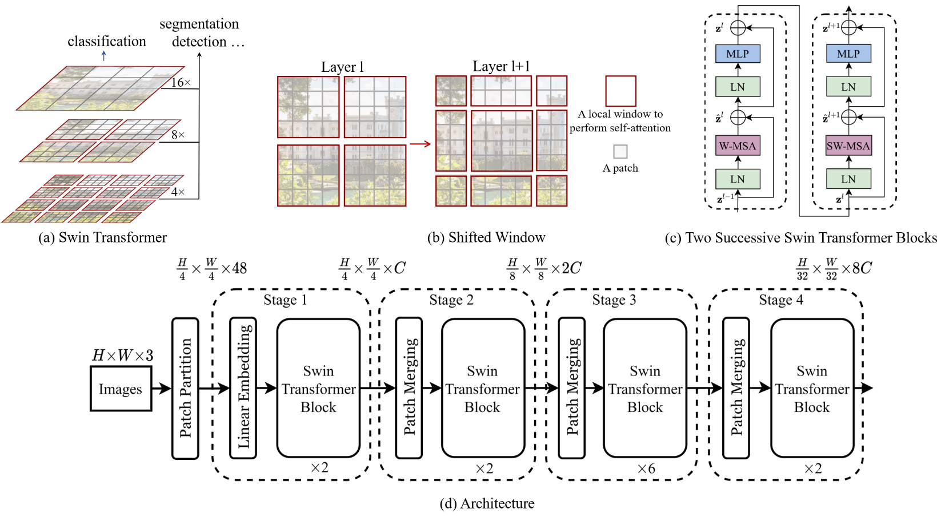
Introduction
Local Attention: Swin Transformer
Architecture of Swin Transformer
Liu, Ze, et al. "Swin transformer: Hierarchical vision transformer using shifted windows." Proceedings of the IEEE/CVF international conference on computer vision. 2021.

Slide 8
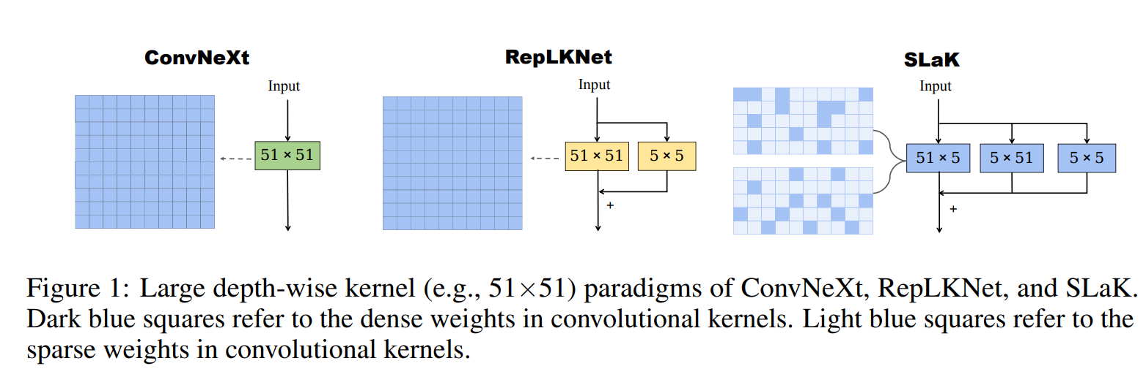
Introduction
Large Kernel: SLaK
Liu, Shiwei, et al. "More convnets in the 2020s: Scaling up kernels beyond 51x51 using sparsity." arXiv preprint arXiv:2207.03620 (2022).

Slide 9
Introduction
Concentration on CNN-based Model
InterImage
Brand-New CNN-based Backbone Network
Characteristics
Dynamic sparse convolutional layer
Only with 3x3 kernels
Adaptive spatial aggregation
Reduce inductive bias
Low computational cost compared to large convolutional layers
Overall Architecture of ViT

Slide 10
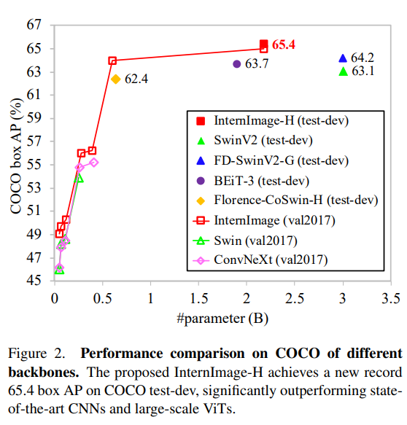
Introduction
Contributions
1st CNN-based backbone with more than 1 billion params.
Add long-rage dependencies and adaptive spatial aggregation with 3x3 DCN
SOTA accuracy in COCO dataset

Slide 11
Q & A
Q & A

Slide 12
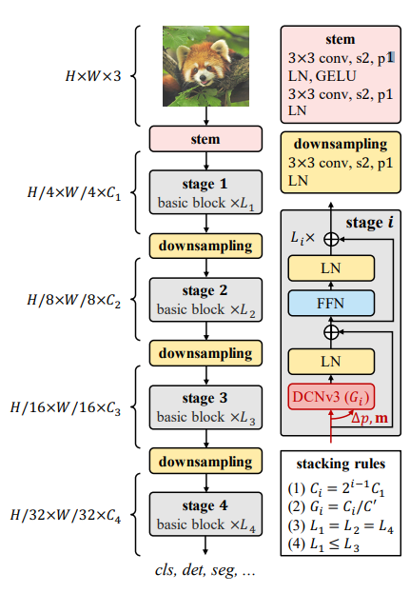
Overall Architecture
2. Architecture Design
1. Deformable Convolutional Layer V3

Slide 13
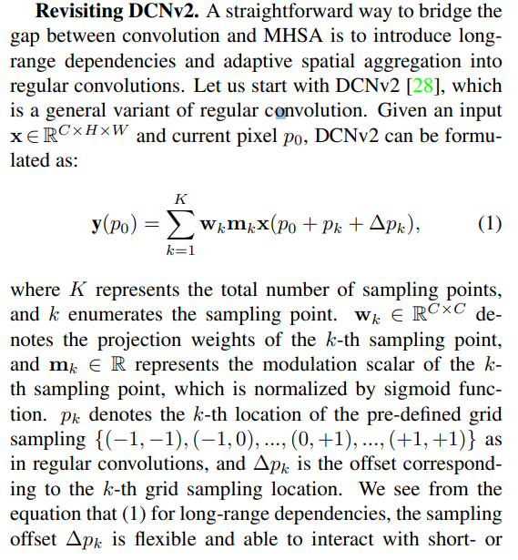
Deformable Convolutional Layer v3
Revisiting DCNv2

Slide 14
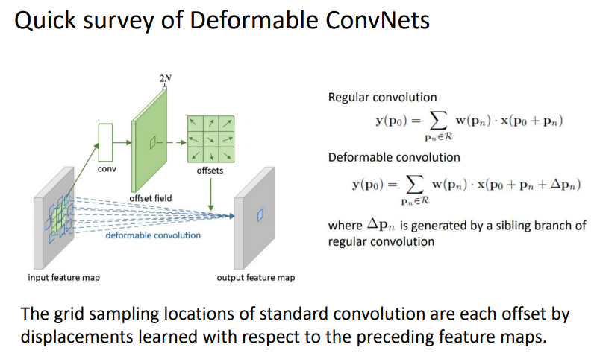
Deformable Convolutional Layer v3
https://www.taokong.org/report/DCN_v2_paper_reading.pdf

Slide 15
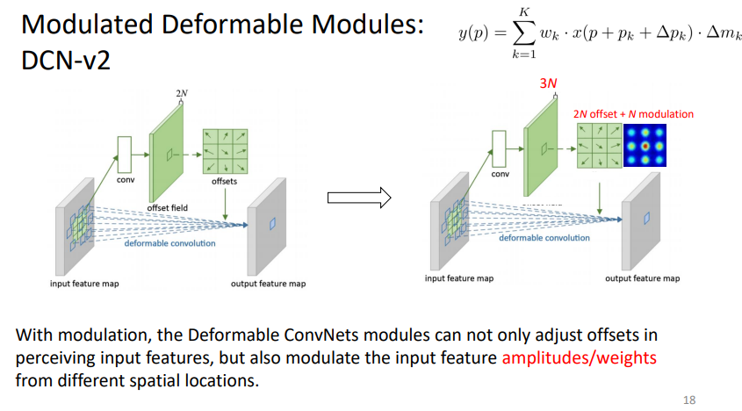
Deformable Convolutional Layer v3
https://www.taokong.org/report/DCN_v2_paper_reading.pdf

Slide 16
Deformable Convolutional Layer v3
Sharing weights among convolutional neurons.
Heavy computational cost of DCNv2
independent linear projection weights
memory complexity is linear with the total number of sampling points
To remedy this problem, we borrow the idea from the separable convolution and detach the original convolution weights into depth-wise and point-wise parts
Introducing multi-group mechanism
Split the spatial aggregation process into G groups
Normalizing modulation scalars along sampling points
Change element-wise sigmoid normalization to softmax normalization along sample points.

Slide 17
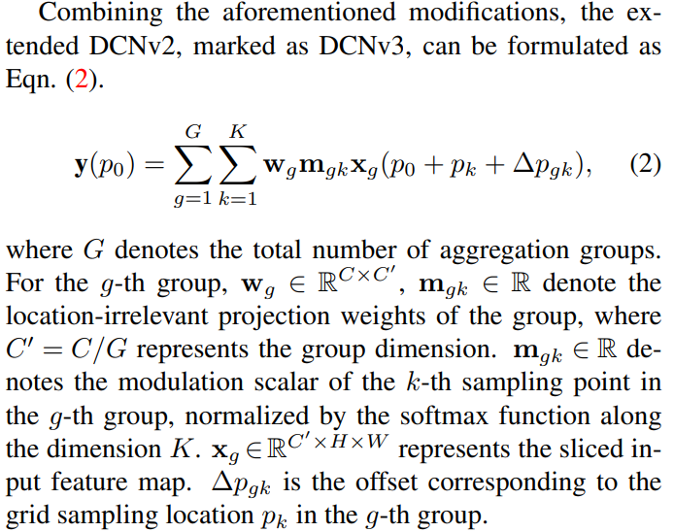
Deformable Convolutional Layer v3

Slide 18









Deformable Convolutional Layer v3
Normal Convolutional Layer
$$D$$
$$d$$
$$D$$
$$H$$
$$h$$
$$k$$
$$k$$
Convolutional Kernel
$$W$$
$$w$$
Output Tensor
Input Tensor

Slide 19















Deformable Convolutional Layer v3
Deformable Convolutional Layer v1
$$D$$
$$d$$
$$D$$
$$H$$
$$h$$
$$k$$
$$k$$
$$W$$
$$w$$
Convolutional Kernel
Output Tensor
Input Tensor
$$k$$
$$H$$
$$2N(N=k^{2})$$
$$2N(N=k^{2})$$
$$k$$
Offset Layer
(Convolutional Kernel)
$$W$$
Offset map

Slide 20





















Deformable Convolutional Layer v3
Deformable Convolutional Layer v2
$$D$$
$$d$$
$$D$$
$$H$$
$$h$$
$$k$$
Convolutional Kernel
$$k$$
$$W$$
$$w$$
Output Tensor
Input Tensor
$$k$$
$$H$$
Offset map
$$2N(N=k^{2})$$
$$k$$
$$2N(N=k^{2})$$
Offset Layer
(Convolutional Kernel)
$$W$$
Sigmoid
$$k$$
Modulation map
$$N(N=k^{2})$$
$$H$$
$$k$$
$$N(N=k^{2})$$
Modulation Layer
(Convolutional Kernel)
$$W$$

Slide 21



Deformable Convolutional Layer v3
Deformable Convolutional Layer v3
$$×G$$
$$D$$
$$d=C′×G$$
Shared Params
in Kernels
$$C′$$
$$H$$
$$h$$
$$k$$
Convolutional Kernel
$$k$$
$$W$$
$$w$$
Output Tensor
Input Tensor
$$k$$
$$H$$
Offset map
$$2N(N=k^{2})$$
$$k$$
$$2N(N=k^{2})$$
Offset Layer
(Convolutional Kernel*)
$$W$$
Softmax (Axis -> Depth)
$$k$$
Modulation map
$$N(N=k^{2})$$
$$H$$
$$k$$
$$N(N=k^{2})$$
Modulation Layer
(Convolutional Kernel*)
*Details not found in the paper
$$W$$

Slide 22
InterImage Model

Slide 23
InterImage Model
1. Basic Block

Slide 24
InterImage Model
2. Stem layer & Downsampling

Slide 25
InterImage Model
3. Stacking Rules

Slide 26
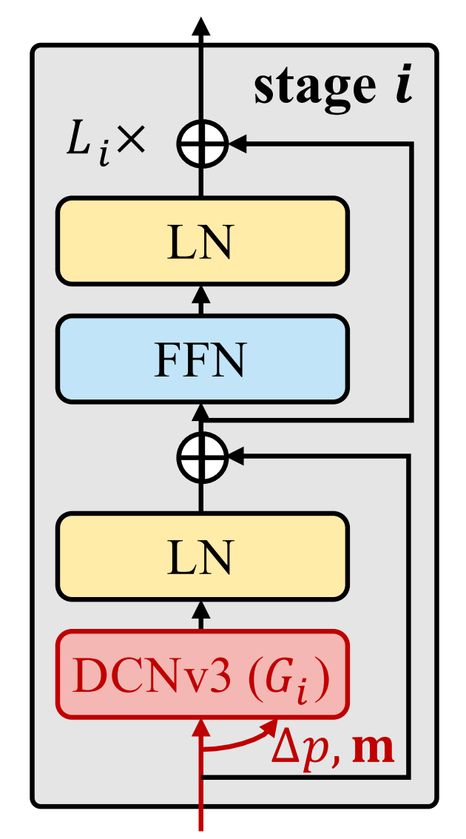
InterImage Model
1. Basic Block

Slide 27
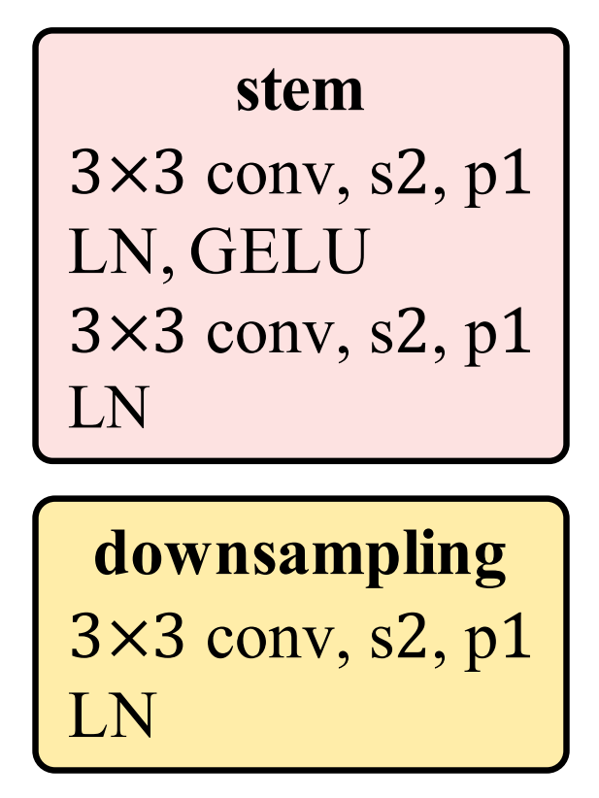
InterImage Model
2. Stem & Downsampling

Slide 28
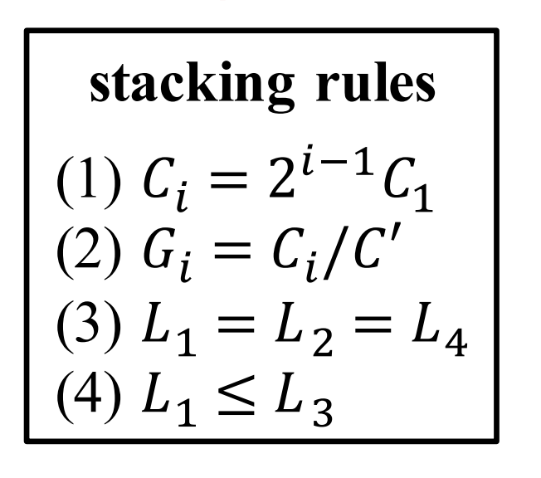
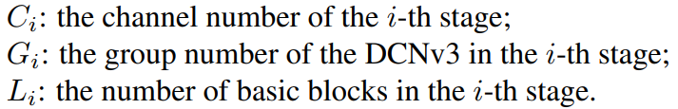
InterImage Model
3. Stacking Rules

Slide 29
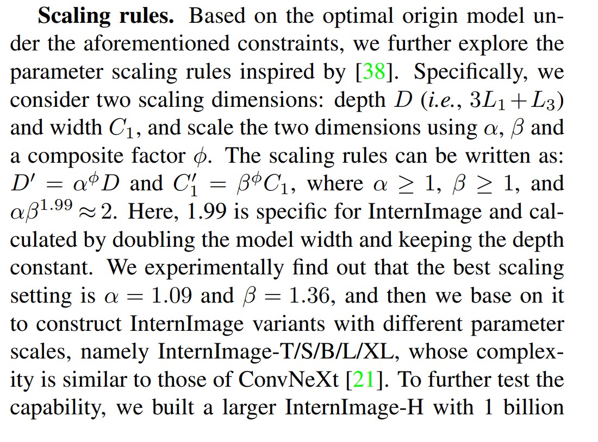
InterImage Model
4. Scaling Rules

Slide 30
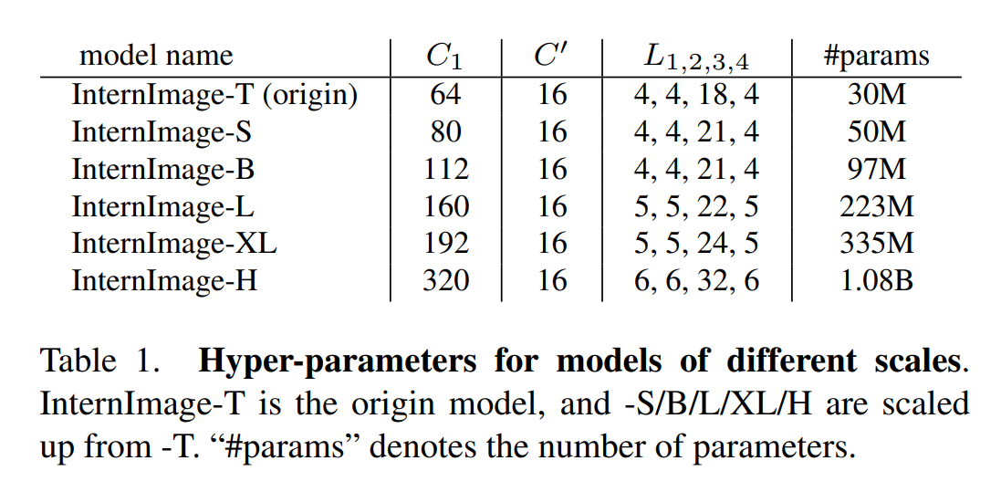

InterImage Model
5. Hyper-parameters for models of different scales
4 Stages Models are prevalent since DETR
Swin Transformer
MetaFormer

Slide 31
Q & A
Q & A

Slide 32
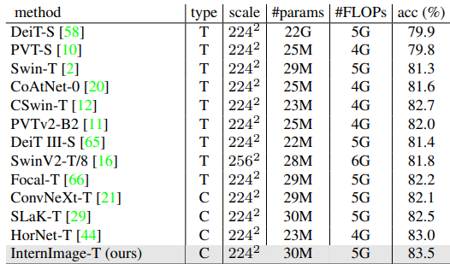
Experiments
Image Classification (Tiny Model)

Slide 33
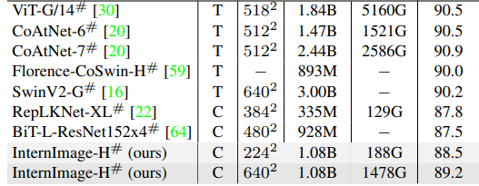
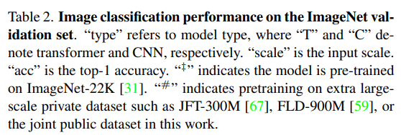
Experiments
Image Classification (Large Model)

Slide 34
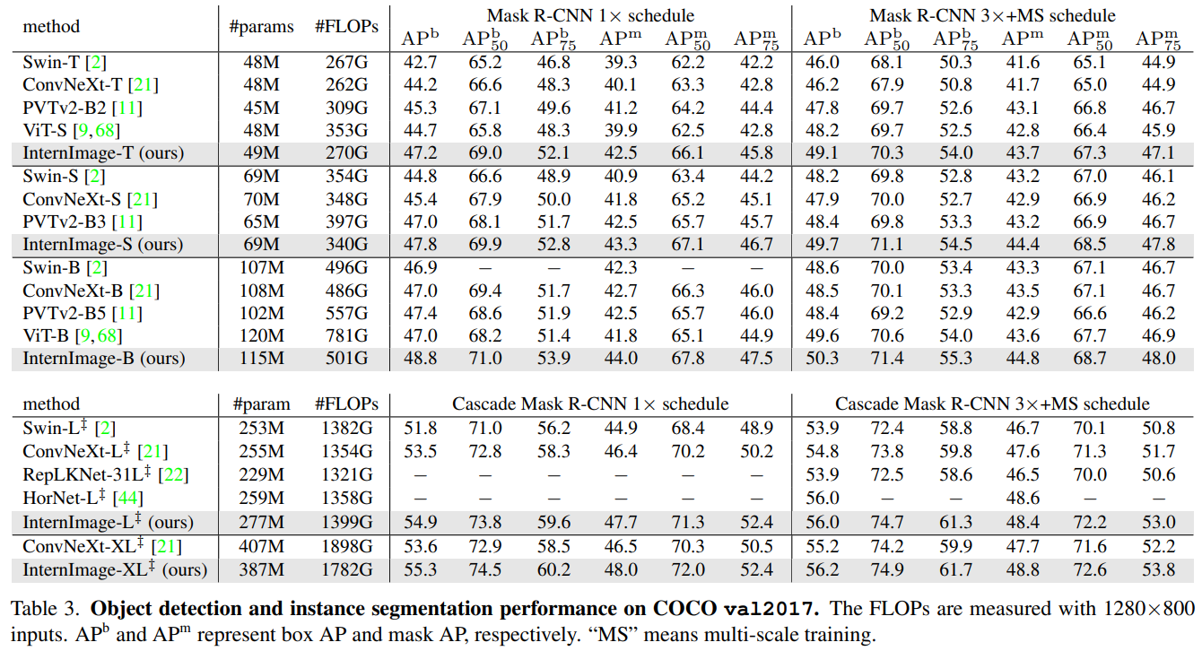
Experiments
Object Detection & Instance Segmentation

Slide 35
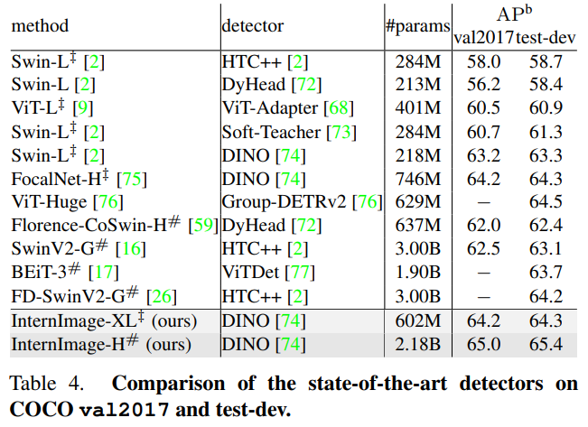
Experiments
Object Detection & Instance Segmentation

Slide 36
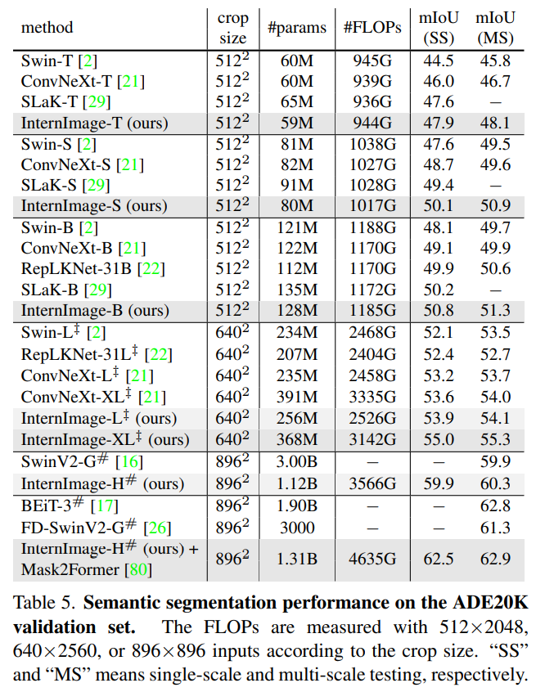
Experiments
Semantic Segmentation

Slide 37
이미지처리팀 리뷰 의견
Deformable Conv V3에 대한 분석이 부재
Ablation Study 부재
ResNet 등 기존 Conv 기반 모델에서 성능향상을 가지는지 확인해줬으면 정말 좋았을 듯
Deformable Conv V3의 장점에 대한 정성적인 분석 부재
Convolution을 Group으로 나누면서 생기는 단일 레이어의 다양한 Offset Map의 장점에 대한 시각화 자료가 있었으면 좋았을 듯
Inductive Bias를 줄일 수 있었다는 주장에 대한 근거자료 부재
코드가 아직 공개되지 않아 정확한 검증은 어려움

Slide 38
Q & A
Q & A

