Slide 1
MetaFormer is Actually What You Need for Vision
CVPR 2022 Oral
발표자
김병현
이미지처리팀
김준철 박재완 이희재 조경진

Slide 2
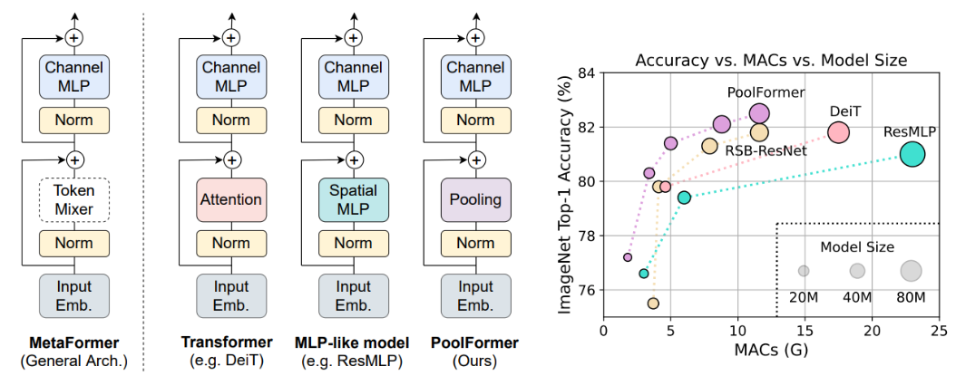
What is MetaFormer?
Generalized Transformer Architecture
Any token mixer performs well in MetaFormer arch. for CV tasks

Slide 3
Rise of Transformers in Computer Vision
Key changes from conventional CNNs to ViTs
Patch Embedding
Convolutional Layer with Kernel
https://medium.com/mad-data-science/convolution-networks-for-dummies-aa8b086020ef

Slide 4
Rise of Transformers in Computer Vision
Key changes from conventional CNNs to ViTs
Patch Embedding
The Vision Transformer treats an input image as a sequence of patches
https://ai.googleblog.com/2020/12/transformers-for-image-recognition-at.html

Slide 5
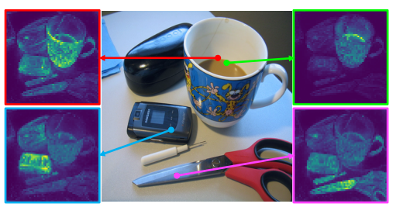
Rise of Transformers in Computer Vision
Key changes from conventional CNNs to ViTs
Attention module (Token mixer mechanism)
Self-attention for a set of reference points (from DINO)
Caron, M., Touvron, H., Misra, I., Jégou, H., Mairal, J., Bojanowski, P., & Joulin, A. (2021). Emerging properties in self-supervised vision transformers. In Proceedings of the IEEE/CVF International Conference on Computer Vision (pp. 9650-9660).

Slide 6
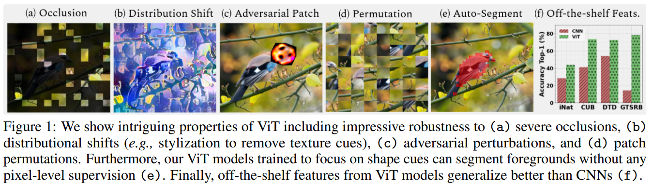
Reason for Success of Vision Transformers
Success of Transformers attributed to the attention-based token mixer
Robustness against occlusion, distribution shift, adversarial patch, permutation, auto-segment
Naseer, M. M., Ranasinghe, K., Khan, S. H., Hayat, M., Shahbaz Khan, F., & Yang, M. H. (2021). Intriguing properties of vision transformers. Advances in Neural Information Processing Systems, 34, 23296-23308.

Slide 7
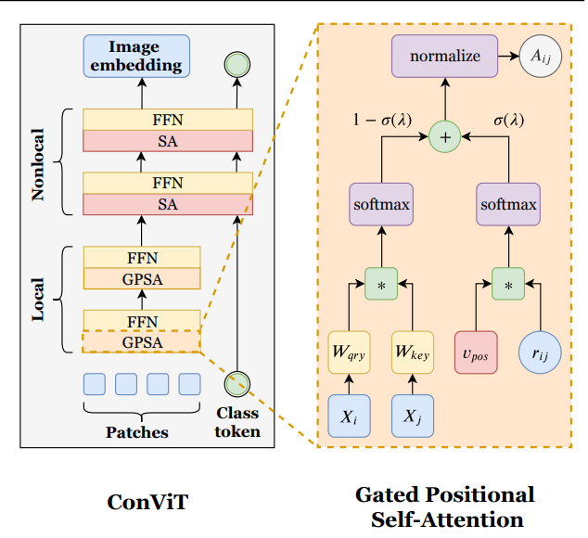
Variants of Attention Module
Attention-based Token Mixers
ConViT with Gated Positional Self-Attention

Slide 8
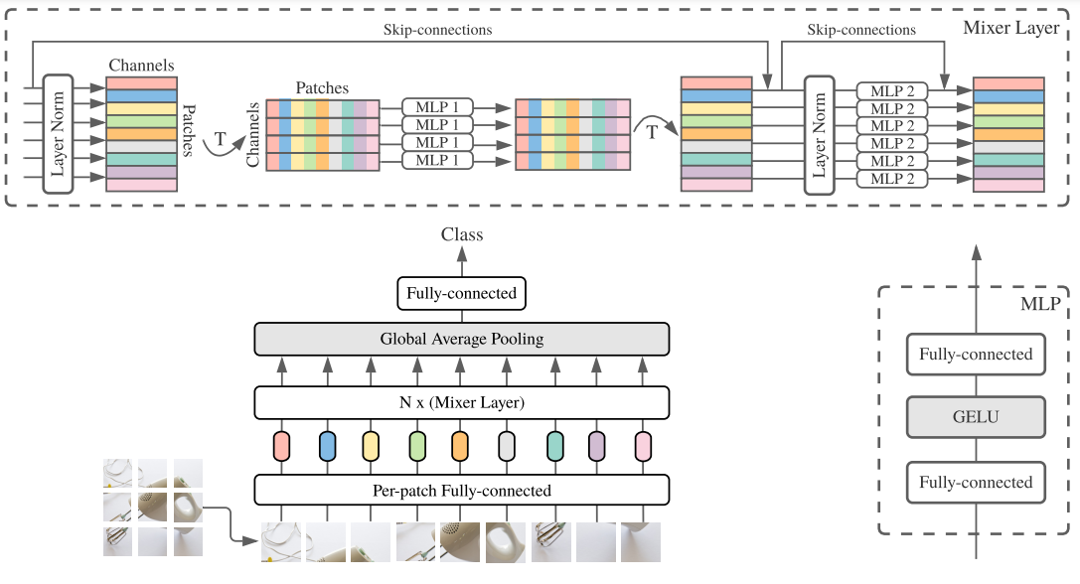
Variants of Attention Module
Spatial multi-layered perceptron (MLP)
Token Mixing MLP
Tolstikhin, I. O., Houlsby, N., Kolesnikov, A., Beyer, L., Zhai, X., Unterthiner, T., ... & Dosovitskiy, A. (2021). Mlp-mixer: An all-mlp architecture for vision. Advances in Neural Information Processing Systems, 34, 24261-24272.

Slide 9
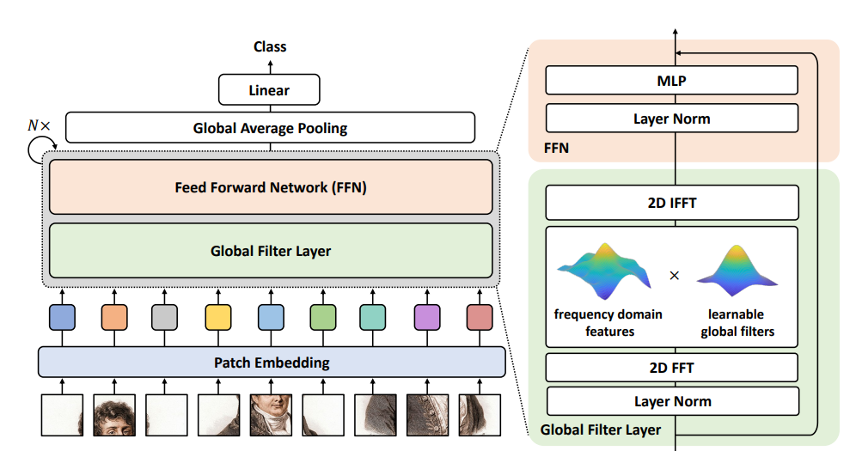
Variants of Attention Module
Token mixer with 2D FFT and IFFT
Rao, Y., Zhao, W., Zhu, Z., Lu, J., & Zhou, J. (2021). Global filter networks for image classification. Advances in Neural Information Processing Systems, 34, 980-993.

Slide 10
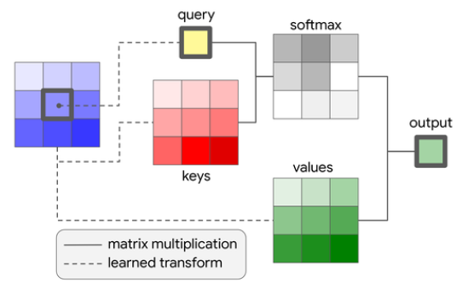
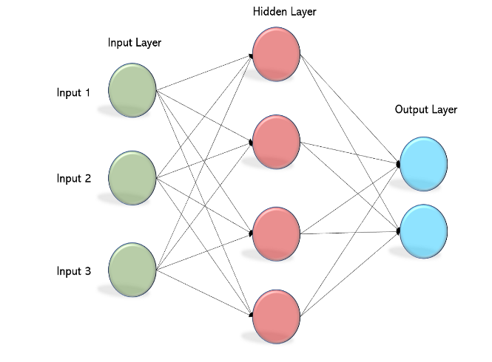
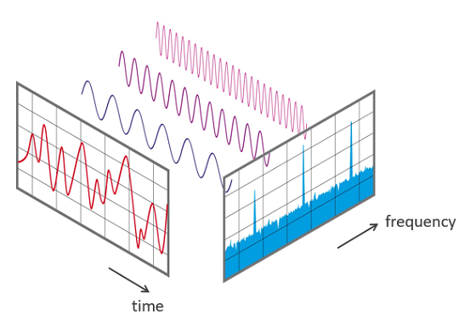

Degradation of Attention Module in ViTs…?
2010s
1980s
1800s
Self-Attention
Multi-layered Perceptron
Fourier Transform

Slide 11
Research Motivation of MetaFormer
What if Attention is not that important ….???
Why not non-parametric operators like ‘pooling’??

Slide 12
Here comes PoolFormer!!
Average pooling Attention module achieved SOTA performance!!
SOTA performance
Image Classification
Object Detection
Semantic Segmentation
Instance Segmentation

Slide 13
Q & A
Q & A

Slide 14
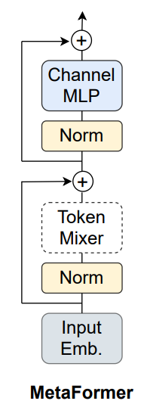








MetaFormer
: Sequence Length
: Embedding Dimension
: Expansion ratio
: Non-linear activation

Slide 15
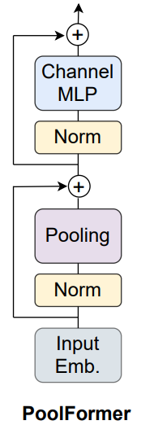
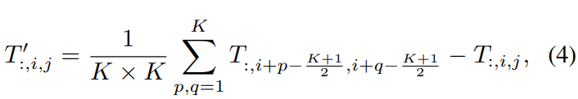
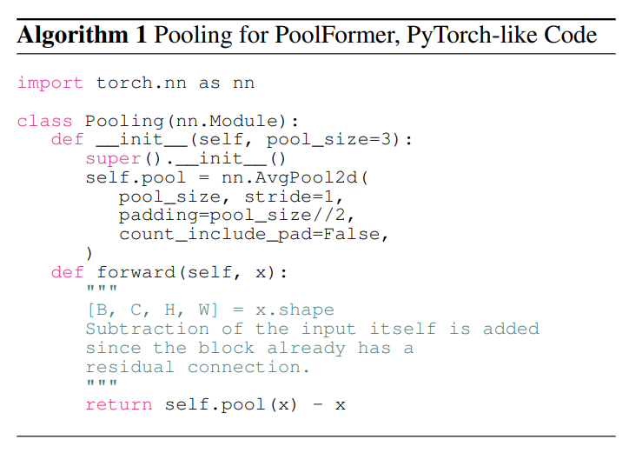
PoolFormer
Average Pooling
: kernel size (odd number)

Slide 16
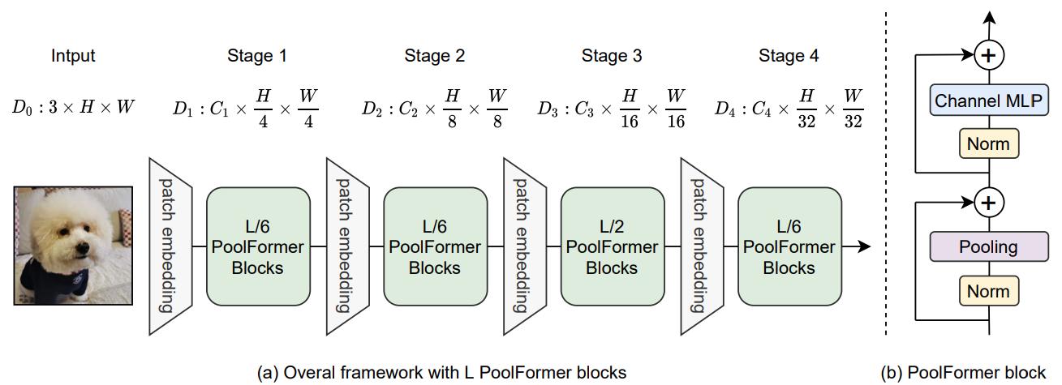
PoolFormer

Slide 17
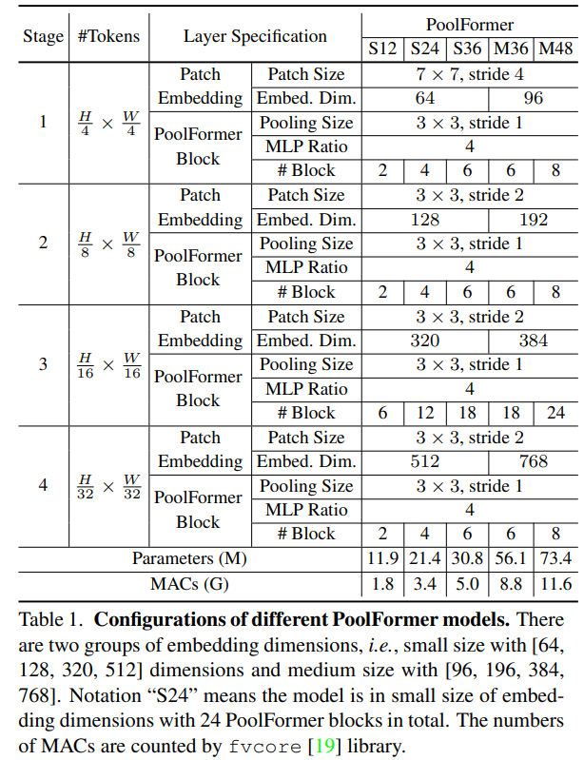
PoolFormer Configuration

Slide 18
Q & A
Q & A

Slide 19
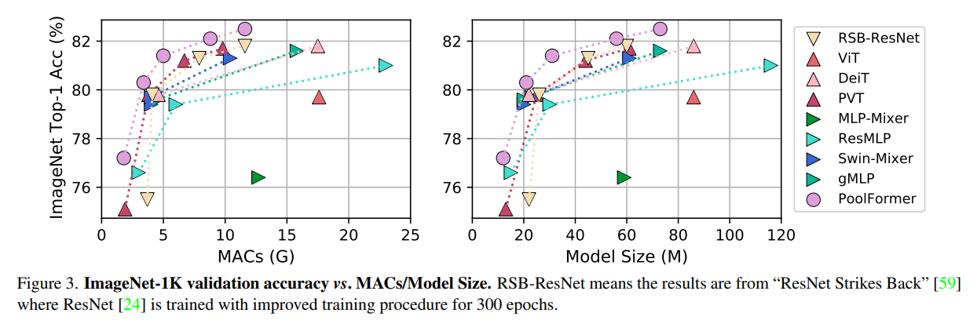
Experiments: Image Classification
Top1 accuracy on ImageNet-1K validation

Slide 20
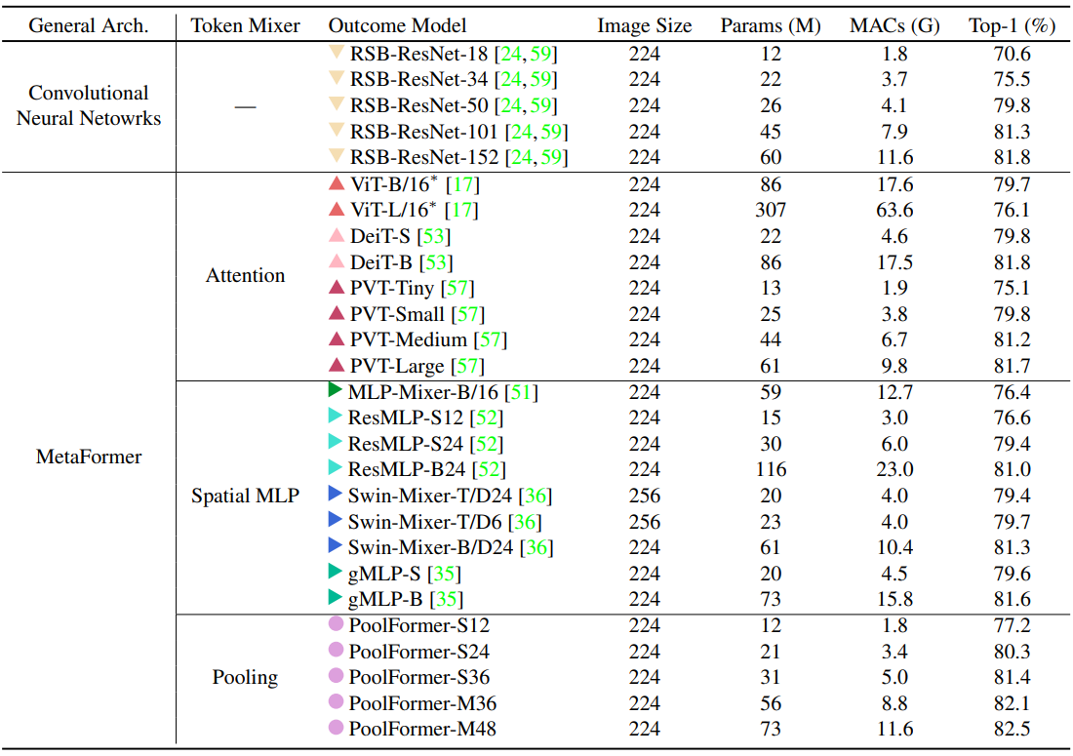
Experiments: Image Classification
Top1 accuracy on ImageNet-1K validation

Slide 21
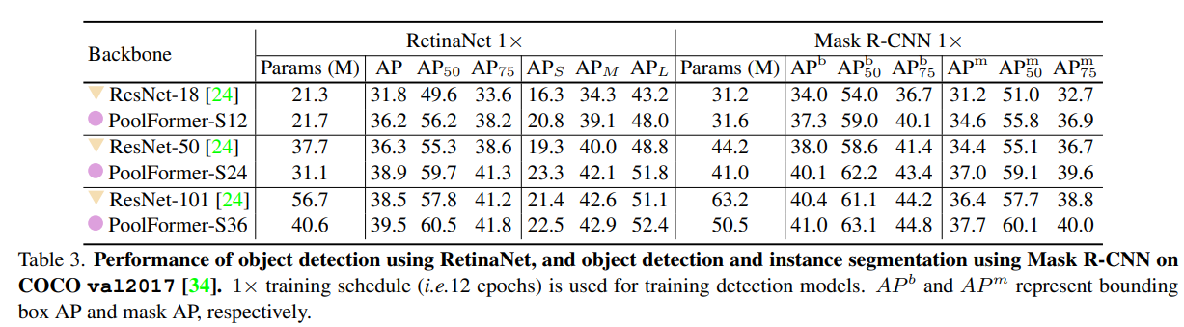
Object Detection & Instance Segmentation

Slide 22
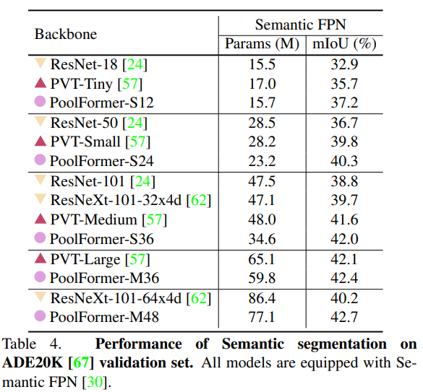
Semantic Segmentation

Slide 23
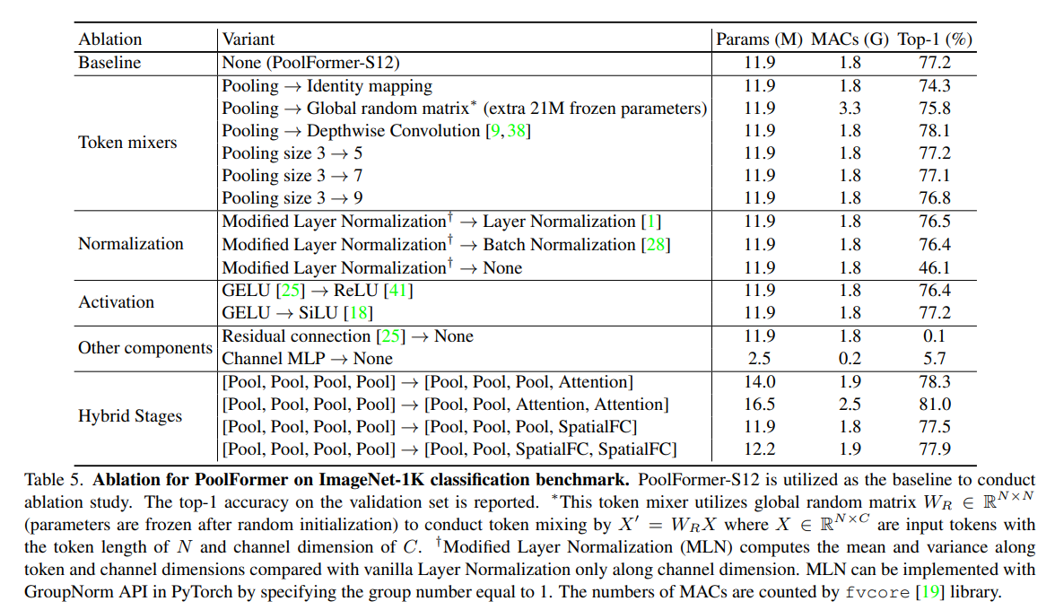
Ablation Study

Slide 24
Ablation Study

Slide 25
Ablation Study

Slide 26
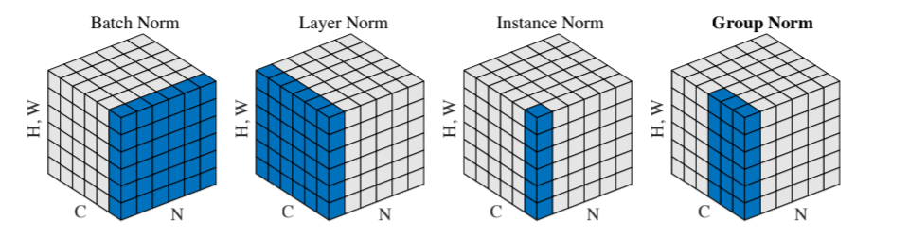
Ablation Study
Modified Layer Normalization -> patch-wise Group norm

Slide 27
Ablation Study

Slide 28
Ablation Study

Slide 29
Ablation Study

Slide 30
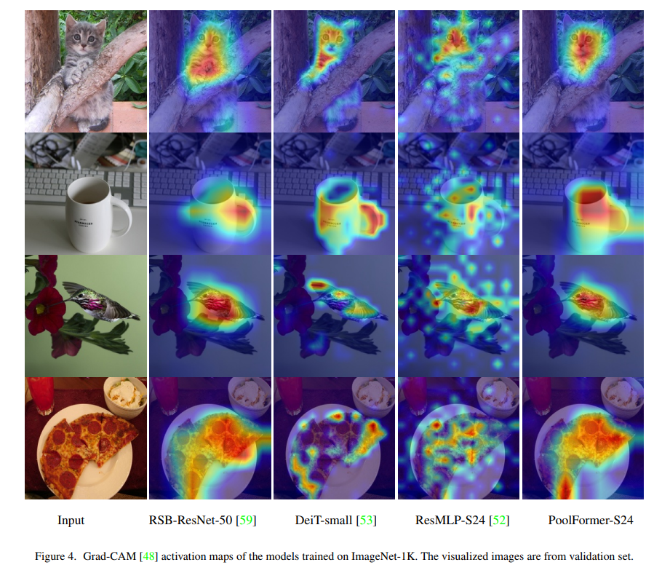
GradCam Visualization

Slide 31
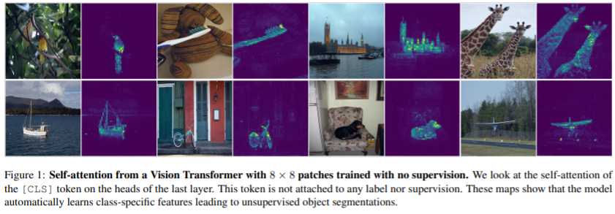
Further Questions?
Is Attention surely unnecessary in VITs?
NO. An attention map is so useful in self-supervised learning and its explainability.

Slide 32
Q & A
Q & A

