Slide 1
Pix2Seq: A New Language Interface for Object Detection
ICLR 2022
Ting Chen, Saurabh Saxena, Lala Li, David J. Fleet, Geoffrey Hinton
이미지처리팀 Detection
김병현, 김선옥, 김현진, 안종식, 이찬혁, 현청천

Slide 2
Pix2Seq
Object detection as a language modeling task
Object descriptions as sequences of discrete tokens
Quantization and serialization scheme converting bounding boxes and class labels into sequences of discrete tokens (similar to captions)
Conceptual illustration of Pix2Seq [1]

Slide 3
Introduction
Characteristics of the existing object detectors
Large set of proposals
Anchor, and Region Proposal Networks (Faster R-CNN [2])
Windows Centers (FCOS [3])
Non-maximum suppression to prevent duplicate detection results
Specialized architectures
Feature Pyramid Networks [4]
Extra layers
Faster R-CNN [2], YOLO [5], DETR [6] ….
Stacking extra layers (Cascade R-CNN [7])
Highly tailored loss functions
Bounding box regression (Faster R-CNN [2])
Intersection over union (Generalized IoU [8])
Set-based Matching (DETR [6])

Slide 4
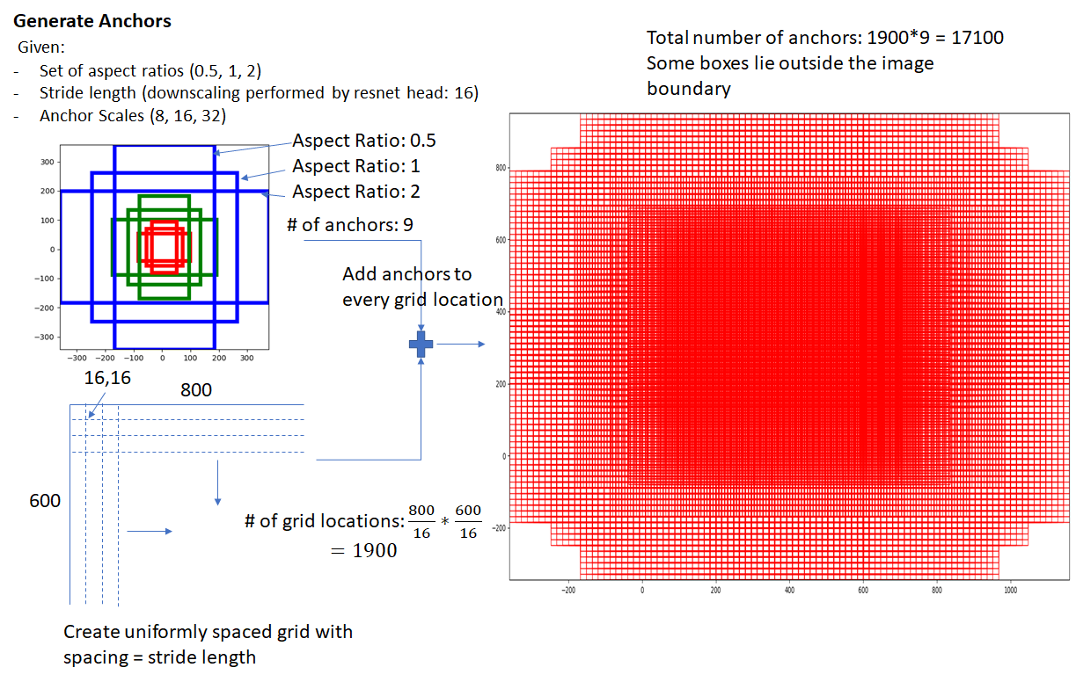
Characteristic 1: Large Set of Proposals
Anchors in Faster R-CNN [2]

Slide 5
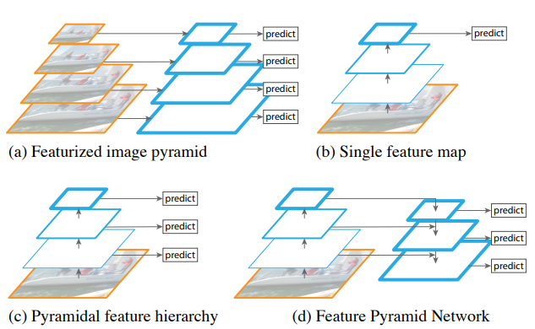
Characteristic 2: Specialized Architectures
Feature Pyramid Networks [4]
Mix 1) semantic information and 2) spatial information

Slide 6
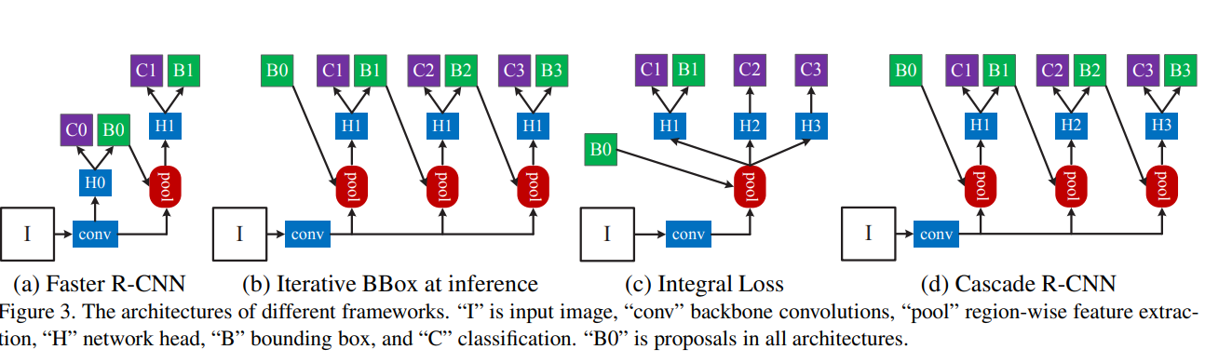
Characteristic 2: Specialized Architectures
Extra layers: Cascade R-CNN [7]

Slide 7
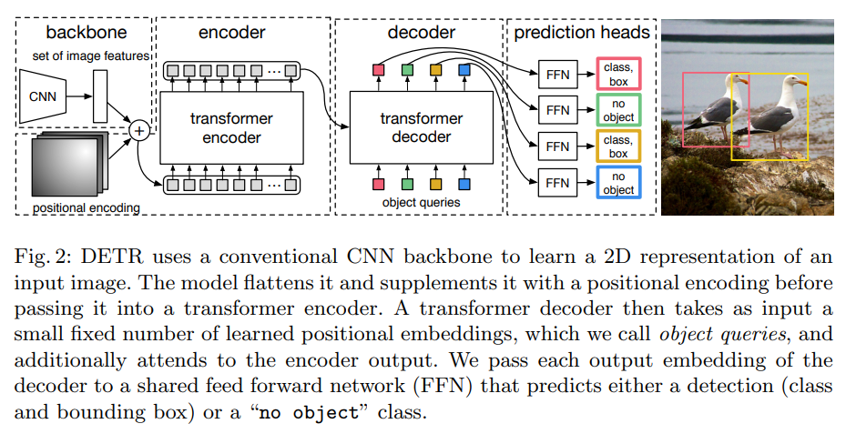

Characteristic 3: Highly tailored loss functions
Set-based matching loss: DETR [6]

Slide 8
Introduction
Goal of this paper
Generalized architecture for object detection
Intuition
If a neural net knows where and what the objects are, we just need to teach it to read them out.
Avoid
Bounding box proposal
Specialized architecture
Highly tailored loss function
Main components
Bounding box as Sequence
General encoder-decoder architecture
Maximum likelihood loss

Slide 9
Q & A
Q & A

Slide 10
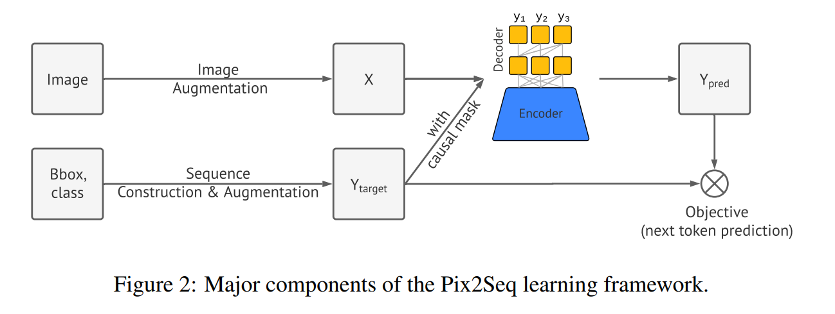
The Pix2Seq Framework
Main components of Pix2Seq
Image Augmentation
Sequence construction & augmentation
Architecture
Objective/loss function

Slide 11

Sequence Construction
Sequence Construction from Object Descriptions
Object representation: a sequence of five discrete tokens
ymin, xmin, ymax, xmax, c
Uniformly discretized into an integer between [1, nbins]
The vocabulary size is equal to number of bins + number of classes.
(0, 0)
dog
cat
(600, 600)
Construction of bounding box sequence

Slide 12
Sequence Construction
Sequence Construction from Object Descriptions
Object representation: a sequence of five discrete tokens
ymin, xmin, ymax, xmax, c
Uniformly discretized into an integer between [1, nbins]
The vocabulary size is equal to number of bins + number of classes.
(0, 0)
dog
nbins: 0-4
dog: 5
cat: 6
Vocabulary size is only 6
cat
(0, 0)
(1, 2)
bounding box sequence
0, 0, 4, 2, 5, 1, 2, 4, 4, 6
(4, 2)
(4, 4)
(600, 600)
Construction of bounding box sequence

Slide 13
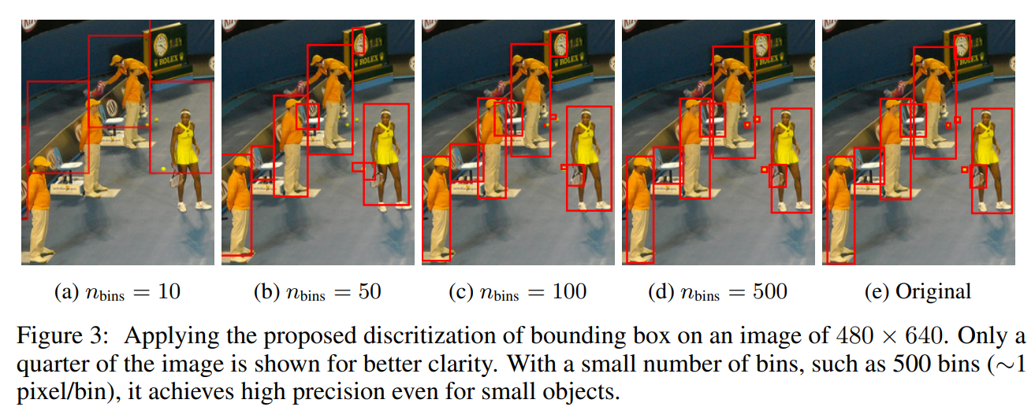
Sequence Construction
Sequence Construction from Object Descriptions
Object representation: a sequence of five discrete tokens
ymin, xmin, ymax, xmax, c
Uniformly discretized into an integer between [1, nbins]
The vocabulary size is equal to number of bins + number of classes.

Slide 14
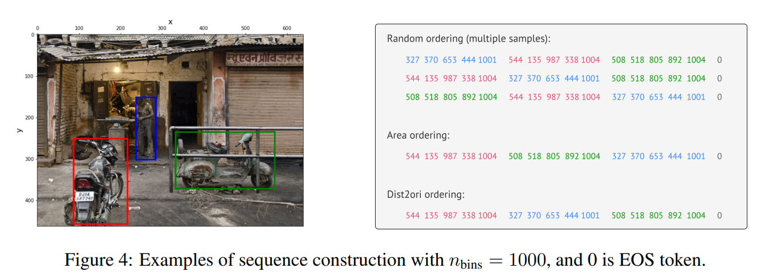
Sequence Construction
Sequence Ordering
Since the order of objects does not matter for the detection task per se, we use a random ordering strategy.

Slide 15
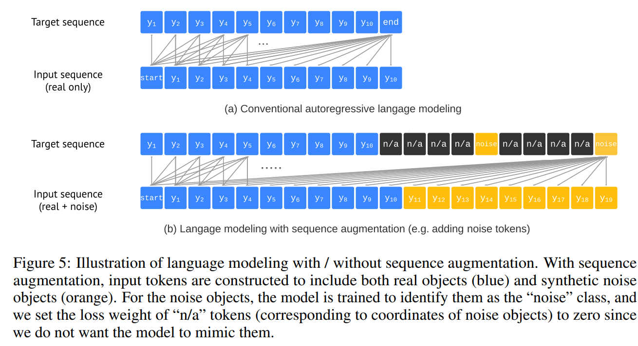
Sequence Augmentation

Slide 16
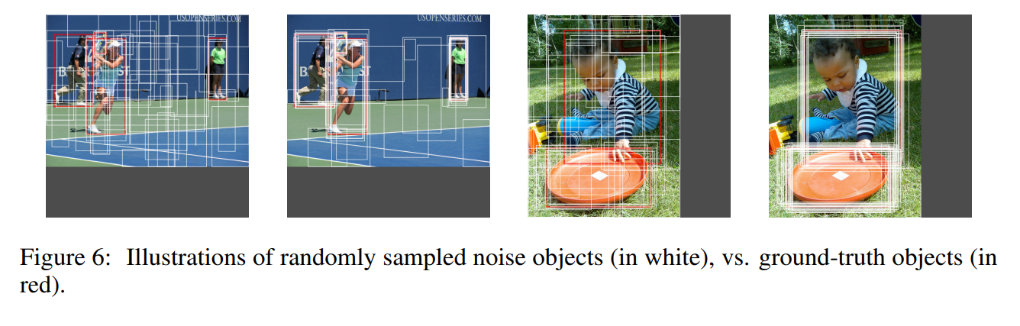
Sequence Augmentation
Augmentation method
Noise objects
Random Location
Adjacent to ground truth

Slide 17
Model Architecture
Encoder-decoder architecture
Encoder
A general image encoder that perceives pixels and encodes them into hidden representations, such as a ConvNet, Transformer, or their combination.
Decoder
Transformer decoder, widely used in modern language modeling. It generates one token at a time, conditioned on the preceding tokens and the encoded image representation. This removes the complexity and customization in architectures of modern object detectors, e.g., bounding box proposal and regression, since tokens are generated from a single vocabulary with a softmax.

Slide 18
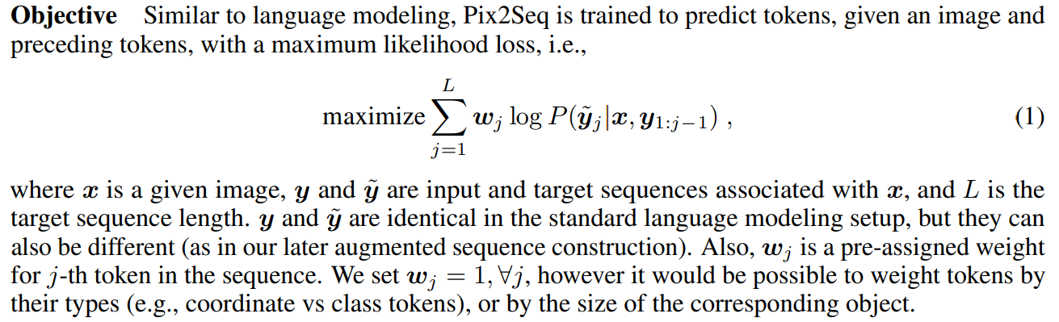
Objective Function
Maximum likelihood loss

Slide 19
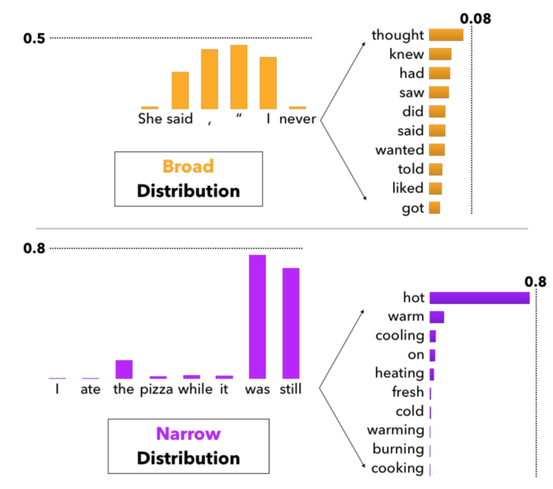
Inference
Top-P Sampling (aka. Nucleus sampling [9])
Nucleus sampling [9] has been applied to language modeling to reduce duplication and increase diversity in generated samples.
Description of nucleus sampling [10]

Slide 20
Q & A
Q & A

Slide 21
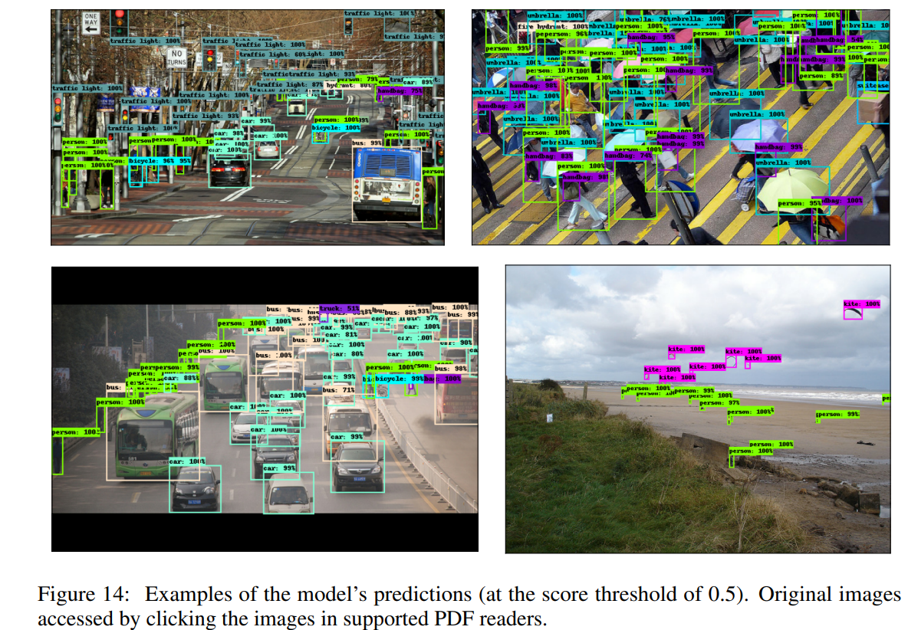
Experiments
Robust in Crowd scene and small objects

Slide 22
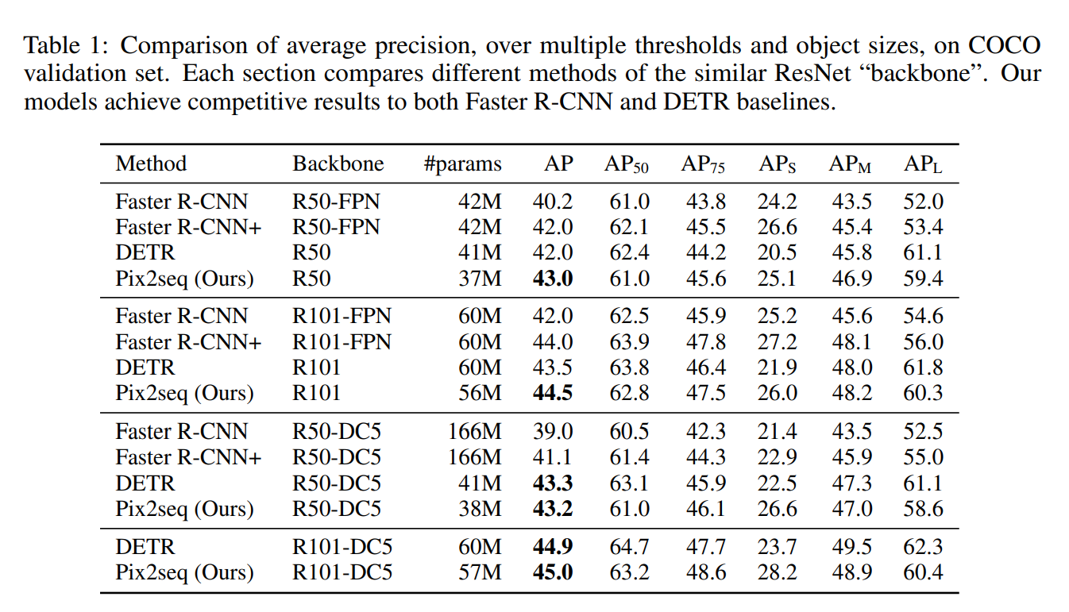
Experiments

Slide 23
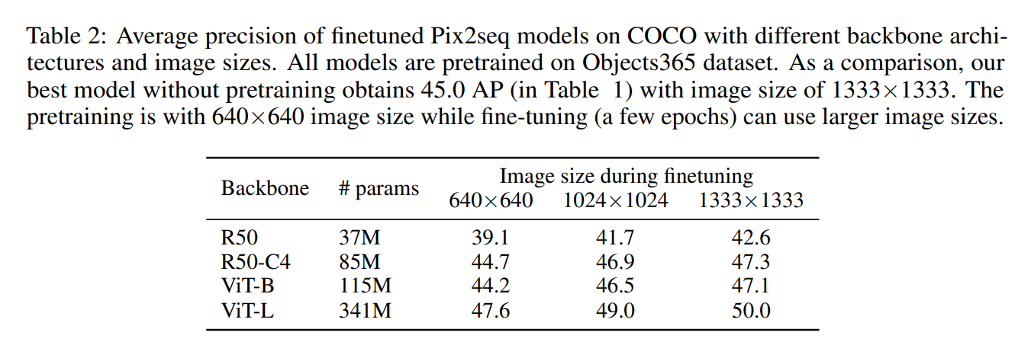
Experiments

Slide 24
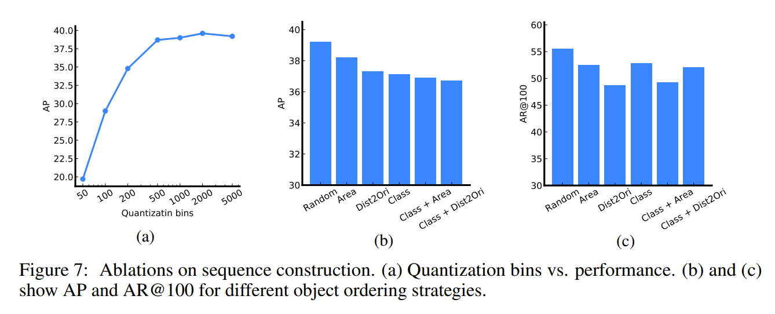
Ablation Studies
Sequence construction

Slide 25
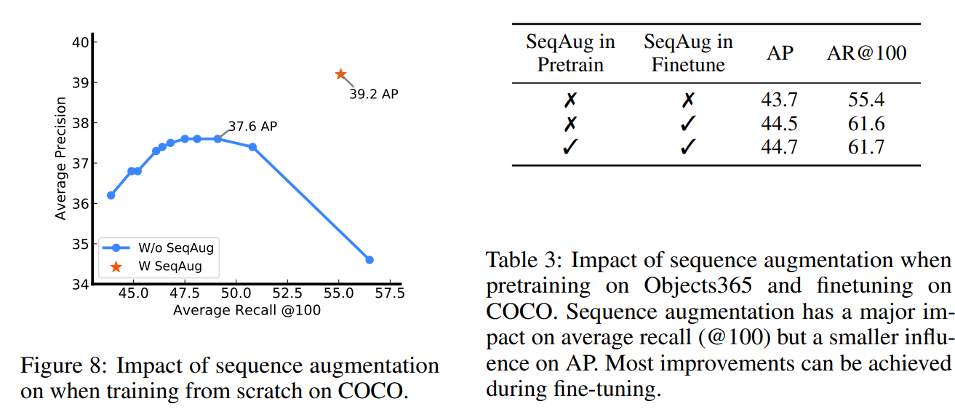
Ablation Studies
Sequence augmentation

Slide 26
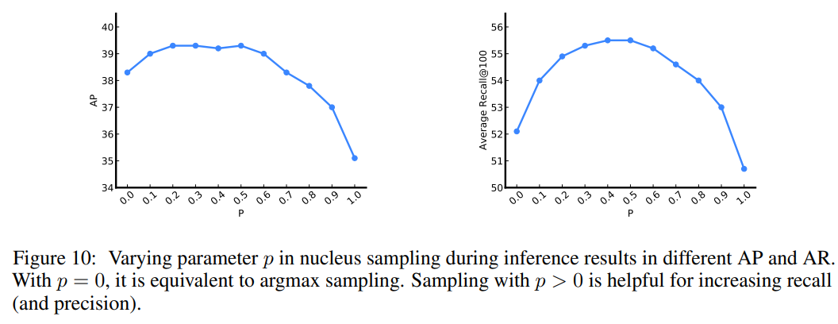
Ablation Studies
Inference: Argmax (p=0) vs Nucleus Sample [9]

Slide 27
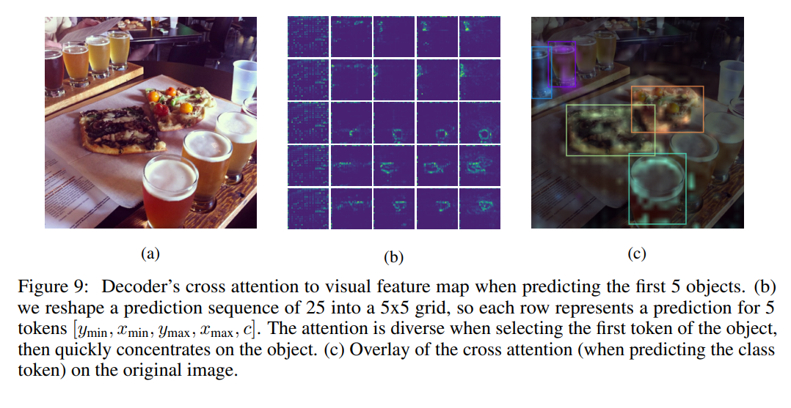
Attention map visualization

Slide 28
Q & A
Q & A

Slide 29
References
https://ai.googleblog.com/2022/04/pix2seq-new-language-interface-for.html
Girshick, Ross. "Fast r-cnn." Proceedings of the IEEE international conference on computer vision. 2015.
Tian, Zhi, et al. "Fcos: Fully convolutional one-stage object detection." Proceedings of the IEEE/CVF international conference on computer vision. 2019.
Lin, Tsung-Yi, et al. "Feature pyramid networks for object detection." Proceedings of the IEEE conference on computer vision and pattern recognition. 2017.
Redmon, Joseph, et al. "You only look once: Unified, real-time object detection." Proceedings of the IEEE conference on computer vision and pattern recognition. 2016.
Carion, Nicolas, et al. "End-to-end object detection with transformers." European conference on computer vision. Springer, Cham, 2020.
Cai, Zhaowei, and Nuno Vasconcelos. "Cascade r-cnn: Delving into high quality object detection." Proceedings of the IEEE conference on computer vision and pattern recognition. 2018.
Rezatofighi, Hamid, et al. "Generalized intersection over union: A metric and a loss for bounding box regression." Proceedings of the IEEE/CVF conference on computer vision and pattern recognition. 2019.
Holtzman, Ari, et al. "The curious case of neural text degeneration." arXiv preprint arXiv:1904.09751 (2019).
https://towardsdatascience.com/how-to-sample-from-language-models-682bceb97277

Slide 30
Thank you for your attention
Thank you for
your attention!

