Slide 1

Implementation of Somewhat Fully Homomorphic Encryption
Huang Chi

Slide 2



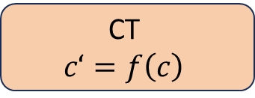
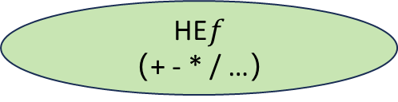

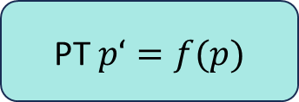

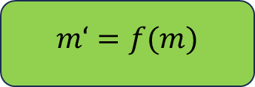

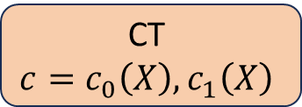


$$ℂ^{N/2}$$
$$ℤ\left[X\right]/(X^{N}+1)$$
$$(ℤ_{q}\left[X\right]/(X^{N}+1))^{2}$$
$$m$$
encode
PT $p(X)$
encrypt
CT
$$c=c_{0}\left(X\right),c_{1}\left(X\right)$$
HE$f$
（+ - * / …）
$$m‘=f(m)$$
decode
PT $p‘=f(p)$
decrypt
CT
$$c‘=f\left(c\right)$$
$$ℂ^{N/2}$$
$$ℤ\left[X\right]/(X^{N}+1)$$
$$(ℤ_{q}\left[X\right]/(X^{N}+1))^{2}$$

Slide 3
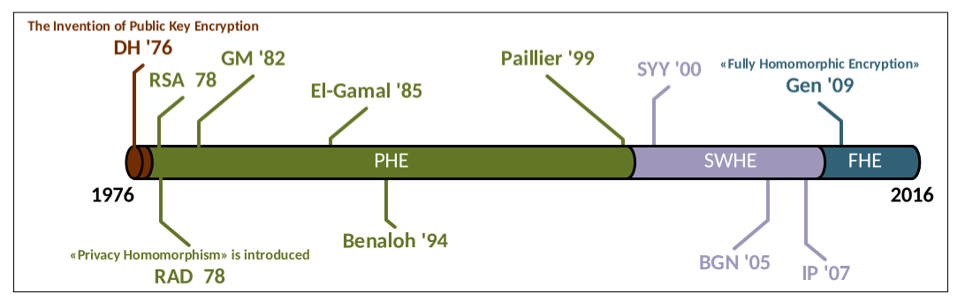
TFHE/FHEW
LFHE
SWHE
PHE
Notes:
PHE
加法or乘法
SWHE
有限次的加法和乘法
LFHE
复杂度上限L下的任意加法和乘法组合
FHE
任意次加法和乘法组合

Slide 4
Papers/Resources
FV12 Somewhat Practical Fully Homomorphic Encryption
(2012/099): Homomorphic Evaluation of the AES Circuit
(2021/204)：Revisiting Homomorphic Encryption Schemes for Finite Fields
OpenFHE: github: openfheorg/openfhe-development
Related:
CKKS17：Homomorphic Encryption for Arithmetic of Approximate Numbers
MP21： Bootstrapping in FHEW-like Cryptosystems

Slide 5
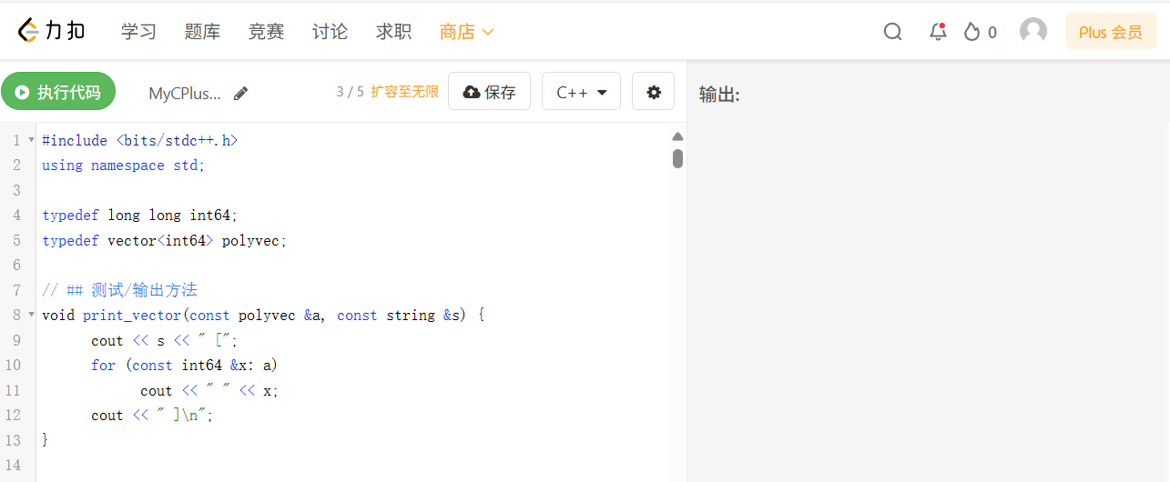
Source Code:
: MyCPlusPlus - LeetCode Playground (https://leetcode.cn/playground/rbCj7dfq/)

Slide 6



Preliminaries
Implementations
Future Works
Notes:
Source code : MyCPlusPlus - LeetCode Playground (https://leetcode.cn/playground/rbCj7dfq/)

Slide 7
Part
Preliminaries

Slide 8
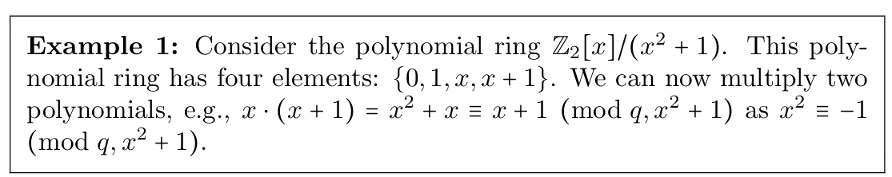

1.1 Polynomial Rings
Let Z be the ring of integers
and Z_{q} be the integer ring modulo $q$
Z[x] to denote the polynomial ring in the variable $x$ with integer coefficients
Z_{q}[x] to denote the polynomial ring with coefficients in Z_{q}
$R_{q}=ℤ_{q}[x]/(x^{n}+1)$, usually take $n=2^{k}$

Slide 9
1.1 Presentations of Polynomial Rings
Coefficient Representation
Value Presentatation

Slide 10
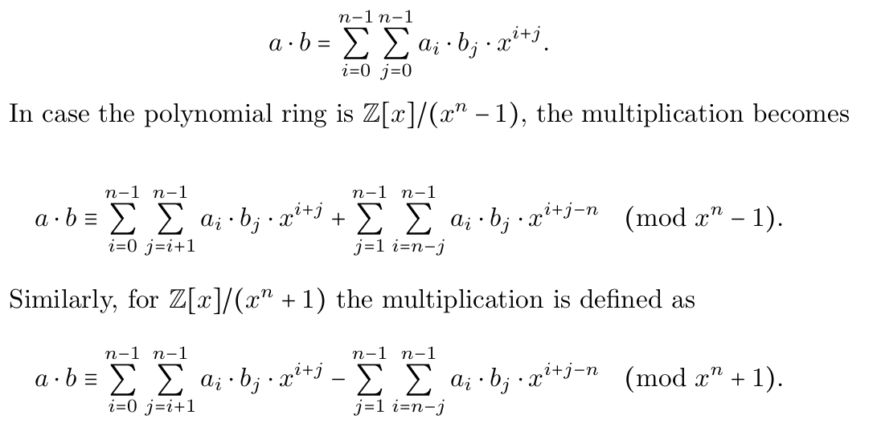

1.2 Polynomial Multiplication (Schoolbook)
Given two $n$-coefficient polynomials $a,b$:
  $a=\sum_{i=0}^{n−1}{a_{i}x^{i}}$ $b=\sum_{i=0}^{n−1}{b_{i}x^{i}}$
The multiplication is defined as:
Notes:
可以看到效率非常低，所以要引入NTT

Slide 11
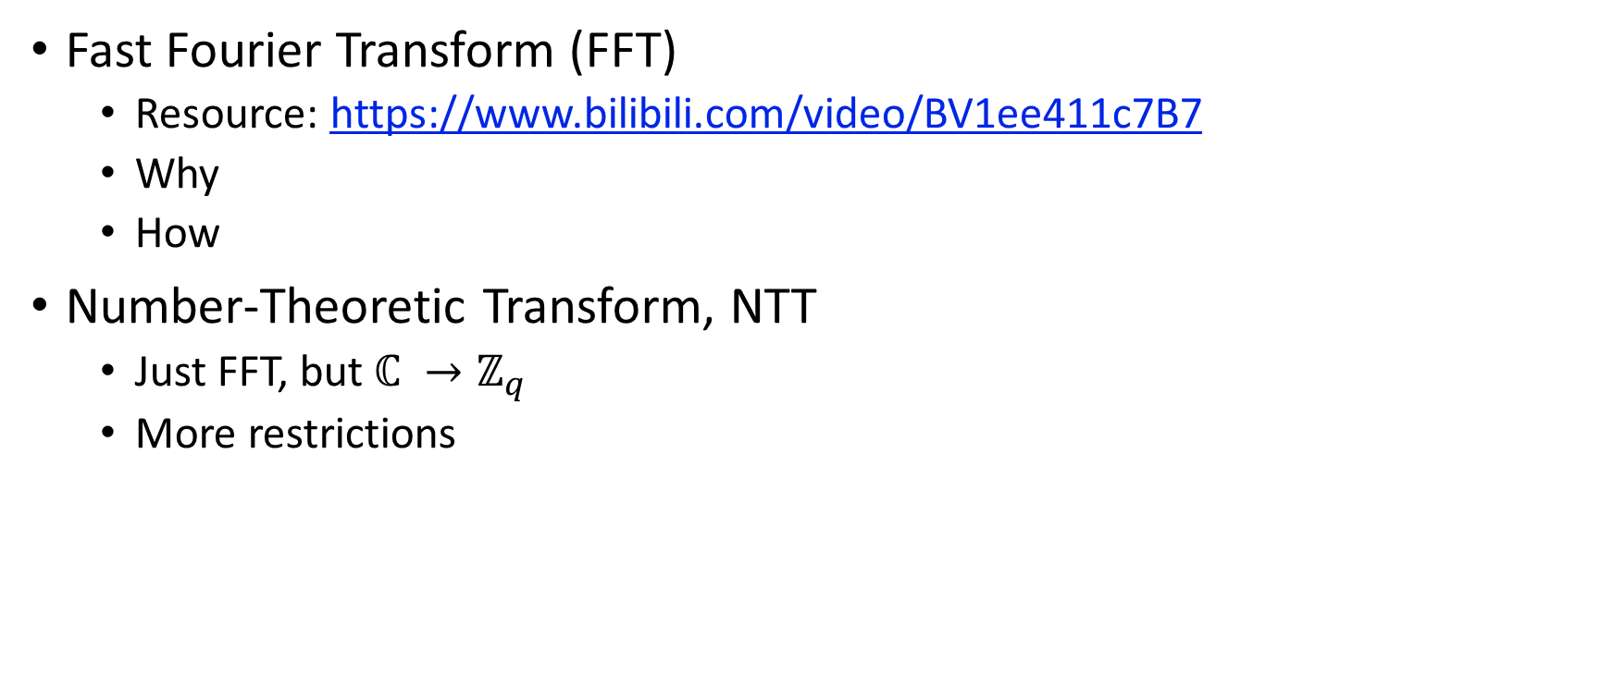
1.3 FFT / NTT
Fast Fourier Transform (FFT)
  Resource: https://www.bilibili.com/video/BV1ee411c7B7
  Why
  How
Number-Theoretic Transform, NTT
  Just FFT, but $ℂ →ℤ_{q}$
  More restrictions
Notes:
Explain later

Slide 12
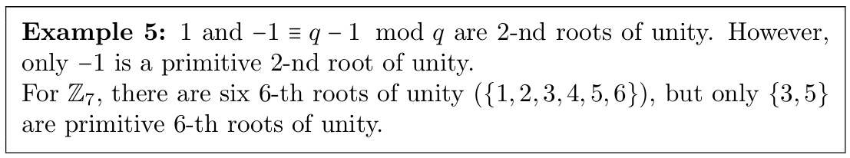

1.3 NTT: Primitive root of unity
An element $a∈ℤ_{q}$is a $k$-th (with $k∈ℕ$) root of unity if $a^{k}≡ 1 mod q$.
It is a primitive root of unity, if there is no $k′<k$, s.t. $a^{k′}≡1 mod q.$
A primitive $k$-th root of unity exists only if $k∣(q−1)$
(or more generally, it only exists if k divides the order of $ℤ_{q}^{∗}$.)
$ω_{k}$ denotes a primitive k-th root of unity
Notes:
说明：3和5都是7的6阶单位原根，但4不是，因为4**3=64 % 7 == 1

Slide 13
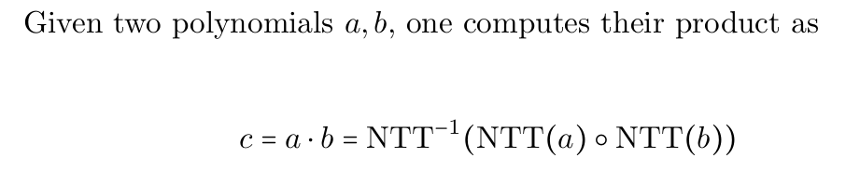
1.3 Number-Theoretic Transform (NTT)
Notes:
DFT to NTT

Slide 14
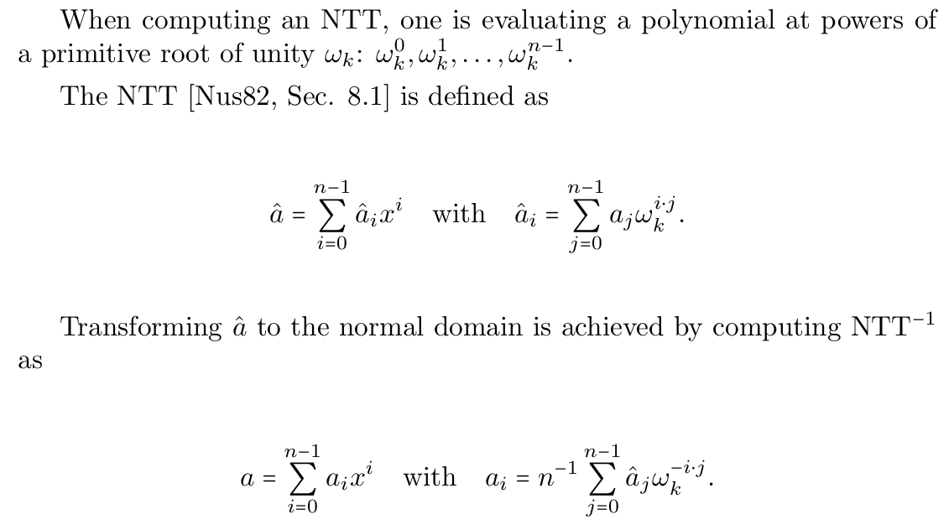
1.3 Compute NTT and NTT⁻¹

Slide 15
1.3 NTT
Pros
  Efficient
Cons (Limitations)
  For given n, only certain primes can be used
    E.g. n=4, only 17, 41, 73, 89, 97 has primitive roots (8 | p – 1)
  Calculation complexity is high when p is big
Notes:
Will Explain later

Slide 16
1.4 Chinese Remainder Theorem, CRT
CRT Core Idea:
  For a composite modulus M = m₁ * m₂ * ... * mₖ where all mᵢ are pairwise co-prime, the ring Z_M is isomorphic to the direct product ring Z_m₁ × Z_m₂ × ... × Z_mₖ.
  A large integer a mod M can be uniquely represented by a tuple of smaller residues (a mod m₁, a mod m₂, ..., a mod mₖ).
Residue Number System (RNS):
  A practical application of CRT that decomposes large-integer arithmetic into multiple parallel small-modulus computations.
  Advantages: Eliminates costly carry propagation, enables massive parallelism, and is highly amenable to hardware acceleration.
Notes:
前面讲到NTT的两个问题，用CRT就能很好的解决

Slide 17
1.5 Ring Learning With Errors (RLWE)
RLWE Problem Definition:
  Let Φ(x) be an irreducible polynomial (typically xᴺ + 1, where N is a power of two), defining the quotient ring R_q = Z_q[x] / (Φ(x)).
  Secret s(x): Sampled from a "small" error distribution (e.g., discrete Gaussian).
  Challenge: Distinguish between:
    RLWE samples: (aᵢ(x), bᵢ(x) = aᵢ(x) * s(x) + eᵢ(x)), where aᵢ(x) is uniform in R_q and eᵢ(x) is a small error.
    Uniform random samples: (uᵢ(x), vᵢ(x)), uniform in R_q × R_q.
Security Basis: The hardness of the RLWE problem is based on worst-case hardness assumptions of lattice problems (e.g., Shortest Vector Problem), making it a leading candidate for post-quantum security .
Application in BFV: The entire security of the BFV scheme is formally reduced to the hardness of the RLWE problem. Key and ciphertext structures are derived directly from this assumption.
Notes:
前面讲到NTT的两个问题，用CRT就能很好的解决

Slide 18
Part
Implementations

Slide 19
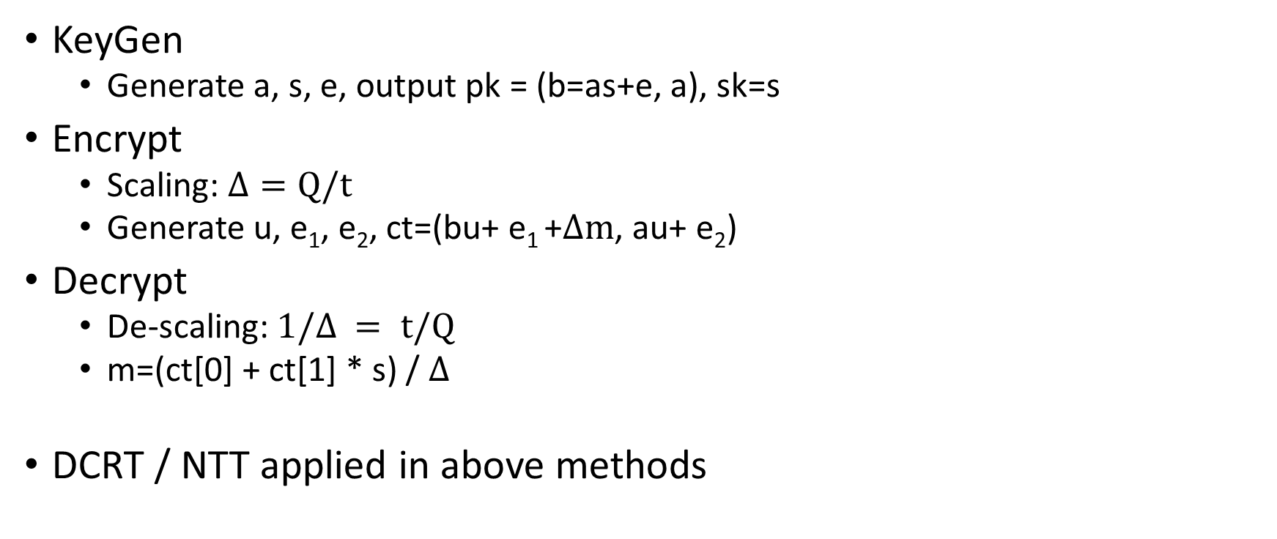
2.1 RLWE base scheme
KeyGen
  Generate a, s, e, output pk = (b=as+e, a), sk=s
Encrypt
  Scaling: $Δ=Q/t$
  Generate u, e₁, e₂, ct=(bu+ e₁ +$Δm$, au+ e₂)
Decrypt
  De-scaling: $1/Δ = t/Q$
  m=(ct[0] + ct[1] * s) / $Δ$
DCRT / NTT applied in above methods

Slide 20
2.2 Eval_Add, Eval_Sub
ct_add = ct1 + ct2
ct_sub = ct1 - ct2
Notes:
RLWE本身就是加法同态

Slide 21

2.2 Eval_Mult
ctx = (ct1[0], ct1[1]) * (ct2[0], ct2[1]) / $Δ$
= (ctx[0], ctx[1], ctx[2])
Decrypt:
  $Δm$ = ctx[0] + ctx[1] * s + ctx[2] * s²
Notes:
RLWE本身就是加法同态

Slide 22
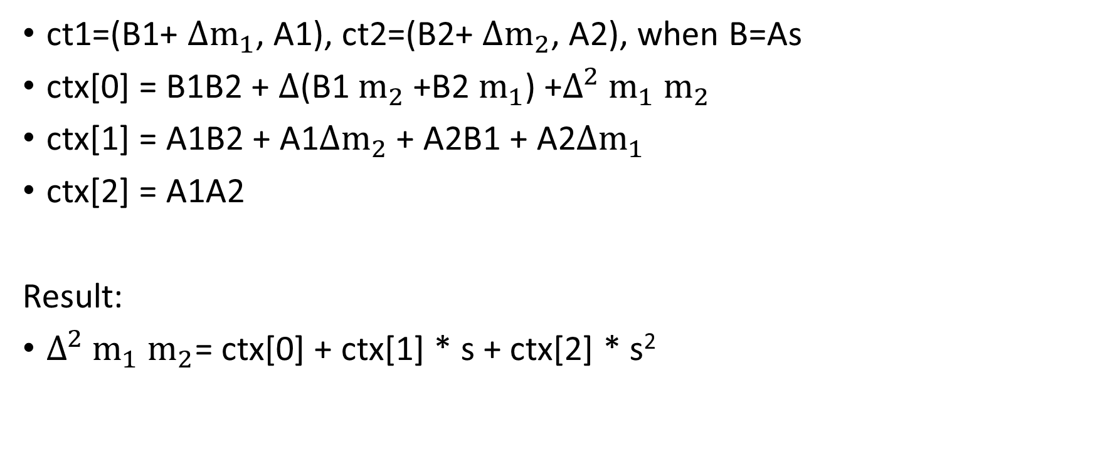
2.2 Eval_Mult Prove
ct1=(B1+ $Δm_{1}$, A1), ct2=(B2+ $Δm_{2}$, A2), when B=As
ctx[0] = B1B2 + $Δ$(B1 $m_{2}$+B2 $m_{1}$) +$Δ^{2}$ $m_{1}$ $m_{2}$
ctx[1] = A1B2 + A1$Δm_{2}$ + A2B1 + A2$Δm_{1}$
ctx[2] = A1A2
Result:
$Δ^{2}$ $m_{1}$ $m_{2}$= ctx[0] + ctx[1] * s + ctx[2] * s²
Notes:
RLWE本身就是加法同态

Slide 23
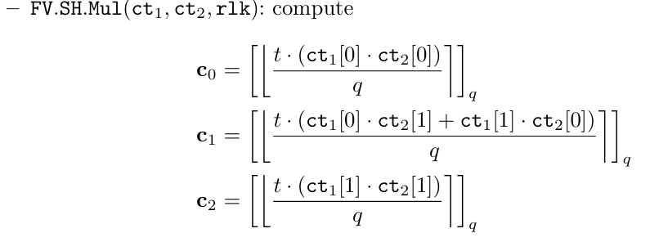
2.2 Eval Mult
Problem: cannot use DCRT
Need HPS/HPSPOVERQ/BEHZ etc..
Notes:
OpenFHE / 2021/204等提到

Slide 24
2.3 Relinearization
ctx = (ctx[0], ctx[1], ctx[2]) -> (ctr[0], ctr[1])
Compute rlk:
Problem?

Slide 25
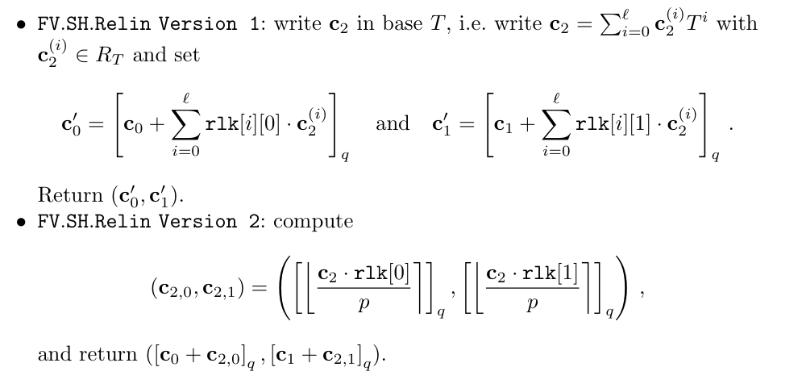
2.3 Relinearization: version1 vs version2

Slide 26
Part
Future Works

Slide 27
3 Future Works
Relinearization
LeveledSHE
Bootstraping (TFHE/FHEW)
Theme switching (RLWE -> LWE)

Slide 28
Thank You

