Slide 1
Antenatal Care
Iteration 1 Recap
Joshua Turner, Joseph Small, Dejan Tisma, Cameron Rothwell

Slide 2

Main Objectives:
Determine a collaborative process to use
Agile or UP? Somewhere in between?
Discover core use cases
Develop a domain model
Define a baseline architecture
Is it extendable?

Slide 3
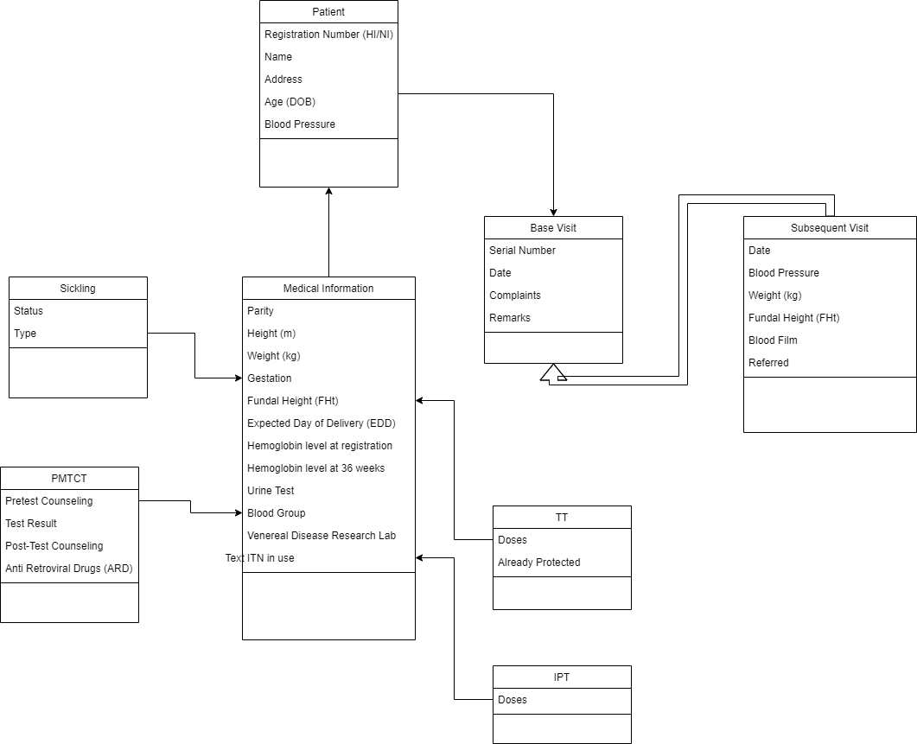
Domain Model:

Slide 4

Use Cases:
Retrieve Patient Information
To be collaborated with Consultant Register
Began this Iteration
Record information about visit
Data persistence and UI
Began this iteration
Retrieve information about previous visits
Generate a monthly report
Automated process
Alerts for time sensitive information

Slide 5

Work Completed:
Core use cases defined
First two slated for partial completion this iteration
Base Patient and Visit classes defined
Useable throughout our application
Constructed to be extended
Full architecture developed
Data access and persistence
Full MVC architecture
CLI built for demo, to be replaced

Slide 6

A Look Ahead: Iteration 2
Extend Base Visit Class
Addition of Subsequent Visits
Extend Base Patient Class
Addition of team specific medical information
Addition of new classes
Sickling, Doses
Construct Swing UI
Will replace CLI

Slide 7
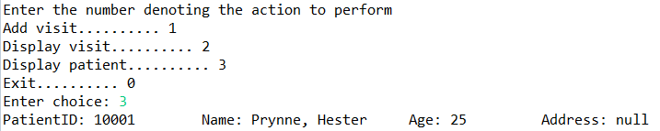
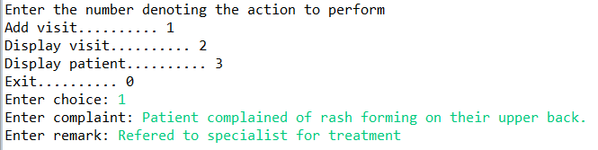
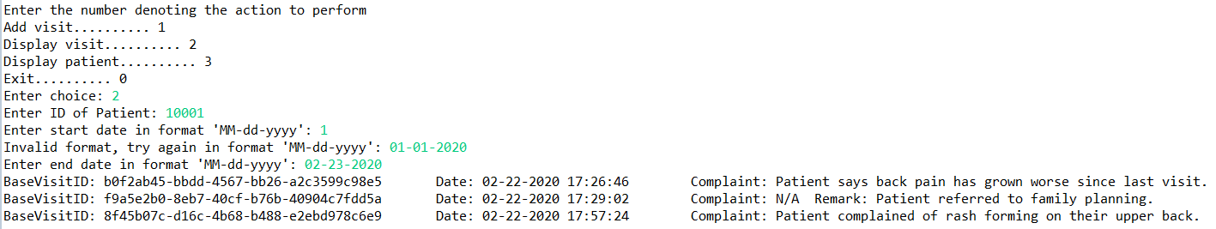
Demonstration:

Slide 8

Questions? Feedback?

