Slide 1
Antenatal – Iteration 3
Project Leader: Cameron Rothwell
Programming Team 1: Joseph Small, Joshua Turner
Programming Team 2: Dejan Tisma

Slide 2
Background Information
Antenatal Jobs:
- Display information about a patient’s pregnancy
- Store information gathered from each visit
- Generate a monthly report
Work done in previous iterations:
- Added first draft of Swing UI
- Added models/controllers for use cases: displaying information and storing visit information
- Implement patient search package from consulting register group

Slide 3
Objectives for this iteration
- Start on Generate Monthly Report use case
- Create methods necessary to generate this
- (optional) Add output
- Add functionality to UI
- Storing Visit Information use case
- Add classes for Sickling, PMCTC, TT, IPT, Dose. Add these fields to UI
- Displaying Patient Information use case
- Make Patient Information UI page read-only
- Add fields for displaying Sickling, PMCTC, TT, IPT, Dose to UI
- Refactoring
- MedicalInformation > PatientInfo
- Split UI code from one huge class into one for each UI tab, with a UI controller class to unite them
- Remove redundant data from multiple classes
- Add more unit testing

Slide 4
Problems/Risk Management
- Switching to online classes/Spring break
- I (Project leader) was very busy being kicked off campus
- Dealing with jobs also switching to remote
- Spring break recovery
- Extra meetings, virtual meetings
- Starting a new use case
- Assigned it to the individual programming team
- Team 2 depended on new classes from Team 1
- These new classes were made priority so Team 2 wasn’t held up very long. In practice, no time was lost.
- Specifically, Monthly Report use case methods needed Sickling, PMCTC, TT, IPT, Dose classes from Team 1

Slide 5
Time
- We accomplished all objectives, go team!
Start on Generate Monthly Report use case
- Estimate: 6.5h (8.5h including optional task)
- High estimate because of unknowns
- Actual: ~12h
Storing Visit Information use case
- Estimate: 3h
- Actual: 3h 10m
Displaying Patient Information use case
- Estimate: 6.5h
- Actual: 4.25h

Slide 6
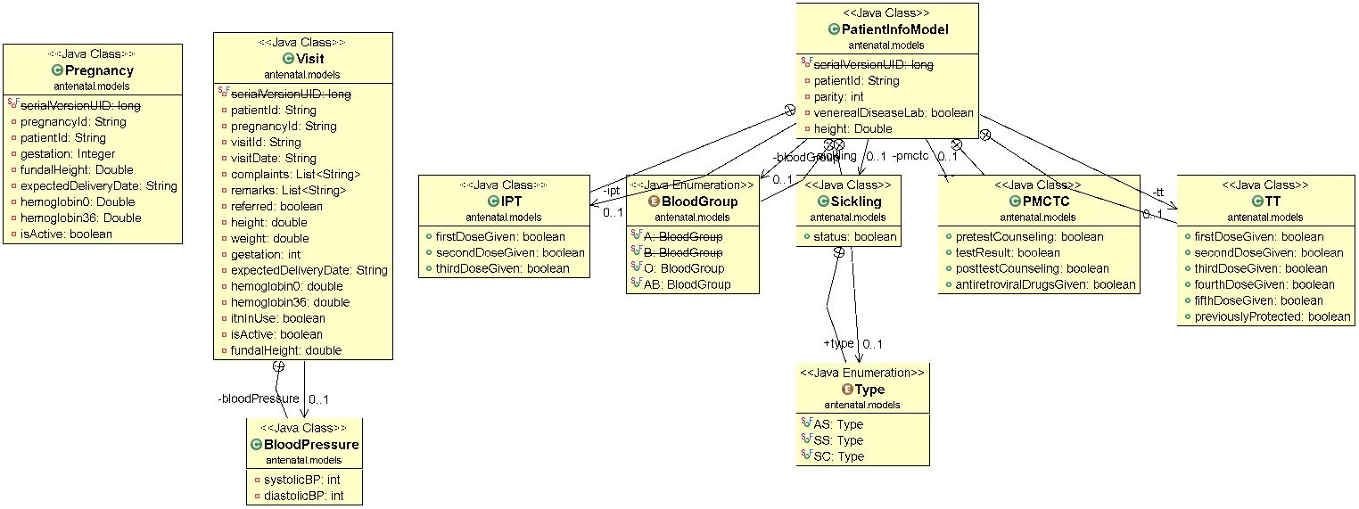
Model

Slide 7
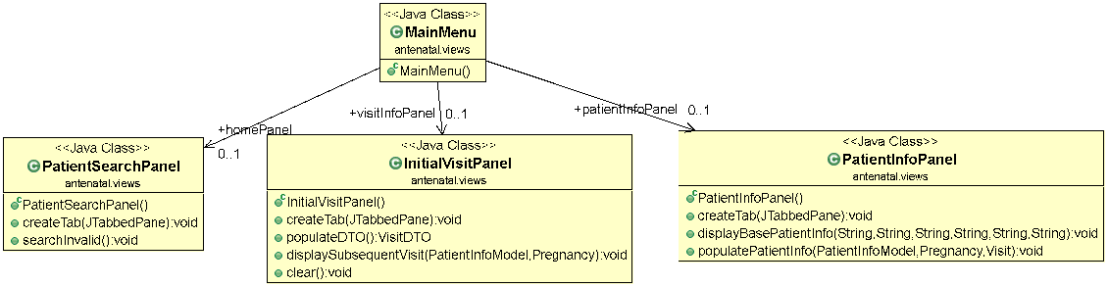
View

Slide 8
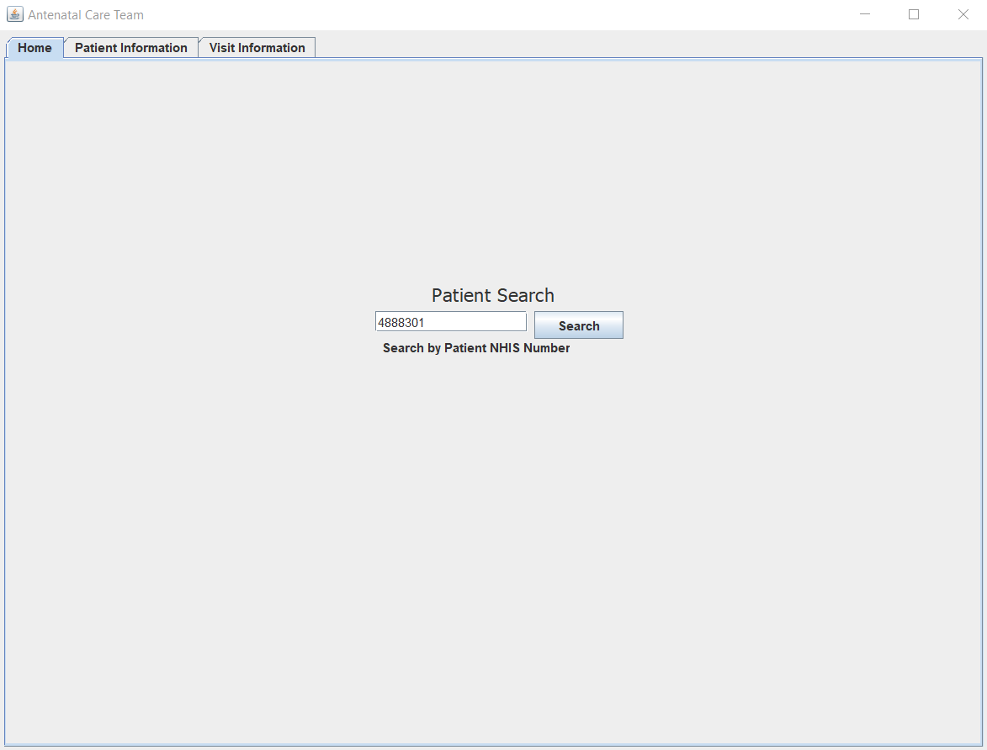
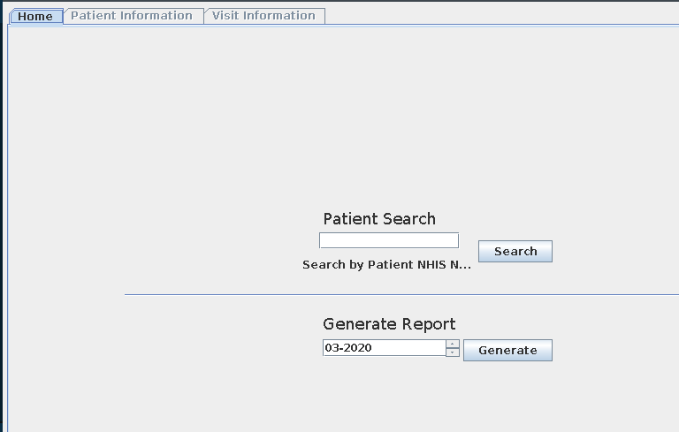
New UI Examples (sorry for format)

Slide 9
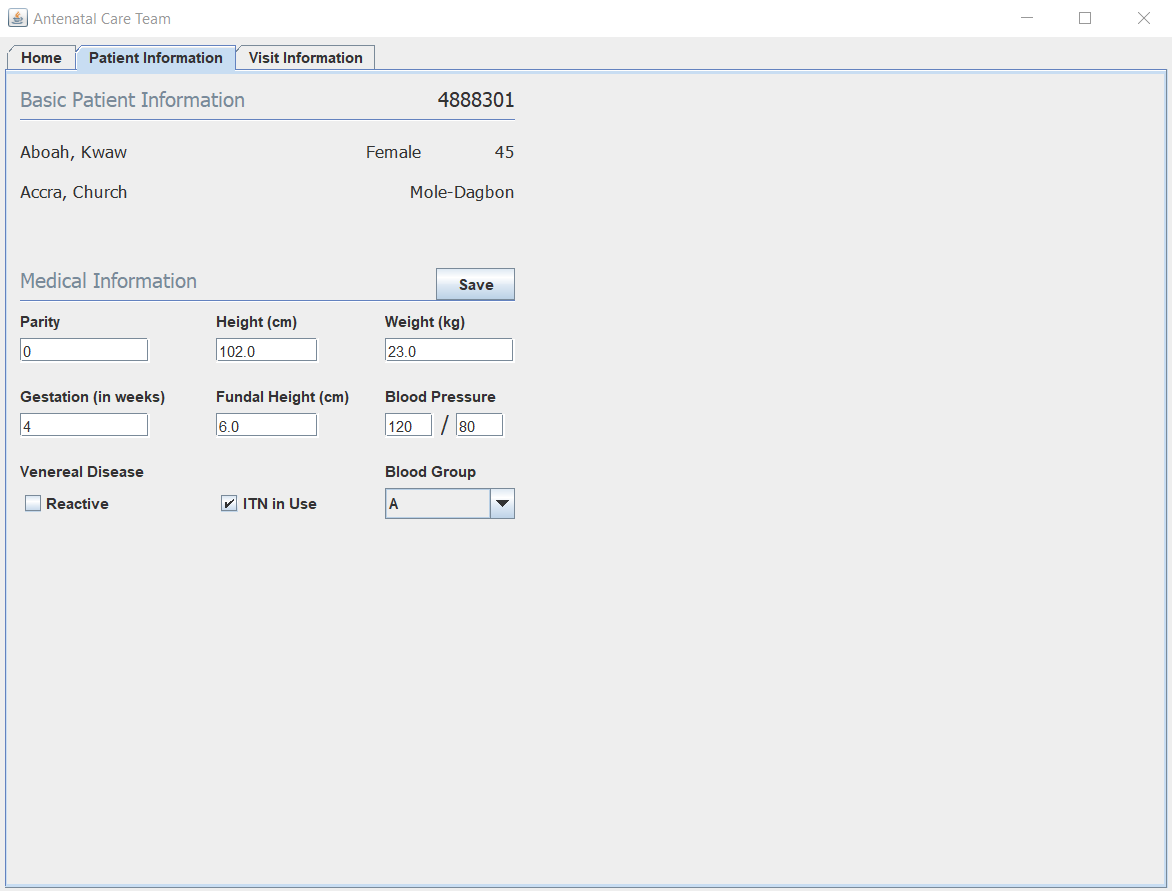
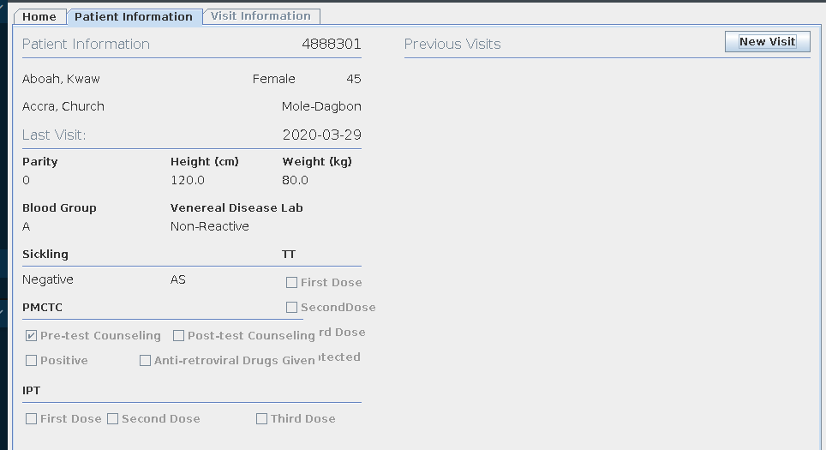

Slide 10
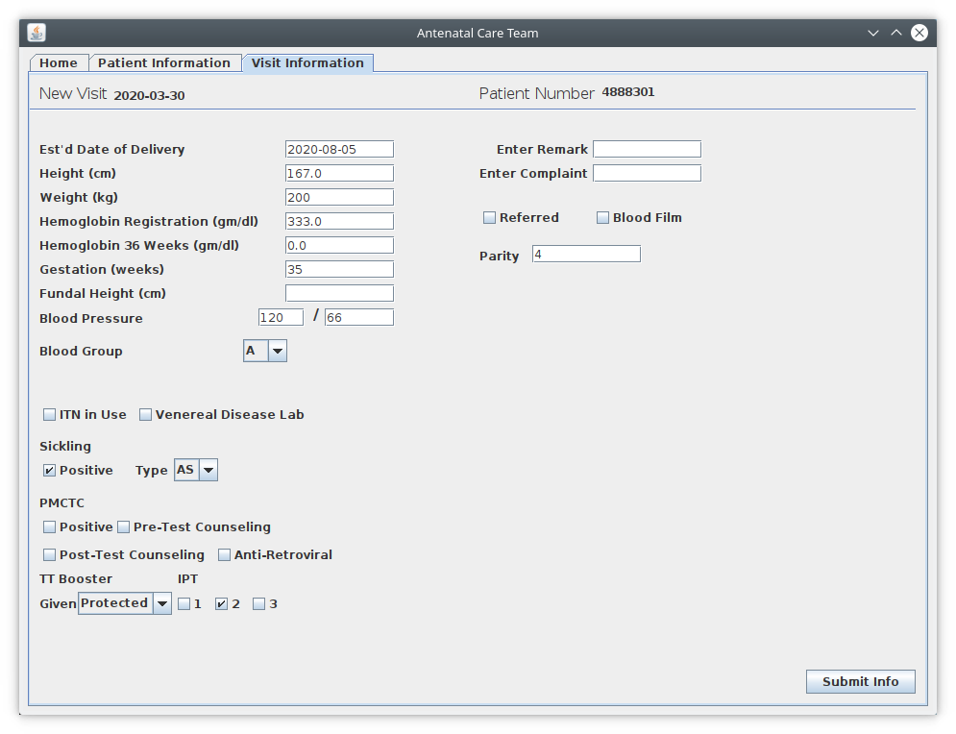
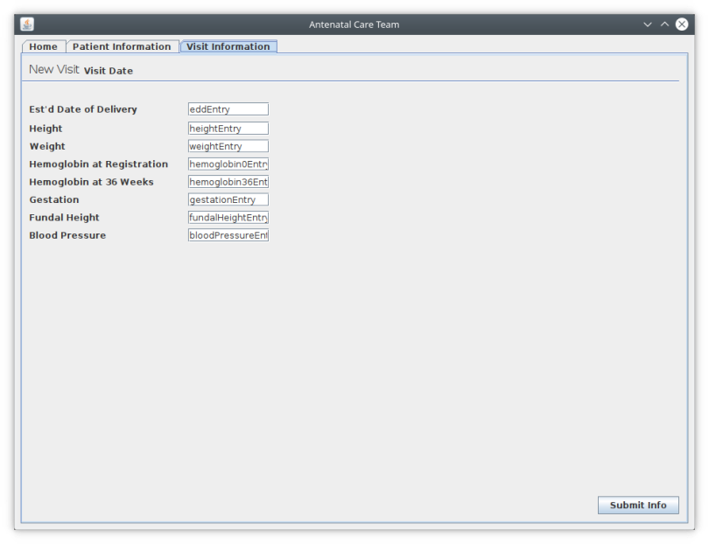

Slide 11
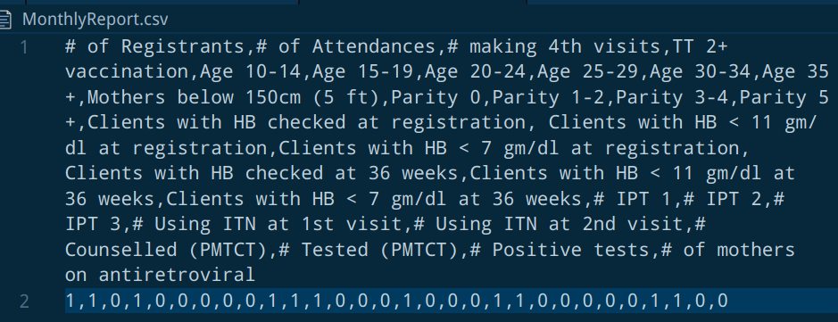
Generate Monthly Report CSV

Slide 12
Plans for next iteration
- Display a list of visits
- Refactoring
- Small bug/feature fixes
- Wrapping up the project/prep for iteration 5

