Slide 1
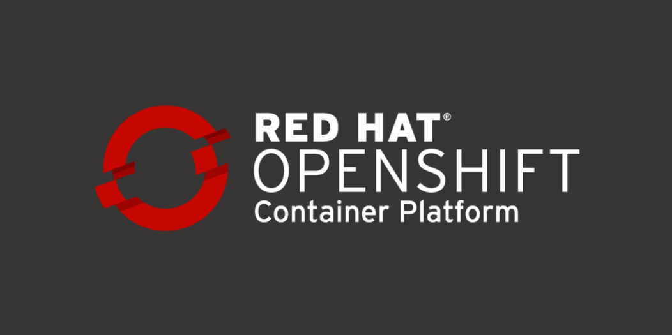
Presenter: Chandra Prakash
Designation: Solution Architect & Principal trainer (RHCA/RHCI)
Certification Verification link: https://rhtapps.redhat.com/verify?certId=140-235-748

Slide 2
Table to Contents DO280V412 – OpenShift Lab based Training
Day 1st
1. Declarative Resource Management
Resource Manifests
Kustomize Overlays
2. Deploy Packaged Applications
OpenShift Templates
Helm Charts
3. Authentication and Authorization
Configure Identity Providers
Define and Apply Permissions with RBAC
Day 2nd
4. Network Security
Protect External Traffic with TLS
Configure Network Policies
Protect Internal Traffic with TLS
5. Expose non-HTTP/SNI Applications
Load Balancer Services
Multus Secondary Networks
6. Enable Developer Self-Service
Project and Cluster Quotas
Per-Project Resource Constraints: Limit Ranges
The Project Template and the Self-Provisioner
Day 3rd
7. Manage Kubernetes Operators
Kubernetes Operators and the Operator Lifecycle Manager
Install Operators with the Web Console
Install Operators with the CLI
8. Application Security
Control Application Permissions with Security Context Constraints
Allow Application Access to Kubernetes APIs
Cluster and Node Maintenance with Kubernetes Cron Jobs
Day 4th
9. OpenShift Updates
The Cluster Update Process
Detect Deprecated Kubernetes API Usage
Update Operators with the OLM
10. Comprehensive Review
Additional contents:-
Production Use cases discussion and one Project implementation based on overall learning

Slide 3
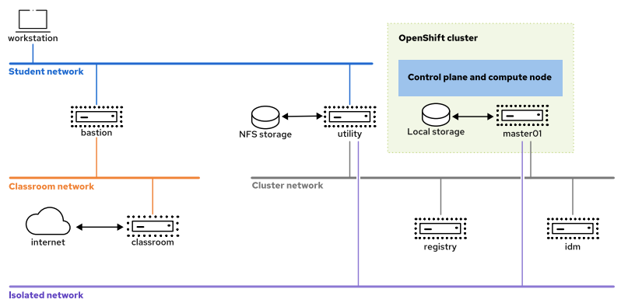
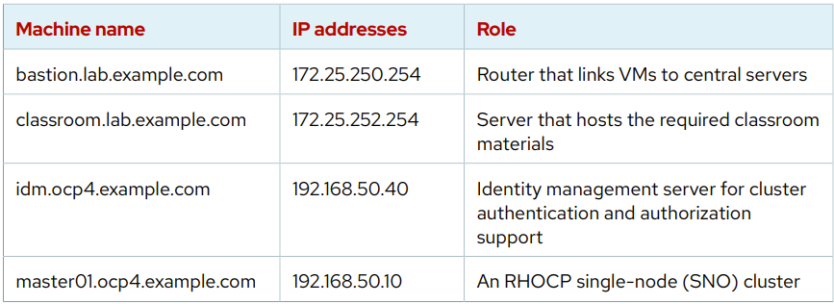
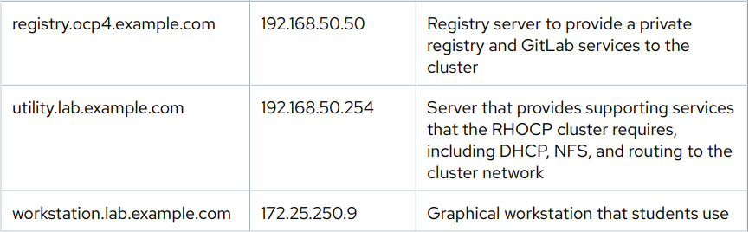
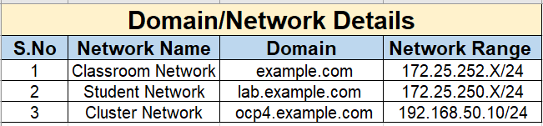

Slide 4
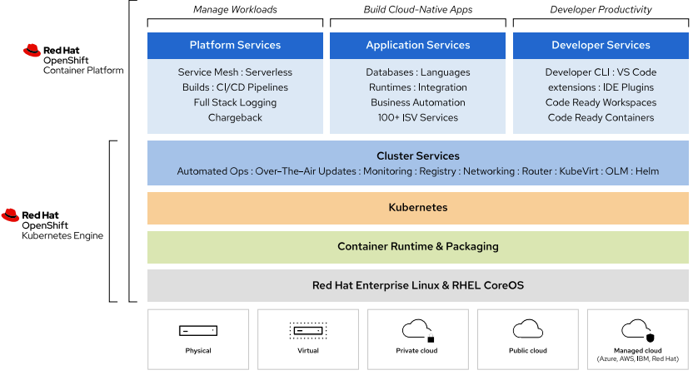
Red Hat OpenShift Container Platform (RHOCPv4.X)
RHOCP is based on the Kubernetes open source project and extends the platform with features that bring a robust, flexible, and scalable container platform to customer data centers, enabling developers to run workloads in a high availability environment.
Red Hat OpenShift product categories
1-Red Hat OpenShift Container Platform
2-Red Hat OpenShift Dedicated
3-Red Hat OpenShift Online
4-Red Hat OpenShift Kubernetes Engine
5-Red Hat Code Ready Containers

Slide 5
Introducing OpenShift Features
OpenShift is a comprehensive platform-as-a-service (PaaS) solution that leverages the power of Kubernetes to provide advanced features for managing and scaling containerized applications in a production environment.
It offers robust capabilities such as automatic scaling, self-healing, and automated upgrades, as well as a web-based user interface and command-line tools for managing and monitoring applications, making it an ideal choice for organizations looking for a streamlined and efficient way to deploy and manage their containerized workloads.
1. High Availability
2. Lightweight Operating System
3. Load Balancing
4. Automating Scaling
5. Logging and Monitoring
6. Services Discovery
7. Storage
8. Application Management
9. Cluster Extensibility

Slide 6
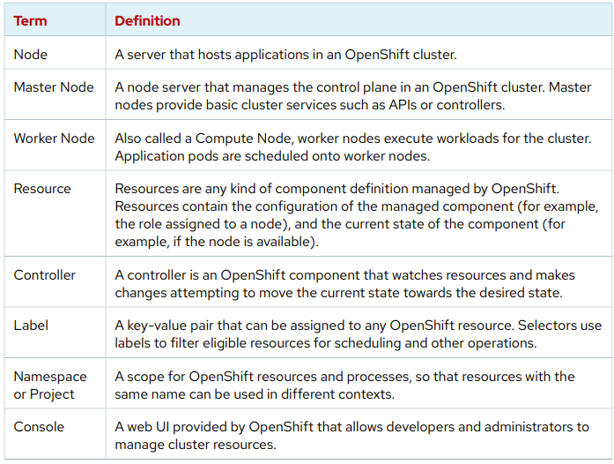
OpenShift Terminology
A ReplicaSet (RS) is a Kubernetes object used to maintain a stable set of replicated pods running within a cluster at any given time. A Kubernetes pod is a cluster deployment unit that typically contains one or more containers.
A ReplicationController ensures that a specified number of pod replicas are running at any one time. In other words, a ReplicationController makes sure that a pod or a homogeneous set of pods is always up and available.
What is the difference between replication controller and deployment in Kubernetes?
Deployments are a newer and higher level concept than Replication Controllers. They manage the deployment of Replica Sets (also a newer concept, but pretty much equivalent to Replication Controllers), and allow for easy updating of a Replica Set as well as the ability to roll back to a previous deployment.

Slide 7
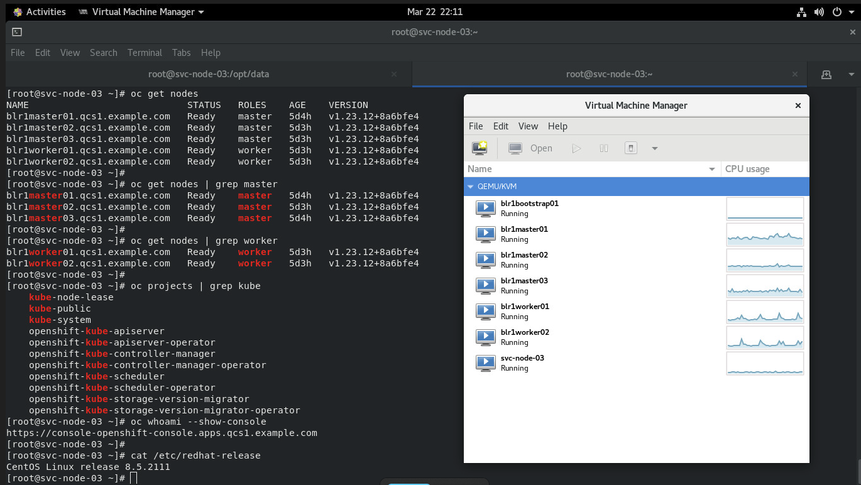

Slide 8
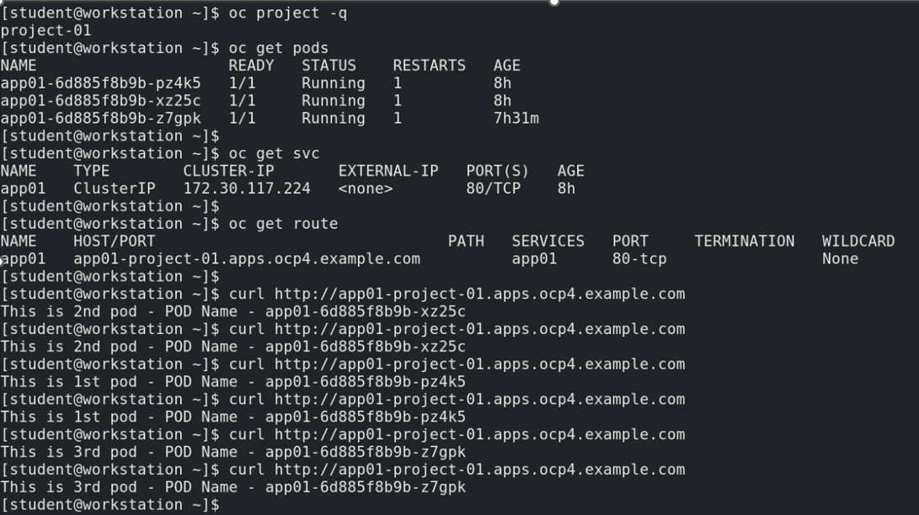
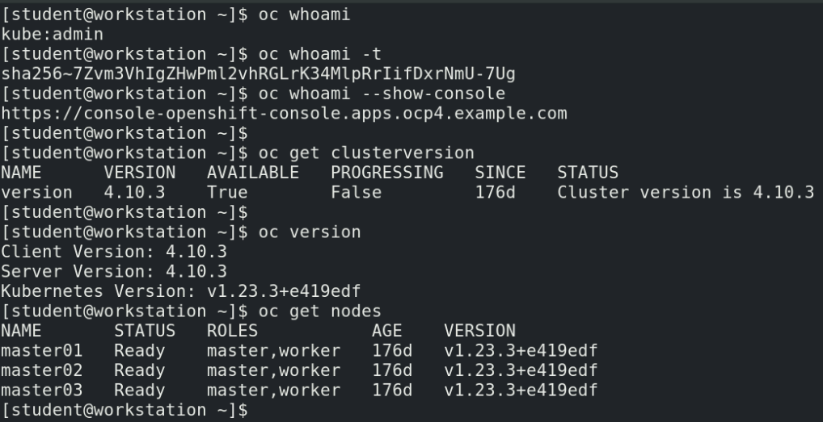
Clusters provide three types of load balancers:
An external load balancer, which manages access to the OpenShift API;
The HAProxy load balancer, for external access to applications;
The internal load balancer, which uses Netfilter rules for internal access to applications and services.
Route resources use HAProxy to manage external access to the cluster. Service resources use Netfilter rules to manage traffic from inside the cluster.
The technology that external load balancers use is dependent on the cloud provider that runs your cluster.

Slide 9
Containers use Linux kernel features, such as namespaces and control groups (cgroups).
Let's break down how containers utilize Linux kernel features like namespaces and control groups (cgroups) with an example.
Consider you have a web application that you want to run on your server. Traditionally, you might install the necessary software directly on the server's operating system. However, this can lead to dependency issues and conflicts with other applications running on the same system.
Instead, you decide to use containers to isolate your web application and its dependencies from the rest of the system using namespaces and cgroups.
Namespaces: Namespaces provide isolation for various system resources. They allow a process and its children to have their own view of the system. For instance, a process running inside a container can have its own isolated namespaces for processes, network, file system, etc., which are separate from those of the host system.
Example: When you run a web server inside a container, it sees its own isolated file system, network interfaces, process IDs, and other resources. This isolation ensures that processes inside the container cannot interfere with processes outside of it, providing a secure and isolated environment.
Control Groups (cgroups): Cgroups allow you to limit and manage resource usage, such as CPU, memory, and I/O, for a group of processes. This ensures that a container does not consume more resources than allocated and prevents one container from starving others on the same system.
Example: You can use cgroups to limit the amount of CPU and memory that the containerized web server can use. This prevents the web server from hogging all the resources on the server and ensures fair resource allocation among multiple containers running on the same host.
Combining namespaces and cgroups, containers provide lightweight and efficient virtualization, allowing applications to run reliably and securely in isolated environments without the overhead of traditional virtual machines.
In summary, namespaces provide isolation for various system resources, while cgroups allow you to manage and limit resource usage, enabling the creation of lightweight and isolated containers.

Slide 10
The Open Container Initiative (OCI)
The Open Container Initiative (OCI) maintains standards about containers, container images, and container runtimes. Because most container engine implementations are designed to conform to the OCI specifications, applications that are packaged according to the specification can run on any conforming platform.
Example illustrating how containers, adhering to OCI standards, leverage Linux kernel features such as namespaces and control groups (cgroups).
Suppose you have a Python web application that you want to deploy using containers. You've packaged your application according to OCI specifications, ensuring it can run on any conforming platform.
Here's how namespaces and cgroups come into play:
Namespaces:
When you run your Python web application inside a container, namespaces ensure that the application perceives its own isolated environment.
For example, the container's PID (Process ID) namespace provides the illusion to the application that it has its own PID space. Thus, the process IDs used inside the container are separate from those on the host system, enhancing isolation.
Similarly, the container's network namespace isolates network interfaces and configurations, preventing the application from directly interacting with the host network or other containers' networks.
Control Groups (cgroups):
Cgroups help in managing resource allocation and usage for the containerized application.
Let's say you want to restrict the CPU and memory usage of your Python web application. By utilizing cgroups, you can impose limits on CPU cores and memory usage, preventing the application from consuming excessive resources and ensuring fair resource distribution among other containers. Additionally, cgroups allow you to prioritize or throttle I/O operations, ensuring that disk and network access by the containerized application does not adversely impact other applications running on the same host.
By leveraging namespaces and cgroups, your Python web application, packaged as a container according to OCI specifications, gains benefits such as:
- Isolation: The application runs in an isolated environment, shielding it from interference and conflicts with other applications.
- Resource Management: You can control and allocate resources efficiently, preventing resource contention and ensuring optimal performance.
- Portability: Since most container engines conform to OCI standards, your containerized application can run seamlessly across different platforms without modification.
- In essence, the combination of OCI standards, Linux namespaces, and cgroups empowers developers to build, deploy, and run applications reliably and consistently across various container platforms.

