Slide 1


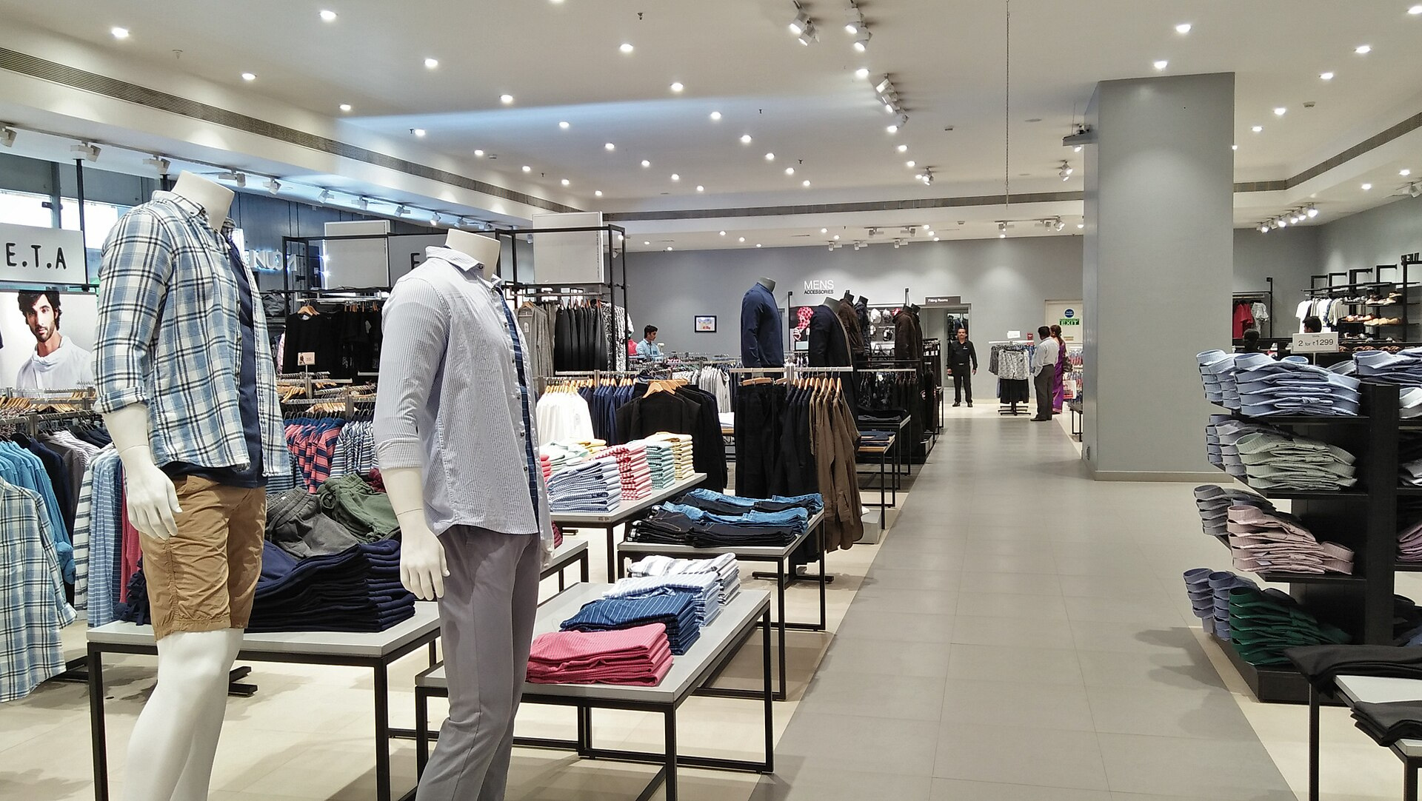
The
Stylist Mirror
Turning every Westside visit
into a complete outfit.
Analytics Capstone Project
Group M
Project Charter D1
Ambarish Sengupta
Arpan Shah
C Prashanth
Photo: Biswarup Ganguly, Wikimedia Commons, CC BY-SA 4.0

Slide 2

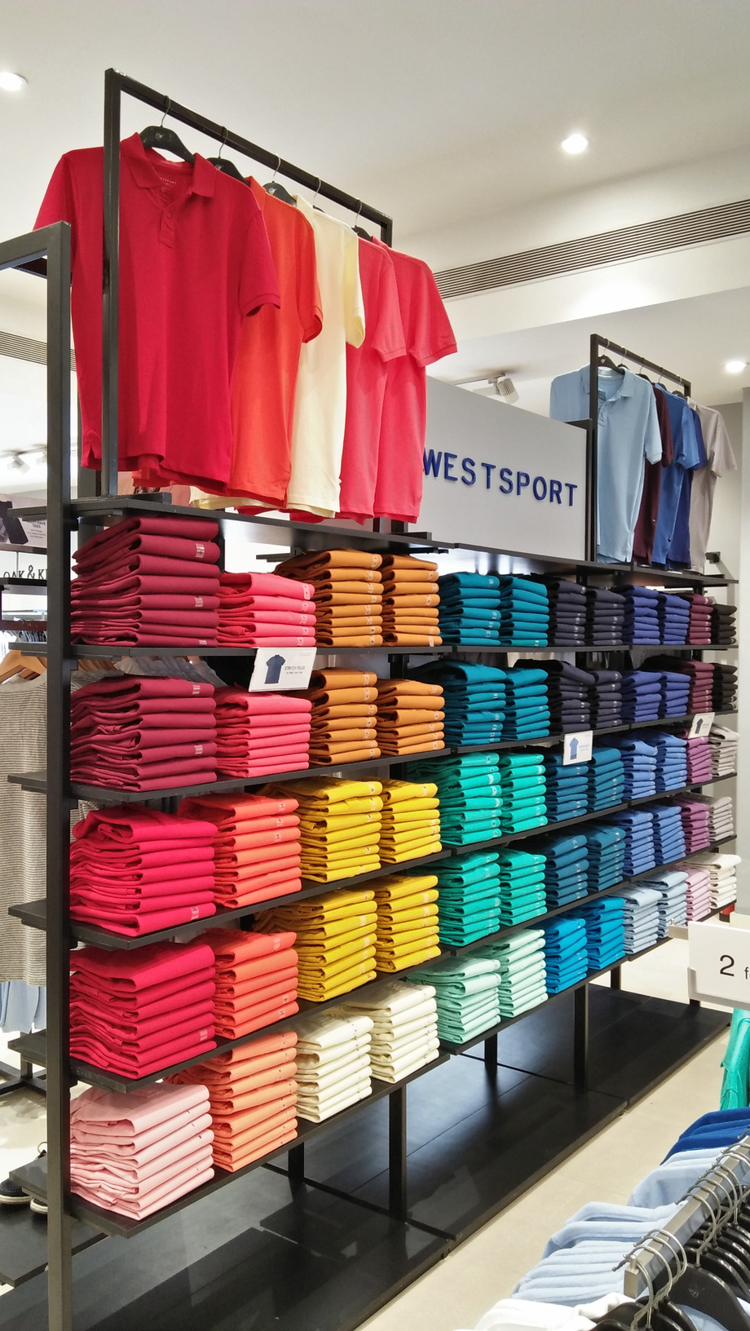
Westside knows its buyers
but sells them one item at a time
300
11.85M
19%
stores in
97 cities
WestStyleClub members drive over 90% of revenue
Trent Q1 FY27 revenue up, but like-for-like growth only low single digits
Shoppers get little styling help,
so many buy one item and leave
Stock is allocated on past sales,
so sizes run out while other items are marked down
Photo: Biswarup Ganguly, Wikimedia Commons, CC BY-SA 4.0

Slide 3

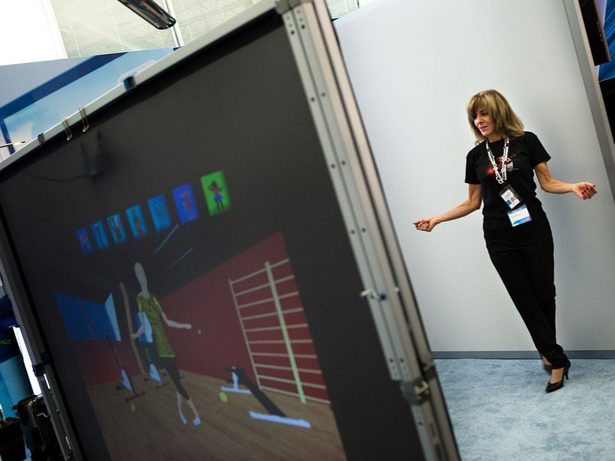
One mirror
01
Recognise
opt-in face login, or loyalty QR code
as an equal alternative
02
Read
purchase history, body proportions,
optional skin tone or shopper-chosen colours
03
Recommend
complete outfits, in stock, in the shopper's size, each with a plain-language reason
Photo: Intel Free Press, Wikimedia Commons, CC BY-SA 2.0. Similar technology built by others, not the Westside product.
04
Learn
what was viewed but not bought
sharpens the demand forecast

Slide 4

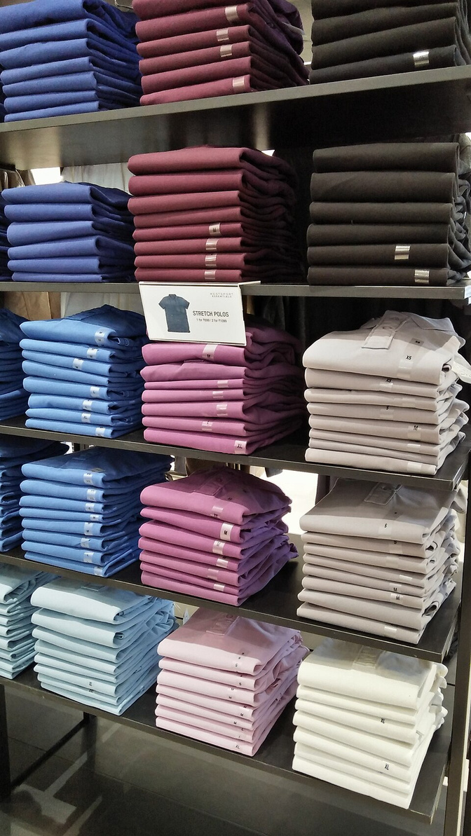


We prove it against best-sellers, across skin tones, and on stock
SUCCESS TESTS
GUARDRAILS
MAP@12 at least 3x a best-seller baseline (about 0.006 vs 0.038 competition winner)
Safety: no member matched to another; failed match falls back to QR
Outfit matching:
beat the published 51.8% accuracy
and 0.81 AUC on Polyvore
Privacy: opt-in only, face template not photo, no under-18s, deletion on request, DPDP Rules 2025
Fairness: error gaps across skin-tone groups stay within a limit set in M5
Honest limits: public proxy data; uplift figures are hypotheses, not results
Photo: Biswarup Ganguly, Wikimedia Commons, CC BY-SA 4.0
M1
M2
M3
M4
M5
M6
M7
Framing
Data
EDA
Modelling
Evaluation
Deployment
Communication

Slide 5

References and sources
Trent Limited, About us
trentlimited.com/pages/about-us
Polyvore Outfits, Vasileva et al. 2018
arxiv.org/abs/1803.09196
Trent Investor Presentation Q1 FY27 (NSE)
nsearchives.nseindia.com
BodyM dataset, Ruiz et al.
arxiv.org/abs/2210.05667
Trent MD&A FY2025-26
indiainfoline.com/company/trent-ltd/management-discussions
NIST FRVT Part 3 demographic effects
nvlpubs.nist.gov/nistpubs/ir/2019/NIST.IR.8280.pdf
Rebecca Minkoff digital store, Digiday
digiday.com/marketing/rebecca-minkoff-digital-store
Patent US20240169414A1
patents.google.com/patent/US20240169414A1/en
H&M smart mirrors at COS, Retail Dive
retaildive.com/news/hm-tests-smart-mirrors-at-cos-stores
Kaggle H&M Personalized Fashion Recommendations
kaggle.com/competitions/h-and-m-personalized-fashion-recommendations
Photos: Wikimedia Commons, Biswarup Ganguly (CC BY-SA 4.0), Intel Free Press (CC BY-SA 2.0)
Full list of 37 references is in Project Charter D1, Section 4.

