Slide 1

ExpenseShare: Group Trip Expense Manager
The problem statement involves designing a simple app for a group of 5 friends who are going on a 2-day trip. The app should help them manage their expenses during the trip.
The app should allow users to onboard, create and modify user groups, enter expenses, upload receipt copies, tag and untag group members for each expense, facilitate payback to selected group members.

Slide 2
MY OUTLOOK ON PROBLEM
Designing an app called "ExpenseShare" to help a group of 5 friends manage their expenses during a 2-day trip to any destination. The friends, Ram, Tom, Raj, Dan, and Amir , have different responsibilities for the trip. For E.g ‘Raj' handles travel booking, ‘Tom' takes care of accommodation, and food expenses are shared among the group. ‘Ram' pays for himself Tom, and Raj, while ‘Amir' pays for Dan and himself.
And the app allows users to onboard, create and modify trip groups, enter expenses, upload receipts, tag relevant group members for each expense, facilitate payback to selected members, and ultimately close the group when all expenses are equally split and reconciled. For E.g
Expense | Total Amount | Description | Category | Date | Paid by | Tagged Members
Expense 1 | 10000 | Flight tickets | Travel | 2023-07-01 | Raj | All

Slide 3
Basic FLOW CHART
Onboarding
[Users can register and create an account also log in]
Home Screen
[Users can view their active trips or create new trip group]
Trip Details
[Users can enter the details of the trip, such as the destination, dates, and purpose.]
Add/Edit Expense Entry
[Users can add new expenses, including the amount, description, and category. Also can attach receipt copies.]
Expense Management
[Users can tag or untag group members for each expense.
Users can split expenses equally among all group members.]
Group Closure
[Once all expenses are split equally and reconciled with payments, the group can be closed. A summary will be provided.]
Payback
[Users can initiate paybacks to selected group members. Paybacks can be done in whole or in parts.]

Slide 4
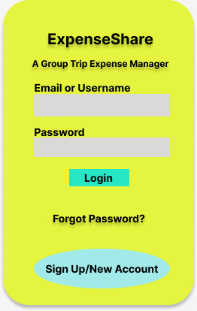
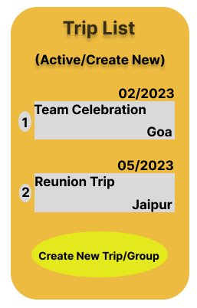
Wireframes for the app
Onboarding
Home Screen

Slide 5
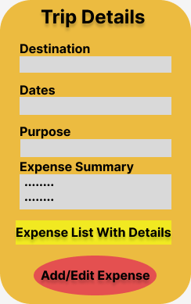
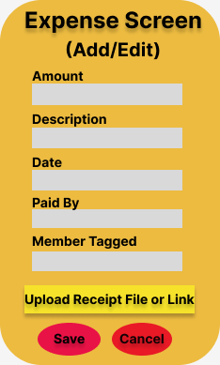
Wireframes for the app
Trip Details
Expense Entry Screen

Slide 6
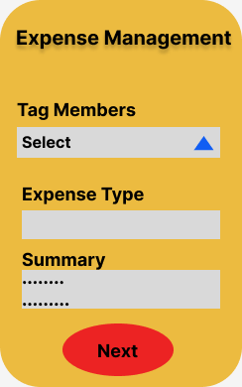
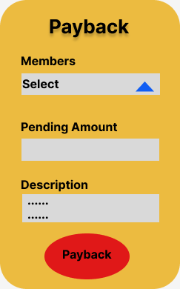
Wireframes for the app
Expenses Management
Payback

Slide 7
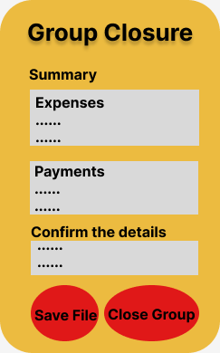
Wireframes for the app
Group Closure Screen

Slide 8
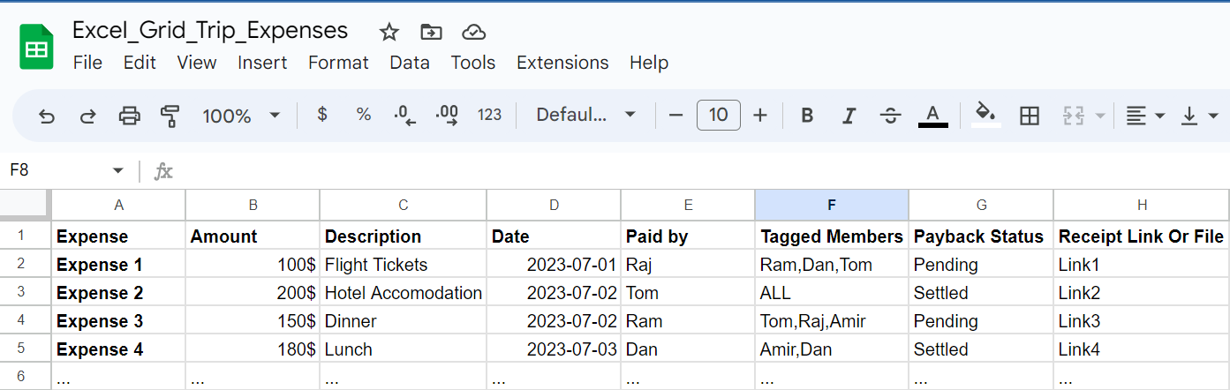
Excel grid for expense tracking
Link for the Excel File :-
https://docs.google.com/spreadsheets/d/1guA47E2-mqzaayjdPMYXGRIcTNDKitFxbH92xc0S8uk/edit?usp=sharing

