Slide 1
tutorials

Slide 2
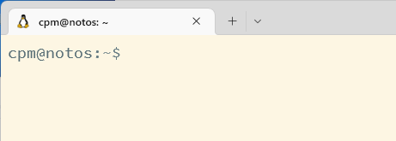
Rounded Corners
Problem: Windows 11 rounded corners have background bleeding through
Solution: https://github.com/valinet/Win11DisableRoundedCorners

Slide 3
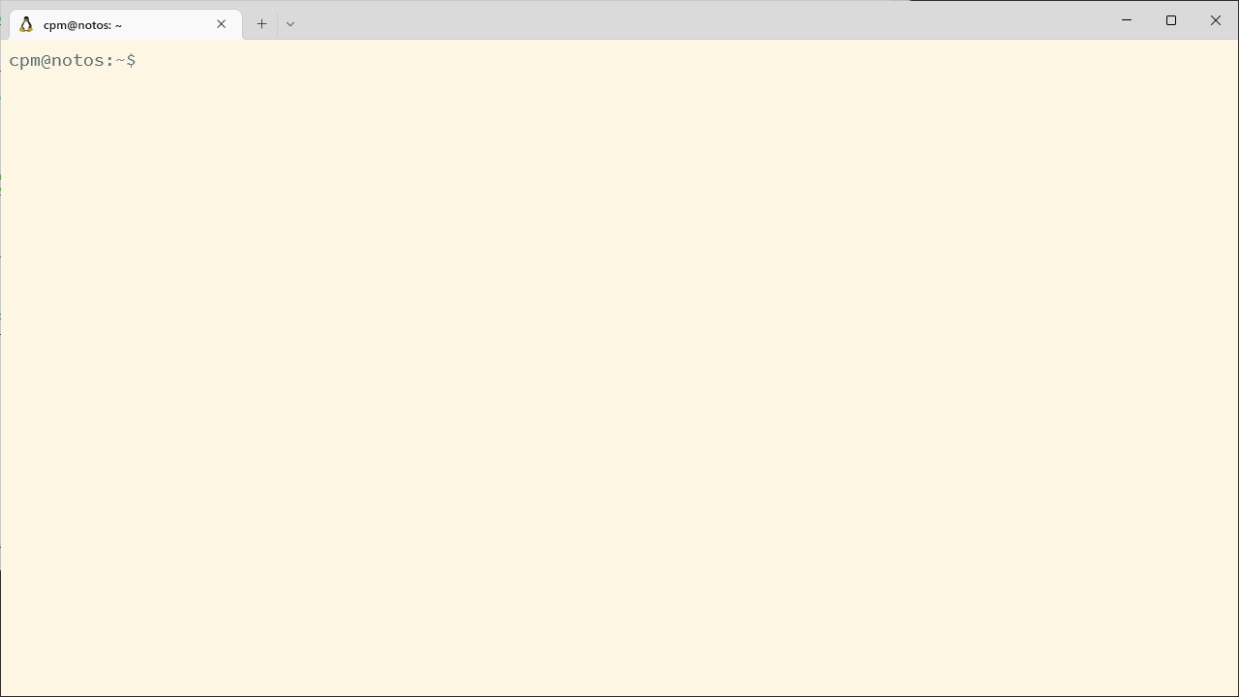
Window capture bleed
Set `sizer` to e.g. 1282x722
Crop with imagemagick.org in a script

Slide 4
Speed up and freeze
Problem: narration and screenrecording differ in pace
Solution:

