Slide 1
An Introduction to GoLang
Chris Prinz

Slide 2
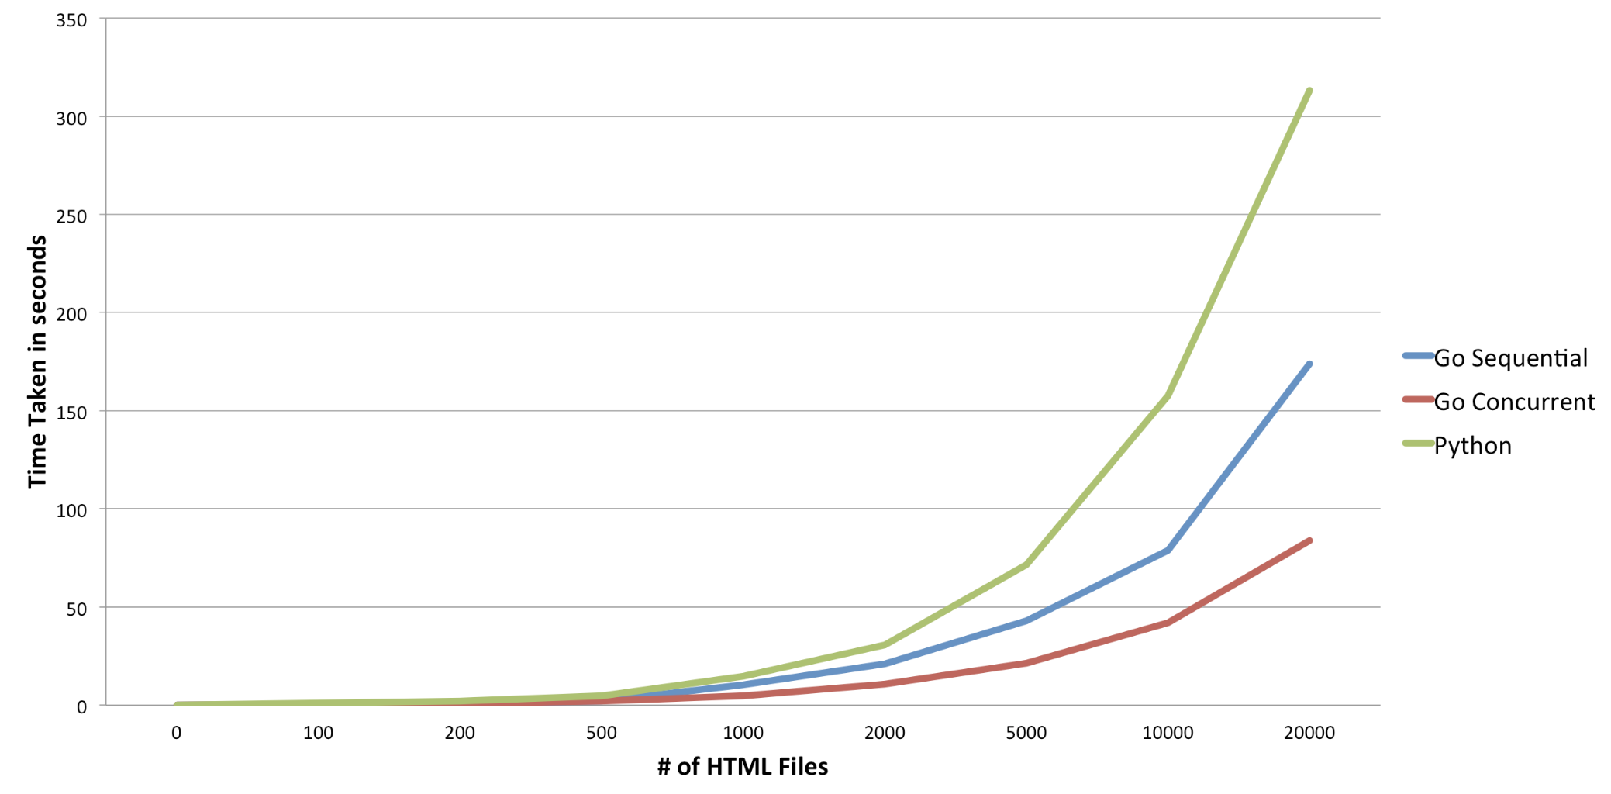
Language Overview
Go = C + Python + JS
Language goals
Easy to learn
Type and memory safe
Ideal for concurrency
Fast compilation
Good for any asynchronous programming that demands high performance
http://blog.dataweave.in/post/81760696759/web-scraping-at-scale-python-vs-go

Slide 3
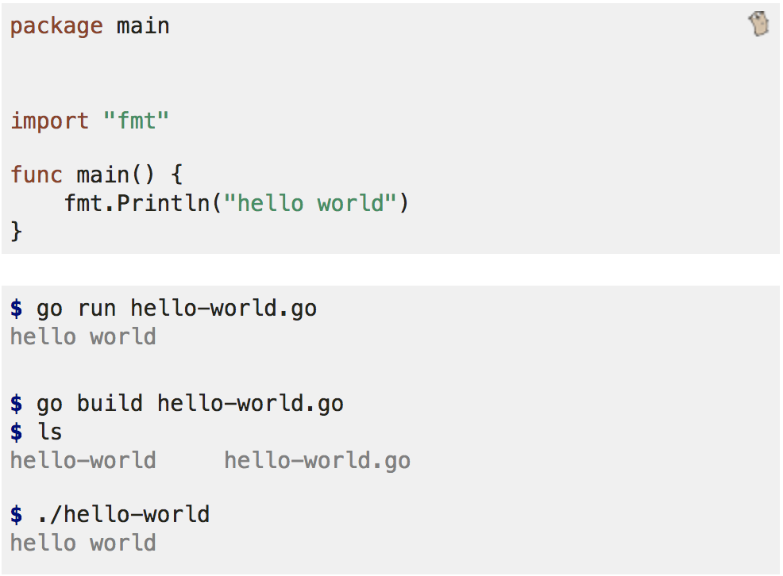
Hello World
https://gobyexample.com/hello-world
Notes:
Go run compiles and runs the binary
Go build builds the file into an executable binary

Slide 4
Language Quirks
Unused variables result in compilation error
Unused imports result in compilation error

Slide 5
Control Structures
If/else
For
for i := 0; i < 10; i++ {}
for foo == true {}
for {}
Switch/Case

Slide 6
Syntax Quirks: Declaration and Initialization
Declaration
var myInt int
Initialization
myInt = 0 // setting myInt to a value
myOtherInt := 0 // int typing is implicit

Slide 7
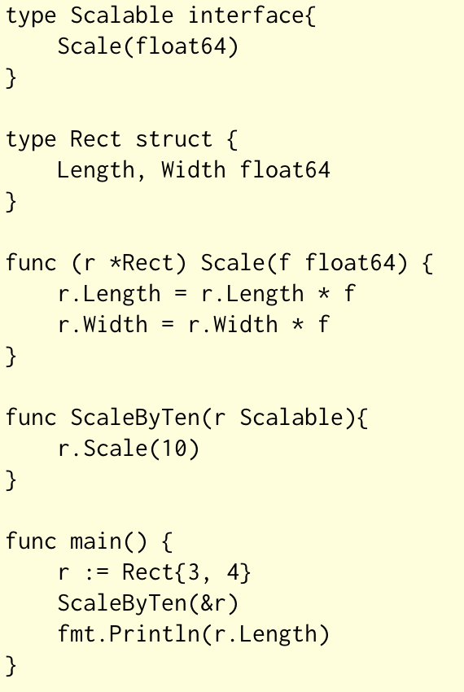
Syntax Quirks: Interfaces, Structs, Methods
Notes:
ScaleByTen and take anything that has a Scale method

Slide 8
Syntax Quirks: Public and Private Visibility
func Foo()
Visible outside of package
func bar()
Not visible outside package
type Rect struct{ Width int; height int}
Width is accessible outside package via Rect.Width
height is not visible outside of package

Slide 9
Channels and GoRoutines
“Do not communicate by sharing memory, instead share memory by communicating”
GoRoutines
Lightweight concurrent functions (like threads)
Removes complexities of thread management
Channels are used to communicate between routines
stringChan := make(chan string)
Read from channel: val := <- stringChan
Write to channel: stringChan <- val

