Slide 1
LAB 3B
Computer Programming

Slide 2
Topics for Today
Break/Continue
Type Casting
Static vs Global Variables
Arrays
Notes:
Objectives:
Understand the use of break and continue statements in loops.
Learn type casting in C for converting data types.
Distinguish between static and global variables.
Introduction to arrays: Definition, syntax, and usage.
Problem-solving using arrays: Leaders in an array, reversing arrays, finding subarrays with a given sum.
Explore row-major and column-major forms for arrays.

Slide 3
Break and Continue Statements
Break and Continue in Loops:
Break: Terminates the loop prematurely.
Example: Exiting a loop when a certain condition is met.
Continue: Skips the current iteration and moves to the next one.
Example: Skipping even numbers in a loop that processes only odd numbers.

Slide 4
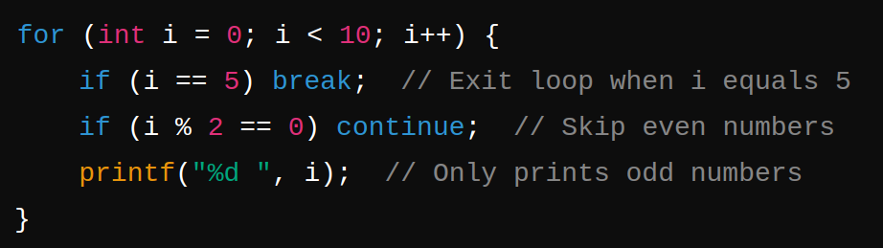

Slide 5
Type Casting
Type Casting:
Implicit Casting: Automatic conversion of data types (e.g., int to float).
Explicit Casting: Manual conversion of data types using type casting operators.
Example: Converting float to int to truncate decimal values.

Slide 6
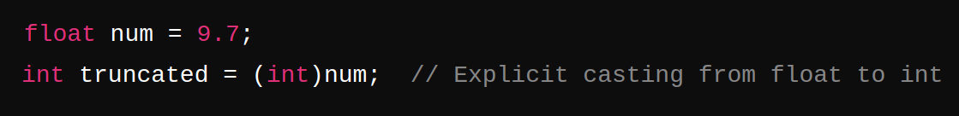
Use Case: Handling mixed data types in arrays and arithmetic operations.

Slide 7
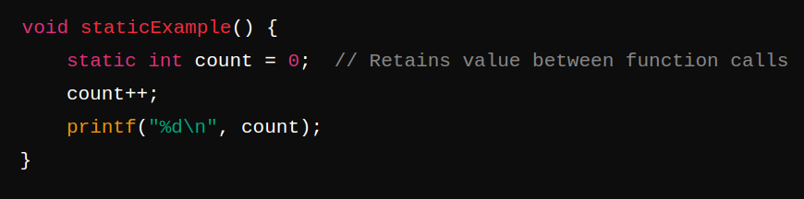
Static vs Global Variables
Static Variables:
Static inside functions: Retains value between function calls.
Static outside functions: Limits the scope to the file, similar to global but restricted to that file.

Slide 8
Static vs Global Variables
Global Variables:
Declared outside all functions and accessible to all functions in the program.
Use Case: Control variable scope and lifetime effectively.

Slide 9
Arrays
Array Basics:
Definition: An array is a collection of elements of the same data type stored at contiguous memory locations.
Accessing Elements: Array elements are accessed using indices, starting from 0.
Notes:
Use Case: Storing and processing a sequence of values efficiently.

Slide 10
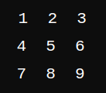
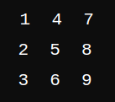
Row-Major and Column-Major Forms
Row-Major vs Column-Major:
Row-Major Order: Elements of a 2D array are stored row by row in memory.
Example: arr[0][0] is followed by arr[0][1].
Column-Major Order: Elements are stored column by column in memory.
Example: arr[0][0] is followed by arr[1][0].
Row-Major:
Column-Major:
Notes:
Use Case: Storing and processing a sequence of values efficiently.

Slide 11
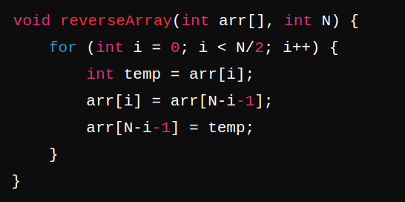
Problem on Arrays: Reversing the Array
Reversing an Array:
Concept: Swap elements from the beginning and end of the array, moving towards the center.
Notes:
Use Case: Storing and processing a sequence of values efficiently.

Slide 12
Questions?
LET'S START CODING !

