Slide 1


Gas selling support system
GSS team
GSS team

Slide 2
About Us
Team Member:
    Nguyễn Xuân Quyết
    Nguyễn Đức Vượng
    Đinh Nho Hào
    Lê Thế Đại Dương
    Nguyễn Huy Tuấn
Supervisor:
    Phan Duy Hùng
GSS team

Slide 3
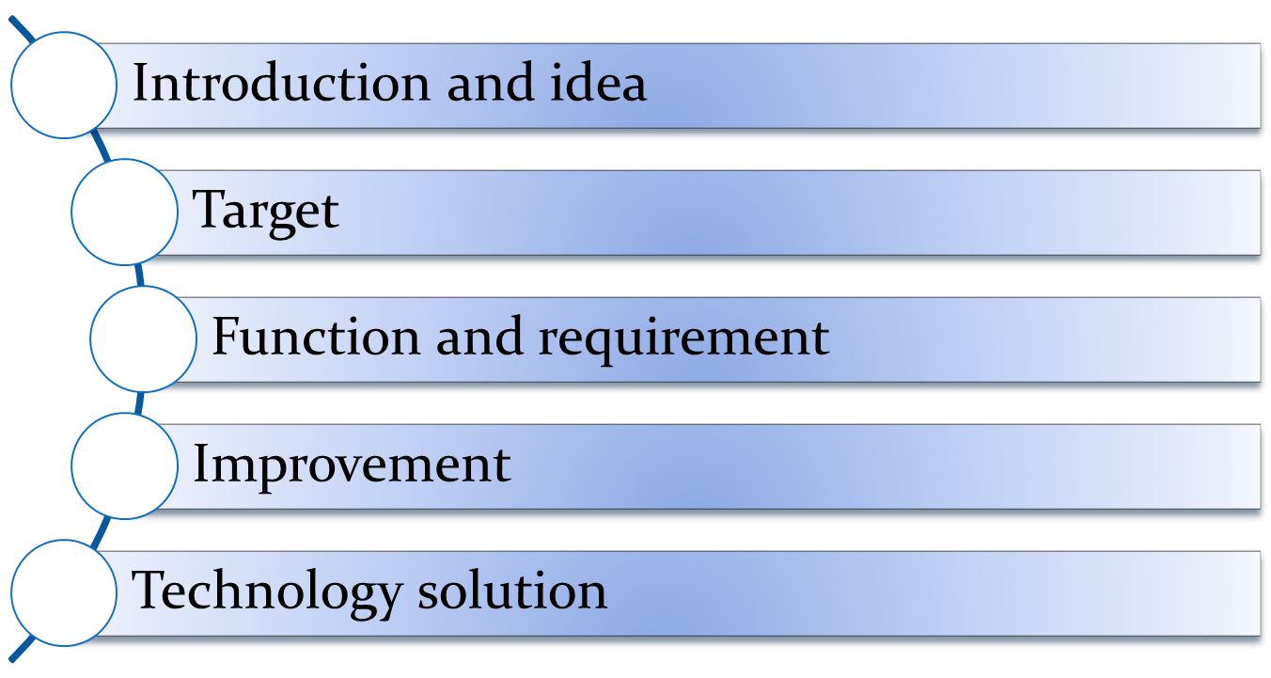
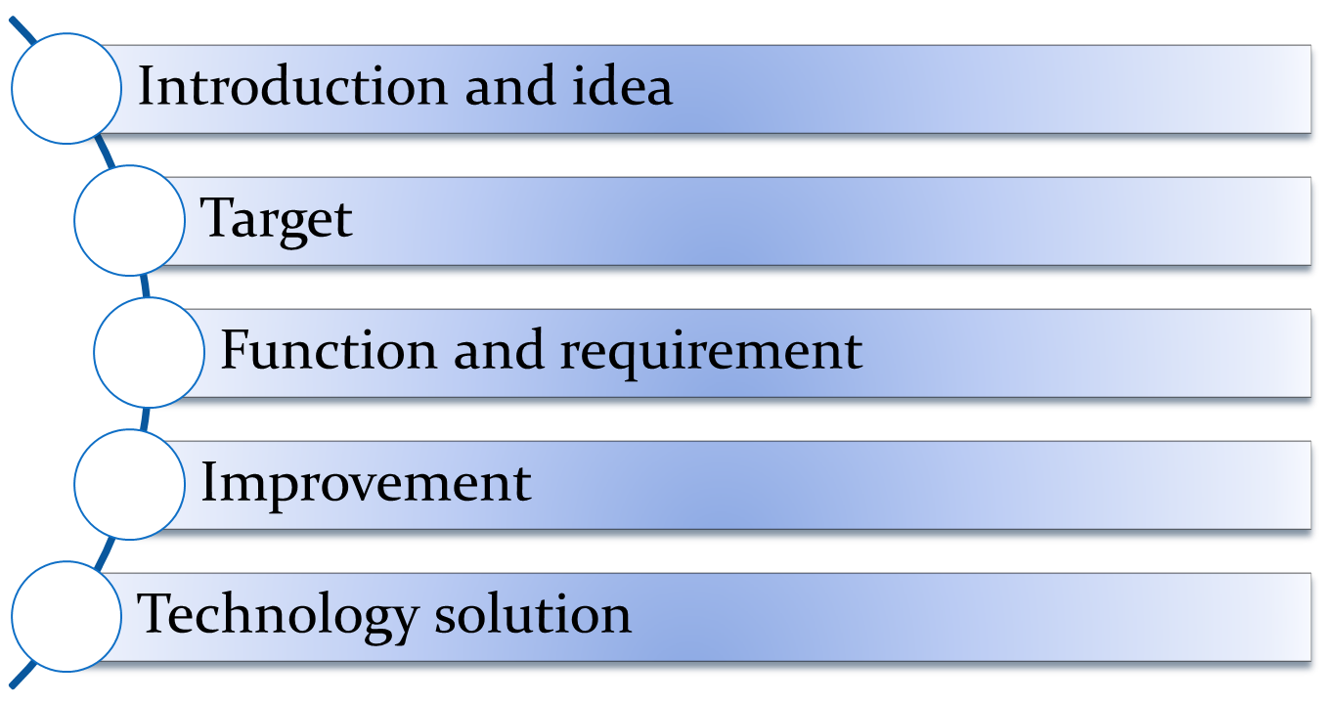
Objectives
1
1
1
2
3
4
5
GSS team

Slide 4
Introduction and idea
Reality of Gas shop in Vietnam
  Order by telephone
  Problem in storing data
  Low service when communicate with customer by telephone
  Opportunities
    Create a system support communicate with customer by telephone
GSS team

Slide 5
Target
Fulfill the requirements of a capstone project
Improve service of gas shop
Make a system that can be traded
Have more knowledge about new technical after project
GSS team

Slide 6
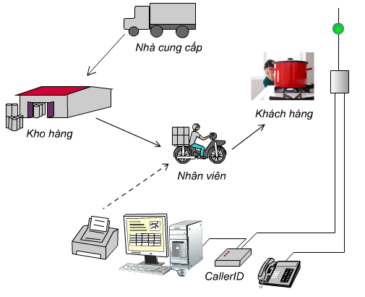
Function and requirement
GSS team

Slide 7
Function and requirement
Embedded
  Connect with telephone.
  Decode and log telephone number of customer (DTMF and FSK type).
  Transmit phone number to computer.
GSS team

Slide 8
Function and requirement
Software
  Support User on communicating with customers by telephone
    Display information of customer by phone number.
    Log miscall
    Statistic and calculate purchasing circle
    Print bill with map
    Finding shortest way
GSS team

Slide 9
Function and requirement
  Support Management
    Manage information of customer
    Manage information of products
    Manage import-export store
    Manage profit, turnover and products by month or quarter
    Manage business activities: debt, report, discount, promotion…
GSS team

Slide 10
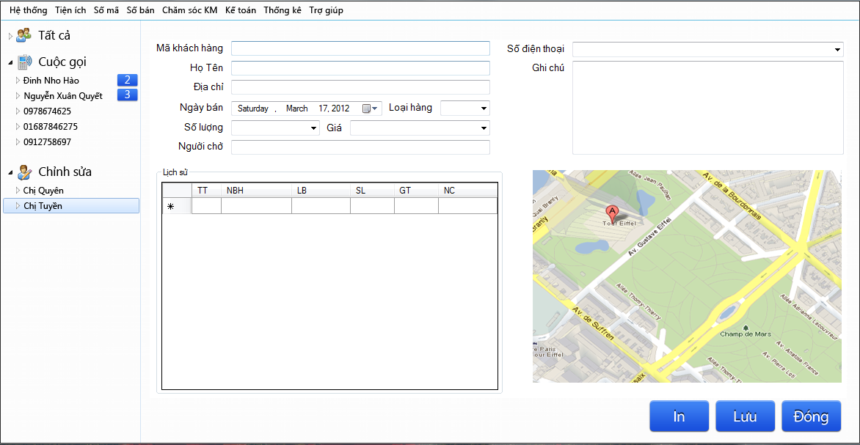
Function and requirement
GSS team

Slide 11
Improvement
Find shortest path to support delivery
Contain more function to improve customer support services.
Low price
GSS team

Slide 12
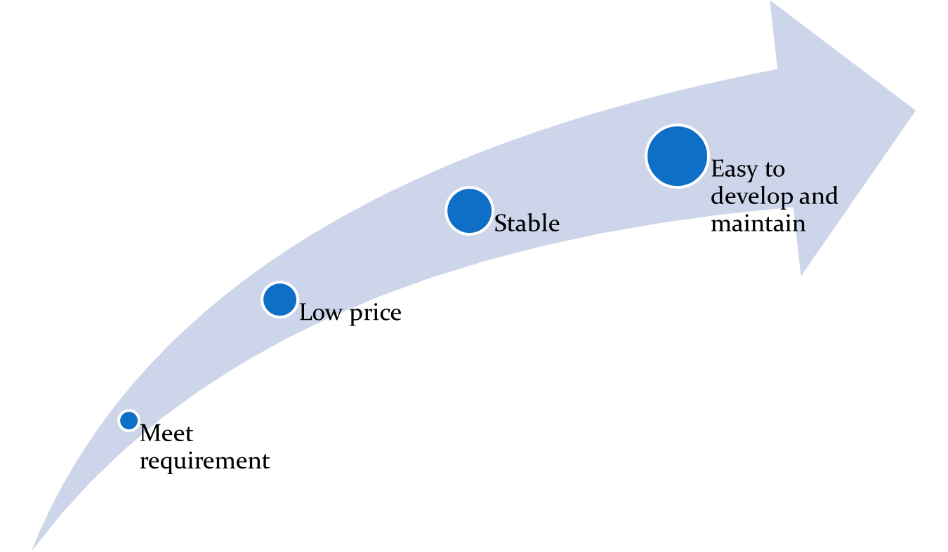
Technology solution
Base on:
GSS team

Slide 13
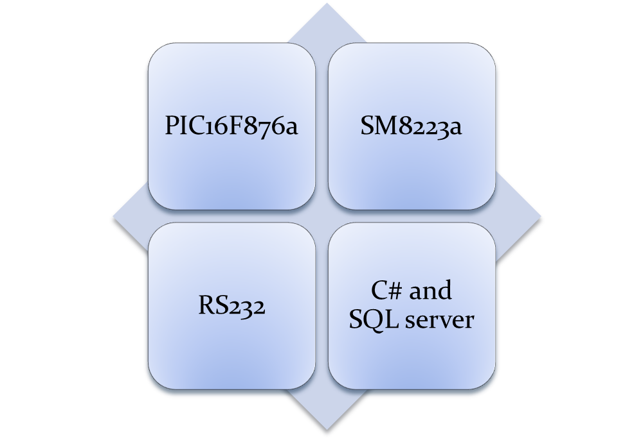
Technology solution
GSS team

Slide 14

GSS team

