Slide 1
A Nice Game!

Slide 2
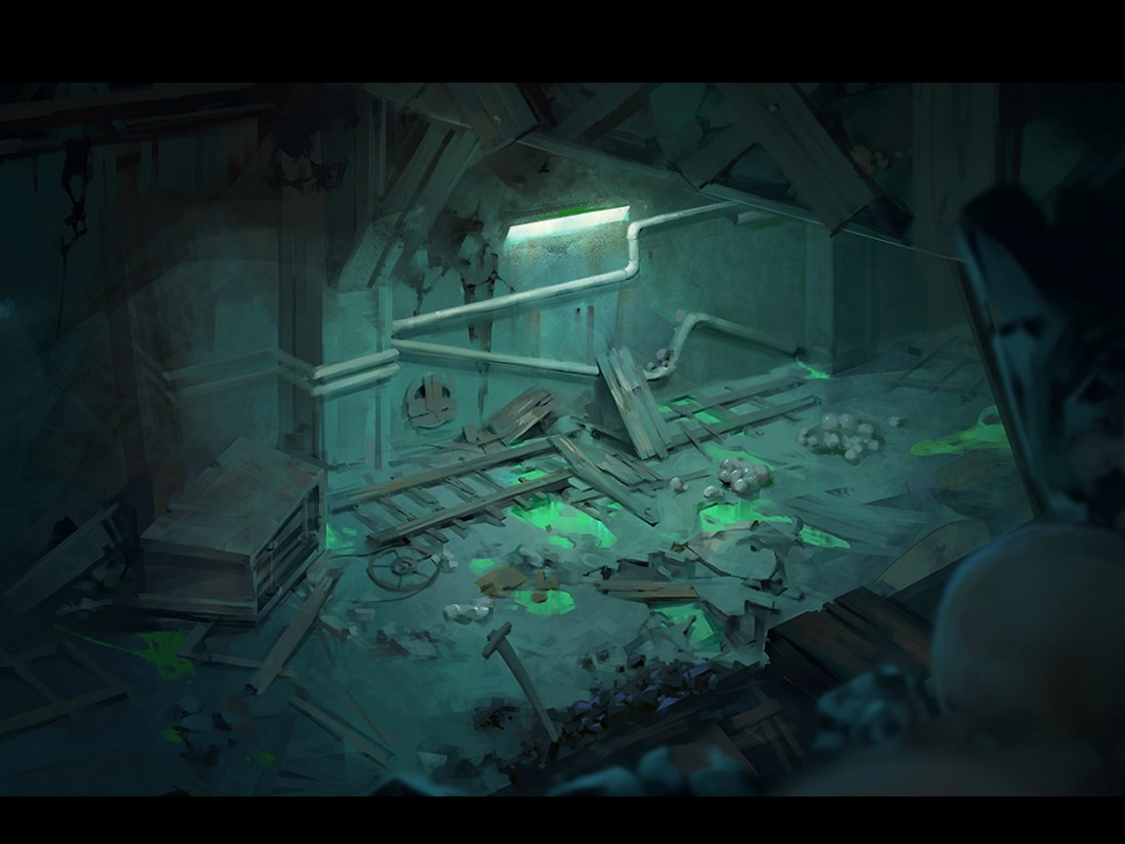
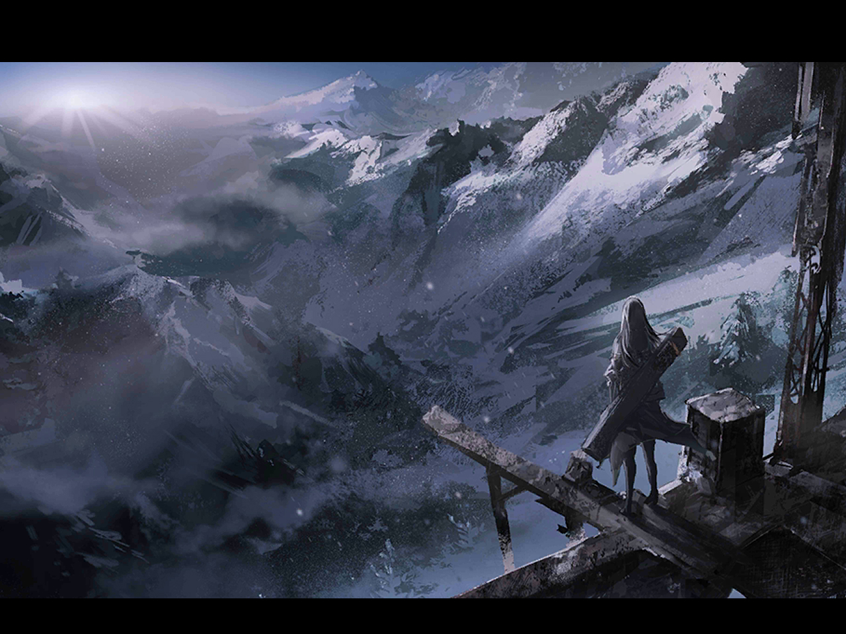
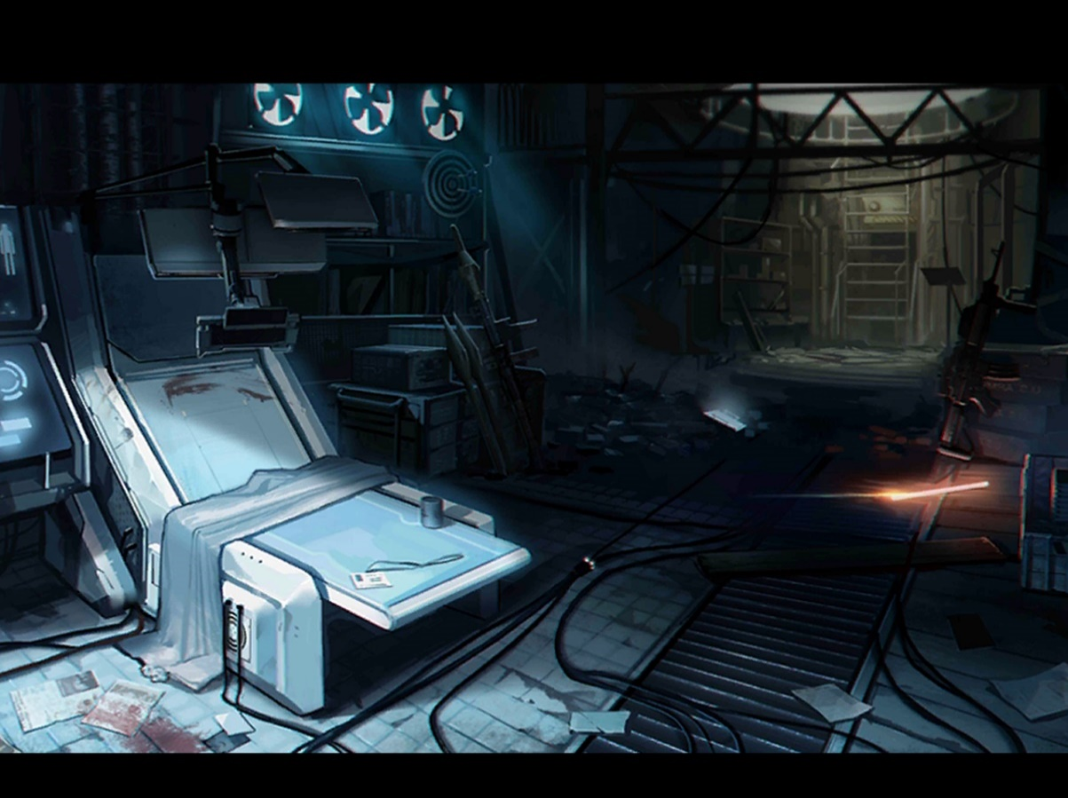
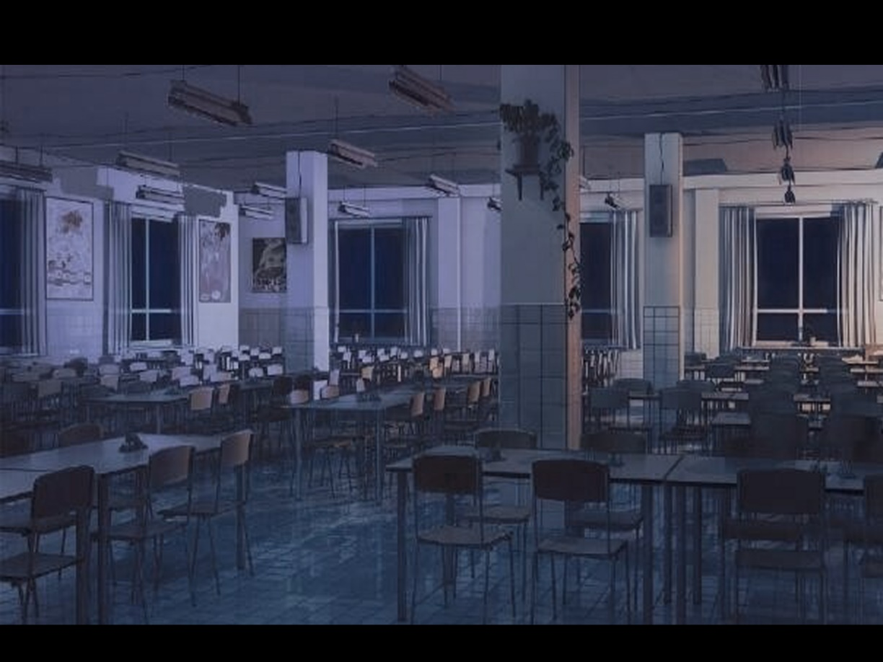


Slide 3
Team Member
Tony（祁浩洋）
Jack（陈盛哲）
1
2
Team Leader
main body of the GAME
make the happy cancellation game
Horus（薛宇杰）
Olivia （刘若冰）
3
4
Scenarist
make the Retro snake game
Artist director/Art designing
make the Jigsaw puzzle game
Notes:
网络增强系统

Slide 4
Galgame——
Re cycletime S
—— the world's endless dream
By/Tony(祁浩洋)/Horus（薛宇杰）
By/Olivia(刘若冰)/Jack （陈盛哲）
Notes:
网络增强系统

Slide 5
CONTENTS
Problem Statement
Analysis and Design
1
2
Implementation
TEST
3
4
Notes:
网络增强系统

Slide 6
PART I
Problem Statement
Notes:
网络增强系统

Slide 7

What we want to do
A NICE GALGAME ABOUT ADVENTURE
At first, our teammates see a movie about adventure and love
So we decided to do a program
To show the story through the game
It is you can see ---- RecycleTimeS game

Slide 8
About Galgame
Brief introduction of gal game
Galgame is a video game in which players can interact with animated character.
It is very popular in Japan and China
It is a special but beautiful cultural phenomena in East Asia

Slide 9
PART II
Analysis and Design

Slide 10
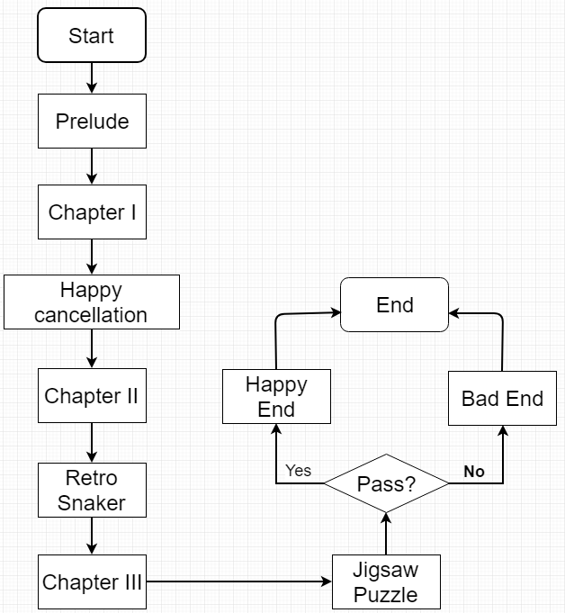
Analysis and Design
Game contain the script
Contain 3 games–
Happy cancellation
Retro snake
Jigsaw puzzle

Slide 11
What our program do
Our program is Normative Strong interactivity
In our game, you can get the story then interactive
The story is about the future world---
After a world wide war, the world was badly destroyed, and a disaster will happen soon, at this time, a young scientist use a robot’s information to build time machine to save the world, but another things happen……
You can also play the small game happily and tensely! Game is pretty fun!
We almost have 4,000 lines!!!!

Slide 12
PART III
Implementation

Slide 13
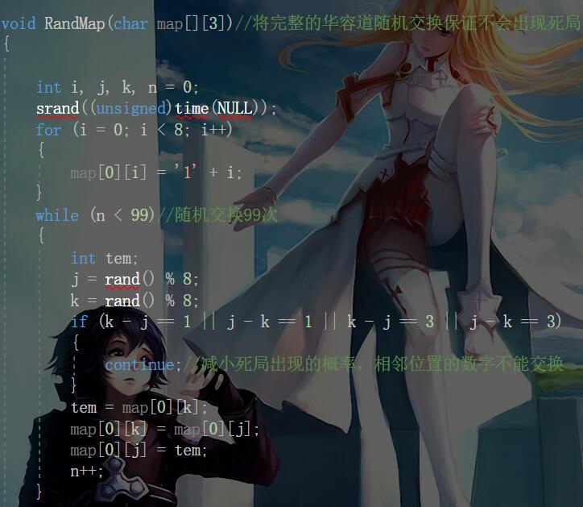
Function we used
We use a lot of functions……
Huarong Dao
creating function
Notes:
UE通过NAS层消息，向MME发起一个定位请求，请求获取自身的位置信息。
步骤2：MME向E-SMLC发起定位请求。
步骤3a/3b：E-SMLC查询并获取UE的定位能力信息。
步骤4a/4b：UE请求并获得E-SMLC提供的辅助数据。
步骤5a/5b：在E-SMLC的请求下，UE利用辅助信息进行A-GNSS相关测量，并将测量结果发送给E-SMLC。
步骤6：E-SMLC根据UE的测量结果以及其他各方面输入，计算出UE的位置信息。
步骤7：E-SMLC将定位结果（位置信息）发给MME。
步骤8：MME将定位结果（位置信息）发给UE。

Slide 14
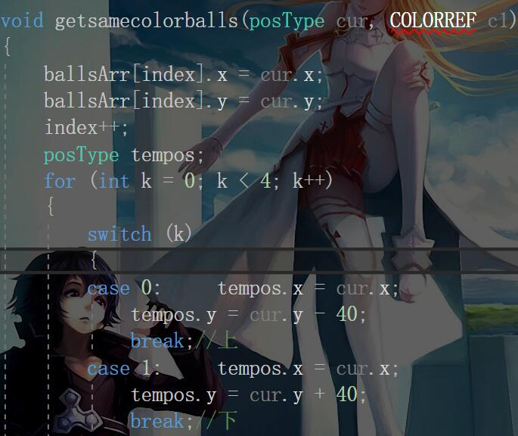
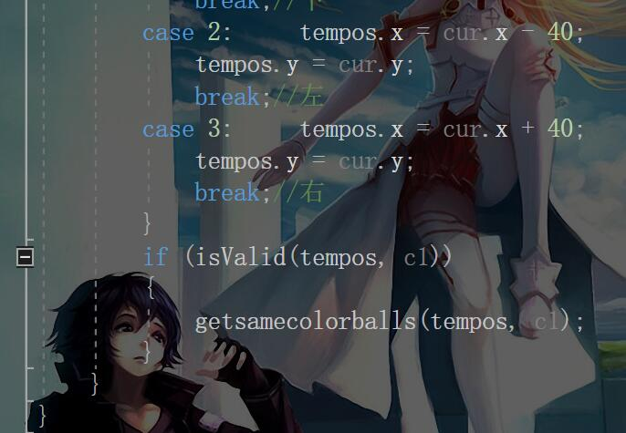
Function we used
We use a lot of functions……
Determine whether the sphere
nearby has same color function
Iterative Method
Notes:
UE通过NAS层消息，向MME发起一个定位请求，请求获取自身的位置信息。
步骤2：MME向E-SMLC发起定位请求。
步骤3a/3b：E-SMLC查询并获取UE的定位能力信息。
步骤4a/4b：UE请求并获得E-SMLC提供的辅助数据。
步骤5a/5b：在E-SMLC的请求下，UE利用辅助信息进行A-GNSS相关测量，并将测量结果发送给E-SMLC。
步骤6：E-SMLC根据UE的测量结果以及其他各方面输入，计算出UE的位置信息。
步骤7：E-SMLC将定位结果（位置信息）发给MME。
步骤8：MME将定位结果（位置信息）发给UE。

Slide 15
Two ways to move
1.kit function for the address movement of the linked list
2.using handle to creat location function for the movement of the linked list
Function we used
Notes:
UE通过NAS层消息，向MME发起一个定位请求，请求获取自身的位置信息。
步骤2：MME向E-SMLC发起定位请求。
步骤3a/3b：E-SMLC查询并获取UE的定位能力信息。
步骤4a/4b：UE请求并获得E-SMLC提供的辅助数据。
步骤5a/5b：在E-SMLC的请求下，UE利用辅助信息进行A-GNSS相关测量，并将测量结果发送给E-SMLC。
步骤6：E-SMLC根据UE的测量结果以及其他各方面输入，计算出UE的位置信息。
步骤7：E-SMLC将定位结果（位置信息）发给MME。
步骤8：MME将定位结果（位置信息）发给UE。

Slide 16
PART IV
TEST

Slide 17
THANKS
!
Any Questions?

