Slide 1
Rescue Apples
Final Presentation of Group 1
2019.6.28

Slide 2
Problem Statement
Interface System & Function Choice
Interface System & Function Choice
main interface
other functions: setting, game & score
Setting
5 parameter
3 button & 4 sliders
Game Wordlist Creation
Create game wordlist previous errors

Slide 3
Problem Statement
Game Control
Animation of falling apples
decide game condition to end
Record Historical Score
Save data
Read data of the latest 10 games
Show Historical Score
two line charts to show typing speed and accuracy rate

Slide 4
Analysis
Play more than one time in an execution
All function return to Main_Interface function
Control interface jump
Location of click
Set, save and apply setting parameters
data.txt

Slide 5
Analysis
Judge the state of game
compare vertical coordinate value of apple with window
Realize word operation
linked list

Slide 6
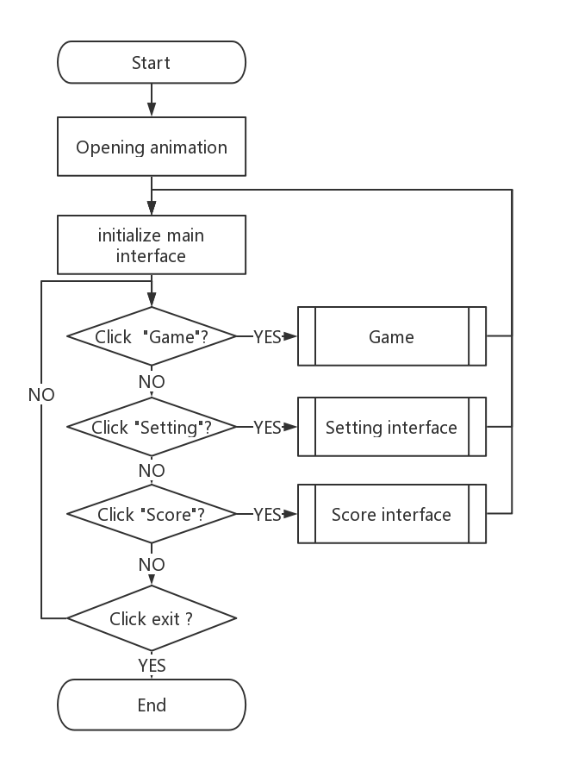
Design
3 functions chosen by click
Users can play repeatedly for program doesn’t exit until window closed

Slide 7
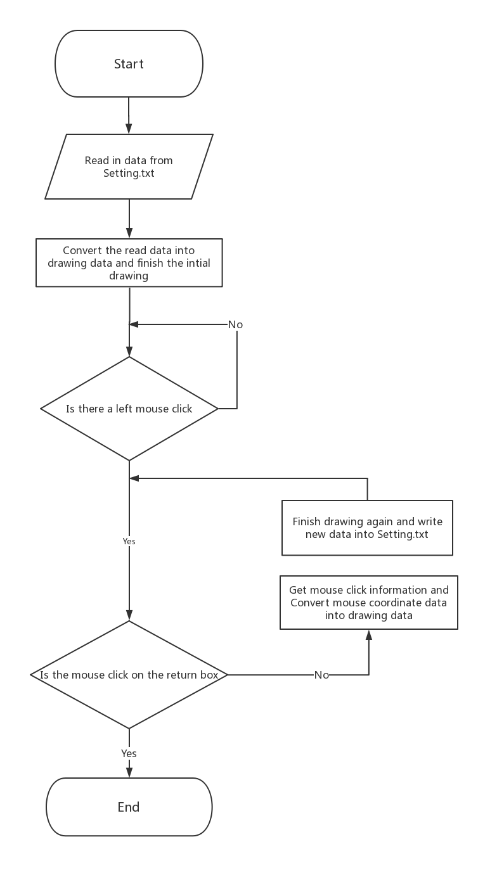

Design
Setting interface

Slide 8
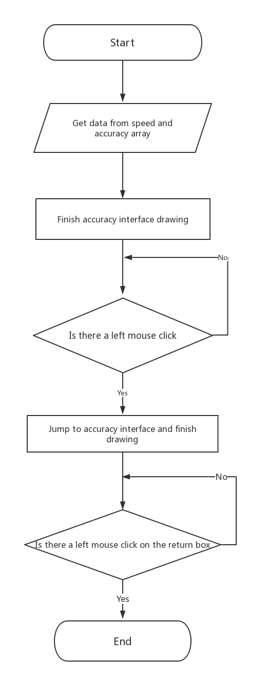
Design
Score interface

Slide 9
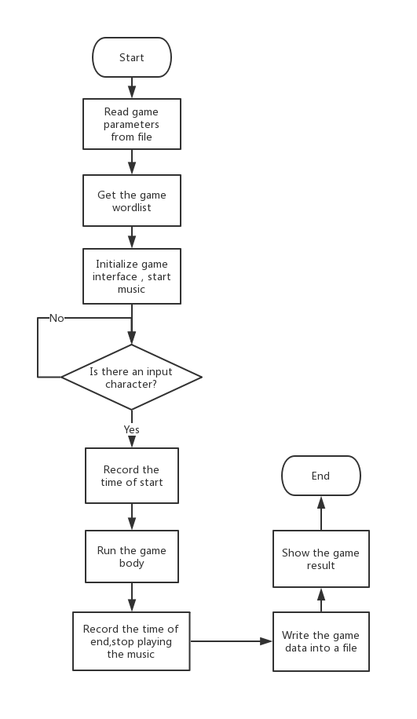
Design
Game

Slide 10
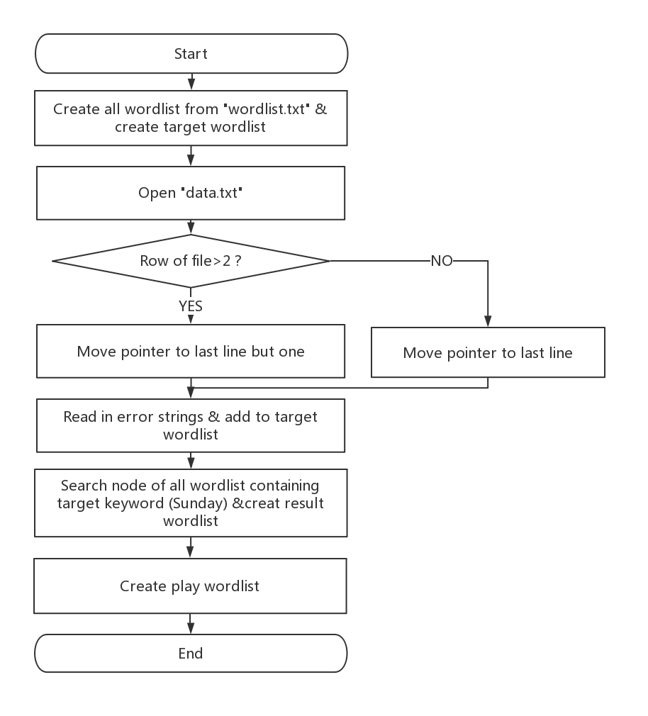
Design
Create game wordlist
Get target list from errors of last 1 or 2 games

Slide 11
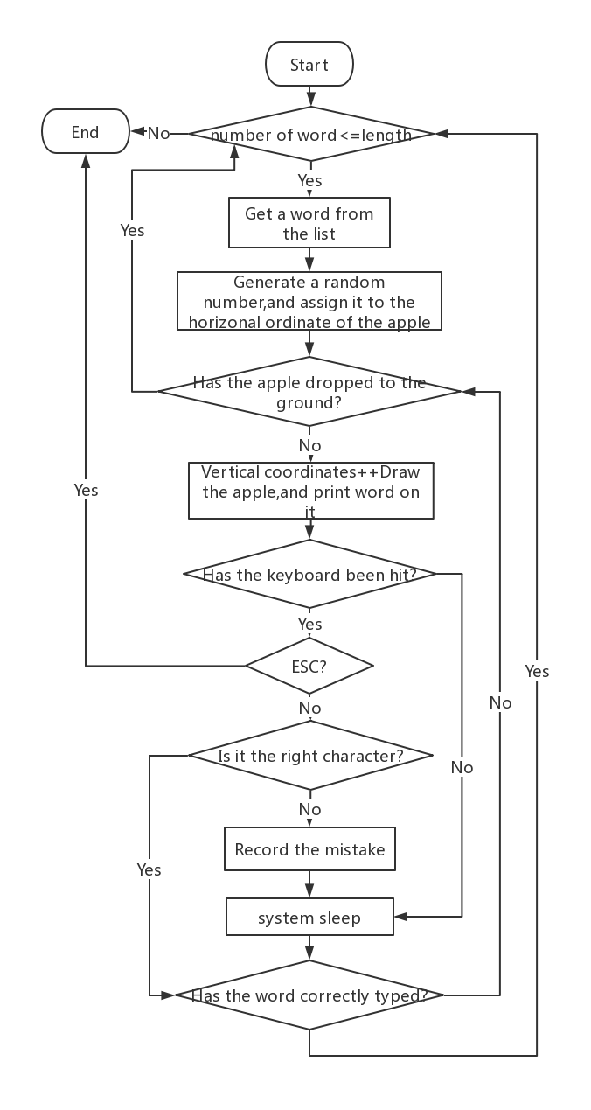
Design
Game body
Big loop:
Different words
Small loop:
Falling effect

Slide 12
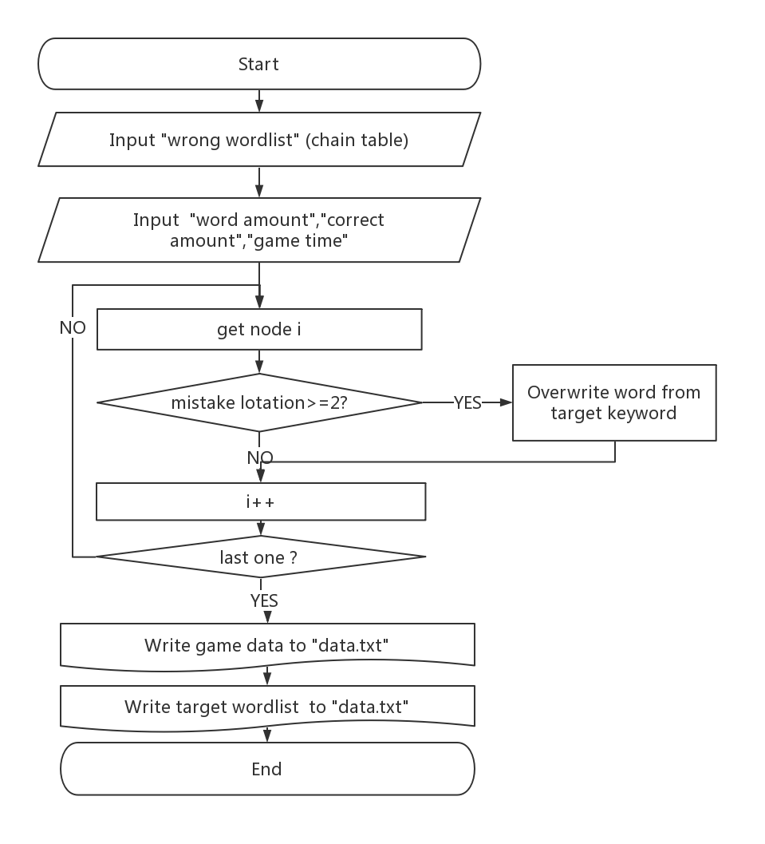
Design
Write data to file
Select & save error fragments with specific characteristic

Slide 13
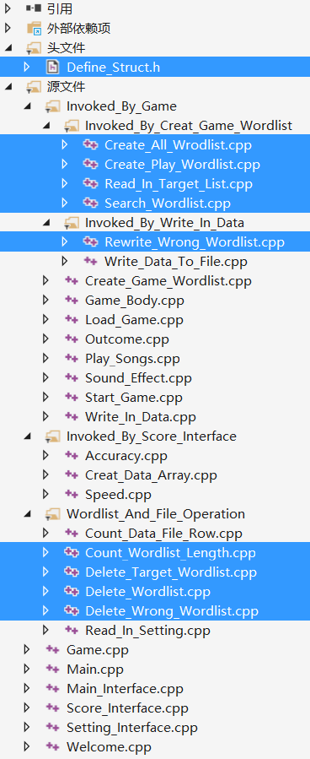
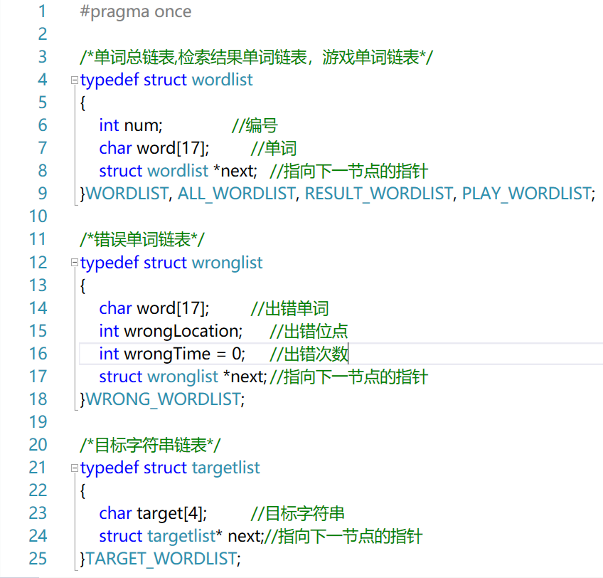
Implementation
Usage of linked list
5 kinds of linked lists
All word processing is done by linked list operations

Slide 14
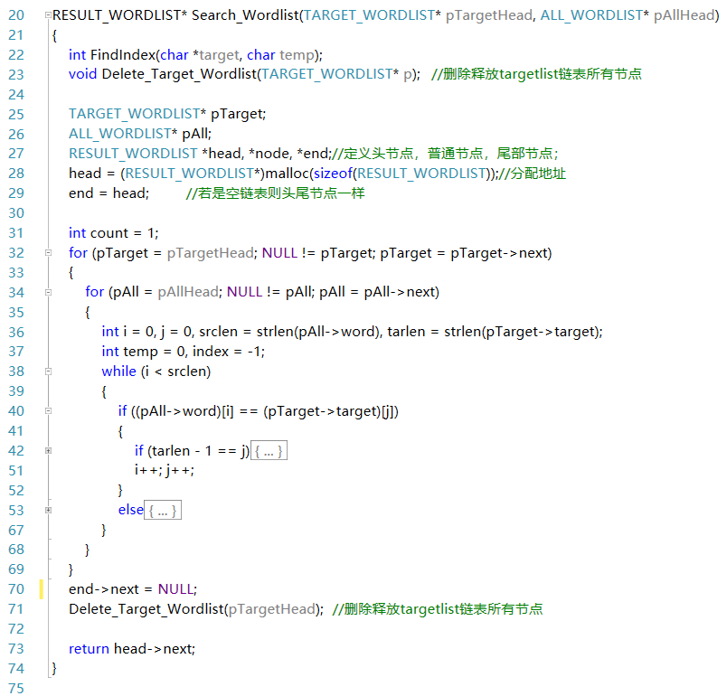
Implementation
Algorithm: “Sunday”
String matching
Search all nodes (of linked list “All wordlist”) containing the word fragment (in linked list “Target wordlist”)

Slide 15
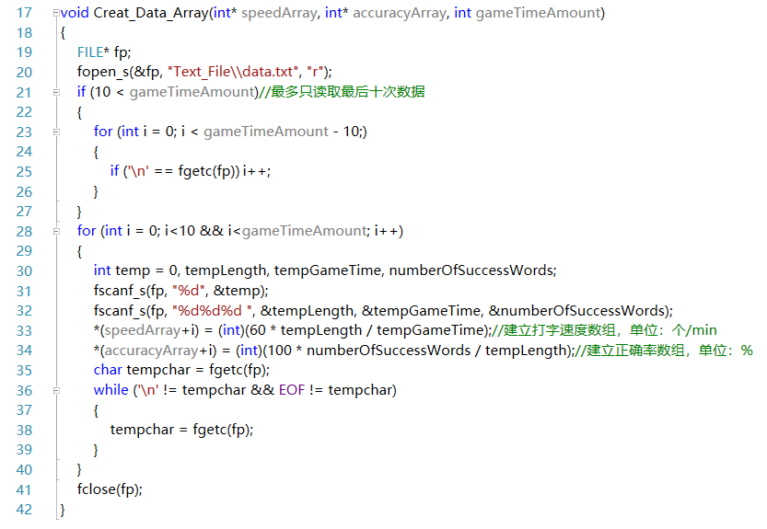
Implementation
Usage of array
2 arrays are used to transfer data

Slide 16
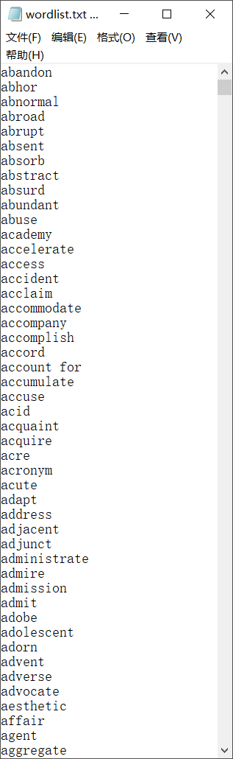
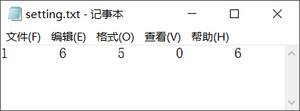
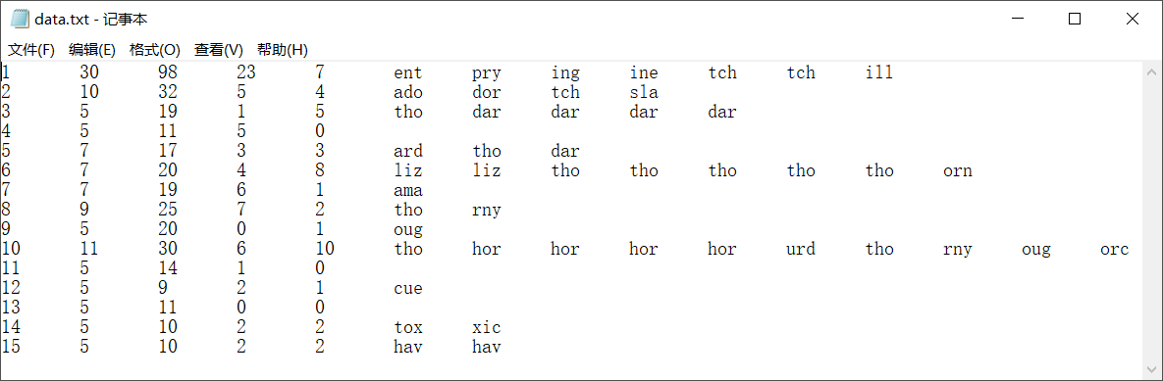
Implementation
Usage of file
Save lexicon, historical data & setting parameters

Slide 17
Test

