Slide 1
BES 440 Project
By Robert Catherman
GIS instructor for MEDRIX - Vietnam
Goal: Perform Supervised Classification
using QGIS open source GIS software
Study Location: River valley in northern Idaho
Data Source: Landsat 8 images
GIS Software: QGIS (open source)
using Semi-automatic Classification Plugin
Product: Workflow documentation

Slide 2
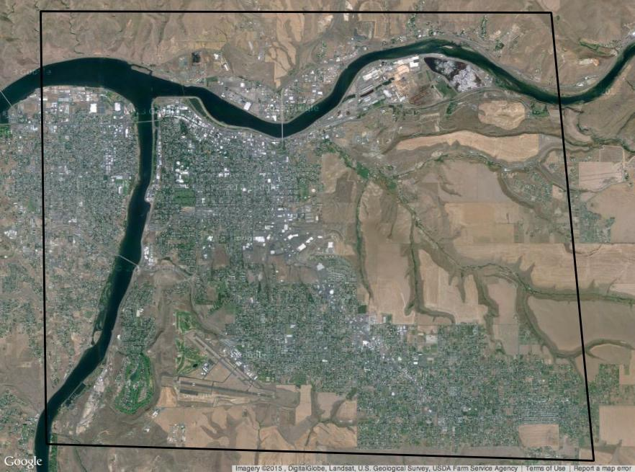
Google Earth with Study Area

Slide 3
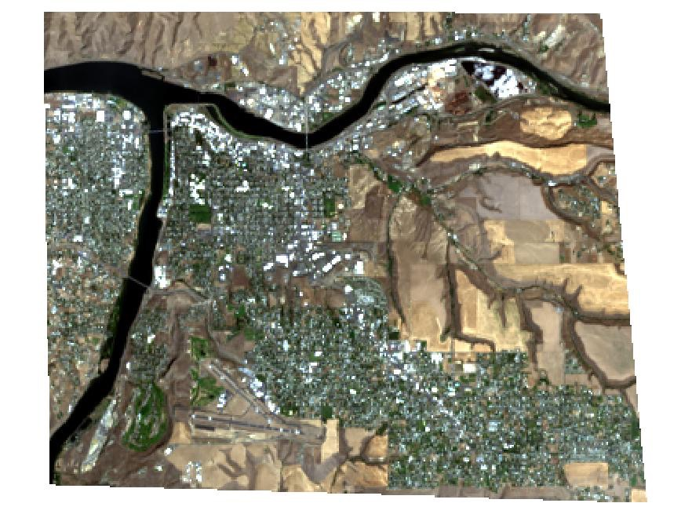
Landsat 8 RGB

Slide 4
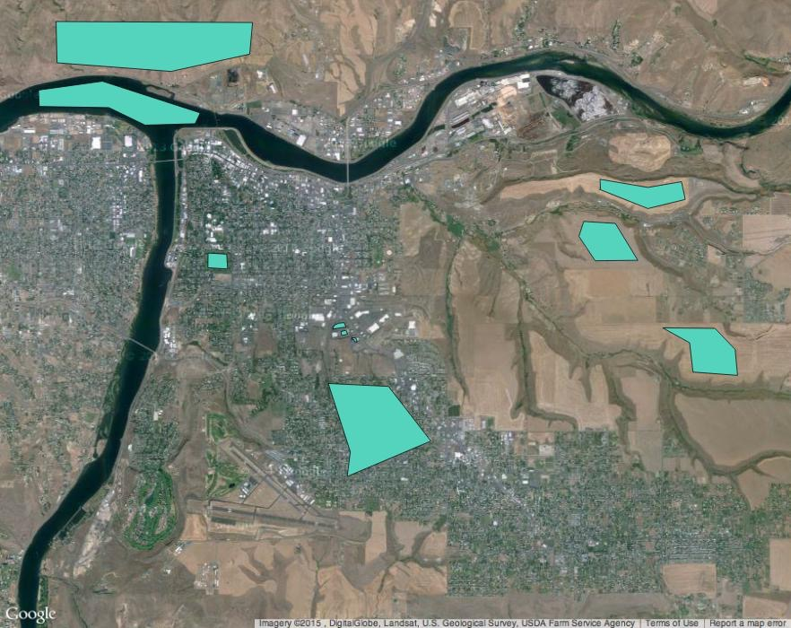
Training Areas (ROI)

Slide 5
