Slide 1
R-based tools for open and collaborative science
@recology_
Scott Chamberlain

Slide 2

Science needs to
be more open

Slide 3

http://everyoneknowsbest.files.wordpress.com/2008/08/bodysculpture.jpg
We build on the knowledge of others
http://everyoneknowsbest.files.wordpress.com/2008/08/bodysculpture.jpg

Slide 4
Less mistakes
More fortiutious findings

Slide 5



http://everyoneknowsbest.files.wordpress.com/2008/08/bodysculpture.jpg
The public paid for it!

Slide 6
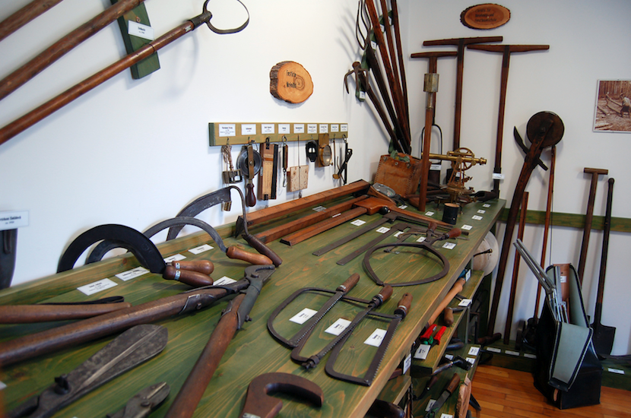
http://www.fotopedia.com/items/flickr-4796633039
But we need tools to do it!!!!!

Slide 7

What kinds of tools? Not these

Slide 8

These!!!!!!

Slide 9
What does an ecologist do?
Collect data
Manipulate data
Visualize
Analyze
Write

Slide 10

Data increasingly on the web

Slide 11

R may be the perfect solution

Slide 12
Why?
R is Open source = Free + Rapid change
R = entire workflow in 1 place
R = reproducible science

Slide 13
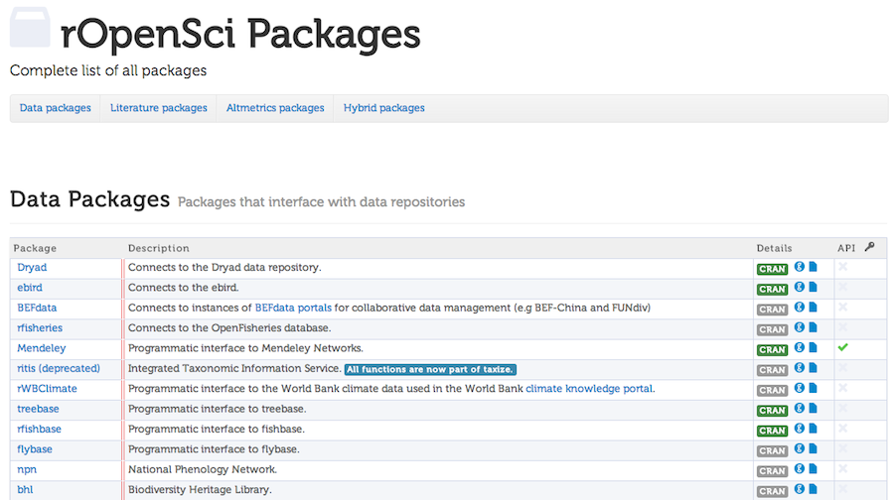
http://ropensci.org/
The toolbelt

Slide 14

Literature

Slide 15
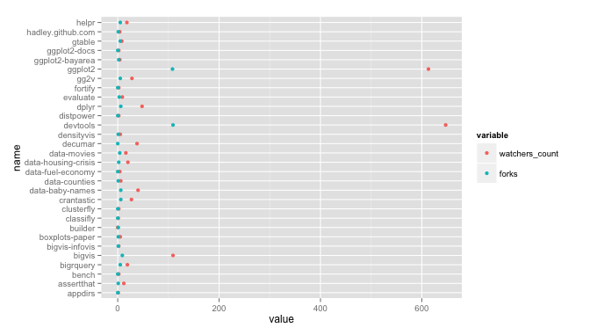
Make an API call
library(RCurl); library(RJSONIO)
dat <- fromJSON(getURL("https://api.github.com/users/hadley/repos"))
Manipulate the data
library(plyr); library(reshape2)
dat_melt <- melt(ldply(dat, function(x) data.frame(x[names(x) %in% c("name","watchers_count","forks")])))
Run some statistical model
lm(value ~ variable, data = dat_melt)
Visualize results
library(ggplot2)
ggplot(dat_melt, aes(name, value, colour = variable)) +
geom_point() +
coord_flip()
Write the paper
# Introduction...

Slide 16
Taxonomy
library(taxize)
specieslist <- "Abies procera"
classification(specieslist, db = "itis")
rankName | taxonName | tsn
Kingdom | Plantae | 202422
Subkingdom | Viridaeplantae | 846492
Infrakingdom | Streptophyta | 846494
Division | Tracheophyta | 846496
Subdivision | Spermatophytina | 846504
Infradivision | Gymnospermae | 846506
Class | Pinopsida | 500009
Order | Pinales | 500028
Family | Pinaceae | 18030
Genus | Abies | 18031
Species | Abies procera | 181835

Slide 17
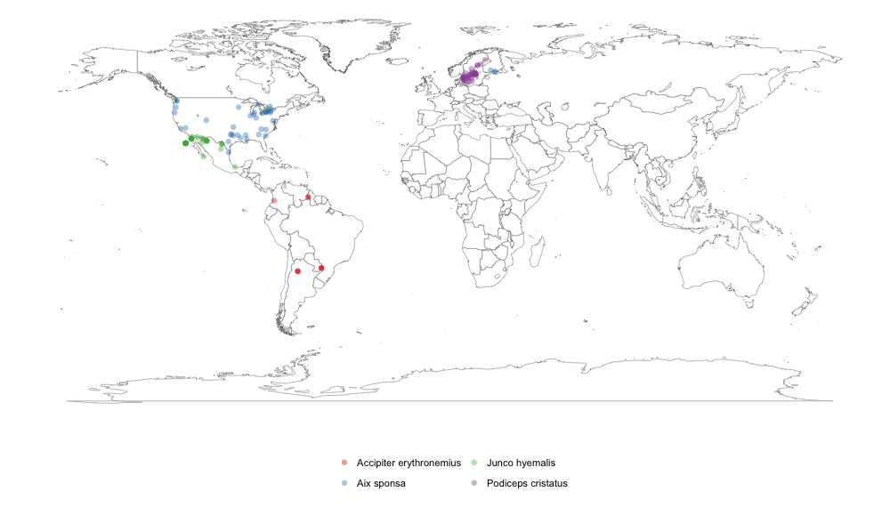
Taxonomy
library(rgbif)
splist <- c('Accipiter erythronemius', 'Junco hyemalis', 'Aix sponsa', 'Podiceps cristatus')
out <- occurrencelist_many(splist, coordinatestatus = TRUE, maxresults = 40)
gbifmap_list(out)

Slide 18
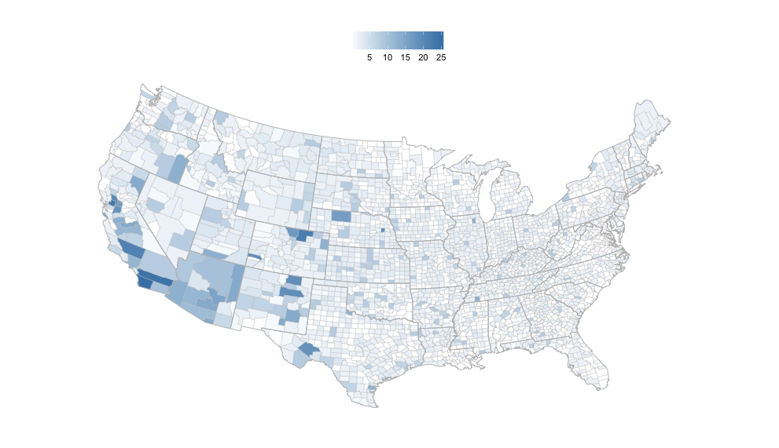
Taxonomy
library(rbison)
out <- bison(species="Helianthus annuus", count=500)
bisonmap(input=out, tomap="county")

Slide 19



Take action!
FontAwesome http://fortawesome.github.io/Font-Awesome/
fontawesome 2 png https://github.com/odyniec/font-awesome-to-png

Slide 20
The deets
Presentation made using Slidify
https://github.com/ramnathv/slidify
See it online here:
linklink

