Slide 1
Reviews

Slide 2
Review What?
Review Everything
Vision & Scope Document
Requirements Specification
Project Plan
Design - High Level and Detailed Design
Code
Test Plan
Documentation

Slide 3
Why Review?
1. Save time.
2. Save money.
3. Gain approval & increase sense of shared ownership.
4. Reviews find more defects than testing.
5. Share knowledge.
6. More ideas make better results.

Slide 4
Kinds of Reviews
Inspection
Code Review - Inspection of Code
Walk-through
Desk check
Self-review
Formal
Informal

Slide 5
Which Review to Use?
Source: Prof. Claude Laporte, U. of Quebec, Dept of Software and IT Engineering

Slide 6
Inspection
The most formal kind of review.
Purpose: find defects.
How To:
1. Choose work product to inspect.
2. Choose 4-5 people, including a moderator
3. Prepare: Everyone reads the work product in advance and notes suspected defects.
4. Inspection meeting: confirm defects & log them
Inspections may proposal correction (e.g. words in document)
5. Rework: author fixes defects from inspection log

Slide 7
Inspection Team
Author of document or work product
Project manager - for project documents
Representative of groups affected by the document, e.g. developers, management, PPQA person.
Inspectors should
be familiar enough with project to understand problems and propose changes
provide different perspectives on work product

Slide 8
Inspection Meeting
Moderator guides inspectors through work product.
Ask inspectors for defects.
Other inspectors (and author) confirm each defect, or explain why they disagree.
Inspectors agree on a fix (for document) or leave it to author to fix (code).
Record each defect in a written log.

Slide 9
After the Inspection
Rework: author fixes the work product.
Follow-up: inspectors individually review the revised work and approve or not approve it.
Acceptance: once all inspectors approve, the work product is accepted.

Slide 10
Inspection is NOT...
Review of style
Attempt to improve or optimize design*
Evaluation of the author
Subjective evaluation of quality
*Infosys: inspectors use a separate form to record comments, offer insights and ideas.

Slide 11
Is Inspection Worth the Time?
Inspection involving 5 people takes 10-20 man-hours, about half the time is preparation.
Inspection finds 5 - 10 defects, on average.

Slide 12
Defect Injection and Detection
Injected
Detected without Inspections
New Gap
Detected with Inspections
25
20
Gap
15
Defects/KLOC
10
5
0
START
REQ
HLD
LLD
CODE
UT
IT
ST
SHIP
Activity
Source: Ron Radice, ‘Software Inspections: Past, Present, and Future.’, Software Technology Conference, Salt Lake City, Utah, May, 2001

Slide 13
Software Development Spending Profiles
Source: IEEE Software Engineering

Slide 14

Cost/Benefit of Inspections
Before Review/Inspection
After Implemented Review/Inspection
19%
Reduce 31%
in rework
12%
Rework Effort
8%
3%
4%
1%
Req. Design Code Test Post-Release
Formal Review/Inspection increased design effort by 4%
Decreased rework effort by 31%
Source: Vu, J., ‘Software Process Improvement Journey’, 8th Software Engineering Process Group Conference San Jose, California March, 1997.

Slide 15
Conclusion
Inspection Saves Time & Money

Slide 16
How Much Time Does it Take?
Inspection Type
Checking Rate
Logging Rate
Architecture
2 – 3 Pages Per Hr (PPH)
2 - 3 PPH
Requirements
2 - 3 PPH
2 - 3 PPH
Preliminary Design
3 – 4 PPH
3 – 4 PPH
Detailed Design
3 – 4 PPH
3 – 4 PPH
Source Code
100 – 200 LOC Per Hour (LPH)
100 – 200 LPH
Test Plan
5 – 7 PPH
5 – 7 PPH
Fixes and Changes
50 – 75 LPH
50 – 75 LPH
User Documentation
8 – 20 PPH
8 – 20 PPH
Source: Radice, ‘High Quality Low Cost Software Inspections’, 2002.

Slide 17
Code Review
An inspection of code.
Similar to Inspection but more time is spent on alternatives and qualitative issues.
Before Review:
- choose the code to review (you can't review everything this way) - see Stellman & Greene
- choose moderator, reader, and inspectors
- choose a date/time and duration (60-90 minutes)
- everyone reviews code individually and makes notes of issues they find (paper or online notes)

Slide 18
Code Review Meeting
During Review:
- the "reader" walks through the code aloud -- by section (class, method, code block), not literally reading code.
- Inspectors:
ask about anything they don't understand
question correctness of code
suggest "better" or more self-explanatory alternatives
- Moderator: keep the review on track. Don't get bogged down discussing specific design or code issues.
- Recorder: writes down issues for follow-up

Slide 19
Code Review Follow-up
After Review:
- author addresses all issues, either revise code or explain to reviewer why he things no rework is needed
- do it promptly!
- gain agreement to close all issues
Product & Process Quality Assurance (PPQA):
- verify all issues were recorded
- verify all issues were fixed or addressed, not just closed

Slide 20
Code Review vs. Inspections
Code Review results in more open issues.
May refactor the code during the meeting... if it makes it easier to review.
May discuss alternatives or improvements.
Follow-up and consensus may be done online.

Slide 21
Walk-through
Author "walks" a small group through a work product.
More informal than code review and led by author.
Procedure is more flexible than inspections.
Can be done for code, design docs, use cases, test plan

Slide 22
Goals of Walk-through
find defects
get feedback and ideas
discover other solutions
help everyone understand the work product
improve knowledge & skill
shared ownership

Slide 23
Desk Check
Purpose
Individually review of code by another developer.
Usually done individually, with follow up discussion.
Procedure
A developer asks another developer to review his work.
The reviewer (at his own desk) checks the work and reports defects, questions, and suggestions for alternatives or improvement.

Slide 24
Git Pull Request
Purpose
Request review of work before incorporating it into a main "dev" branch or master branch.
A kind of "desk check" using Github or Bitbucket.
Tutorial: https://yangsu.github.io/pull-request-tutorial/
Guide: https://help.github.com/articles/using-pull-requests/
Example (JQuery):
https://github.com/jquery/jquery/pull/1051#discussion-diff-2287441

Slide 25
Self-Review
Always review your own work
Obvious, but often not done.
How to:
take a break before review. This is required.
decide what criteria you are going to use (what are you checking for?)
allocate sufficient time
record defects you find

Slide 26
Scripts and Checklists
Scripts and Checklists save time & make results more consistent.
How Save time?
- don't re-discover what you did before
- focus on the creative, not the routine
Script - describe the activity, its purpose, desired result, important steps, and "exit criteria".
Checklist - concise list of particular things to do or inspect

Slide 27
Script
Purpose: Find defects in code
Entry criteria: Code specification and design
Source code with tests that all pass.
Goal for Code Review: review why?
Checklist
Steps: 1.
2.
3.
Exit criteria: source code completely reviewed.
written record of all defects, suggestions, and open issues

Slide 28
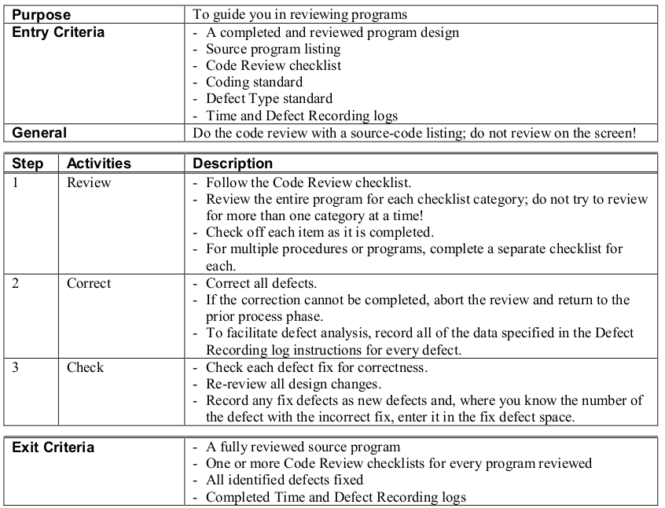
PSP Code Review Script

Slide 29
Checklist
Reviews should use a checklist.
Contents of checklist depend on kind of thing being inspected!
Self-review and desk check are more effective if you use a checklist.

Slide 30
Example Checklist for Requirements Specification (RS)
RS 1 (TESTABLE) – All requirements are verifiable (objectively)
RS 2 (TRACEABLE) – All requirements must be traceable to a systems specification, contractual/proposal clause.
RS 3 (UNIQUE) – Requirements must be stated only once
RS 4 (ELEMENTARY) – Requirements must be broken into their most elementary form
RS 5 (HIGH LEVEL) – Requirement must be stated in terms of final need, not perceived means (solutions)
RS 6 (QUALITY) – Quality attributes have been defined.
RS 7 (HARDWARE) – Is hardware environment is completely defined (if applicable).
RS 8 (SOLID) – Requirements are a solid base for design
Source: Gilb, T., Graham, D., ‘Software Inspection’, Addison Wesley, 1993.

Slide 31
Example Checklist for C++ Code (CC)
CC1 (COMPLETE) - Verify that the code covers all the design.
CC2 (INCLUDES) - Verify that includes are complete.
CC3 (INITIALIZATION) - Check variable and parameter initialization.
CC4 (CALLS) - Check function call formats
CC5 (NAMES) - Check name spelling and use
CC6 (STRINGS) Check that all strings are ...
CC7 (POINTERS) - Check that:
Pointers are initialized to NULL,
Pointers are deleted only after new, and
New pointers always deleted after use.
CC8 (OUTPUT FORMAT) - Check the output format:
Line stepping is proper.
Spacing is proper.
CC9 (PAIRS) - Ensure the { } are proper and matched.
CC10 (LOGIC OPERATORS) - Verify that the proper use of ==, =, //, and so on.
Adapted from: Humphrey, W., ‘Introduction to the Personal Software Process’, Addison Wesley, 1997.

Slide 32
Another Code Inspection checklist
Notes:
<number>
<footer>
<header>
11/09/19

Slide 33
PSP Checklist
This is worth studying.
He divides items into categories.
Humphrey's advise:
1. Keep your checklist simple and short.
2. Checklist must be complete.
3. Tailor to the programming languages you use.
4. Designed to address the kind of defects you inject.

Slide 34
Example Checklist for Java
Defect Type | Description
variable name | are names descriptive? correct case?
comments | Descriptive Javadoc method comments? In method: is complex logic explained?
exception handling | Are all reasonable exceptions caught and handled, or explicitly allowed to be thrown?
logging | Are security or unusual events being logged?
null pointers | Are any possible null values used? (Does NullObject pattern apply?)
floating point types | double used in place of BigDecimal?
output formats | Are printed values always explicitly formatted?

Slide 35
Another Code Review Checklist
Applied Software Project Management, page 90.
1. parts of that list are too broad or vague for your project.
2. some items are outside the usual scope of Inspection.
For example:
Efficiency
Reusability (this can be a waste of time)

Slide 36
Summary
1. Review Everything - not just code
2. Choose an appropriate level of review
3. Reviews must produce a written result - not just talk
result is online where everyone can see it
open issues for specific items
4. Follow up & close all issues, answer all questions
5. Use tools to automate routine stuff (style checking ...)
6. Scripts and checklists make reviews more effective

Slide 37
Questions
1. Look at the PSP Code Review Checklist.
what categories do not apply to Python?
what categories can be done by automated tools?

Slide 38
References
Stellman & Greene, Applied Software Project Management, chapter 5 on Reviews.
- chapter 5 is available online.
Ship It! Item 13 - Review all Code
Practical advise for code reviews.
review only a small amount of code
one or two reviewers at most
review very frequently, often several times per day

Slide 39


References
Karl Weigers, Peer Reviews in Software - A Practical Guide. Considered the "bible" on peer reviews.
Karl Weigers, Improving Quality Through Software Inspections article online.
https://www.processimpact.com/articles/inspects.pdf
Tom Gilb, Software Inspection.
R. Radice, High Quality Low Cost Software Inspections.

Slide 40
Acknowlegement
Some of these slides are from a workshop at NECTEC by Prof. Claude Leporte, U. of Quebec.

