Slide 1
Balancing Plan-Driven & Agile Processes
Based on material from the book
Balancing Agility and Discipline
by Prof. Barry Boehm and Richard Turner

Slide 2
Plan-based Characteristics
Systematic, engineering approach to software dev't.
A well-defined process for moving from inception through project finish.
Requirements and commitments are documented.
Work at each step is documented.
Work is assigned to roles; roles have defined responsibilities.
Progress is monitored using reports and metrics, and managed against a plan.

Slide 3
Plan-based Process Goals
Predictability of progress and results
Stability
High assurance (through measurement, validation, and verification)

Slide 4
Agile Process Characteristics
Adaptive, collaborate approach to software development.
View of software development as a craft, although life-cycle and practices are well-defined.
Emphasis on early and frequent delivery of incremental software product.
"Customer collaboration" instead of complete requirements.
Code and test results are primary evidence of work done.
In "pure" agile, teams are self-organizing with no specific roles.

Slide 5
Agile Process Goals
Early delivery of value.
Responsive to change.

Slide 6
Process Improvement
Plan-based
Usually include process improvement, based on analysis of collected data and documented retrospective.
May have a Software Process Group focused on improving the defined, standard process.
Agile
Retrospectives to evaluate work and practices.
Rely on developers remembering lessons learned.

Slide 7
Key Factors affecting Success
Areas that strongly influence how successful agile or plan-based methods are.
1. Application Characteristics
2. Management Characteristics
3. Technical Characteristics
4. Personnel

Slide 8
Home Grounds
In the following slides, describe the "home ground" of Plan-based and Agile processes with respect to the given area.

Slide 9
Project Goals
Home ground of plan-based or agile?
____________ Early delivery of working code
____________ Large number of requirements
____________ Must inter-operate with legacy components
____________ Assurance that code has been thoroughly verified and tested.

Slide 10
Requirements
Planned-based work best when requirements can be determined in advance and "stable".
What % change in requirements is acceptable?
When requirement change increases, what is the cause of inefficiency in plan-based methods?

Slide 11
Customer Relations
Home ground of plan-based or agile?
____________ Knowledgeable customer on-site
____________ Fixed price contract for functionality
____________ Customer expectations are specified up-front, to avoid misunderstanding.

Slide 12
Customer Characteristics
Agile values "customer collaboration over contract negotiation".
Under what conditions would this work? (the customer would actually agree to it)
In Thailand, would this work for government sponsored software project?

Slide 13
CRACK Customer Representative
What is a CRACK customer?
Why is CRACK customer important to agile?
(describe problems that arise when each attribute is missing)
- According to Kent Back (XP), the lack of CRACK rep. is why big Chrysler software project failed. (See Beck's quote on p. 45.)

Slide 14
Part-time Representative
Suppose the customer representative is available only occasionally.
How can a project compensate to maintain efficiency?

Slide 15
Management
____________ Need to frequently assess project progress toward completion.

Slide 16
Communication
Agile projects are characterized by ____________ ____________ communication.
Plan-based method rely more on explicit ____________ ______________.
But, in reality both styles use both forms of communication.
How does team size affect these?
What "modern" tools can teams use to get benefit of both agile and plan-based style communications.
Notes:
Agile relies more on frequent, person-to-person communications (verbal).
Agile also relies on tacit knowledge (in people's heads but not written).
Plan-based relies more on explicitly documented knowledge.
Both styles can benefit from "modern" tools like Slack, Hipchat, or other, that allow interactive communication while leaving a record for others.

Slide 17
Scale-up or Tailor down?
Agile prefers the minimum amount of "ceremony" and documentation,
but can more to scale-up to larger teams or projects.
Plan-based define a complete set of practices for any project and recommend tailoring down to a specific project's needs.
What is wrong with the "tailor down" approach?

Slide 18
Architecture & Design
Agile processes prefer ___________ design that evolves as features are implemented.
This relies on low-cost _____________ to update code.
When does this assumption (low-cost _____) break down?
Book also mentions the risk that initial design works but then fails to satisfy quality attributes (like response time or throughput).
[See p. __]

Slide 19
Architecture & Design
Plan-based processes try to establish & verify the architecture early, and use architecture-based design.
Two claimed benefits of this are:
1. Less ____________, even in iterative methods.
2. More opportunity for software r______.
Notes:
Page 40:
The cost of rework increases as project scales up.
It also increases as more features are implemented.

Slide 20
Team Characteristics
What is difference in required skill level for agile versus plan-based?

Slide 21
Culture
In _______________ teams, people are trusted and expected to do whatever is needed to finish project.
In _______________ teams, roles and responsibilities are clearly defined.

Slide 22
Home Grounds
In the book, what are the 5 key factors that help define the "home ground" for Agile and Plan-based processes?
What domain is home for Agile?
What domain is home for Plan-based?
Does this make sense?

Slide 23
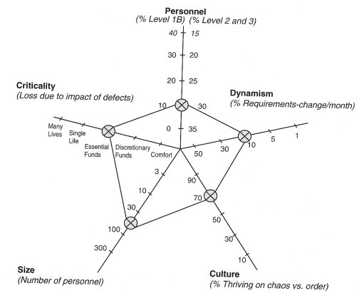
5 Key Factors

Slide 24
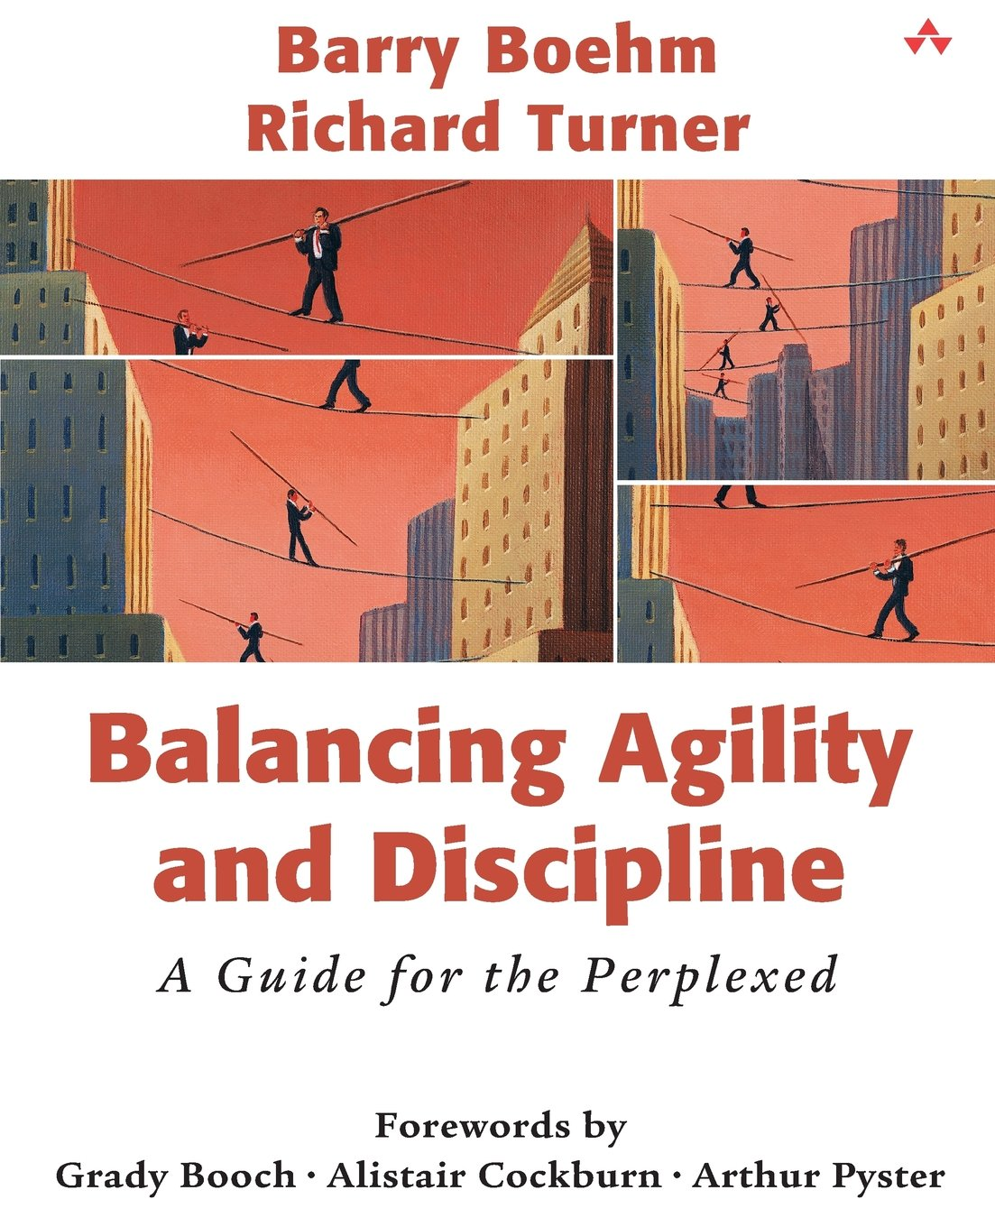
Resources
B. Boehm & R. Turner, Balancing Agility and Discipline.

