Slide 1
Database Basics
A basic introduction to relational databases
James Brucker

Slide 2
Relational or NoSQL
Relational Databases - data stored in structured format, with data in fields (columns), one record per row, in tables. Tables are similar to tables in a spreadsheet, but columns have fixed size.
Data in different tables can be related based on common values or expressions.
Examples: Sqlite, MySQL, Oracle, H2
NoSQL Databases - any database not organized like a Relational Database. Some forms are document-oriented and graph databases.
Examples: MongoDB, CouchDB (document),
Neo4j (graph)

Slide 3
Database Structure
Database
A database contains schema, which describe its structure.
A schema can contain:
tables - containing data
index files - for fast lookup of data in tables
stored procedures, constraints, triggers, and more
Schema
Schema
Table
field1: t1
field2: t2
field3: t3
Table
field1: t1
field2: t2
field3: t3
Table
field1: t1
field2: t2
field3: t3
Table
field1: t1
field2: t2
field3: t3
indexes
indexes
indexes
indexes
SQLite databases have only one schema, so its not shown.

Slide 4
A Table
A table contains the actual data in records (rows).
A record is composed of fields (columns).
Each record contains one set of data values.
+------+------------+-------+-------------+---------+
| ID | Name | CCode | District | Populatn
+------+------------+-------+-------------+---------+
| 3320 | Bangkok | THA | Bangkok | 6320174 |
| 3321 | Nonthaburi | THA | Nonthaburi | 292100 |
| 3323 | Chiang Mai | THA | Chiang Mai | 171100 |
+------+------------+-------+-------------+---------+
records
(rows)
fields (columns)

Slide 5
Key field to Identify Rows
A table contains a primary key that uniquely identifies a row of data.
Each record must have a distinct value of primary key
The primary key is used to relate data in tables.
ID is the primary key in City table.
+------+------------+-------+-------------+---------+
| ID | Name | CCode | District | Populatn
+------+---------------+------------------+--------+
| 3320 | Bangkok | THA | Bangkok | 6320174 |
| 3321 | Nonthaburi | THA | Nonthaburi | 292100 |
| 3323 | Chiang Mai | THA | Chiang Mai | 171100 |
+------+------------+-------+-------------+---------+

Slide 6
Structure of a Table
Every field has:
a name
a data type and length
To view the structure of a table use:
DESCRIBE tablename
sql> DESCRIBE City;
+-------------+-----------+-----+-----+---------+----------------+
| Field | Type | Null| Key | Default | Extra |
+-------------+-----------+-----+-----+---------+----------------+
| ID | int(11) | NO | PRI | | auto_increment |
| Name | char(35) | NO | | | |
| CountryCode | char(3) | NO | | | |
| District | char(20) | NO | | | |
| Population | int(11) | NO | | 0 | |
+-------------+-----------+-----+-----+---------+----------------+

Slide 7
Field types and attributes
Each field (column) has an SQL data type, like char(20).
Fields can have constraints (not null) and default values.
sql> SHOW columns FROM City;
+-------------+-----------+-----+-----+---------+----------------+
| Field | Type | Null| Key | Default | Extra |
+-------------+-----------+-----+-----+---------+----------------+
| ID | int(11) | NO | PRI | | auto_increment |
| Name | char(35) | NO | | | |
| CountryCode | char(3) | NO | | | |
| District | char(20) | NO | | | |
| Population | int(11) | NO | | 0 | |
+-------------+-----------+-----+-----+---------+----------------+
A default value to use if value is not assigned explicitly.

Slide 8
Keys
Every table should have a primary key that uniquely identifies each row.
sql> DESCRIBE Country;
+-------------+-----------+-----+-----+---------+----------------+
| Field | Type | Null| Key | Default | Extra |
+-------------+-----------+-----+-----+---------+----------------+
| Code | char(3) | NO | PRI | | |
| Name | char(52) | NO | | | |
| ... | | | | | |
City
ID (PK)
Name
CountryCode (FK)
Population
District
Country
Code (PK)
Name
Continent
Capital
...
CountryCode

Slide 9
Joining Tables
Relate or "join" data in different tables.
This is what makes an RDB so powerful and useful.
City contains the CountryCode for the country it belongs to. This is called a Foreign Key.
City
ID (PK)
Name
CountryCode (FK)
Population
District
Country
Code (PK)
Name
Continent
Capital
...
*
1
City.countrycode = Country.code

Slide 10
Example: find all cities in SE Asia
Join the Country table and City table.
Search for Country.region = 'Southeast Asia'
SELECT City.Name, City.Population
FROM Country, City
WHERE Country.Code = City.CountryCode
AND Country.Region = 'Southeast Asia';
Country
Code
Name
Continent
Region
SurfaceArea
Population
GNP
LocalName
Capital
City
ID
Name
CountryCode
District
Population
Country.Code = City.CountryCode

Slide 11
Structure of a Database
A database system may contain many databases.
Each database is composed of schema and tables.
sql> SHOW databases;
+--------------+
| Database |
+--------------+
| mysql |
| test |
| bank |
| world |
+--------------+
sql> USE world;
sql> SHOW tables;
+-----------------+
| Tables_in_world |
+-----------------+
| countries |
| city |
+-----------------+
"shows databases" only shows db that the user has permission to access.

Slide 12
Database Management System
USE World;
SELECT * FROM city WHERE ...;
Database Manager
Client
User Interface & communication protocol
Control access to the database.
authentication
permissions
data integrity
access services
Database:
a structured, self-describing collection of data.

Slide 13


Client - Server Databases
Database Server is a separate process on a host.
Clients can be on any machine.
Many programs may be clients using a standard API.
"mysql" utility
Server
mysqld
Java App
+JDBC client
server controls access to database
Excel client
Client side
Server side

Slide 14
4 Basic Database Operations
The 4 most common operations:
  SELECT query (search & retrieve) data
  INSERT add new records to a table(s)
  UPDATE modify existing record(s)
  DELETE delete record(s) from a table
What is CRUD?
Programmers call these operations "CRUD".
What does CRUD stand for?

Slide 15
Exercise: O-O Analogy of a Table?
Database Object Oriented Construct
table __________________
record (row) __________________
fields (columns) __________________
+------+------------+--------------+---------+
| ID | Name | District | Popula..}
+------+------------+--------------+---------+
| 3320 | Bangkok | Bangkok | 6320174 |
| 3321 | Nonthaburi | Nonthaburi | 292100 |
| 3323 | Chiang Mai | Chiang Mai | 171100 |
+------+------------+--------------+---------+
records
(rows)
fields (columns)

Slide 16
Exercise: O-O Analogy of a Table?
Database Object Oriented Construct
table ______class_______
record (row) __instance of class (object)__
fields (columns) _____attributes_____
City
name: String
district: String
population: long
UML for
City class

Slide 17
Exercise
The database for the Django Polls project is db.sqlite3.
Use a database browser to answer some questions (separate file).
Tools
  - sqlite3 command line tool, included with Sqlite
  - sqlitebrowser free GUI tool. Works on all platforms.
  - DBeaver popular database editor/browser that works with (almost) any database. Uses Java.

Slide 18
SQL Field Types are Different
SQL field types only partially match the data types in most programming languages.
SMALLINT (16-bit) | -32,768 - 32,767
INTEGER or INT | 32-bit same as int in C, Java
DECIMAL(m, d) DECIMAL(6, 2) | Decimal with m digits, n digits after decimal point. 1234.56
REAL or FLOAT | 8-byte floating point, like "double" in Java or C.
BOOLEAN | True (1) or False (0). Not standard.

Slide 19
SQL Date, Time, and String Types
SQL has a lot more types than shown here.
Not all databases support all types, and details differ.
DATE | yyyy-mm-dd
TIME | HH:MM:SS
DATETIME | yyyy-mm-dd HH:MM:SS Python datetime.datetime is more accurate.
TIMESTAMP | Stores number of seconds since 1970-01-01 00:00:00 (the unix "enoch")
CHAR(n) | Character data with fixed length n. n <= 8000.
VARCHAR(n) | Variable length character string. n <= 8000
TEXT | Variable length string storage, maximum 2GB (varies)
NCHAR(n) NVARCHAR(n) | Character data stored as Unicode (likely 2-byte/char)

Slide 20
Why Should You Care?
> Appropriate data type can improve code & accuracy.
Example:
Use Decimal(10,2) for Thai money.
> Save storage, especially when you have lots of data.
Example:
You have 1 billion temperature measurements.
If you store them as Float, you need 8GB.
If you store them as 2-byte Int (maybe scaled), you need 2GB.

Slide 21
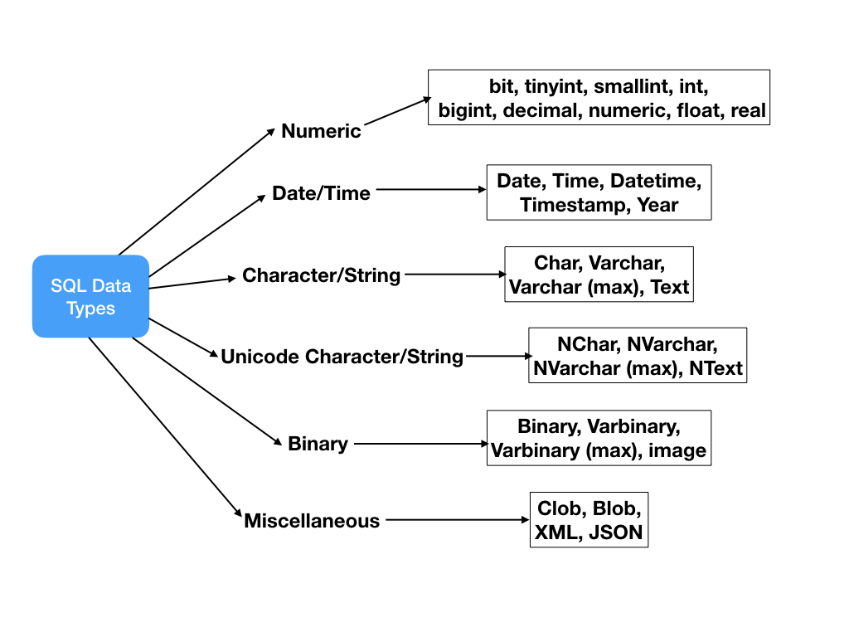
Data Type Hierarchy

Slide 22
Django Model Field types
Fields in a Django Model subclass are saved to the database.
For list of Field types in Django:
https://docs.djangoproject.com/en/2.2/ref/models/fields/

