Slide 1
Web Servers and Web Apps

Slide 2
What a Web Server Does
Receives http requests & sends replies
Serve static content (web page in a file, images, etc)
Forward requests to other servers (proxy, load balancing)
Provide dynamic content from applications written in PHP, Python, Java, other -- via a back-end processor
Handles security certificates and secure sessions
May perform authentication, but many web apps and web frameworks do this themselves

Slide 3
Static vs Dynamic Content
https://yoursite/index.html static file
https://yoursite/media/logo.png static file
https://yoursite/media/xmas.mp3 static file
https://yoursite/media/intro.webm static file
https://yoursite/index.php dynamic page from PHP app
https://amazon.com/books/ dynamic page of
best selling books
https://yoursite/polls/ list of polls from Python
app written with Django

Slide 4

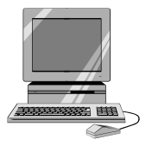

Handling a web request
(1) A web client submits a web request:
https://store.com/index.html
an https request is sent to the store.com server...
GET /index.html
(2) A host (server) receives tcp packet and looks for app listening on port 443.
(3) Give packet body to listening web server.
listen *:443

Slide 5
Serving Static Content
If the request is for a static file, server returns it directly
https://store.com/index.html
GET /index.html
HTTP/1.1 200 OK
content-type: text/html
content-length: 1542
(data for html page)
index
.html
file
store
listen *:443

Slide 6
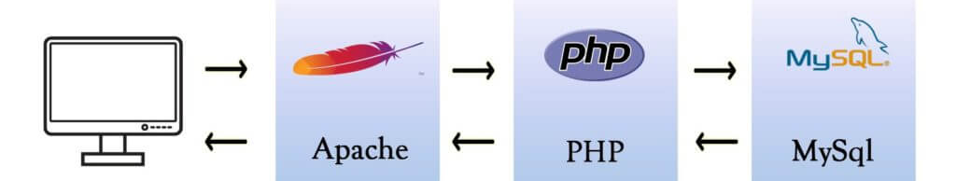
Web Server for Application
To provide dynamic content a web server invokes an application, in a programming language.
The web server forwards the HTTP request to an application "container" running in a separate thread or process.
The app returns a response (or an i/o stream) that the server returns to the web client.
Web Client: GET /store/products.php
PHP code run in mod_php module

Slide 7
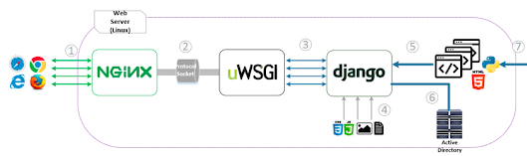
Overview of a Production Django App
(1) Web server (Nginx) receives http requests. It handles requests for static content itself.
(2) Web server forwards other requests to a WSGI container.
uWSGI is a web app container that supports WSGI.
(3) Django receives the request via uWSGI, processes it, and returns an HTTP response

Slide 8
Step-by-step for Dynamic Content
(1) A web client submits a web request:
https://store.com/products/list
an https request is sent to the store.com server...
GET /products/list
(2) A host (server) receives tcp packet and looks for app listening on port 443.
(3) Give packet body to listening web server.
listen *:443

Slide 9
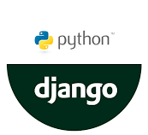

Http Server hands request to web app
(4) The web server examines the request path and determines it should give it to the web application.
For Python, this is handled by a WSGI adapter.
The WSGI adapter is also called a container or app server.
WSGI adapter

Slide 10
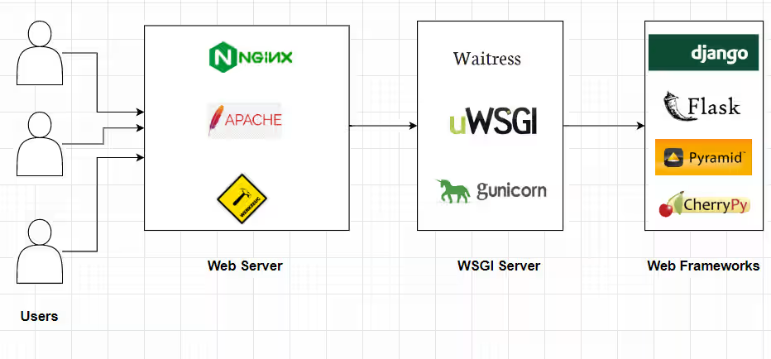
Web Server Gateway Interface
WSGI defines a standard way for web servers to communicate with web application written in Python.
A WSGI implementation (like uWSGI) is an adapter or container.
It translates HTTP requests into a standard format & invokes code via a standard API.
WSGI Adapter
Python app using framework

Slide 11

Decide which code should handle it
(5) Django framework parses the HTTP request and creates a HttpRequest object containing request path, headers, session info, query params, and request body.
(6) Django router compares the request path /products/list/ to a "routing" or "url mapping" table specified by the app.
(2) The server computer forwards it to a web server running on port 8080.
HttpRequest
object
urls.py
path --> code
pattern --> code2
urlpatterns = [
path('products/list/', prod_list),
... ]
framework

Slide 12
Django invokes your code to process the request
(7) Django framework invokes your code (prod_list) with the HttpRequest object as parameter...
(8) your code must handle the request and return an HttpResponse object.
(2) The server computer forwards it to a web server running on port 8080.
HttpRequest
object
prod_list(request)
HttpResponse
framework
Syntax:
prod_list(request: HttpRequest, [other params]) -> HttpResponse

Slide 13
What your request handler does
(8) Your code (Django calls it "view") applies application logic and may call Django code to handle the request.
For a product list, it uses the Product model class to get the products from a database (the Django framework does this).
Then, use a template (your code) to create a web page containing product data. This is called rendering.
(2) The server computer forwards it to a web server running on port 8080.
all()
prod_list(http_request)
<<model>>
Product
list[Product]
render template
<<template>>
product_list.html

Slide 14
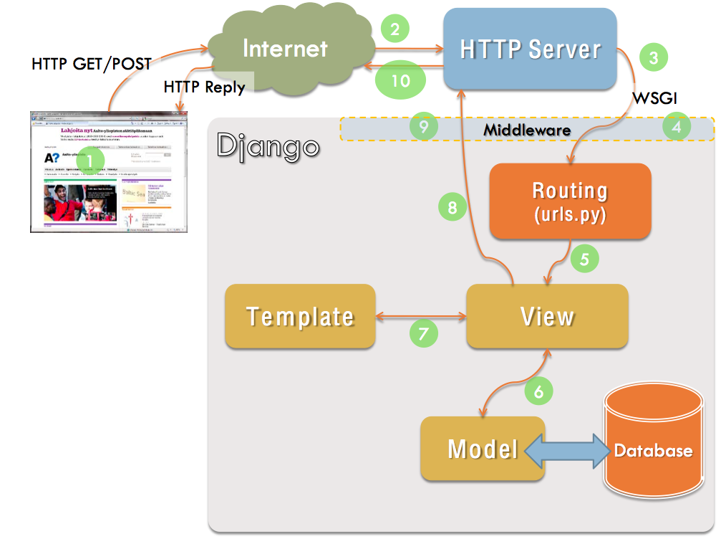
Summary of Request Processing
Source: https://devopedia.org/django

Slide 15
Web App Vocabulary
What | Typical Web Framework | Django
Mapping of request path to handler code | routing based on url | routing, uses urls.py
Code that handles requests | controller | view
Class that represents something in the app domain | model | model
Code or template to generate a web page | view | template
Process a template with data to create a web page | rendering | rendering

Slide 16
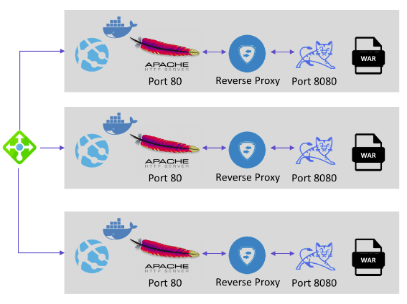
Containers and VMs
For reliability and repeatable deployments, many apps are run in Docker "containers" or on virtual machines (VMs).
Docker container.
The app and its dependencies are bundled in an "image" and run in a Docker container.
New instances can be started quickly to handle high loads.
Virtual Machine.
All components run on a "virtual" computer with its own OS. Stronger isolation, but more resource intensive.
isolated web apps
Http request

Slide 17
The Most Popular Web Servers?
Nginx
Cloudflare servers
Apache httpd
LiteSpeed
Node.js
Microsoft IIS
Netcraft Server Survey https://www.netcraft.com/resources/blog
https://www.datanyze.com/market-share/web-and-application-servers/
https://w3techs.com/technologies/overview/web_server

Slide 18
Running Django w/o a Web Server
During development, we can "run" a Django app directly.
No separate web server.
How does that work?

Slide 19
Django App in Development Mode
Django includes a built-in HTTP server, written in Python.
The server parses requests and passes them to the Django application.
This is low performance and not for production use.
Django Framework
Web
Client
HTTP Server
Your Django App
Running in Python (of course)

Slide 20
Extra Material
Frameworks - what are they?
CGI - the original interface for server-side application code

Slide 21
Frameworks
A Framework contains an "almost" complete app code, including logic for the flow of control.
You must supply
configuration data (text file, XML, Json, ...)
missing methods the framework will invoke, "slots"
application logic
domain models ("model") for persistent objects
and optionally...
override frameworks methods with custom code
add callbacks or "hooks", for extra functionality

Slide 22
Framework versus Library
An application framework "runs" the application.
the framework calls your code
"don't call us, we'll call you"
Library - provides functions you call, classes you use
Requests is a library of functions for sending HTTP requests
numpy is a library for numerical computing
Your app calls numpy code, it returns a result

Slide 23
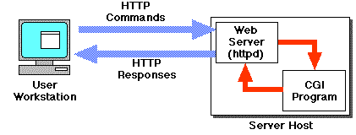
Common Gateway Interface
The original way to generate dynamic content by running code used the Common Gateway Interface (CGI).
Each CGI request was run as a separate process, and it was the CGI app's responsibility to parse http requests, manage sessions, manage storage, etc. Very low performance due to per-invocation overhead.
CGI scripts (apps) often written in Perl, C, or Bash script.

