Slide 1
Intro to Testing
James Brucker

Slide 2
Many Kinds of Software Testing
Software testing is critical!
Test requirements - consistent? unambiguous?
Test software specification - is it consistent with the requirements? Satisfy all the requirements?
Unit Testing - test individual methods and functions
Integration Testing
End-to-End or Functional Testing
Acceptance Testing
Usability Testing

Slide 3
Why Test?
1. Saves time!
  Testing is faster than fixing "bugs".
2. Testing finds more errors than debugging.
3. Prevent re-introduction of old faults (regression errors).
  Programmers often recreate an error (that was already fixed) when they modify code.
4. Validate software: does it match the specification?

Slide 4
Psychological Advantages
Keeps you focused on current task.
Increase satisfaction.
Confidence to make changes.

Slide 5
Test-Driven Development (TDD)
Write the tests first ... what the code should do.
Then write code that passes the tests.

Slide 6
Testing is part of development
Agile Development Practices
Test early.
Test continually!
Design
Test
Code
Test
Code
Test
Design
Test
Code
When To Test?
- Test while you are writing the source code
- Retest whenever you modify the source code

Slide 7
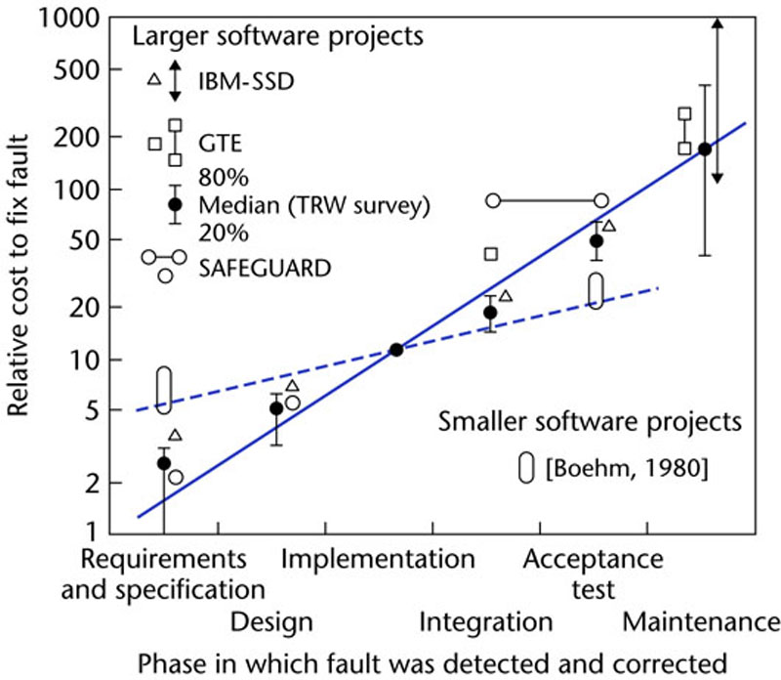
The Cost of Fixing "faults"
Discover & fix a defect early is much cheaper (100X) than to fix it after code is integrated.
Figure 1.5

Slide 8
What to Test?
In unit testing, we test functions or methods in classes.
Input
Function
Output

Slide 9
How to Test?
We can not test all possible input / output.
Divide input into categories or sets.
Discover "rules" that apply to different sets of input.
Test a few samples from each set, category, or class.
  Test boundary values.
  Test "typical" values.
  Test "extreme" values.
  Test impossible values.
  Try to make the code fail.

Slide 10
Example: gcd(a,b)
gcd(a:int, b:int) = greatest common divisor of a & b
gcd(24,30) -> 6
gcd(3, 7) -> 1 (no common factors)
Rule: gcd is always positive
gcd(80,-15) -> 5
gcd(-7,-3) -> 1
Rule: gcd involving zero is positive
gcd(8,0) -> 8
gcd(0,-8) -> 8

Slide 11
Defining Test Cases
Test Case | Example Arguments
Two positive ints with common factor | (30, 35), (48, 20), (36, 999)
Two int with no common factor | (1, 50), (50, 3), (370, 999), (1,1)
One or both args are negative | (-30,45), (72,-27), (-1,-2)
One or both args zero | (99, 0), (0,-33), (0,0)
Extreme case to test algorithm efficiently terminates | (123*123457890123, 123*789012345890)

Slide 12
Python unittest
import unittest
class TestGcd(unittest.TestCase):
def test_gcd_positive_values(self):
self.assertEqual(6, gcd(30,35))
self.assertEqual(4, gcd(48,20))
def test_gcd_involving_zero(self):
self.assertEqual(1, gcd(0,0))
self.assertEqual(99, gcd(0,99))
self.assertEqual(1, gcd(1,0) )

Slide 13
FIRST - guide for good tests
Fast
Independent - can run any subset of tests in any order
Repeatable - always get same result
Self-checking - test knows if it passed or failed
Timely - written at same time as the code to test

Slide 14
Stack Example
Stack implements a stack data structure.
Has a fixed capacity and methods shown below.
Throws StackException if you do something stupid.
Stack<T>
+ Stack( capacity )
+ capacity( ): int
+ size( ): int
+ isEmpty( ): boolean
+ isFull( ): boolean
+ push( T ): void
+ pop( ): T
+ peek( ): T

Slide 15
What to Test?
Border Case: Stack with capacity 1 | 1. no elements in stack capacity() is 1 isEmpty() -> true isFull() -> false size() -> 0 peek() returns ??? 2. push one element on stack isEmpty() -> false isFull() -> true size() -> 1 3. can peek()? push one element peek() returns element stack does not change 4. push element, peek it, then pop pop -> returns same object test all methods idea: a helper method for all tests of an empty stack or full stack

Slide 16
Test for Methods
push( ) | Hard to test by itself! Need to use peek( ), pop( ), or size( ) to verify something was pushed. 1. Stack of capacity 2. push(x) verify size=1 peek()==x, not full, not empty push(y) verify again pop(y) push(x) - should have 2 items both == x

Slide 17
References
unittest in Python Library
  Search for "unittest" on main page of Library
  You should have this installed on your own computer
Test-Driven Development in Python, 2E
  "the testing book" for Python
  create & test a Django app using TDD
Hitchhiker's Guide to Python Testing
  short introduction to several testing tools
  https://docs.python-guide.org/writing/tests/

