Slide 1
Agile Methods and Practices
©Ravindar Gujral
MNG Technologies

Slide 2
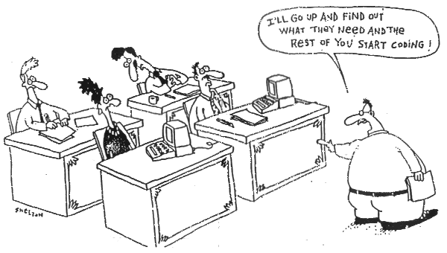
Why Agile?

Slide 3
In my mind all of this has to do with success.

Slide 4
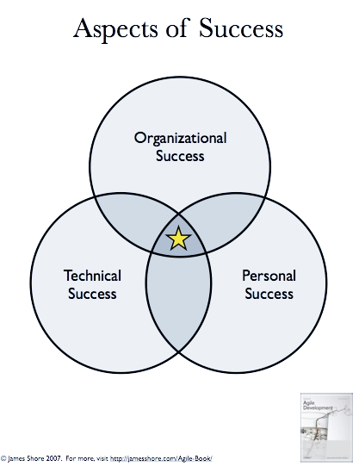
The way I look at it

Slide 5
So success is intersection point of various other successes as defined by the parties involved.
What has this got to with Agile Methods? What are Agile Methods?

Slide 6
What are Agile methods?
public Method getMethod( ) {
return Agile::agile;
}

Slide 7
Definition Time
Agile Philosphy
Agile methods are processes that support the agile philosophy. Examples include Extreme Programming and Scrum.
Agile methods consist of individual elements called practices.
Practices include using version control, setting coding standards, and giving weekly demos to your stakeholders.
Agile Methods combine these practices to accentuate parts that support agile philosophy.

Slide 8
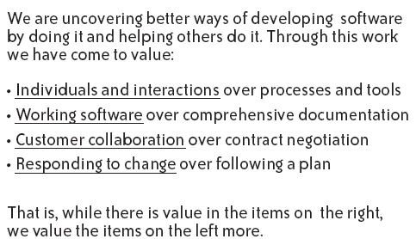
And the philosophy….

Slide 9
Again looking at Success

Slide 10
Organization success is about delivering value – and agile philosophy has this at the heart of it.
Personal success is, well Personal, but everyone gains from improved collaboration.
Technical success, because of practices like TDD, CIT and pair programming you are continuously improving. This overlaps with personal.

Slide 11
Agile Practices
Every project is unique. So the trick is to customize an existing agile method to your project.
From Art of Agile Development- James Shore
Thinking - Pair Programming, Energized Work, Informative Workspace, Root Cause Analysis, Retrospectives etc.
Collaborating – Trust, Sit Together, Real Customer Involvement, Ubiquitous language, stand-up meeting, coding standards, sprint demo, reporting etc.
Releasing – Done, No Bugs, Version Control, Continuous Integration, Collective Code ownership, documentation etc.
Planning – Vision, Release Planning, Iteration Planning, estimating etc.
Developing – Customer Tests, Test Driven Development, Simple Design etc.

Slide 12
Lets look at some of the Agile methods

Slide 13
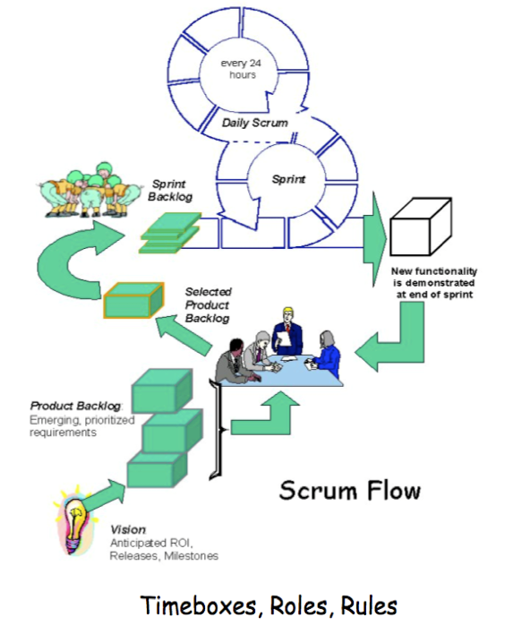
Scrum

Slide 14
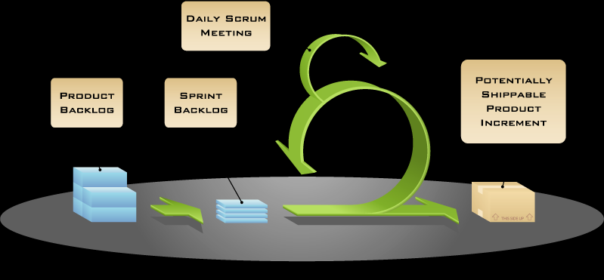
Scrum, by Mike Cohn

Slide 15
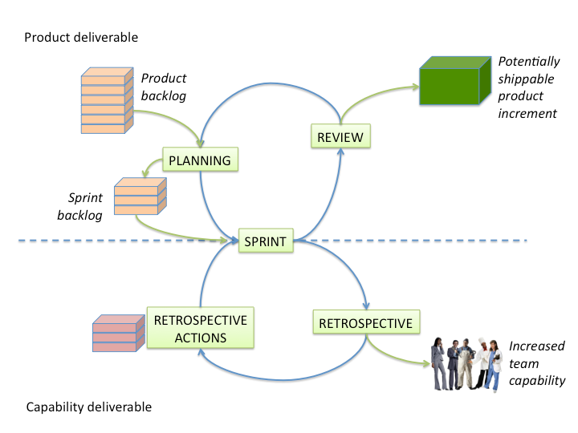
The one I like and will explain
©David Harvey

Slide 16
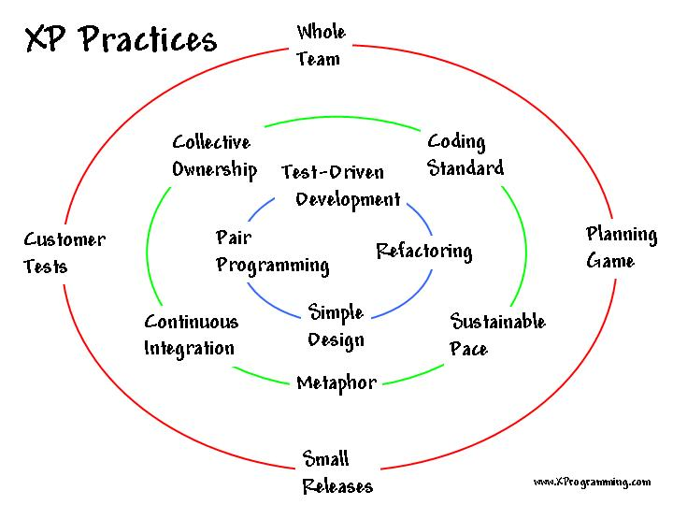
XP: the one I like

Slide 17
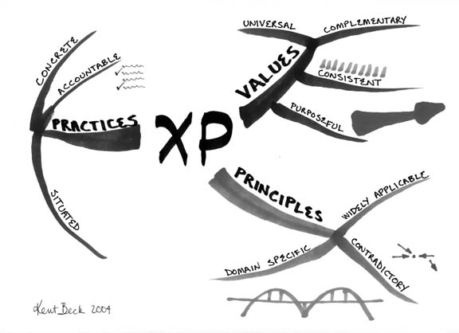
By Kent Beck

Slide 18
XP and Scrum
Scrum teams typically work in iterations (called sprints) that are from two weeks to one month long.
Scrum product owner prioritizes the product backlog but the team determines the sequence in which they will develop
XP teams typically work in iterations that are one or two weeks long.
XP teams work in a strict priority order.

Slide 19
XP and Scrum
Scrum teams do not allow changes into their sprints.
Scrum doesn't prescribe any engineering practices
XP teams are much more amenable to change within their iterations.
XP prescribes engineering practices, particularly things like test-driven development, the focus on automated testing, pair programming, simple design, refactoring.

Slide 20

Waiting till the last responsible moment

Slide 21
Individual Practices
Pair Programming
Continuous Integration
And
Test Driven Development

Slide 22

Is this Pair Programming?

Slide 23
Pair Programming
We help each other succeed. This practice comes from XP.

Slide 24
Pair Programming
When you pair, one person codes—the driver. The other person is the navigator, whose job is to think
The driver focuses on writing syntactically correct code.
The navigator sometimes works on understanding how the current work fits in the over-all design and sometimes thinks of the next task.
Since we are trying to do simple design things are evolving the developers require a lot of discipline and pair programming enforces this.
This form of development is very resilient to external interruptions.
Above all it allows and forces individuals to collaborate and share knowledge.

Slide 25
Pair Programming- Challenges
Pair programming can be uncomfortable in the beginning, especially if you are not used to collaborating.
Comfort needs repeating.
Communication issues.
Organizational buy-in - Isn’t it more expensive?

Slide 26
Continuous Integration
We keep our code ready to ship.
At heart this is stop the line culture from TPS.

Slide 27
Continuous Integration
The ultimate goal of continuous integration is to be able to deploy all code.
Although you won’t release in the middle of a sprint, the point is to be technologically ready, even if you are not functionally.
With Continuous integration, you are integrating in short cycle and thus have smaller changes to deal with as you integrate.
Continuous integration does not make sense unless it’s automated, has a short turn around time (fast builds), and everyone owns the concept of Green Builds.
You need tests to fail or pass a build. Tests are the backbone that give you a green or a red light to take a snapshot of your build.

Slide 28
Continuous Integration- Challenges
Don’t force this. It requires everyone to buy-in.
CI also requires some setup, if you don’t have one.
Keeping build times short. This might require some serious effort and might show you the deficiency of your builds.
And you need a good version control system – VC systems like subversion that allows atomic check-in.

Slide 29
Test Driven Development
We produce well-designed, well-tested, and well-factored code in small, verifiable steps.

Slide 30
Test Driven Development
Test-driven development, or TDD, is a rapid cycle of testing, coding, and refactoring
Why do this: Programming is demanding. It requires perfection and consistency for months.
TDD cranks up the feedback on the execution of your code. Every few minutes TDD verifies that the code does what you think it should do.
If you do this correctly and in incremental steps you can reduce the defects in your system.

Slide 31
Test Driven Development
Benefits
Makes finding mistakes easy.
Think of double-entry bookkeeping. You express your intent twice, once with a testand another with production code.
All these tests are checked in and become part of your continuous integration.

Slide 32
Test Driven Development- Challenges
It will increase your effort. But should reduce effort at the end of delivery cycle.
If you have legacy code extra effort and time is required to place hooks for TDD.
The basic steps of TDD are easy to learn, but the mindset takes a while to master.
This is a skill and requires continuous practice to get better.

Slide 33
Being Agile
It is about the people and teams
It is about customer and delivering software
It is about continuous improvement

Slide 34
Stuff I read, listen
http://www.threeriversinstitute.org/blog/
http://www.jbrains.ca/
http://blog.objectmentor.com/
http://martinfowler.com/bliki/
http://jamesshore.com/Blog/
http://programmingtour.blogspot.com/
http://xprogramming.com/blog/
http://www.agilephilly.com
http://www.infoq.com/
http://www.ted.com/
http://thoughtadrian.blogspot.com/
http://blog.mountaingoatsoftware.com/
http://www.stackoverflow.com/
http://www.javaposse.com/
http://epistemologic.com/
http://elhumidor.blogspot.com/
http://blogs.agilefaqs.com/
http://sebastianlab.com/
http://aydsoftware.blogspot.com/
http://dhondtsayitsagile.blogspot.com/
http://mitworld.mit.edu/
http://ecorner.stanford.edu/podcasts.html
http://www.feld.com/wp/
Great set of essays: http://www.poppendieck.com/publications.htm
Presentation styles: http://www.agileopen.net/2006/PresentationZen.html

