Slide 1
Agile
Values, Principles, & Practices for Software Dev't

Slide 2
Agile Manifesto
We are uncovering better ways of developing
software by doing it and helping others do it.
Through this work we have come to value:
Individuals and interactions over processes and tools
Working software over comprehensive documentation
Customer collaboration over contract negotiation
Responding to change over following a plan
That is, while there is value in the items on
the right, we value the items on the left more.

Slide 3
Values & Mindset
The most important part of Agile is the values.
The values result or inform a mindset.
Different people express the values differently:
Communication
Customer Collaboration
Incremental Development & Minimalism
Sustainability

Slide 4
Values
James Newkirk's Values
Minimalism
Feedback
Transparency
Sustainability
XP Values
Simplicity
Feedback
Communication
Courage
Video presentation by James Newkirk
https://www.agilealliance.org/agile101/agile-basics/introduction-to-agile/
Values start at time 40:00

Slide 5
Practices Based on Values
The Agile Practices come from the values.
Adopting practices without values often fails.

Slide 6
Example: Daily Meetings
A project manager wants to improve his team's ability to delivery good quality software on-time.
He/she reads about Agile and decides that the daily stand-up meeting sounds like a great place to start!
(Many organizations do this.)
So he tells his team...
Ref: example from Chapter 1 of Learning Agile by Stellman and Green. This is the best book I know about Agile.

Slide 7
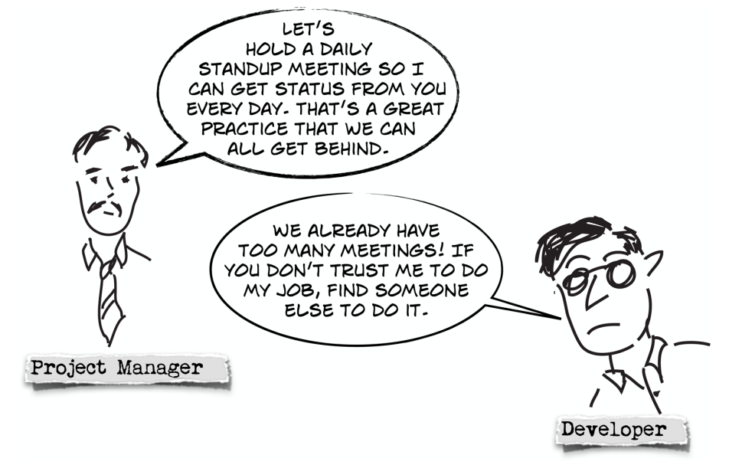
Let's have a Daily Stand-up

Slide 8
What Went Wrong?
The development team resents the idea.
The team sees a stand-up meeting as:
interrupting their work,
lack of trust that they are using their time effectively,
nagging

Slide 9
Lack of Mutual Understanding
What do they want to get from the meeting?
Manager:
- wants to know if progress is deviating from plan
- wants to know what developers are doing
Developer:
- wants the meeting to end as soon as possible

Slide 10
Change in Mindset
Manager needs to change his mindset and communicate the purpose of the meeting...
- Not about deviating from his plan
- Not a status report from developers
Instead:
- everyone on the team works together to create a plan
- involve whole team in discovering ways to work better
- help developers obtain time & resources they need

Slide 11
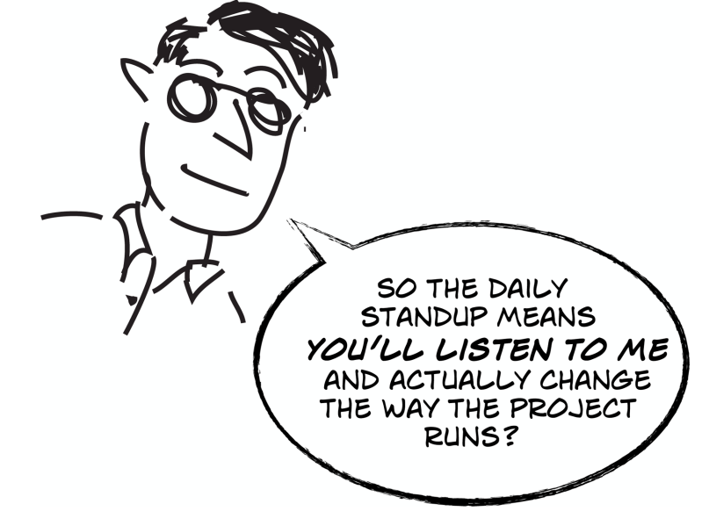
Change in Mindset of Developers
When developers feel that they "own" the project plan and the meeting is about their input...

Slide 12
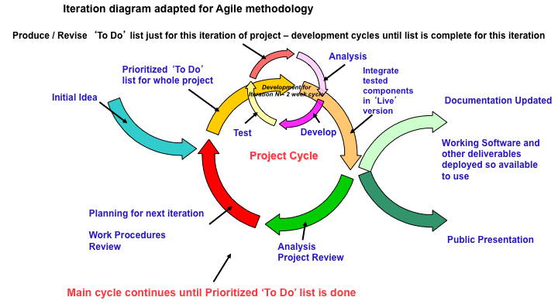
Agile Development Lifecycle

Slide 13
Agile Process Characteristics
create customer "value" at each iteration
welcome evolving requirements
working software as primary measure of progress
lack of up-front architecture design (YAGNI)
simple design (XP: "do the simplest thing that ...")
small, self-organizing teams at one site
frequent customer feedback
shared understanding instead of comprehensive documents … but do write documentation
...

Slide 14
Some Agile Processes
eXtreme Programming
  Kent Beck: Chrysler
Scrum - called "more a management technique"
  iterative development in "Sprints"
  daily stand-up meeting
  no advise about requirements
Crystal
  a family of methods to address different types of projects
Synchronize and Stabilize (Microsoft process)

